Slide 1

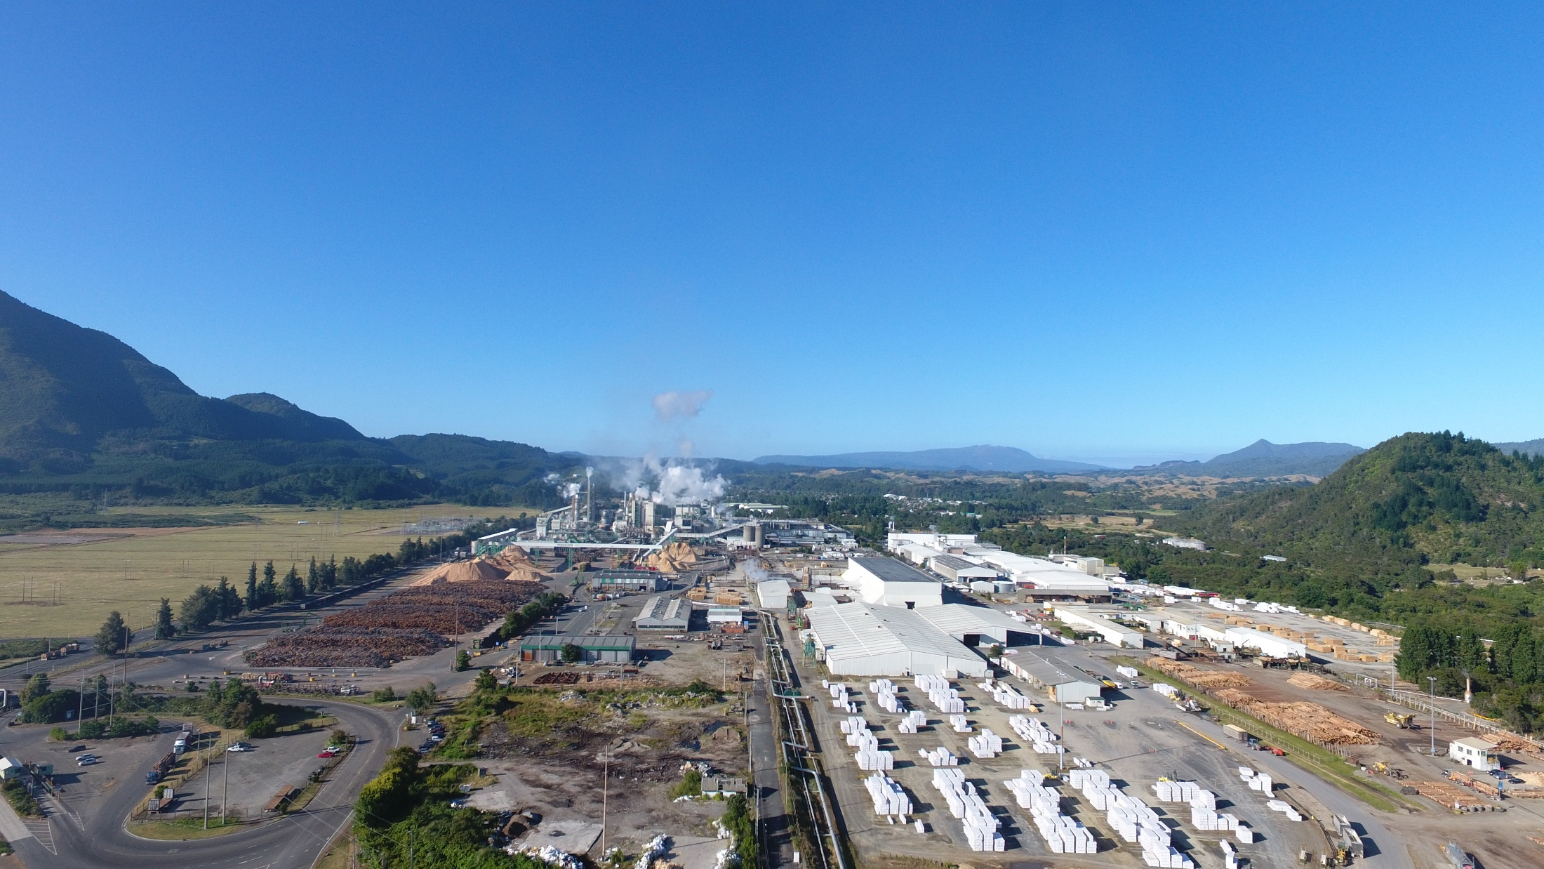
Kawerau Industrial Complex
Ngati Tuwharetoa Geothermal Assets Ltd. Updates
The world’s largest industrial direct user of geothermal energy
60 years (since 1957) of ongoing operations
Renewable and reliable energy supply
New Zealand Geothermal Workshop 2019
2017
Notes:
Tena koutou katoa.
Ngati Tuwharetoa Geothermal Assets Ltd. is an iwi-based geothermal business operating at the Kawerau Geothermal Field, supplying process heat in the form of steam to its industrial partners and to generate 21 MW of renewable electricity.
We pride ourselves in providing renewable, reliable, iwi energy, enabling our industrial partners to transition into the low-carbon future.

Slide 2

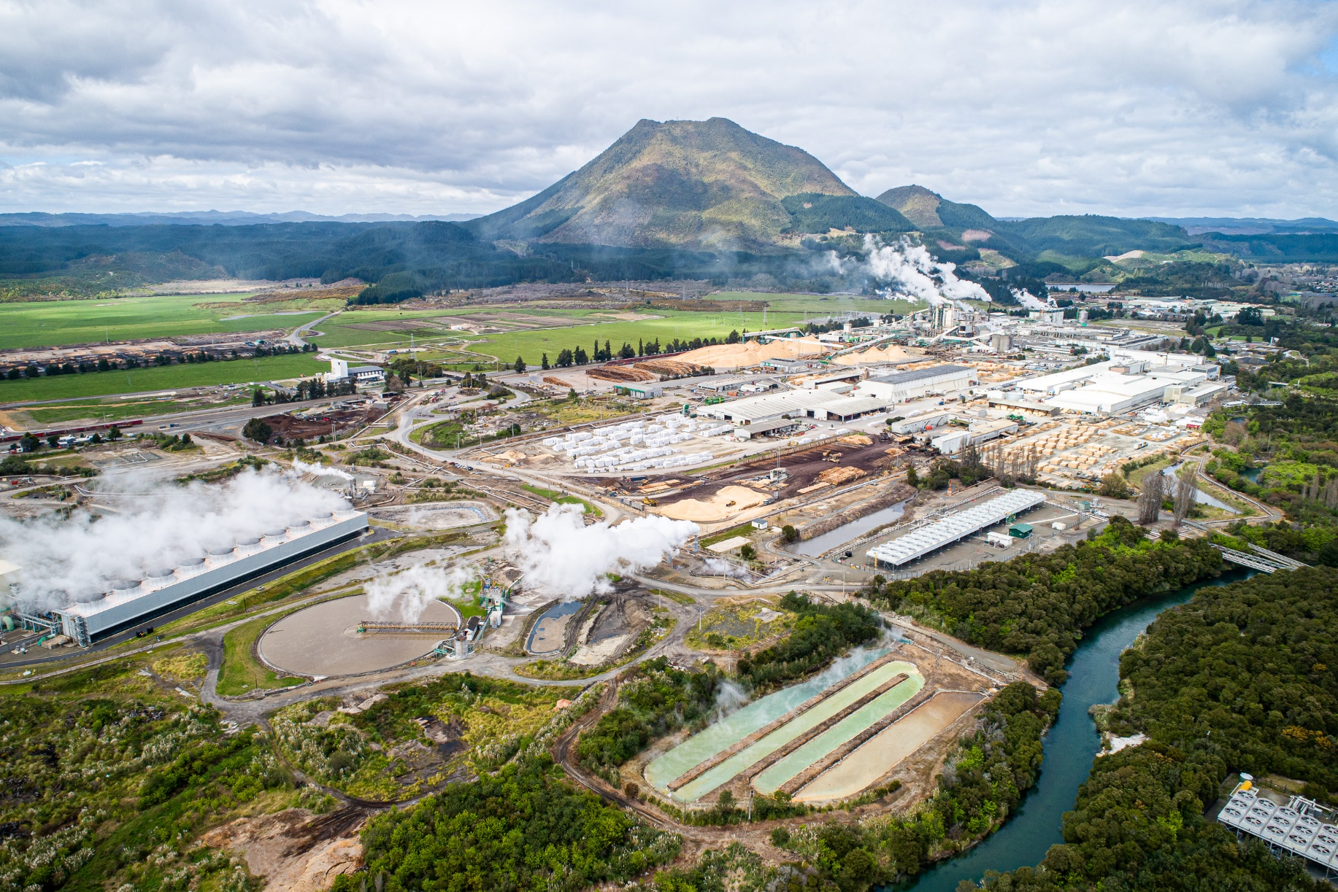
World’s largest geothermal process heat operation
Sequal Lumber
Town
Waiū Dairy
Norske Skog Tasman
Oji Fibre Solutions
CHH Woodproducts
Asaleo Care
TOPP1 power plant
2019
Notes:
We continue to provide geothermal process heat to the Kawerau Industrial Complex, the world’s largest geothermal process heat user, using around 5-6 PJ of thermal energy in the different process plant operations, displacing around 90% of the green house gas emissions that would otherwise be produced if the process steam is produced from gas boilers.
The Kawerau Industrial Complex includes pulp, paper and timber industries, with the new addition of milk processing through the Waiuu Dairy plant. The long-term and increasing utilisation of geothermal process heat in Kawerau highlights the reliability and maturity of the technologies available to support the transition of industrial energy from fossil fuel-raised steam to geothermal process heat.
The excess process steam and process water that are not utilised by the industrial complex are used to generate 21MW of electricity, enough to power 25,000 New Zealand homes per year, contributing to the country’s 84% renewable electricity generation.
Our geothermal operations help ensure that 40% of the total energy consumed in New Zealand are from renewable sources.

Slide 3
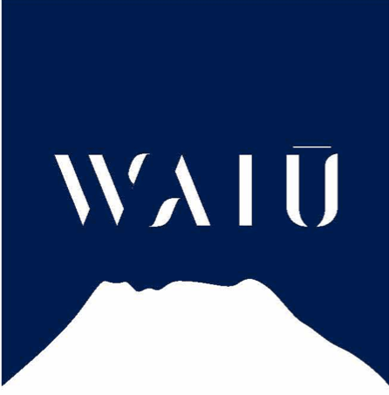
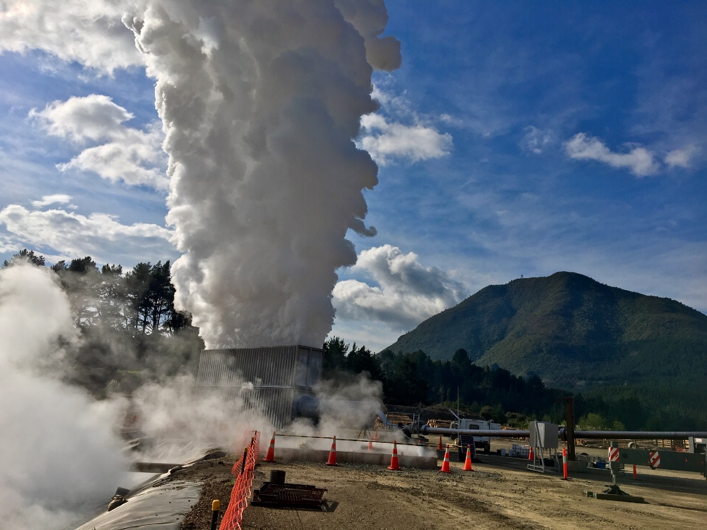

Recent Highlights
30 MW_{e} (250 MW_{th})
18-20 MW_{th}
2019
Notes:
Our recent updates highlight the continued organic growth of our operations, through new or increased geothermal energy utilisation.
Since our company update last year, NTGA has started supplying high-pressure geothermal clean process steam to the Waiuu Dairy plant for drying milk, and to Oji Fibre Solutions, to replace one of their fossil-based boilers. The combined additional energy supplied to these new partners is around 18-20 MWth on the back of a new tube bundle for one of our clean steam plant’s shell and tube heat exchangers.
We have also successfully drilled and tested a new production well, with flow test results indicating at least 30 MWe or 252 MWth production capacity. This additional production capacity ensures stable supply to our partners and proves the availability of the consented resource from the reservoir to the wellhead.

Slide 4
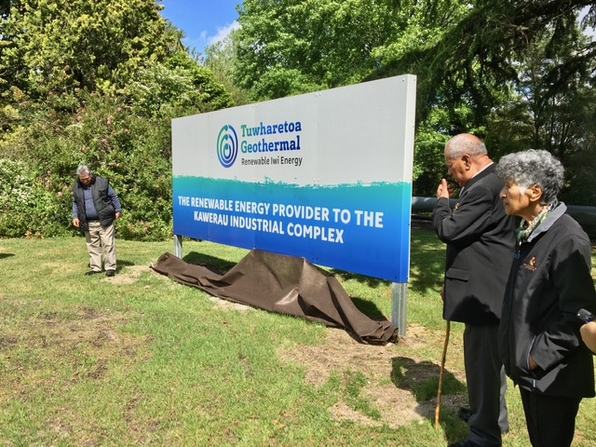
Kawerau Geothermal Opportunities
At least 10 PJ additional thermal energy in consented geofluid take
Around 4 PJ thermal energy currently available in separated water
Ideal energy supply to help industries transition to low GHG process heat and electricity
Lower-temperature cascade uses
Potential for additional power plant development
2019
Notes:
Looking ahead, NTGA’s renewable iwi energy logo will start appearing on the products from the Kawerau Industrial Complex, highlighting the origin and the energy used to create these products. We plan to attach this logo on more products that are keen to transition to or expand their use of renewable iwi energy from Kawerau.
NTGA is well-placed to provide both low-emissions process heat and electricity to New Zealand industries. Our existing consents and available energy enable industries to transition to low-emissions fuels. Transitioning to low-emissions process heat sources in the process industries is one of the key pathways to a low-carbon economy.
We also have the potential for additional geothermal power plant development as electricity demand rises with the electrification of the transportation and industrial sectors.
All these ensures that we have opportunities to grow the business and continue to deliver socio-economic benefits to our owners, the local town of Kawerau and the wider Bay of Plenty region of New Zealand.

Slide 5
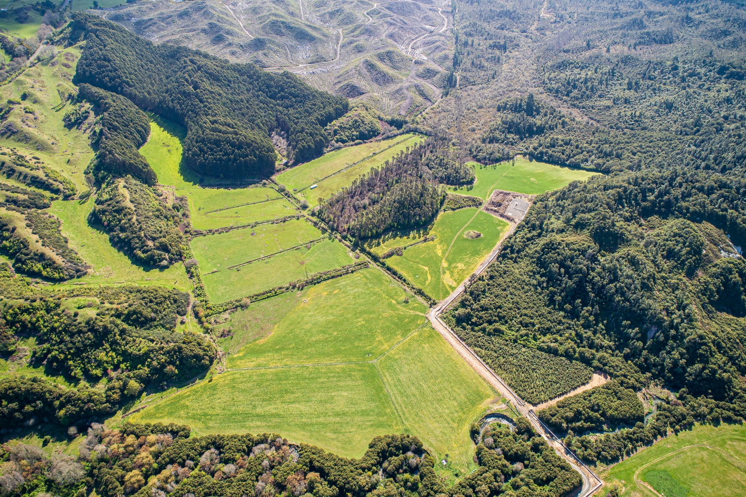
Kia ora!
2019

