Slide 1
NEW ZEALAND GEOTHERMAL WORKSHOP 2019
Nick clarke
GM Geothermal & Safety
November 2019
Notes:
SPEAKERS NOTES:

Slide 2

“ELECTRICITY IS THE SOLUTION, NOT THE PROBLEM”
Interim Climate Change Committee – now is the time to be in renewable electricity
Notes:
SPEAKERS NOTE

Slide 3

FIELD ACTIVITY
ROTOKAWA/NGA AWA PURUA
Just completed two-yearly Nga Awa Purua shut
  Turbine swap
10th birthday next year.
KAWERAU – 10 year birthday last year!!
Drilling injection and production make-up wells
December – two-yearly station outage
  Install new steam turbine
  Hot well pump overhaul
  Installation of a new generator rotor.
NGATAMARIKI
  Quiet year.
Notes:
SPEAKERS NOTES:

Slide 4
TECHNICAL RESOURCES
SILICA & CARBON
We are looking at a range of treatments.
MODELLING
Our reservoir team are building more sophisticated models – integrating chemistry, well bore and process model to improve model outputs certainty
Continue to develop well targeting – with excellent results in recent campaigns.
INCREMENTAL MW
  We continue to increase annual GWh through process optimisation and look for further MW uplift.
ANNUAL REVIEWS
Another year of positive engagement.
Notes:
SPEAKERS NOTES:

Slide 5
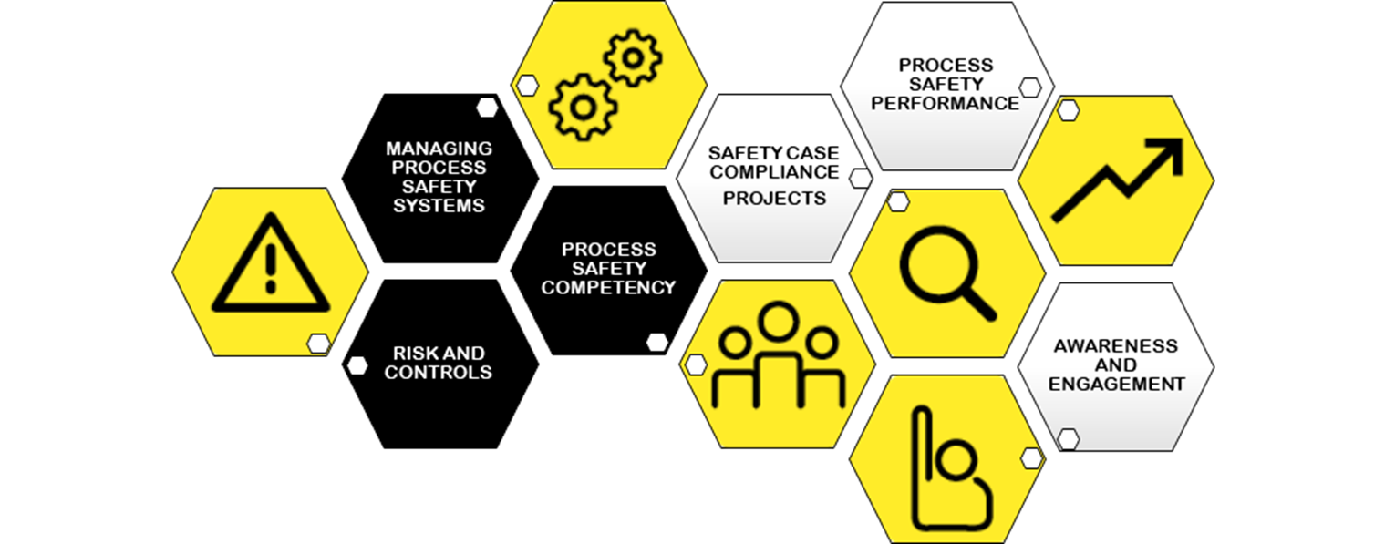
SAFETY
A busy year of continuous improvement
Process safety is fundamental to our operations - submitted safety cases in 4/18.
Notes:
SPEAKERS NOTES:

Slide 6
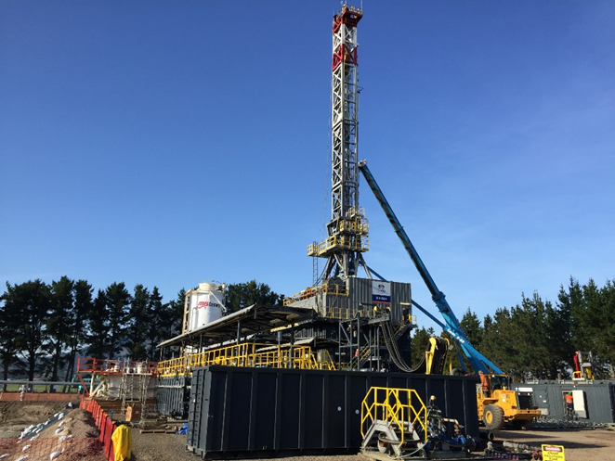
DRILLING
KAWERAU
  One injection well – near completion
  One production well – spudding in December.
ROTOKAWA
  One production well – likely spudding in February / March 2020.
Notes:
SPEAKERS NOTES:
.

Slide 7
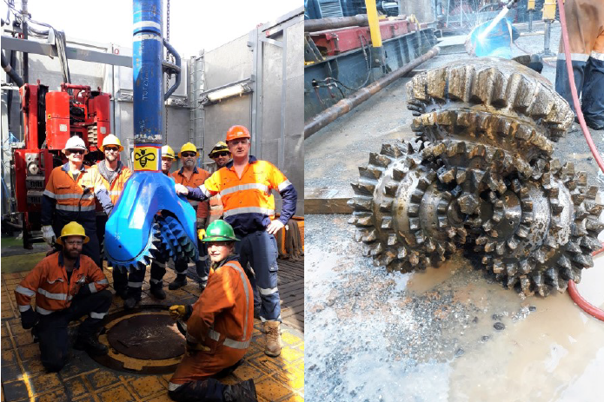
BIG BEN
We have successfully “converted” Big Ben
A collaborative efforts by Todd Energy, MB Century and the Mercury team to enable this rig option for New Zealand.
Notes:
SPEAKERS NOTES:

Slide 8
PEOPLE
HIGH PERFORMANCE TEAMS
  Internal high performance team (HPT) coaches trained and working with cross-functional teams
  Significant improvement in team behaviours.
TEAM ENVIRONMENT DRIVES COLLABORATION
  Consolidation of 3 Auckland offices to 33 Broadway, Newmarket
  Our Rotorua office has undergone a refurbishment.
WELLBEING
  Life, Income Protection & Health Insurances for all staff
  My Days – five additional paid leave days for all employees
  Wellbeing Warrant of Fitness & Employee Assistance Programme services available for all employees
  75% increase in flexible working since 2017.
Notes:
SPEAKERS NOTES:

Slide 9
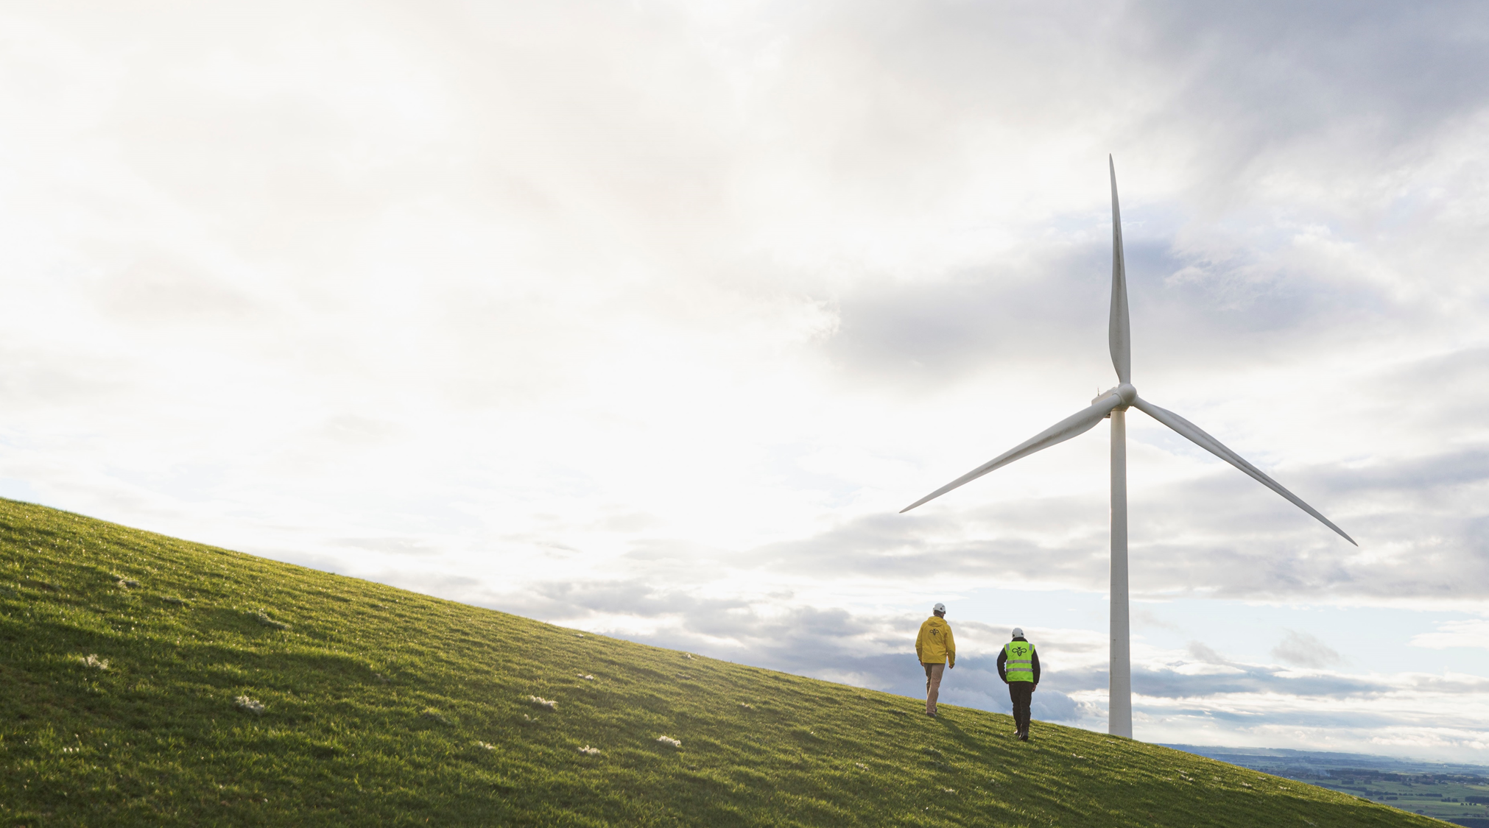
TURITEA TO BE NZ’S LARGEST WIND FARM
66 turbines at Turitea in the Manawatu
222MW, 840GWh – enough for 375,000 EVs
Reliable energy complements hydro’s reliable capacity and baseload geothermal.
Notes:
SPEAKERS NTOES

Slide 10
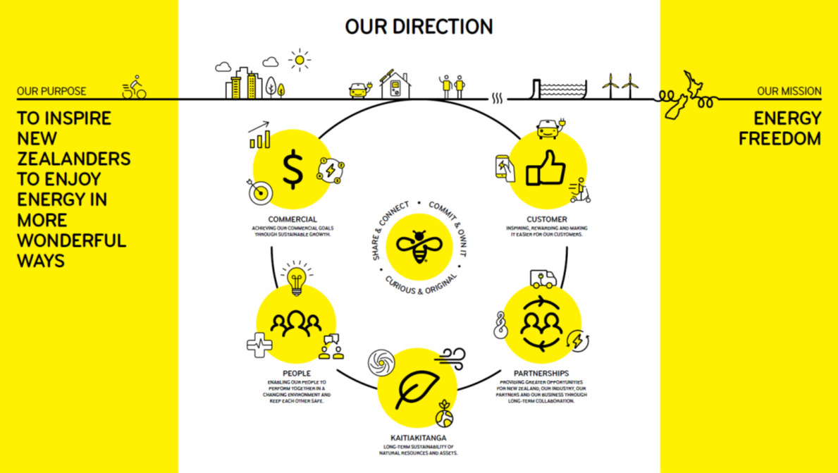
OUR DIRECTION
Notes:
SPEAKERS NOTES:

Slide 11
Notes:
SPEAKERS NOTES:

