Slide 1
GNS Geothermal Science: Present and Future
NZGW – November 27, 2019
Dr Anya Seward – Geothermal Research Programme leader

Slide 2
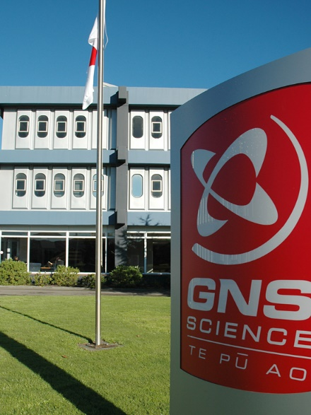
GNS Science : Who we are …
Independent, New Zealand Government-owned Crown Research Institute.
New Zealand’s leading supplier of earth science research and consultancy services.
Earth Resources & Materials:
  > 30 geothermal experts, Multi-disciplinary team, Researchers, specialists and Engineers
Our activities:
  Geothermal Research, Consultancy, Training, laboratory services
Our Clients:
  private sector, government organisations, international funding agencies, research groups in New Zealand and overseas.
Core purpose : To understand Earth system processes & resources, and translate these into economic, environmental and social benefits.

Slide 3
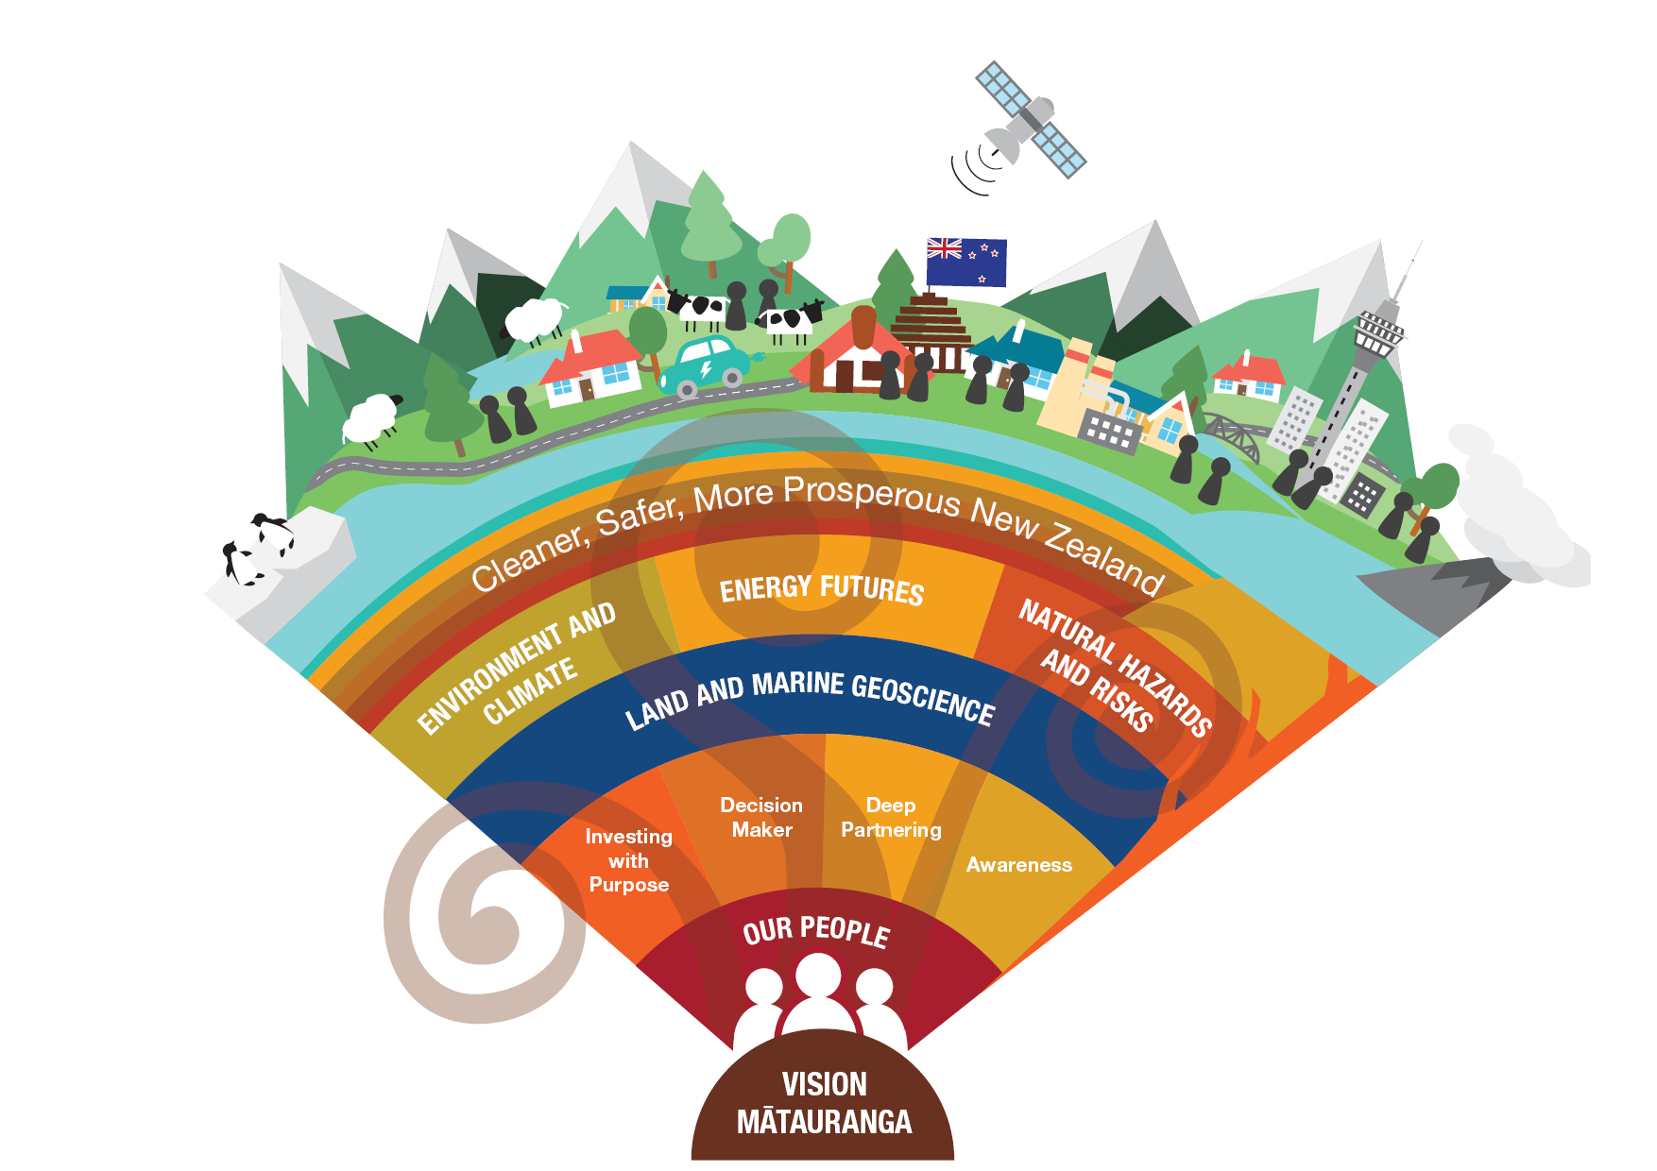
GNS Science : Who we are …
Natural Hazards and Risks – enhancing New Zealand’s resilience to geological hazards
Environment and Climate – ensuring sustainable management of the environment, and effective adaptation to a changing climate
Energy Futures – enabling New Zealand to transition to a low-carbon future
Land and Marine Geoscience – providing deeper understanding of the continent Te Riu-a-Māui/Zealandia

Slide 4
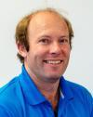
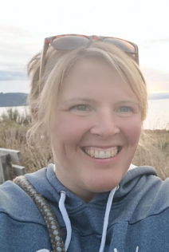



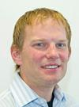


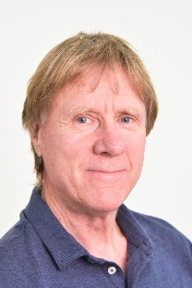
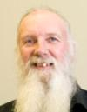

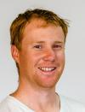
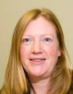
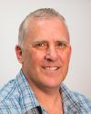



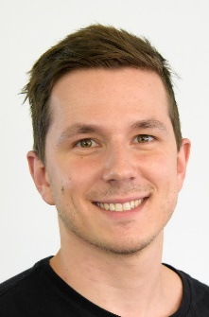
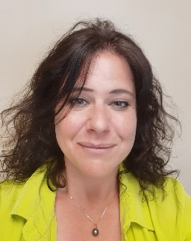
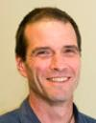
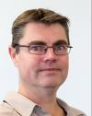
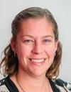


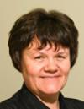
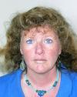
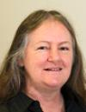

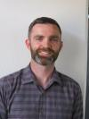

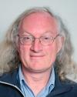
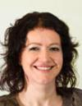

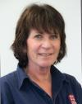
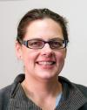
Geothermal: Who we are …
Geophysics
Geochemistry
Geology
NZGAL
Modelling
Business
Development

Slide 5
Research and consultancy
Geothermal : What do we do…
Geothermal Research and Consultancy
International clients
  Japan, Taiwan, Philippines, Indonesia, PNG, Turkey, Mexico, Djibouti, Kenya
Domestic
  Central government, councils, power companies, research institutes, universities
Expertise:
Geophysics
Geochemistry
Geology
Modelling
Analytical services

Slide 6



Research Programmes:
Geothermal : What do we do…
Research Programmes:
New Zealand’s Geothermal Futures
Thermal Processes
Super Hot fluids
Geothermal: The Next Generation

Slide 7
Present Research:

Slide 8
Understanding New Zealands Geothermal resources
Near-surface
Natural surface feature mapping
Heat flow
Thermal properties
Effects of use
Strategy and uptake
Vision Mātauranga
High enthalpy
Geological modelling
Fluid-rock interaction
Numerical modelling
Power station chemistry
Borehole imaging
Regional scale geophysics

Slide 9
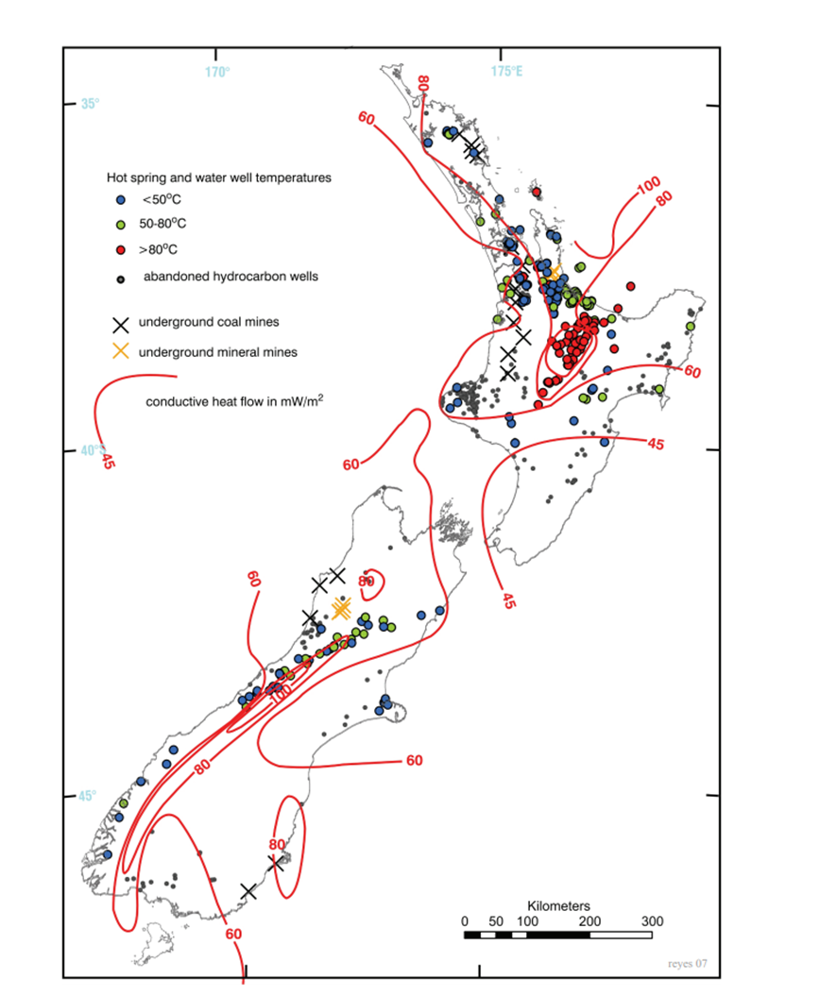
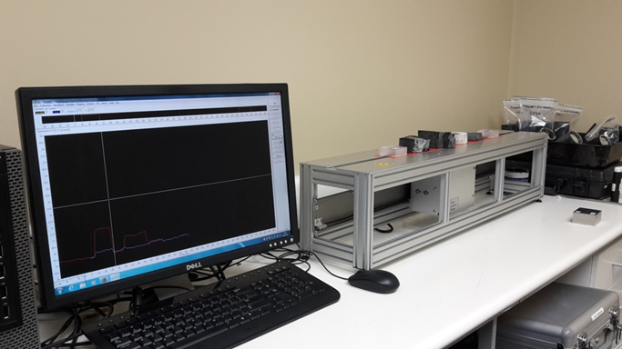
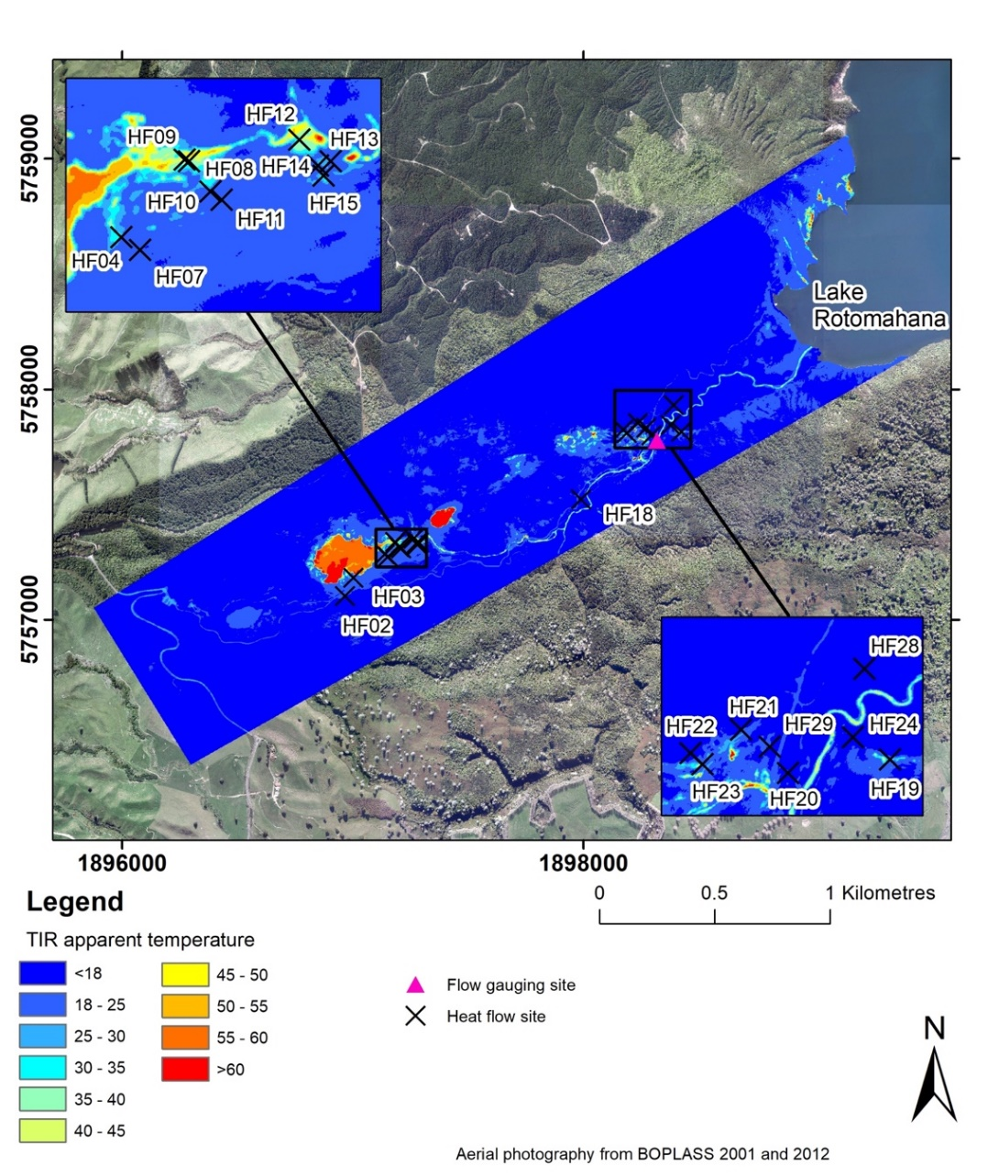
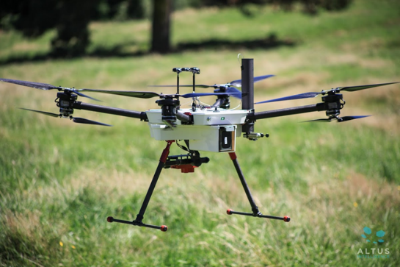
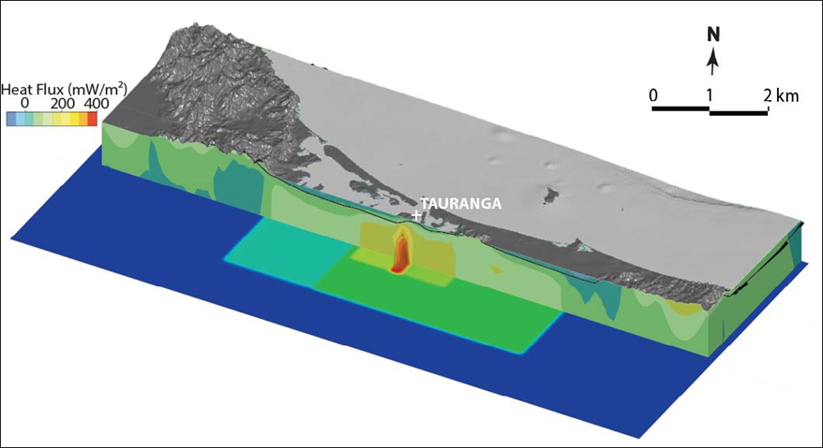
Near – surface Geothermal
Notes:
Mention Tikitere plans.. Last big undeveloped field.

Slide 10
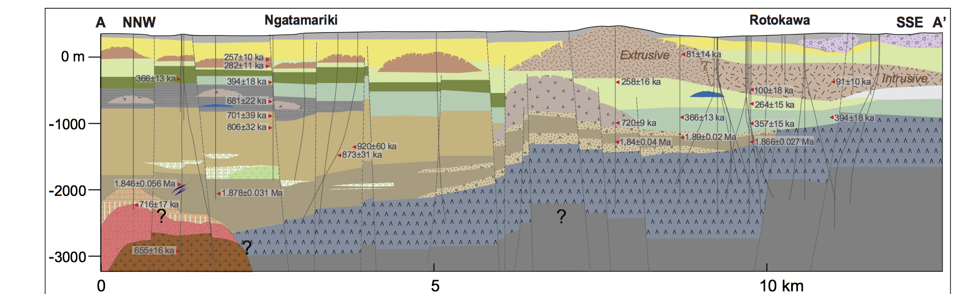
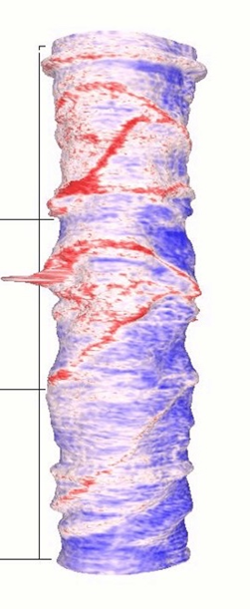
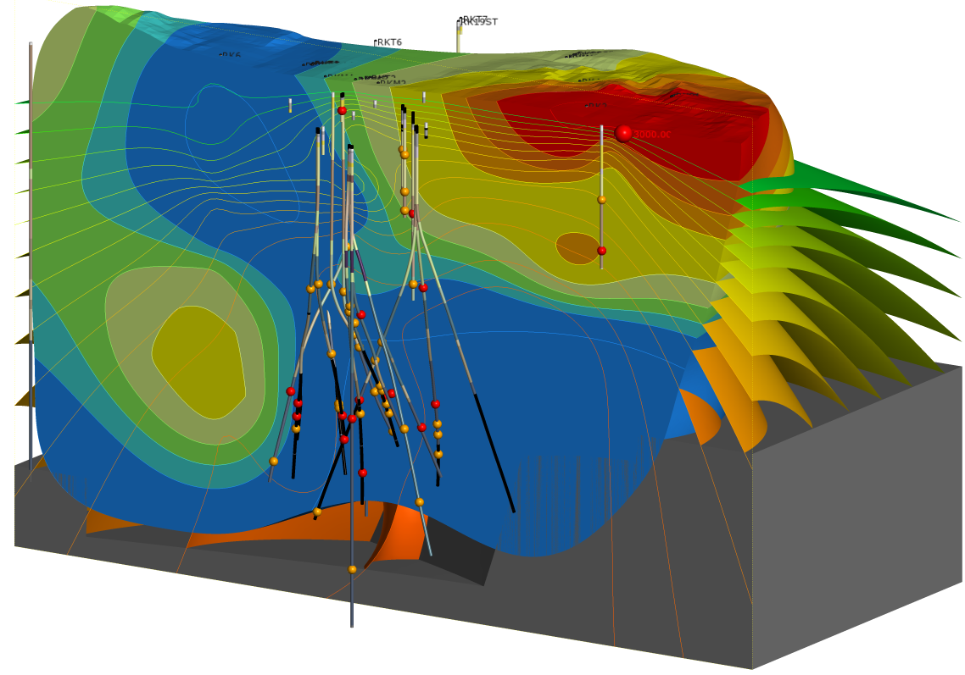
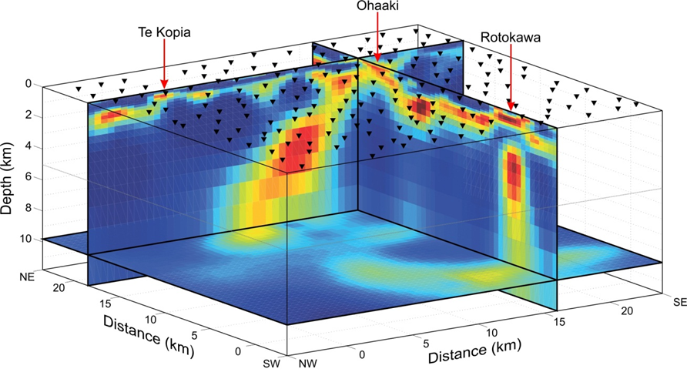
High Enthalpy systems:
Source to Surface Evolution
Notes:
enhance fundamental knowledge of the high enthalpy hydrothermal systems hosted by the basement and volcanic stratigraphy of Zealandia via a multidiscipline approach and to increase economic benefits from reduced costs of energy production, re-injection and reduce environmental effects

Slide 11
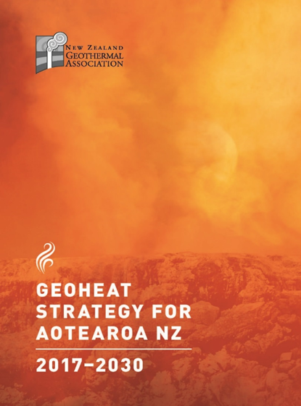
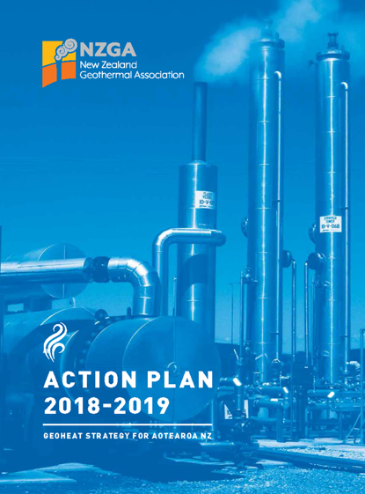
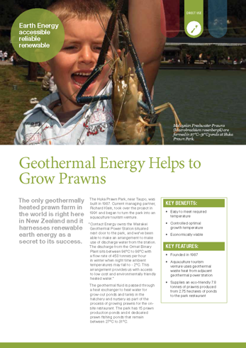
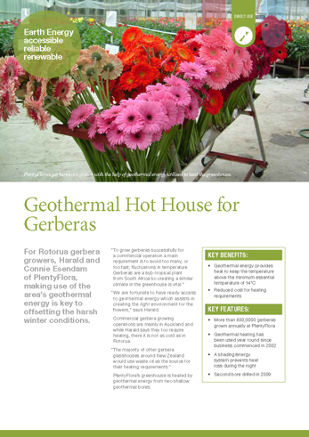
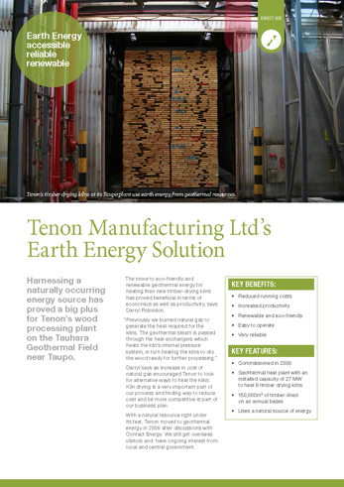
Other work:
Vision Mātauranga Capability Fund:
Kaitiakitanga of geothermal ecosytems through joint scientific and Mātauranga-a-iwi approaches
Te Ahi Tipua ki Tahorakuri A1 Section 30: establishing an economic development plan for hapū in degraded geothermal environments

Slide 12
Future Research:

Slide 13
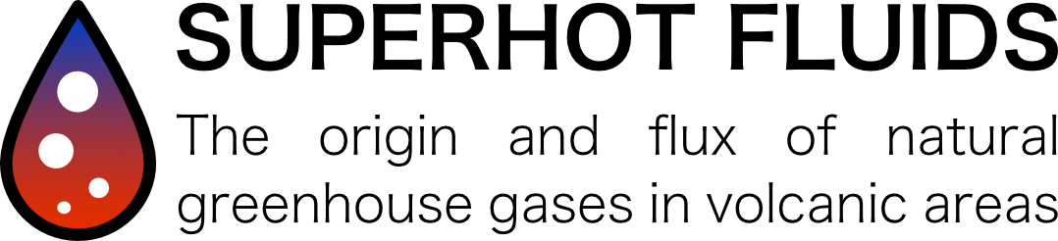
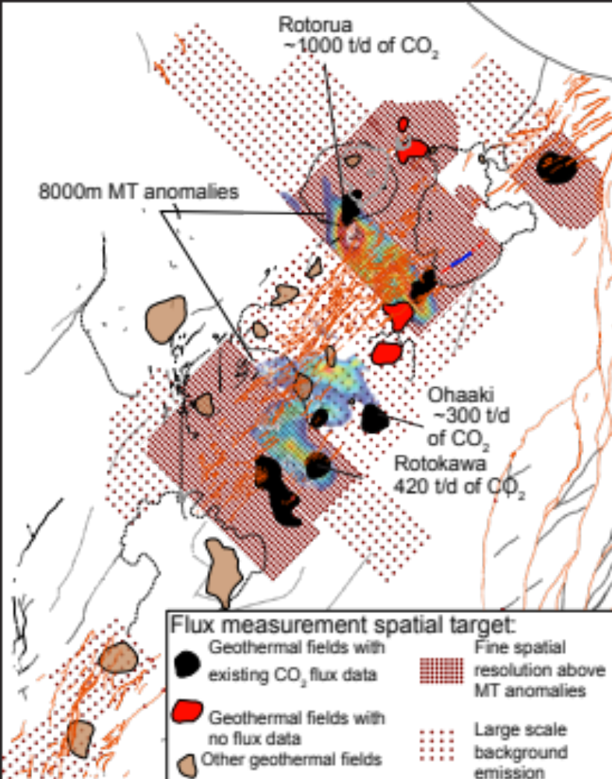
3 years program started in June
Isabelle Chambefort, Michael Rowe, Agnes Mazot, Tsung Han Jimmy Yang, David Farsky
Aim:
Understanding the breathing of the volcanic region
measuring natural gas flux through the TVZ
Paper 58

Slide 14

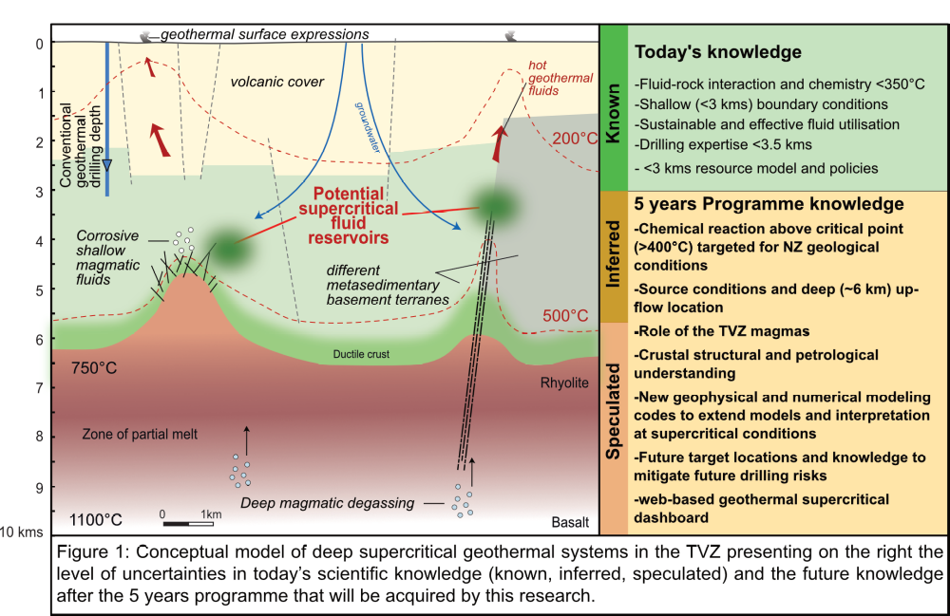
Team:
Dr. Isabelle Chambefort
Dr. Sarah Milicich
Dr. Bruce Mountain
Brian Carey
+ many more
Paper 59

Slide 15

Any Questions:
John Burnell
Energy Futures Leader
j.burnell@gns.cri,nz
Business Development Team
Geothermal Research Leaders
German Orozco
Angus Howden
Dr. Anya
Seward
Dr. Isabelle
Chambefort
g.orozco@gns.cri,nz
a.howden@gns.cri.nz
a.seward@gns.cri,nz
i.chambefort@gns.cri.nz

