Slide 1
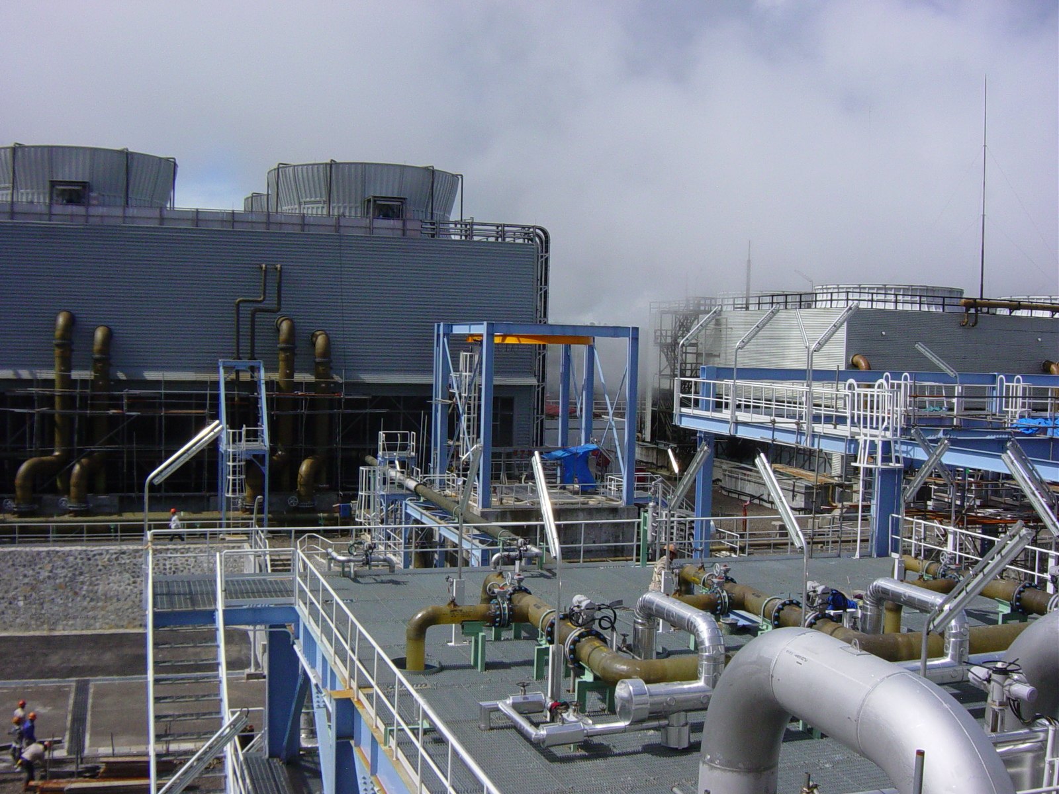

NZGW - Industry Update
2018 Year in review and looking forward
November 2018

Slide 2
AECOM Geothermal

Slide 3
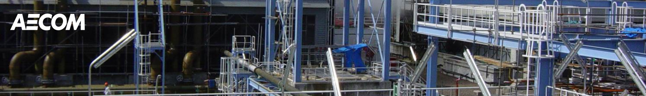

AECOM has experience in Engineering 50 geothermal developments, with a combined output of over 3,000 MW.
Projects includes
    New build
    Modification/ Expansion/ Rehabilitation of existing Plant
    Operational improvements and Upgrading of Plant Controls

Slide 4
AECOM Services

Slide 5
AECOM Geothermal – Life Cycle Support
Project identification
Condition Assessment
Pre-Feasibility
Feasibility Studies
Site layouts and preliminary plant layouts
Environmental Impact Assessment
Licensing Permitting Assistance
Conceptual design
Front End Engineering Design (FEED)
Detailed Design
Owners/Bankers/Lenders Engineer (EPC or BOOT)
Project Management (Traditional, EPC or EPCM)
Strategic development
Planning & Scheduling
Procurement
Cost Estimating
Tender Evaluation & Reporting
Inspection & Expediting
Construction Management and Site Supervision
Start-up, Testing and Commissioning
Economic Analysis
Training
Capacity Building
Financial services
Policy studies and support

Slide 6
AECOM’s Geothermal Activity 2018

Slide 7
New Zealand 2018
Mercury - Ngatamariki, Rotokawa & Mokai Upgrades on Binary cycle plant storage/retention of organic fluid to comply with Major Hazard Facility (MHF) requirements
Mercury – Mokai turbine expansion joint flow liner failure investigation

Slide 8
Indonesia 2018
    PLN – Kamojang Units 2 & 3 Rehabilitation Concept design and Bid Document preparation
    Supreme Energy - Rantau Dedap - FEED and EPC Contractor Procurement
    SAE - Baturraden - Predrilling Feasibility Study
    Supreme Energy – Muara Laboh - Specialist geotechnical engineering support for slope stability.
    Star Energy – Gunung Salak brine heat recovery

Slide 9
Indonesia 2018
    PLN – Kamojang Units 2 & 3 Rehabilitation Concept design and Bid Document preparation
    Supreme Energy - Rantau Dedap – Design review of EPC Contractor design
    SAE - Baturraden - Predrilling Feasibility Study
    Supreme Energy – Muara Laboh - Specialist geotechnical engineering support for slope stability.

Slide 10
Philippines 2018
    EDC – Leyte Assessment of Seismic Resilience
    EDC – Malitbog Control System Integration
    EDC – Tongonan Control System Integration
    EDC – Malitbog GRS Upgrade Concept Study
    EDC – Palayan Binary Contract Assistance
    EDC – Palinpinon 1 & 2 Control System Integration
    EDC –EDC – Bacman Protection Setting Review

Slide 11
Kenya 2018
    KenGen - Olkaria VII – Technical and Commercial Feasibility Study for 140 MW GPP

Slide 12
2019 Looking forward

Slide 13
Indonesia 2019
    PLN - Continuation of Kamojang Units 2 & 3 Rehabilitation project
    Supreme Energy - Continuation of Rantau Dedap implementation
    SAE - Continuation of Baturraden exploration after drilling results available
    Star Energy – Wayang Windu wellpad MBI piping design

Slide 14
Philippines 2019
    EDC – Continuation of Leyte Resilience
    EDC – Continuation of Palinpinon 1 & 2 Control System Integration

Slide 15
Kenya 2019
    KenGen - Olkaria VII – FEED 140 MW GPP
    Sosian - Continuation of Menengai development

Slide 16
Thank you

