Slide 1
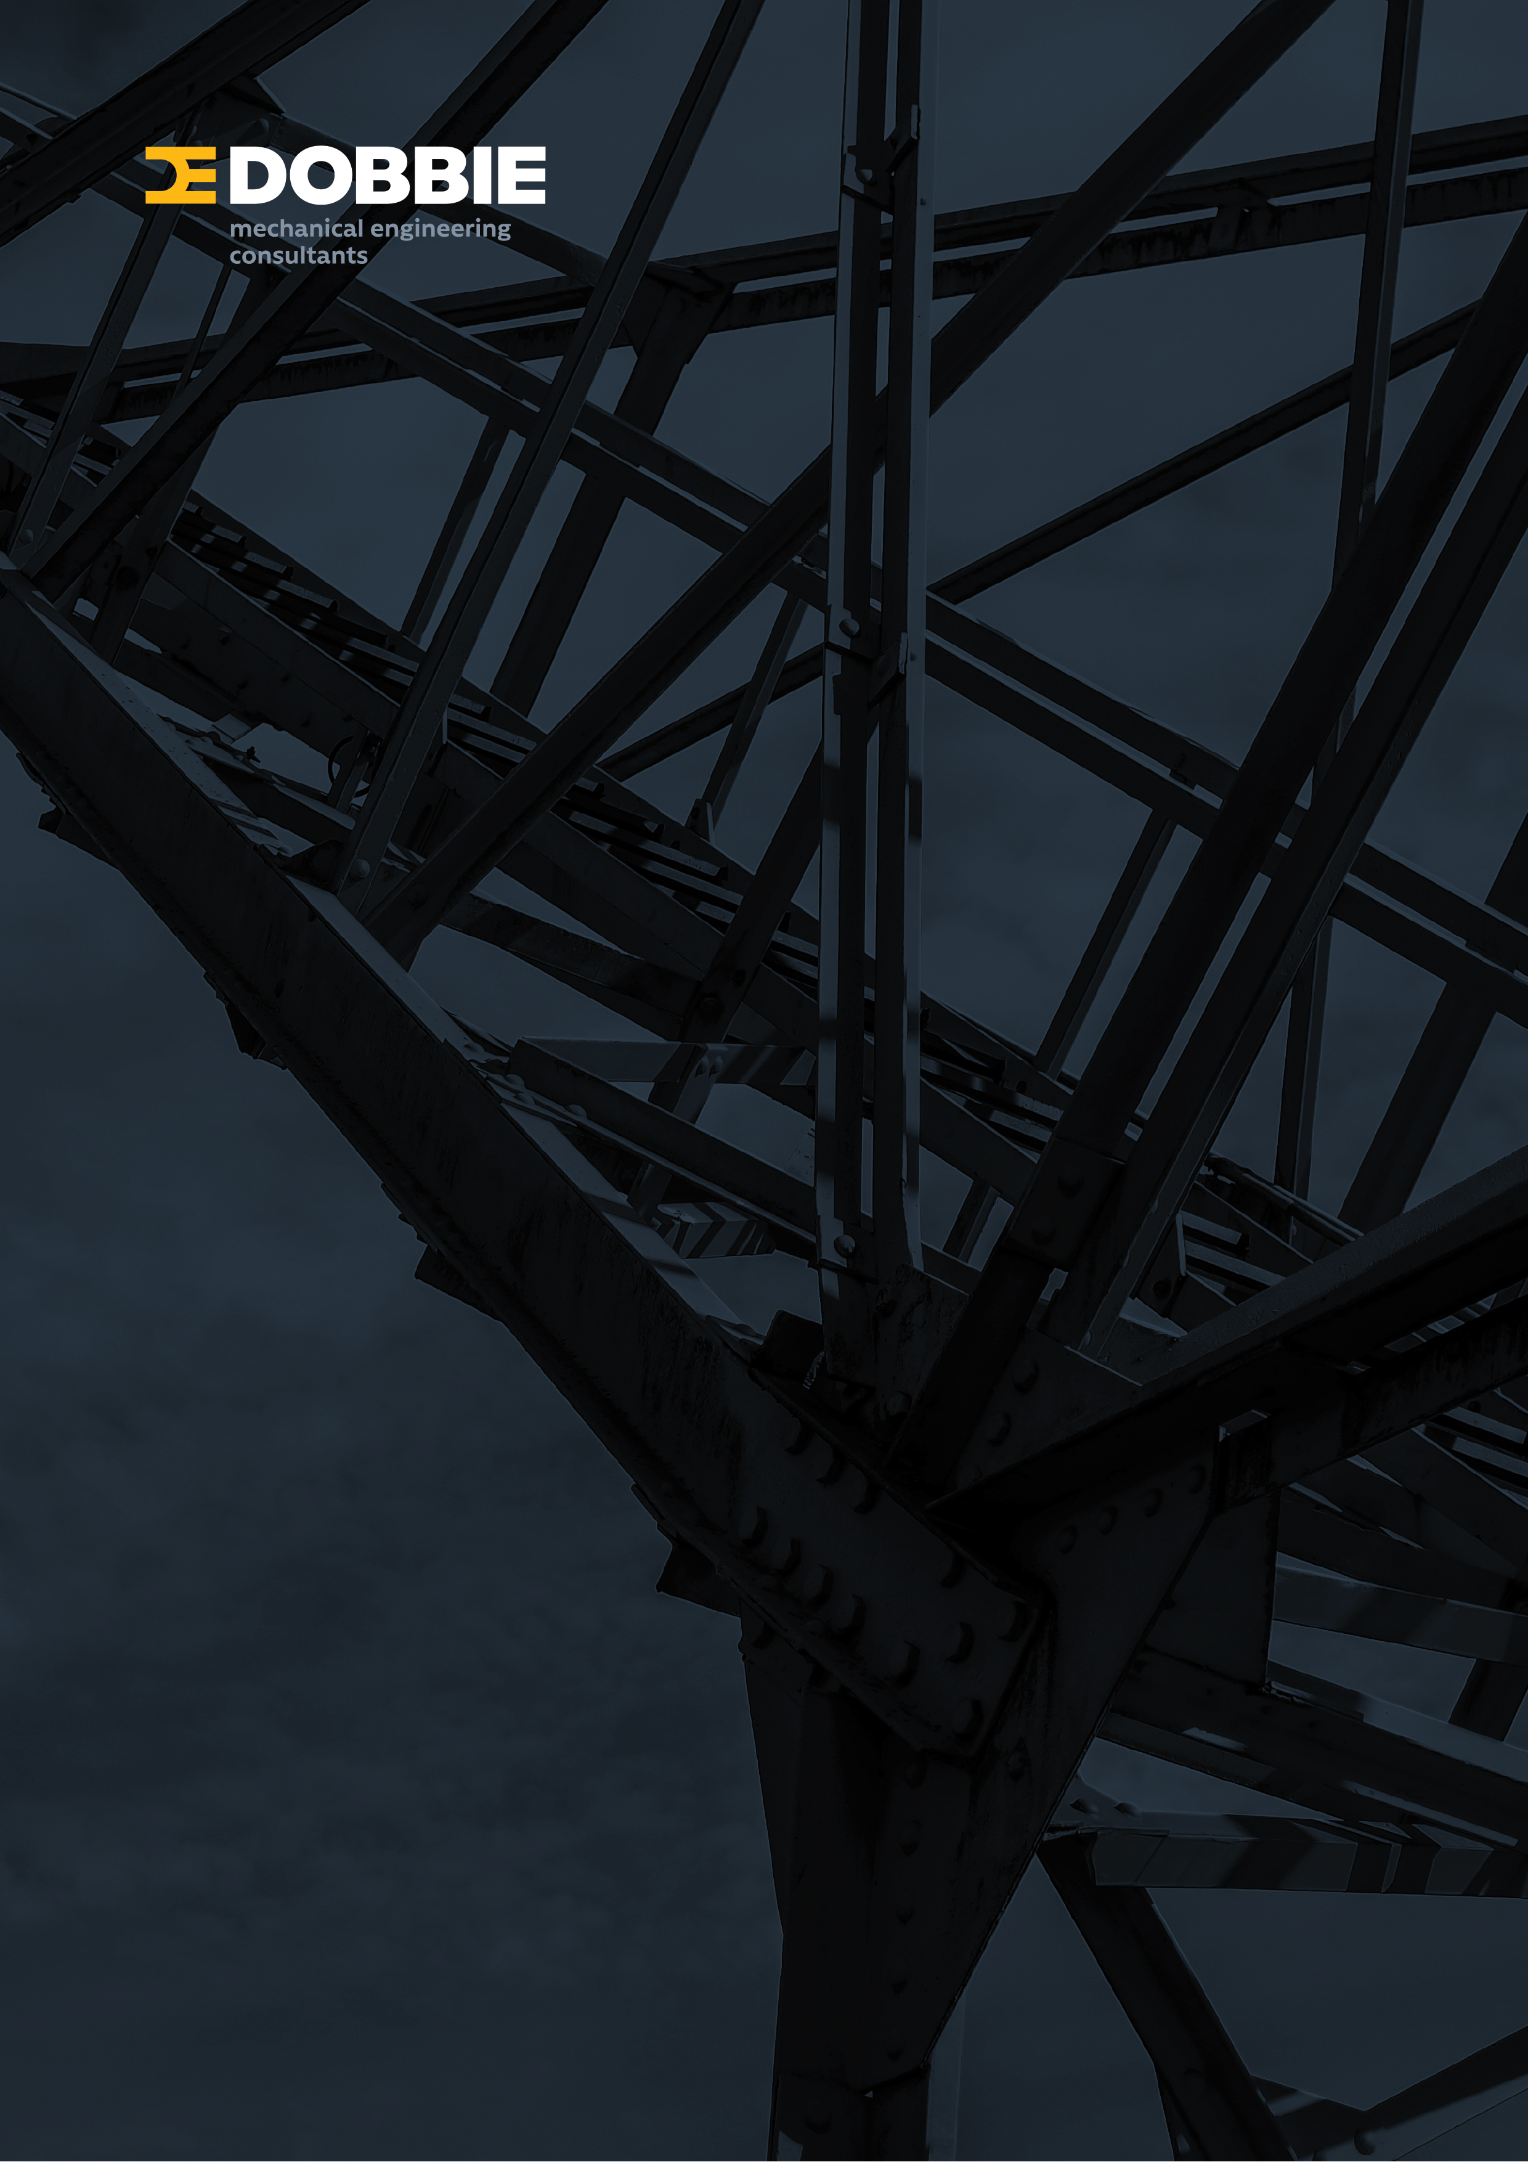

2018 Geothermal Workshop Industry Update
Dobbie Engineers

Slide 2

BACKGROUND
Team of 20 engineering staff in two offices – Rotorua and Auckland
30+ years experience in geothermal direct heat use
Extensive experience in other mechanical engineering fields : Pulp & Paper, Timber Processing, Dairy, Power, and Heating systems.
Experience allows us to understand clients needs and their values.
Our geothermal systems have been recognised by our industry peers with gold and silver awards.
Currently operate a certified ISO 9001 (2015) Business management system.
www.dobbie.co.nz

Slide 3
PAST PROJECTS
Timber Drying | Tenon Taupo: Detailed geothermal plant design for 30MW (peak) of kiln heating CHHWP Kawerau: Geothermal steam supply systems to five HT and MT Kilns Sequal Lumber: Concept Design of energy system and kilns heating equipment
Process Heating | Ngati Tuwharetoa Geothermal Assets: Kawerau clean steam system (16 barg, 26 t/hr) supplying Asaleo. Tasman Mill Kawerau: process steam systems and generation plant
Hotel Space heat | Wairakei Resort: 4 stages of heating upgrade Novotel and Ibis Hotels – Rotorua : 1.5 MW capacity Numerous Motel developments in Rotorua

Slide 4
PAST PROJECTS
Pools | Hanmer Springs: Concept design and heat flow evaluation Waikite Pools : Geothermal supply system Polynesian Pools Rotorua : Mineral bath systems for acid and alkali waters including gas extraction systems AC Bath Taupo : Geothermal heating and bathing systems QE Health Rotorua : Mineral water bathing and showering systems. Development of gas extract systems.
Glass Houses | Gourmet Mokai Glass Houses: Heat plant replacement. 11.5 Ha under glass. Plentiflora: Geothermal heating systems for Gerberas

Slide 5
PAST PROJECTS
Aquaculture Power Generation | Heat exchanger replacement Wairakei Prawn Farm Concept development for large Carp Farm operation (12MW heat) Steam field, separation plant and reinjection system design for Contact Te Huka Binary Plant, Taupo (28MWe) Norske Skog Tasman (Kawerau) Geothermal Turbine replacement (8MWe).

Slide 6
CURRENT & RECENT
PUKEROA LAKEFRONT HOLDINGS WAIARIKI LAKEFRONT SPA LUXURY SPA & WELLNESS EXPERIENCE
Due to open 2019. Includes over 6,000 m² of bathing and spa facilities overlooking Lake Rotorua Utilises geothermal fluid for space, pool and water heating, total demand up to 2.5MW (thermal) Energy provided by 3 production and 2 reinjection bores Provides a variety of geothermal and fresh water bathing experiences Geothermal Pools comply with NZS 5826 with once flow through systems Includes variety of geothermal water pool experiences Private pools and baths Public foot pools and Wet Labyrinth Walks

Slide 7
CURRENT & RECENT
GEO 40 SILICA REMOVAL PLANT
Geo40 have operated a number of test and pilot plants extracting silica Developed production plant at Contacts Ohaaki site Dobbie scope to design and document Incoming high pressure geothermal delivery system Pressure control and relief systems Plant layout Equipment selection : control valves, pumps, safety relief systems, test plant

Slide 8
CURRENT & RECENT
CONTACT ENERGY GEOTHERMAL HEATING SYSTEM
Currently working with Contact to developing a Geothermal heating system Ultimately using up to 22MW of heat The system includes multiple heat exchangers and heat dump systems to minimize well turn down and cycling during plant operation Expected to have a high efficiency with utilization levels of available energy at 90% + (compared to electrical at 15 to 30%)

Slide 9
CURRENT & RECENT
ASHCROFT ESTATE LUXURY GATED HOUSING DEVELOPMENT
New estate being built in central Rotorua 50 central city homes in gated community Utilising 60 tonnes/day of fluid at 95 ⁰C to provide recreational pool heating and a mineral bathing experience Dobbie’s scope Obtaining consent Evaluating resource availability and concept design Detailing plant to recover heat and reinject the fluid

Slide 10
CURRENT & RECENT
TE PUIA SPRINGS-EAST CAPE
Small community 100km north of Gisborne At present there are multiple geothermal surface features discharging to land. Several springs are captured to provide small scale baths and a pool at the local hospital and hotel. Dobbie’s scope was to identify the resources and possible uses. The scope included: Identification and measurement of the spring flows. Complete with assistance from GNS Wairakei Identified what could be economically recovered and utilized Developed concept system designs, cost estimates, risk profiles etc for potential uses including. glass house heating Space and water heating Bathing and spa treatment

Slide 11
CURRENT & RECENT
MIRAKA DAIRY STEAM EFFICIENCY
Dairy factory West Taupo Utilises geothermal energy from the Mokai Steam Field Currently uses clean steam generated from geothermal steam Dobbie are currently : Optimising steam use and plant reliability Evaluating options for additional process heating and drying

Slide 12
CURRENT & RECENT
OJIFS Kawerau CLEAN STEAM SUPPLY
Establishing a geothermally produced clean steam supply to replace existing power boilers Requires a 300mm diameter pipeline, 1500m long, from Ngati Tuwharetoa’s clean steam plant to the Oji site. Dobbie’s scope : Performed initial CEL 1 & 3 evaluations Currently documenting overland steam main and pressure control systems

Slide 13
CURRENT & RECENT
NGATI TUWHARETOA GEOTHERMAL ASSETS GEOTHERMAL CLEAN STEAM SUPPLY
Ngati Tuwharetoa currently operate a clean steam supply system that delivers steam to ASALEO. Currently planning to supply OJIFS and new dairy factory in the future Dobbie’s scope: Assisting NTGAL to improve operation of existing clean steam plant Purchasing new HEX tube bundles Documenting system upgrades Reviewing plant development options and performing HAZOP analysis

Slide 14
CURRENT & RECENT
AUCKLAND GEOTHERMAL
Our client is reviewing options to use low temperature geothermal resources available in the greater Auckland area to provide year round bathing experience to communities Dobbie’s scope : Initial feasibility study Identify energy requirements for bathing systems Develop plant system options and operational and capital cost estimates

Slide 15
CURRENT & RECENT
CHH WOOD PRODUCTS KAWERAU NEW CONTINUOUS KILNS
CHHWP Kawerau recently commissioned two continuous timber drying kilns utilizing geothermal steam. Geothermal steam is used directly in the kiln coils Dobbie’s scope : Establish steam requirements Evaluate and design steam delivery systems Specify and co-ordinate with equipment supplier to optimise plant and energy supplies

Slide 16
CURRENT & RECENT
MERCURY
Operates : Five geothermal power stations (Nga Awa Purua – Ngatamariki – Mokai - Kawerau - Rotokawa Dobbie’s scope included assistance with : Assist with plant development, Health & Safety systems and maintenance. Upgrade system P&ID drawings Brine balancing systems for NAP & Rotokawa Assistance with the design of steam scrubbing systems Kawerau acid dilution systems Steam field maintenance and health and safety upgrades.

Slide 17
SUMMARY
Direct heat use remains one of Dobbies core areas of experience
The Geothermal Resources available are well known and the methods of utilization are established
The problem remains attracting commercial use. They must understand the potential:
  Realising geothermal can provide an abundant heat source
  Direct Heat use provides the best utilization of the resources
  Used as a direct heat source maximizes efficiency – may be 80% - 90%+
  Projects with high utilization levels provide the best long term economics. Suited to : Process heating, Drying (timber), Pools, Aquaculture
  We need to emphasis the renewable and low carbon properties of geothermal energy.
    Products produced using renewable resources will be increasingly recognized as having a commercial marketing advantage

Slide 18
OPPORTUNITY
The manufacturing of the battery of your electric car requires the equivalent amount of energy as of 50,000 + km of travel. Would you rather it was manufactured using energy generated from coal or a renewable energy source such as geothermal?
We need to capture the interest of the Eion Musks of this world and demonstrate the commercial advantages of renewable resources.
And to get there, Dobbies would like the opportunity to assist you and ensure your project is a success for everyone.

Slide 19
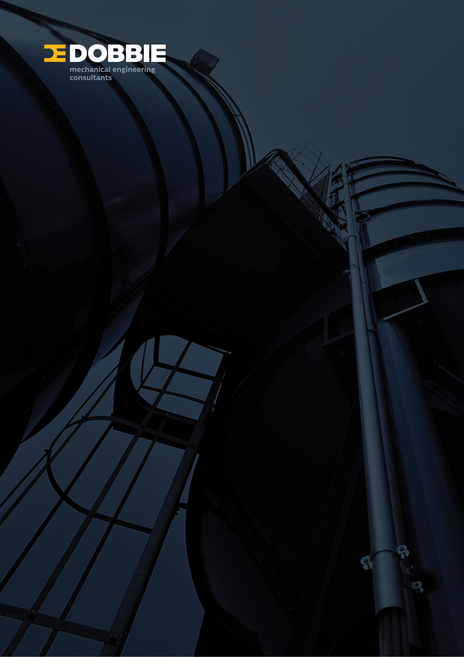
Presenter
Greg Moore
Director
Dobbie Engineers www.dobbie.co.nz

