Slide 1
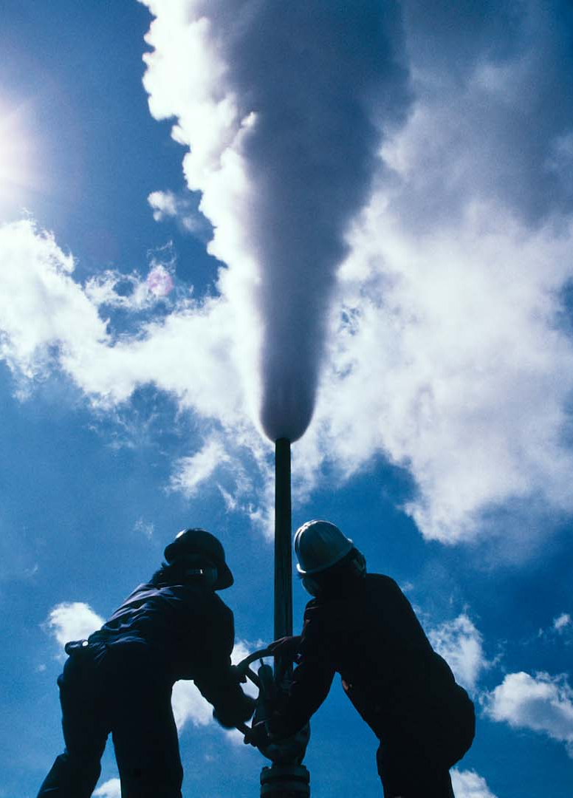
Industry update
NZGW 2019

Slide 2
agenda
Ecolab Overview
Geothermal focus areas
GEOMIZER update

Slide 3
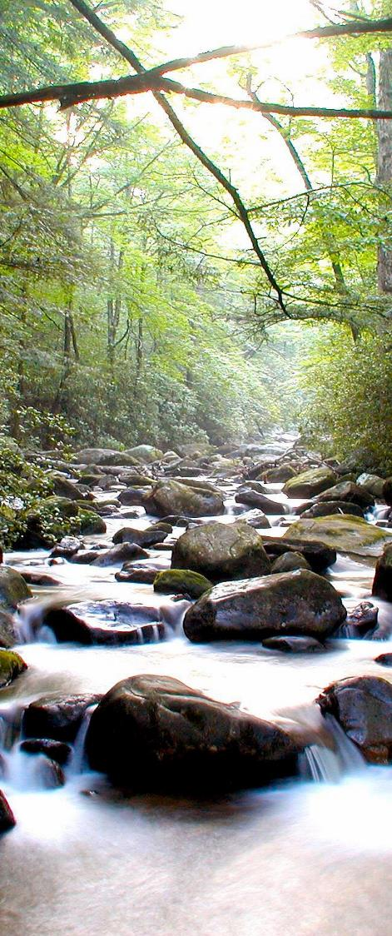




Our vision
CLEAN
WATER
SAFE
FOOD
ABUNDANT ENERGY
HEALTHY ENVIRONMENTs

Slide 4
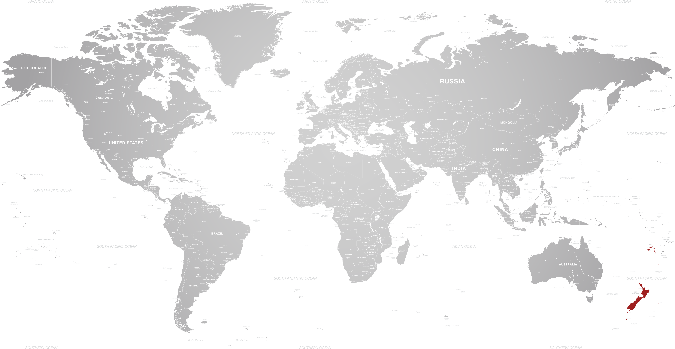
OUR GLOBAL FOOTPRINT
OUR LOCAL FOOTPRINT
19
1
Technology
Centres
Local Technology
Centre
170+
3
Countries
Countries in the ANZ region
370
26
Plants & Warehouses
Plants & Warehouses
49,000+
1,120
Employees
Employees
$47B
$370M
Market Cap
Total ANZ Revenue
4

Slide 5

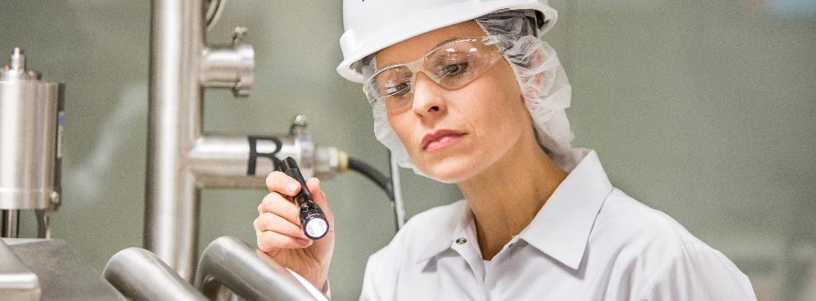
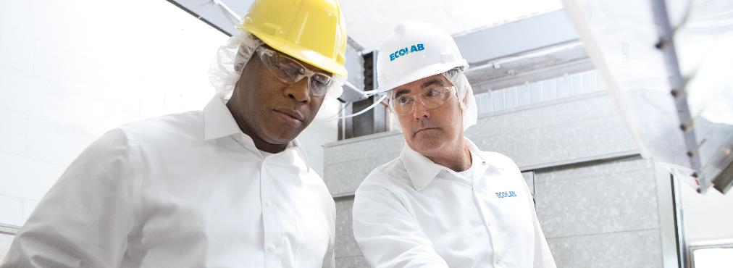
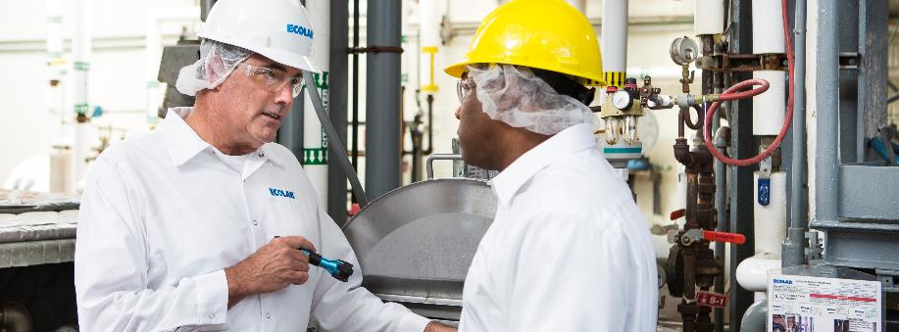
OUR CORE CAPABILITIES
Drive the best results / lowest total costs for customers
Chemistry & dispensing
On-site service
OUR CORE CAPABILITIES
Data-driven insights
Training certification
5
5

Slide 6
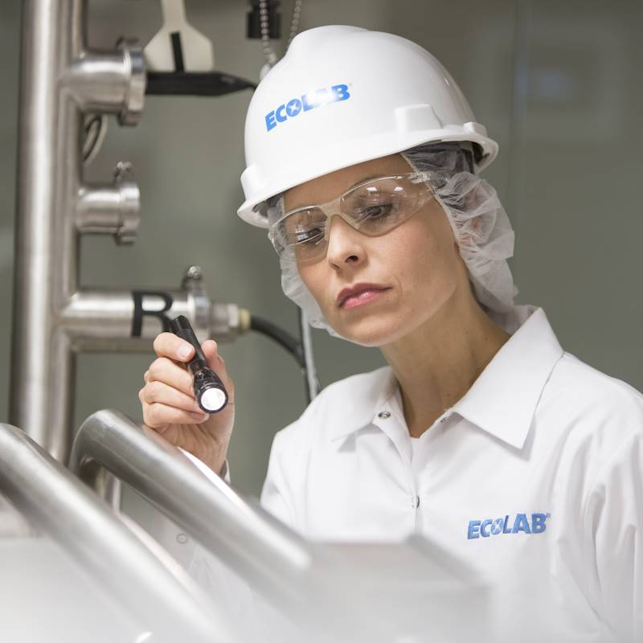
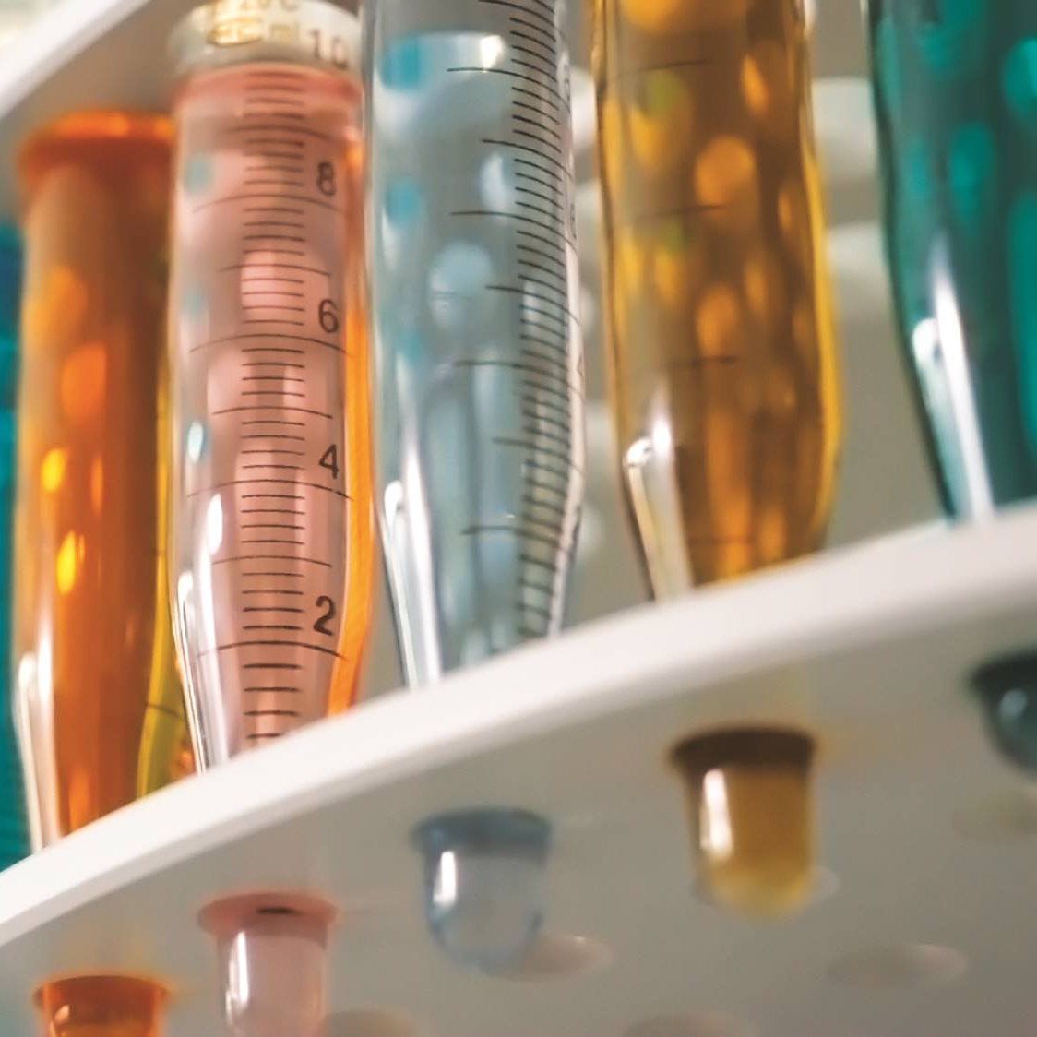
We develop the best solutions for your business by solving
real-world problems
1,600+
8,700+
SCIENTISTS
PATENTS
19
200+
8
Global
Technology Centres
University
and Industry Partnerships
Regional
Technical
Centres

Slide 7
Our sales-and-service team
brings APPLICATION EXPERTISE
to your operation
Personal, on-site service when and where you need us
Problem-solving
and consulting
Training on product use and
best practices
27,000 +
Highly trained
Field Associates
24/7
Customer Service
& Technical Support

Slide 8
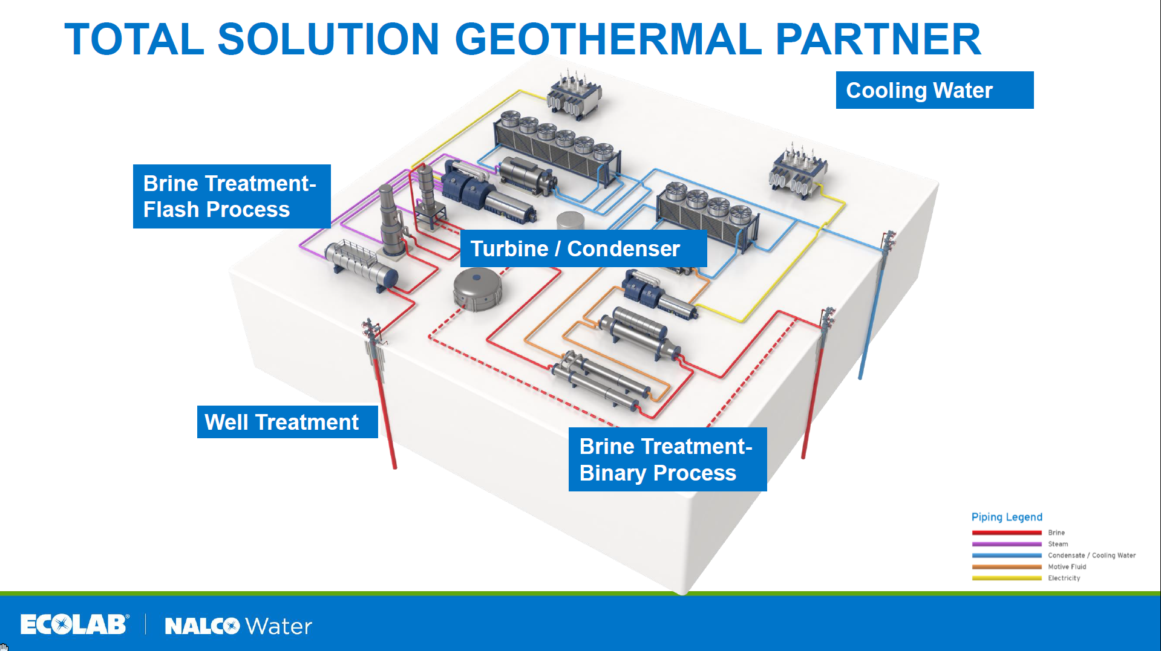

Slide 9
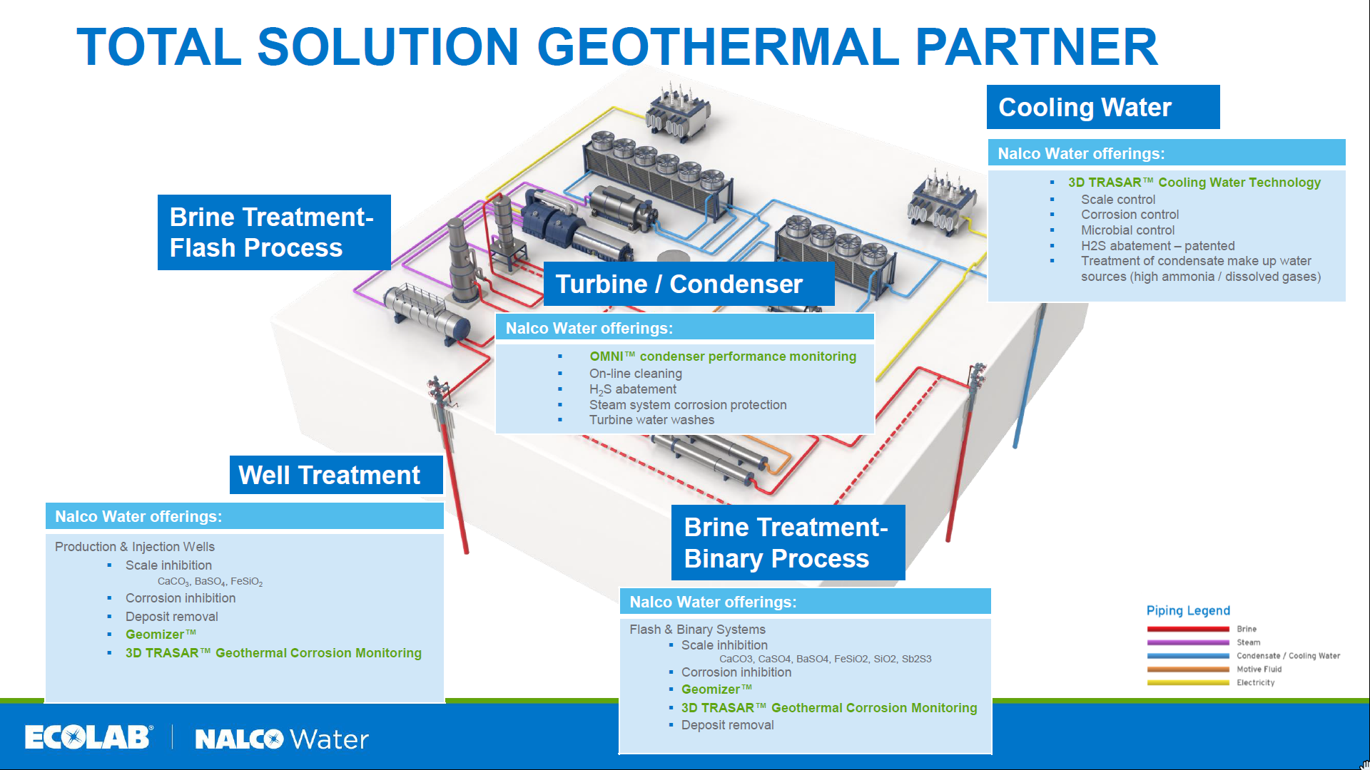

Slide 10
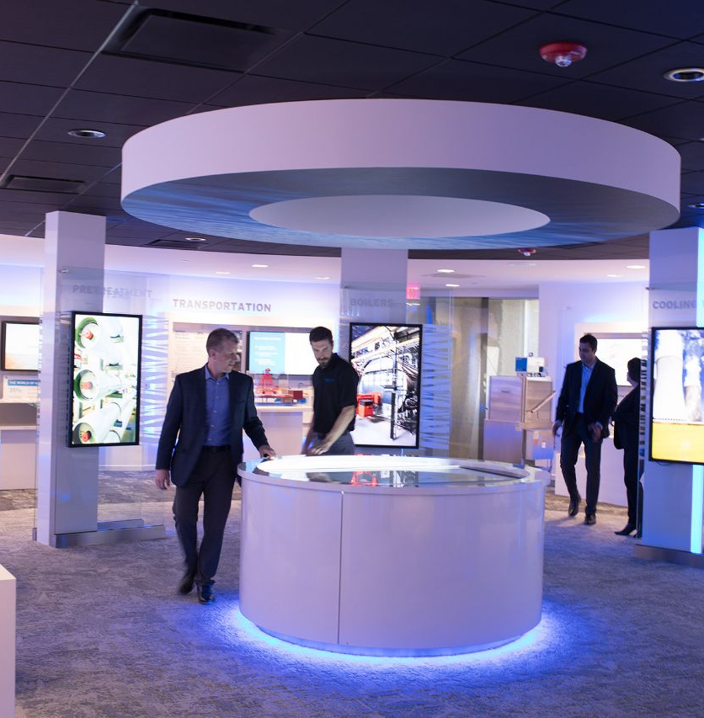

Geothermal focus
Training – Naperville
  Approx. 25 attendees
  Mix of field sales, technical, marketing and research
  USA, Mexico, Costa Rica, El Salvador, Honduras, Brazil, Philippines, Indonesia, Turkey, Europe, Britain, India and ANZ
Updated GEOMIZER modelling tool
New silica inhibitor chemistry
Online well cleaning
H₂S abatement
Corrosion control for direct heating
Cooling water management

Slide 11

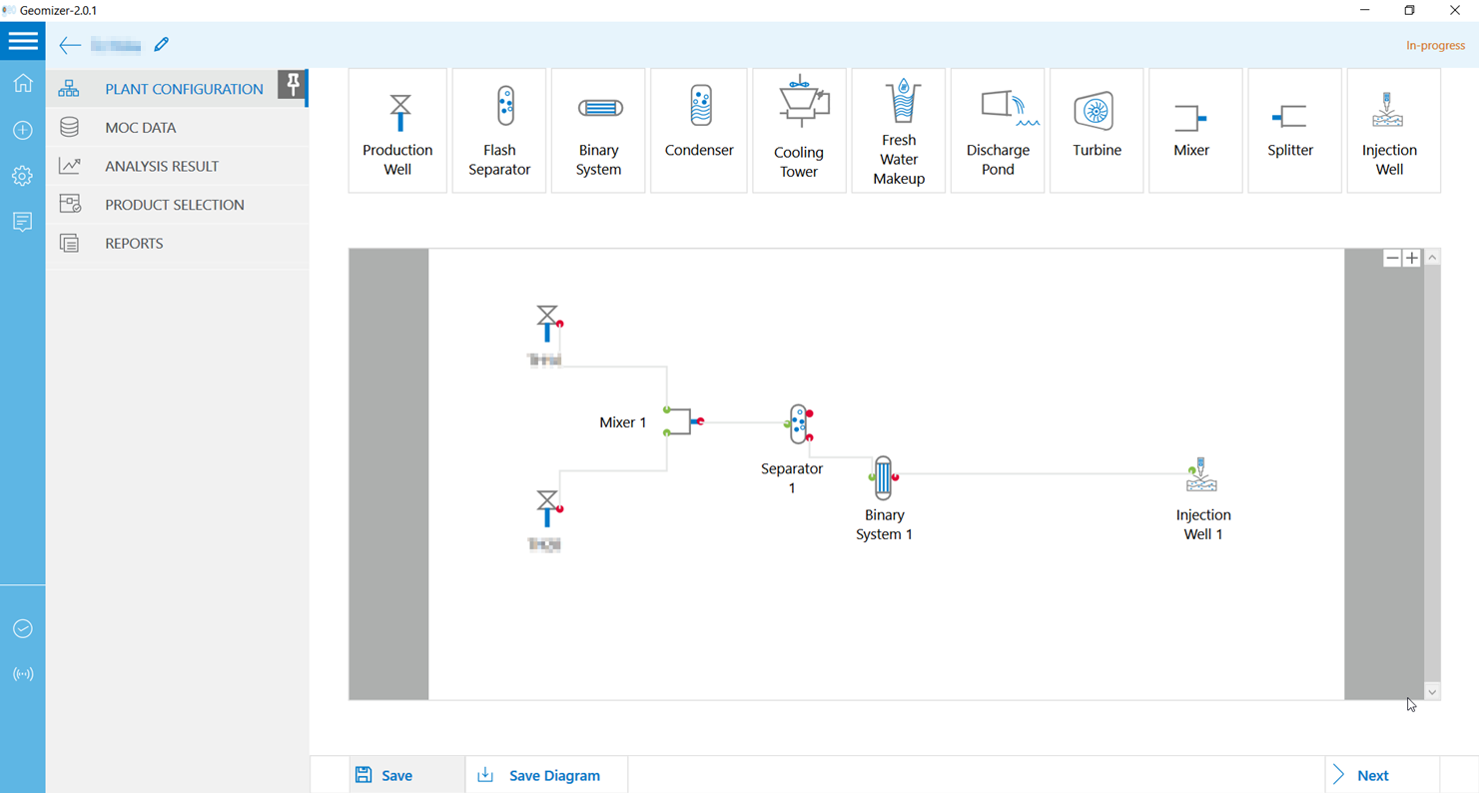
2.0 – updated interface

Slide 12
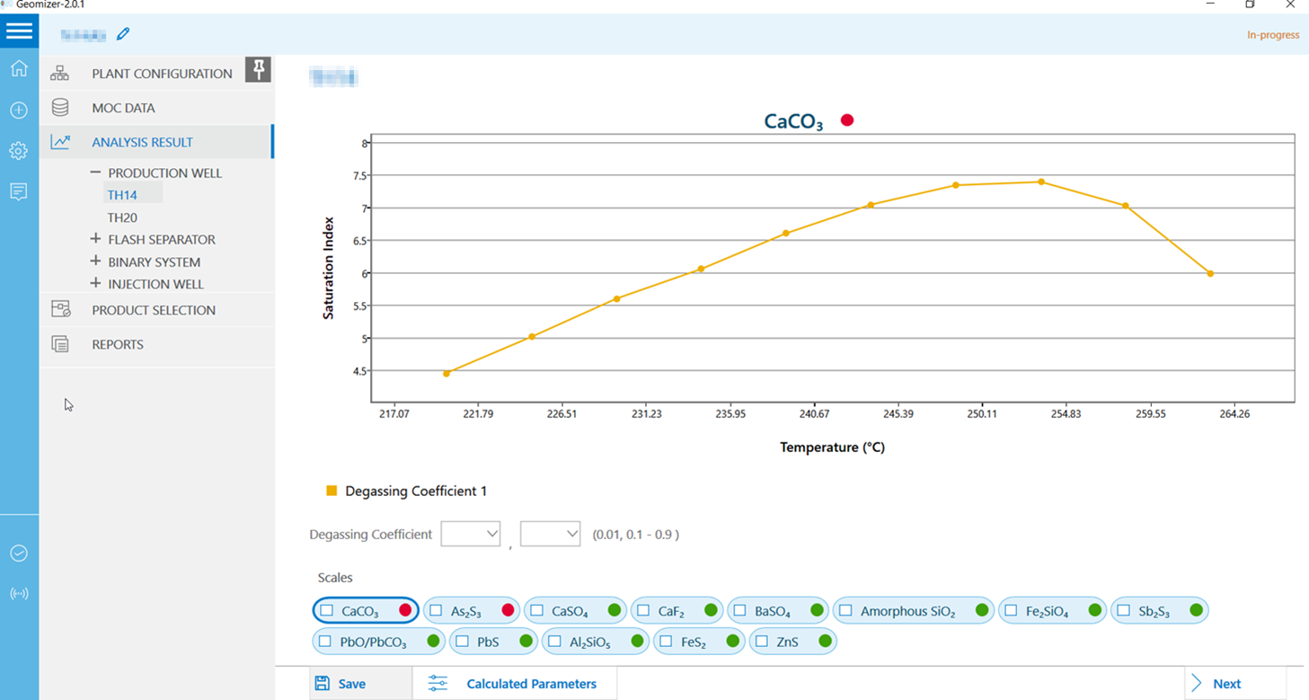
2.0 – New scale models

Slide 13
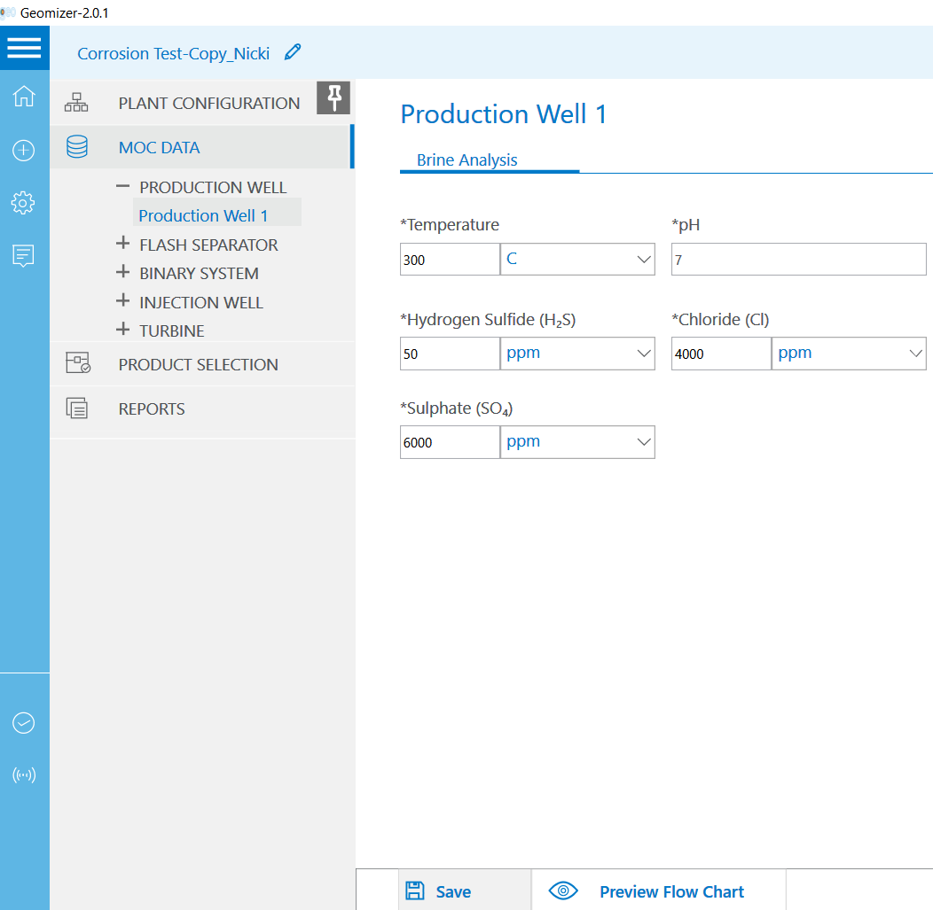
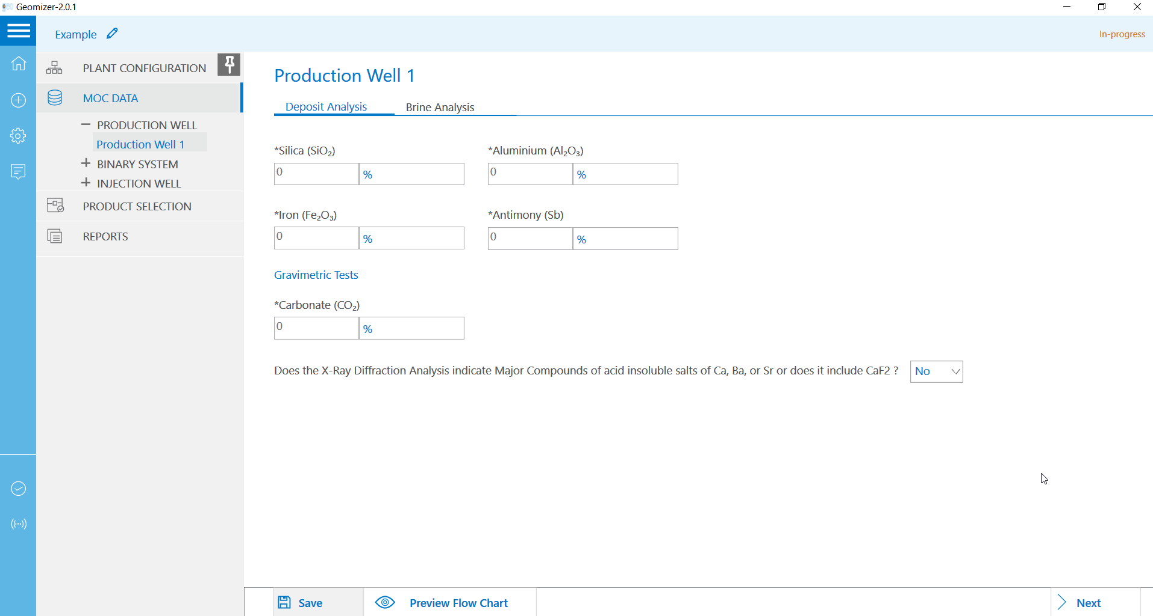
2.0 – new capabilities
Scale Dissolution
Corrosion Control

