Slide 1
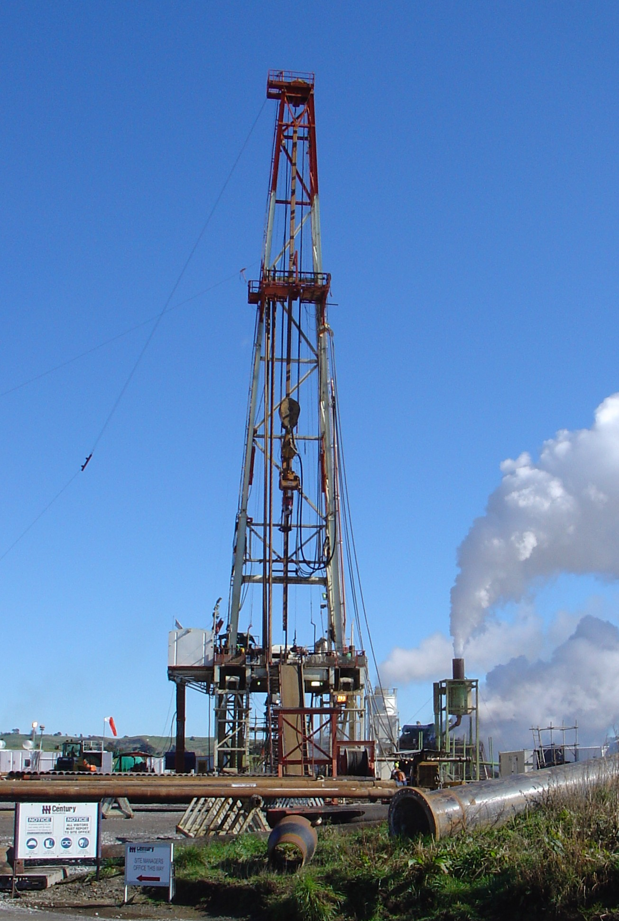
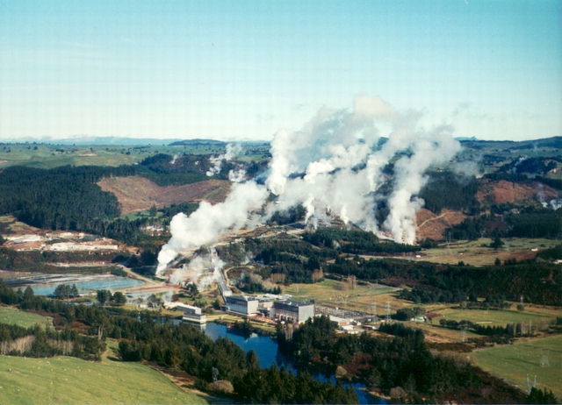
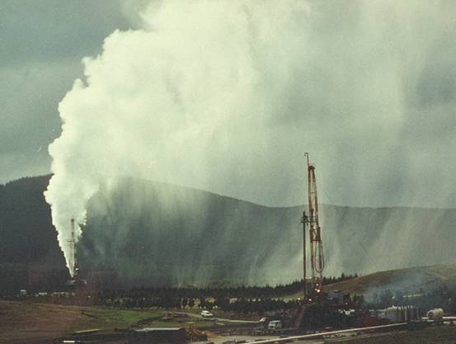

GNS Science : 2017/18 Activities
German Orozco
Department of Geothermal Sciences
Wairakei Research Centre

Slide 2
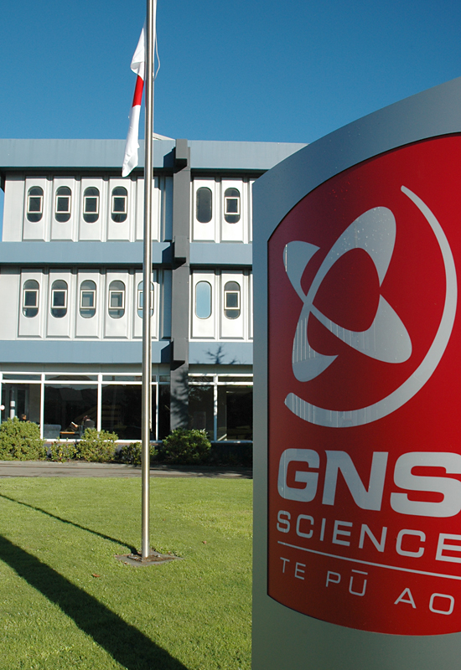
GNS Science : Who we are …
Independent, government-owned Crown Research Institute
New Zealand’s leading supplier of earth science research and consultancy services
320 staff in Wellington, 80 in Taupo and 10 in Dunedin
Clients include private sector, government organisations, international funding agencies, research groups in New Zealand and overseas
Revenue: ~60% Research; ~40% Commercial (15% GeoNet)
3

Slide 3

GNS Science : Mission
To understand natural Earth system processes and resources, and to translate these into economic, environmental and social benefits
4

Slide 4
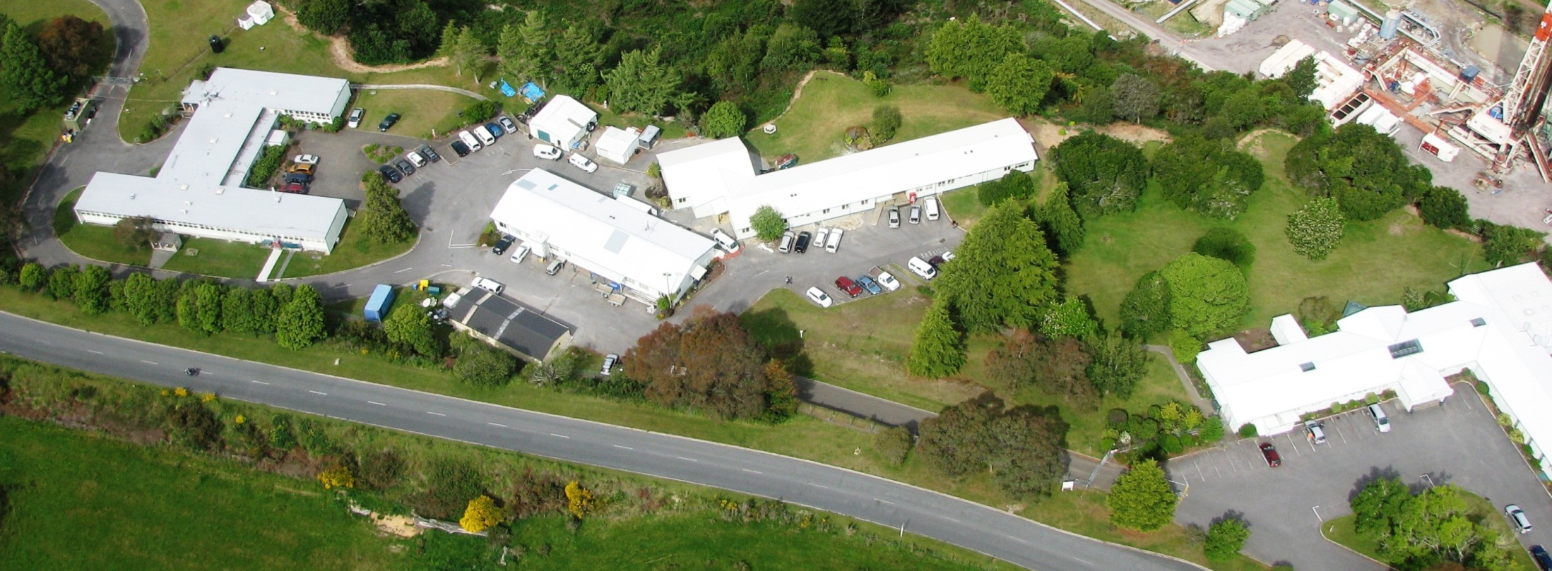
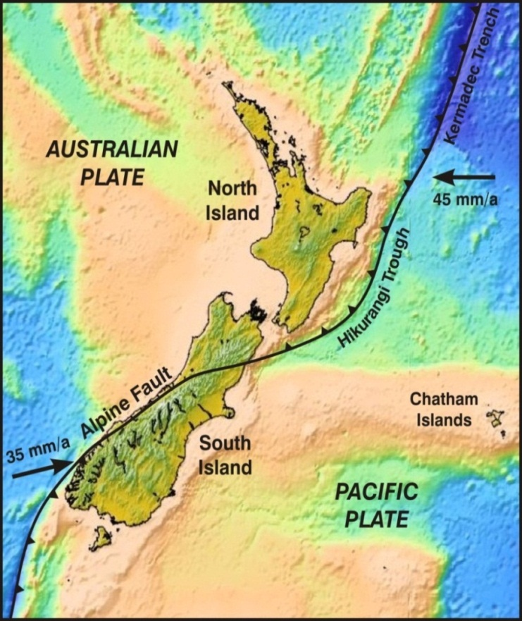
Wairakei Research Centre
Departments of Geothermal Sciences, Volcanology and Hydrogeology
~80 geoscience and support staff
>35 geothermal specialists
Wairakei
Avalon
Gracefield
Dunedin
GNS offices
5

Slide 5
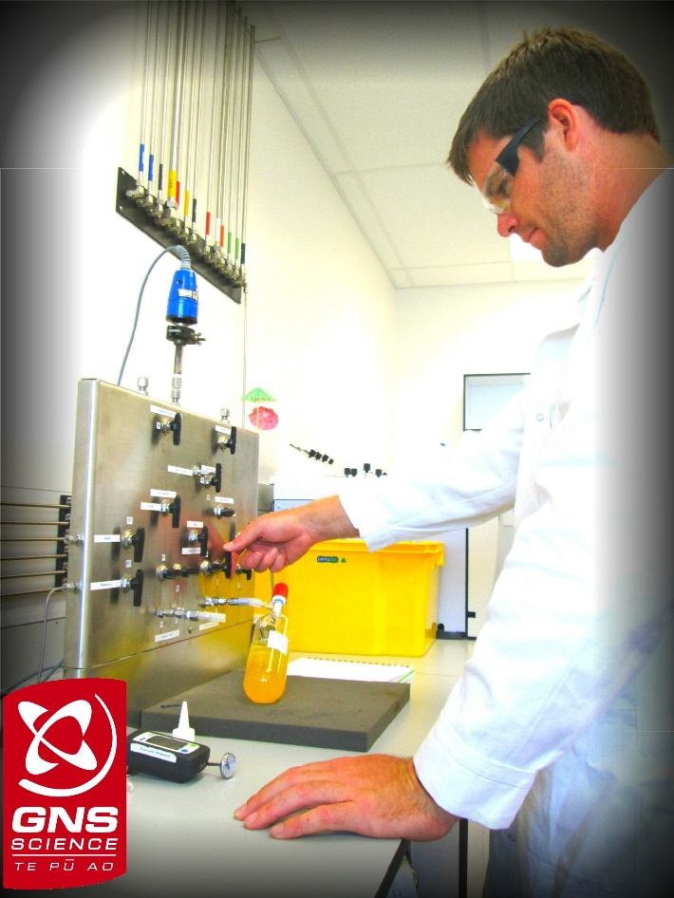
3
GNS Geothermal – what we do …
Broad Geoscientific Expertise
Resource Delineation, Exploration & Development Advice
Core funded, Multidisciplinary Research
Permitting / Resource Consenting (Independent Geoscience Opinion)
NZGAL, Isotope, Mineral Laboratory Services
Training (student / industry internships)
3

Slide 6
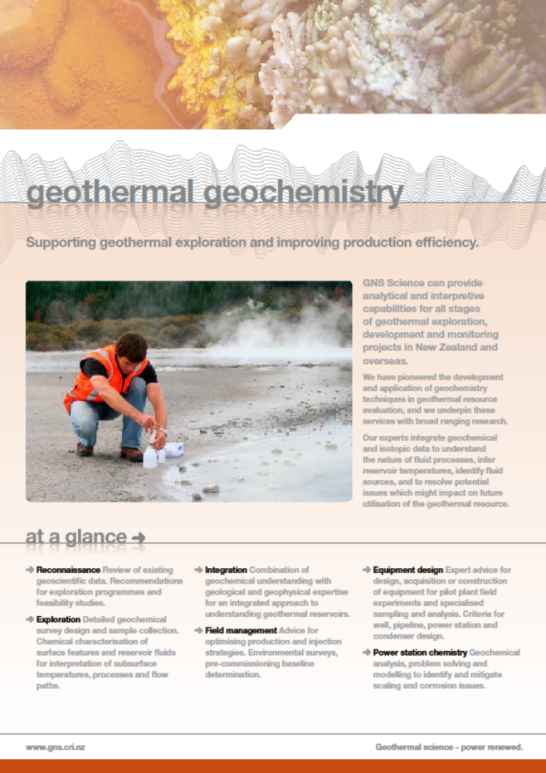
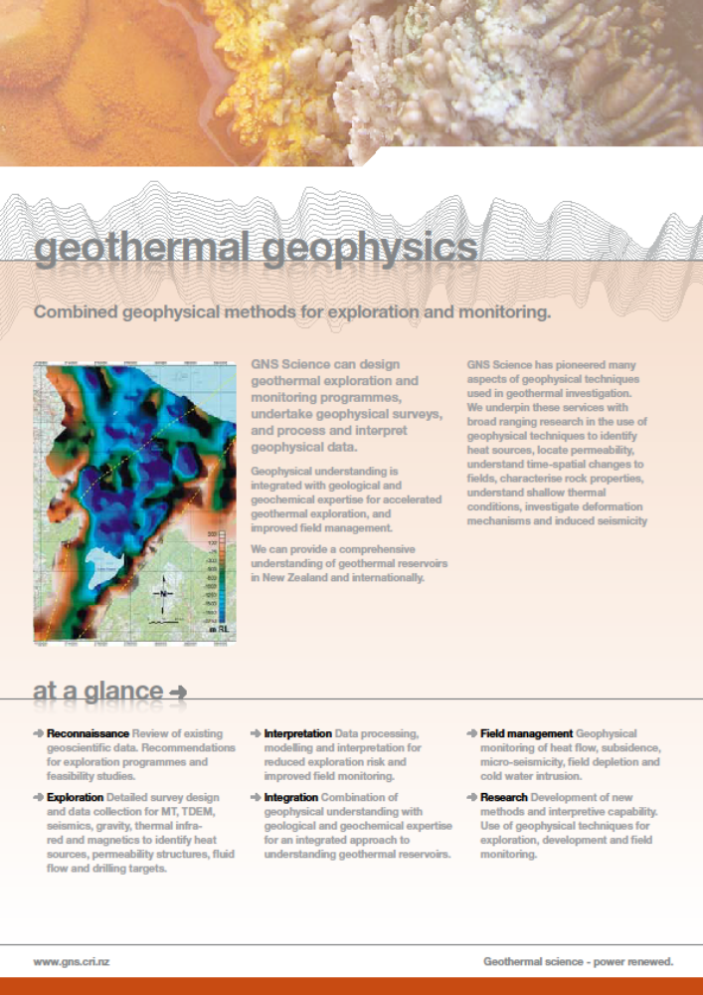
NZ & International Consultancy
Engagements in :
Japan
Taiwan
Philippines
Indonesia
Australia
PNG
Chile
Turkey
and elsewhere …

Slide 7
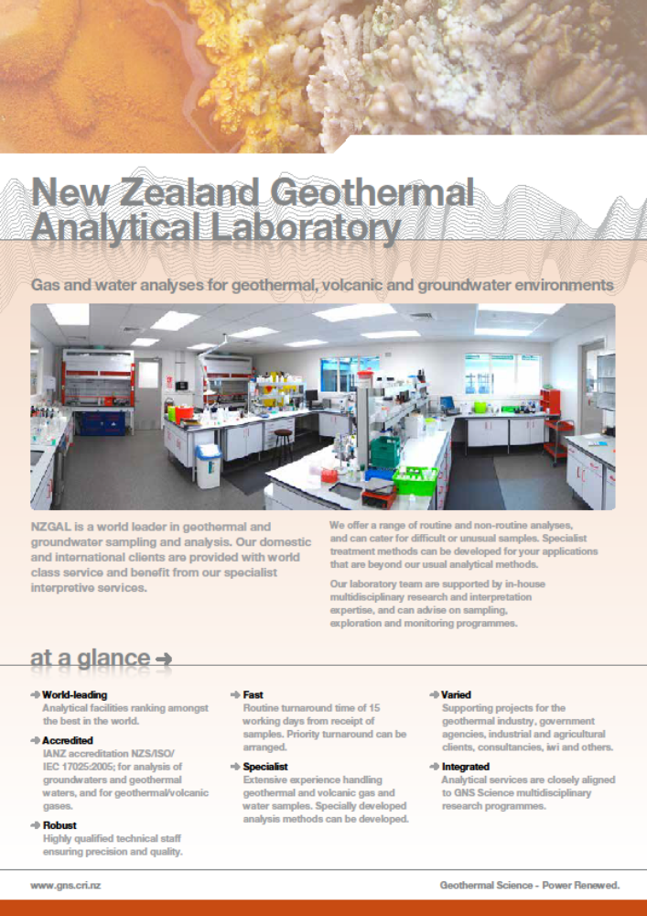
NZGAL
New Zealand Geothermal Analytical Laboratory
NZGAL is a world leader in geothermal & groundwater analysis.
NZS/ISO 17025:2005 accreditation
NZ's most comprehensive and extensive set of geothermal and groundwater databases.
Experimental Geochemistry expanding

Slide 8
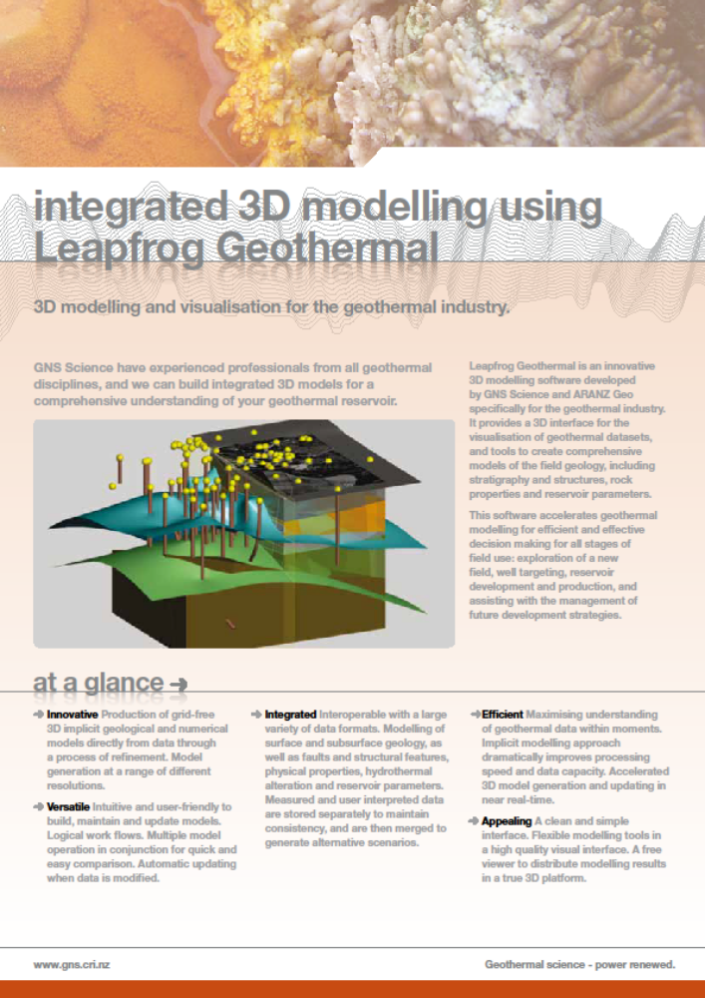
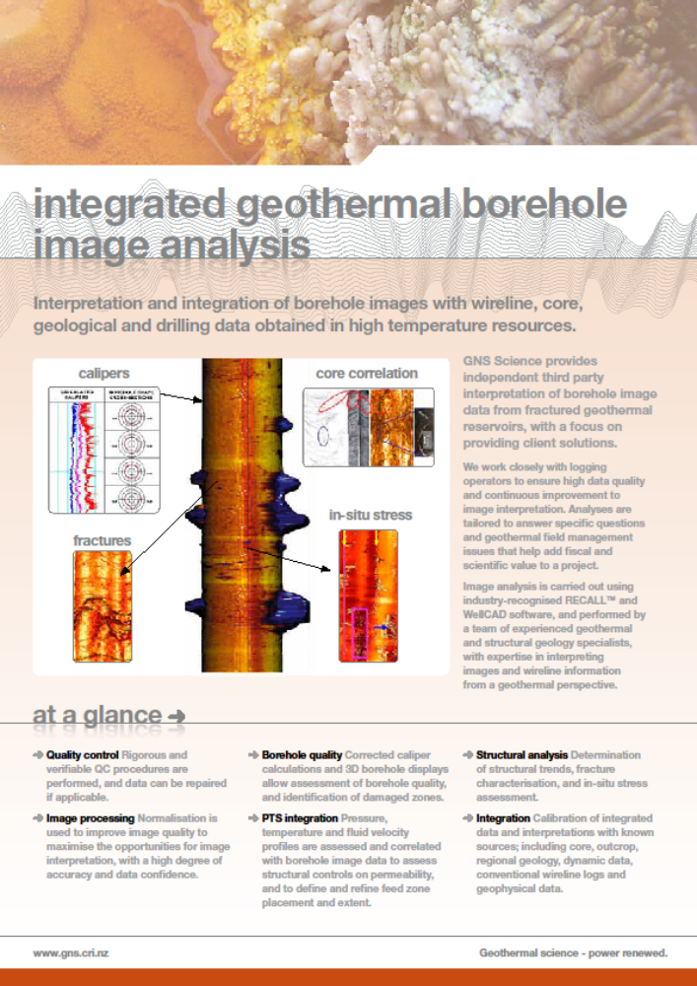
Training

Slide 9
3
GNS Geothermal Research
New Zealand’s Geothermal Future (NGF)
Projects
  Near Surface Geothermal Resources
  Understanding the TVZ: Structure and Dynamics
  Understanding the TVZ: Source and Circumstances
  Sustainability and Environment
Notes:
The type of skills and capabilities utilised in the GRN programme are the same that are used in the commercial space

Slide 10
3
GNS engagement
International Energy Agency (Geothermal)
  Secretariat services (Brian Carey, Chris Bromley)
International Partnership for Geothermal Technologies
  Secretariat services (Anya Seward)
New Zealand Geothermal Association
  Geoheat Strategy (Brian Carey)
31

Slide 11
3
Acknowledgements
Thank you, to the developers, iwi, regional authorities and Government departments, institutional and individual collaborators, who in many direct and indirect ways engage with GNS, and support the research undertaken by GNS staff.
GNS acknowledge the many commercial partners with whom we engage, in New Zealand and internationally.

Slide 12
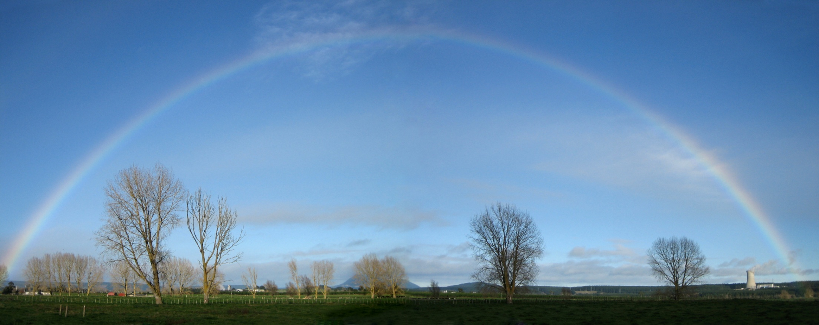

German Orozco
GNS Science
Wairakei Research Centre
Taupo, NEW ZEALAND
http://www.gns.cri.nz
g.orozco@gns.cri.nz
THANK YOU

