Slide 1

Geothermal Institute
University of Auckland
Prof. Rosalind Archer
Director – Geothermal Institute

Slide 2

Geothermal Institute – An Umbrella
All staff based in academic Departments + project funded administrative support.
Geothermal Institute coordinates activity across campus.
Works closely with Uniservices
Engineering, Geoscience, Law, Business, Social Science …

Slide 3
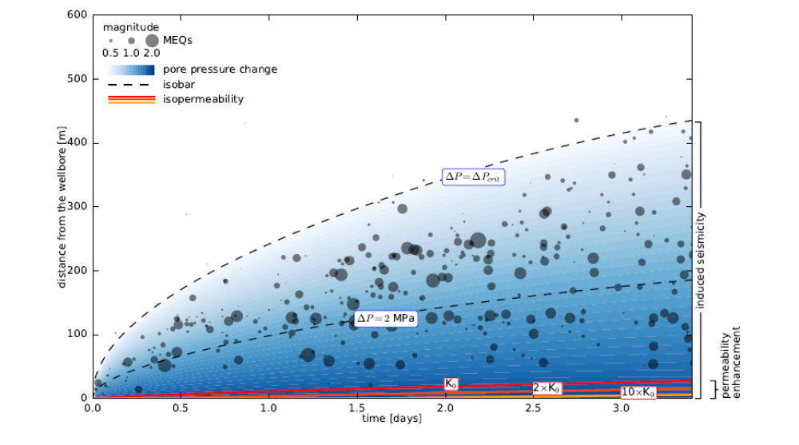

Research
Portfolio of activity including from fundamental geoscience through to reservoir engineering, above ground technology, energy markets and societal questions.
Projects range from short Postgraduate Certificate projects to PhD theses.
Notes:
Applied – two phase flow (Sadiq) through to fundamental – data science – will there room for humans in geo?

Slide 4
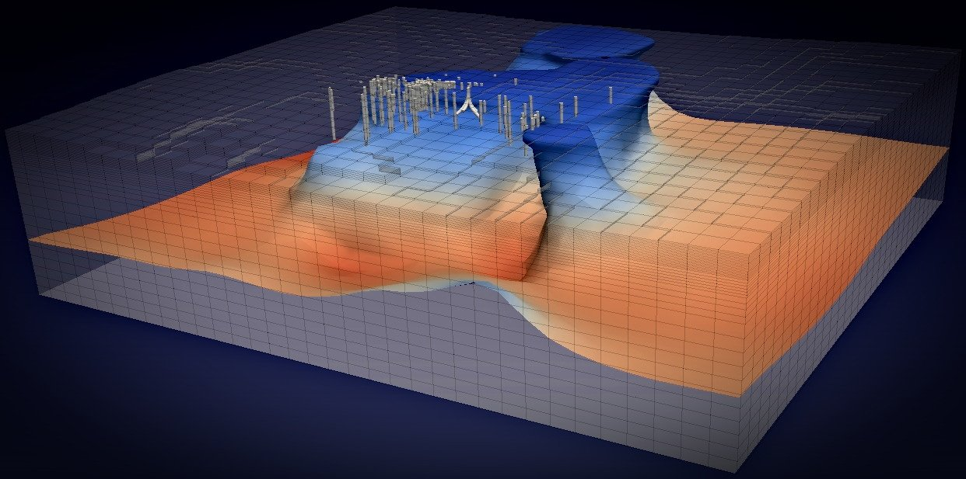
Waiwera – open source modelling code
Check it out at waiwera.github.io

Slide 5
Education
½ year Postgraduate Certificate Program
  Geoscience and Engineering components
  Guest lecturers from GNS, NZ industry and Gadja Mada University
  Field trips
  Short research project
1 year Master of Energy (or ½ year after PG Certificate courses)
  Additional content from business school (energy markets, policy, regulation etc.)
  Larger research project
  New 1.5 year long version for students who lack entry qualification with sufficient depth.

Slide 6
Scholarships
The NZ Ministry of Foreign Affairs prioritises renewable energy in the scholarships provided in the NZ Aid program.
http://www.aid.govt.nz/funding-and-contracts/scholarships/eligible-countriesregions
Indonesia
Phillipines
South America
Africa
Carribean
… and beyond!
Applications open in February, 2020.

Slide 7
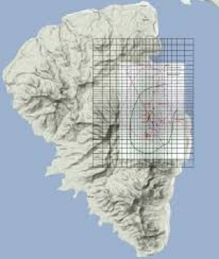
Consulting
The Geothermal Institute team love to solve unusual problems!
We work on reservoir modelling, geoscience and engineering projects around the world.
Example: Lihir, Papua New Guinea
Interaction of a geothermal system with a mining operation.

Slide 8
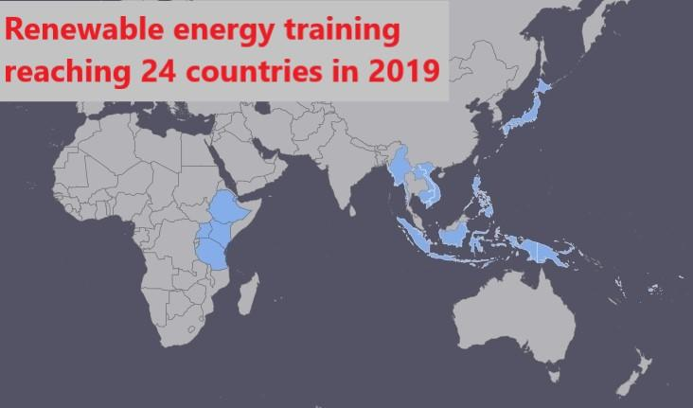
Global Reach – Renewable Energy Training

Slide 9
Project Management Training – MFAT supported
4 week “project management” course in Auckland for Indonesian/Phillipine geothermal professionals. Jacobs, Mike Allen, Jacobs, Mitchell Daysh, Jim Lawless and others.
Also a renewable energy version in Auckland for energy professionals from the ASEAN region.
Underlying theme is integrating technical and economic models to make decisions which move projects forward.

Slide 10
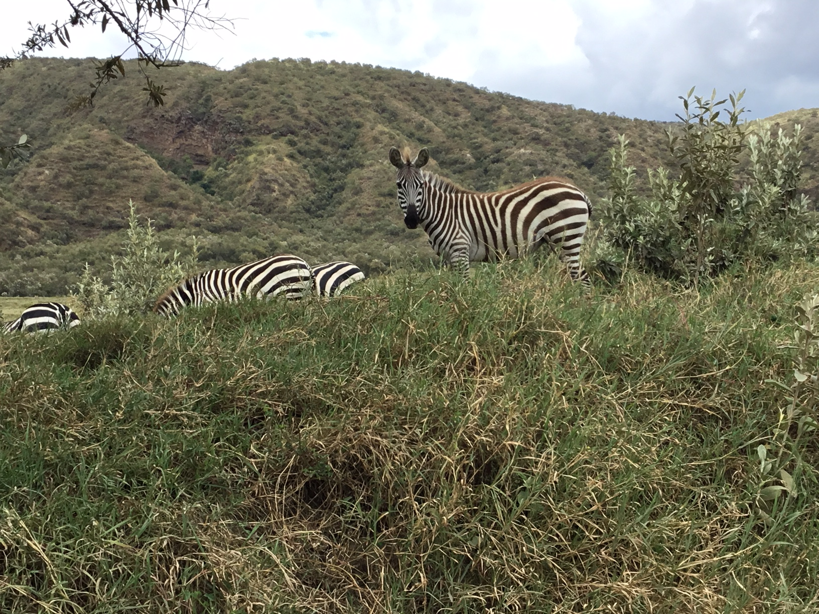
Africa
We’re supporting the African Geothermal Centre of Excellence with training modules.
Two delivered so far, drilling next up in 2020.
Jacobs, Seequent, Contact instructors … will continue to engage “NZ Inc.” as future modules are defined.

Slide 11
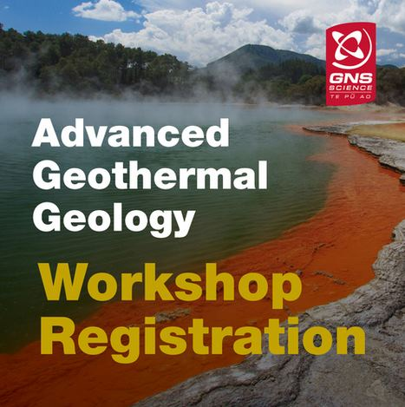
Japan
We’re partnering with GNS to deliver a week long advanced geothermal geology course for Japanese geothermal professionals.
https://www.gns.cri.nz/Home/News-and-Events/Events/Geothermal-workshop
Feb 10 to 14, 2020 in NZ

Slide 12
Email: Rosalind Archer
r.archer@auckland.ac.nz (Director)
LinkedIn: Rosalind Archer
Web: www.geothermal.auckland.ac.nz
Twitter: @Geothermal_Inst

Slide 13
Thank you !
Ka kite anō !

