Slide 1


INTERNATIONAL GEOTHERMAL ASSOCIATION
AN OVERVIEW
Presentation New Zealand Geothermal Workshop
Alexander Richter, President IGA

Slide 2
INTERNATIONAL
GEOTHERMAL ASSOCIATION
Quick Overview
Scientific, educational and cultural organization with 5,000+ members in over 65 countries.
Non-political, non-profit, non-governmental organization with consultative status to the UN and special observer status to the Green Climate Fund – Partner to the Global Geothermal Alliance (IRENA)
Objectives:
  Encouraging research, the development and utilization of geothermal resources worldwide through the publication of scientific and technical information among the geothermal specialists, the business community, governmental representatives, UN organizations, civil society and the general public.
  Encourage, facilitate and, promote the coordination of activities related to worldwide research, development and application of geothermal resources.
Founded in 1988 – 30 years anniversary this year

Slide 3
INTERNATIONAL
GEOTHERMAL ASSOCIATION
History
1960s - First idea to create a structured group of organizations and experts
September 1970 - Concrete discussions on establishment of an IGA
May 1975 - World Geothermal Congress organized by GRC
Late 1986 - GRC appointed three of its board members to form ad-hoc committee for possible establishment of an international organisation
1987 - feasibility study done on the organisational structure (consultation with experts from 30-40 countries, international institutions, five internatioanl geothermal schools at the time)
July 1988 – Establishment of IGA as Incorporated Society in New Zealand
May 1989 – Foundation Meeting in Castelnuovo, Tuscany

Slide 4
INTERNATIONAL
GEOTHERMAL ASSOCIATION
Foundation Meeting, Castelnuovo, May 1989
1960s: first idea to create a structured group of organizations and experts
September 1970: concrete discussions on establishment of an IGA
May 1975: World Geothermal Congress organized by GRC
Late 1986: GRC appointed three of its board members to form ad-hoc committee for possible establishment of an international organisation
1987: feasibility study done on the organisational structure (consultation with experts from 30-40 countries, international institutions, five internatioanl geothermal schools at the time)
July 1988 – Establishment of IGA as Incorporated Society in New Zealand
May 1989 – Foundation Meeting in Castelnuovo, Tuscany

Slide 5
HISTORY
IGA Secretariat
Initially headed by the “Secretary”, later by the Executive Director.
Concept based on rotation between member countries.
Period | # of years | Host Country | Executive Director
1989-1992 | 3 | Italy | Enrico Barbier
1992-1995 | 3 | U.S. | Theodosia H. Fergusson/ George Frye
1995-1998 | 3 | New Zealand | Mike Mongillo
1998-2004 | 6 | Italy | Ruggero Bertani
2004-2010 | 6 | Iceland | Valgardur Stefánsson/ Árni Ragnarsson
2011- 2018 | 7 | Germany | Marietta Sander/ Marit Brommer
2019 - |  | Germany | Marit Brommer

Slide 6
INTERNATIONAL
GEOTHERMAL ASSOCIATION
Current Structure
IGA Board of Directors
30 members – elected every 3 years
Secretariat
Executive Director
Organization Development
Marketing support
Charter
Rules
Bylaws
Officers
President, Vice President,
Secretary, Treasurer
BoD meetings
twice/ year
Executive Committee
Officers
Chairpersons of Committees
Permanent Committees
Finance
Audit
Membership
Programme & Planning
Information
Education
Nominating
Bylaws
Annual
General Meeting
Membership
Affiliated
Individual
Student
Corporate
Institutional
WGC
every 5 3 years

Slide 7
INTERNATIONAL
GEOTHERMAL ASSOCIATION
Our Role
Connect global geothermal community
Support national geothermal associations
Facilitator R&D to market
Policy support
Best Practices & Standards – Sustainability, HSE, Resource Quantification (UNFC)
Representation to international organisations, institutions and agencies

Slide 8
INTERNATIONAL
GEOTHERMAL ASSOCIATION
Strategy work 2017-

Slide 9

INTERNATIONAL
GEOTHERMAL ASSOCIATION
Operation – at the moment
Host
BoD
Funding
Membership
Projects
WGC
IGA SC (limited)
Biz Development & management
Membership

Slide 10
INTERNATIONAL
GEOTHERMAL ASSOCIATION
Operation – from January 1, 2019
BoD
Funding
Sponsors
Projects
Income
Membership
WGC
Biz Development & management
Membership

Slide 11
INTERNATIONAL
GEOTHERMAL ASSOCIATION
Business Model Work

Slide 12
INTERNATIONAL
GEOTHERMAL ASSOCIATION
New Constitution/ Bylaws
Legal requirement under new draft law in New Zealand
Streamline documents
Board composition – 25+5
Regional, gender representation
Gender ballot target 50% women.

Slide 13

INTERNATIONAL
GEOTHERMAL ASSOCIATION
2017 Rebranding (ongoing)
Old logo
from 1992

Slide 14
INTERNATIONAL
GEOTHERMAL ASSOCIATION
New Website launched in 2018

Slide 15
INTERNATIONAL
GEOTHERMAL ASSOCIATION
International collaboration
Role of IGA - independent from national interests presenting industry interests, facilitation and providing access

Slide 16
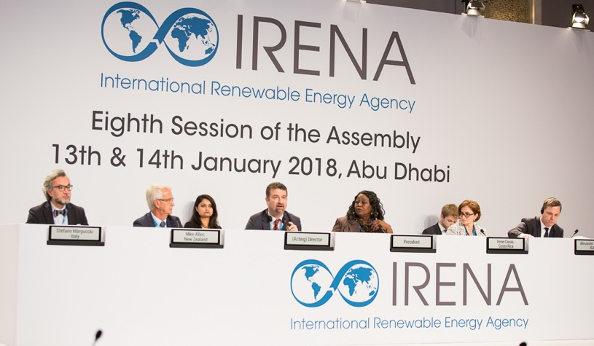
INTERNATIONAL
GEOTHERMAL ASSOCIATION
Activities & Members
IRENA General Assembly 2018
IRENA/ World Bank/ IGA Workshop at ITB Workshop in Bandung ‘18
Support to national Geothermal Associations
European PhD Day
IGA Book release

Slide 17
INTERNATIONAL
GEOTHERMAL ASSOCIATION
Current engagement
Climate Change meetings – Katowice, Poland – December 2018
UNFC – IRENA & World Bank
Geothermal Sustainability Assessment Protocal (GSAP)
Potential role of IGA
Facilitator of development and implementation of GSAP
Promotion of protocol
Management entity for governance of GSAP

Slide 18
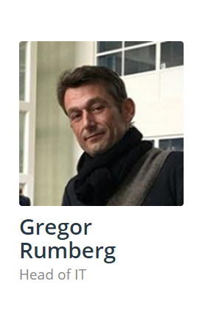
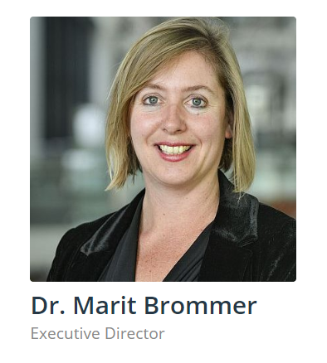
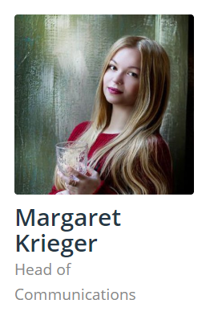
INTERNATIONAL
GEOTHERMAL ASSOCIATION
Our Secretariat
Website:
www.geothermal-energy.org
www.lovegeothermal.org
Twitter: @lovegeothermal

Slide 19
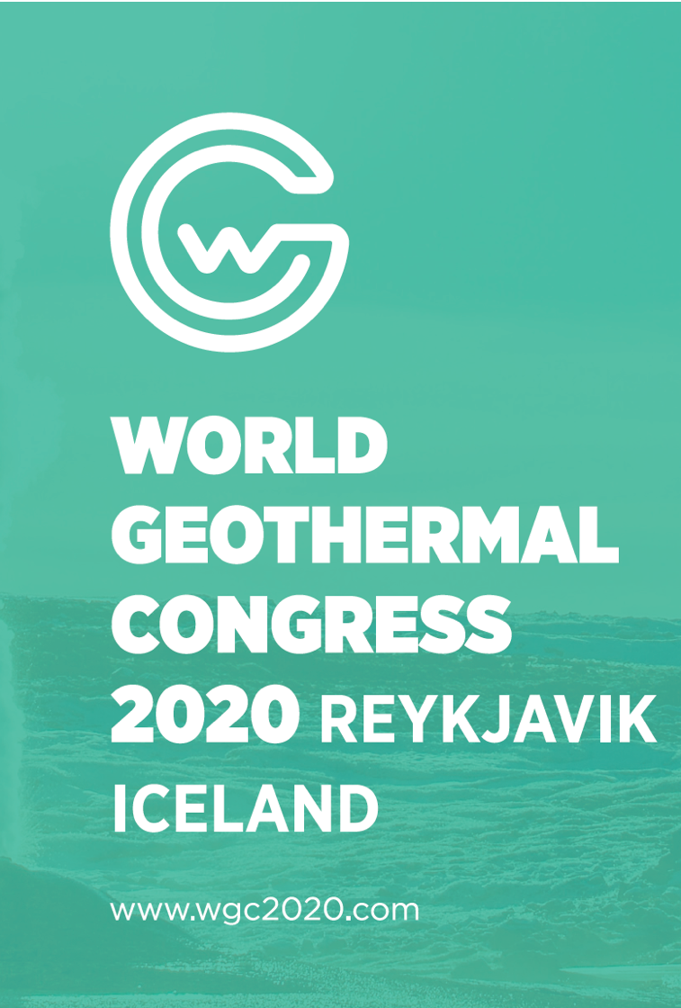
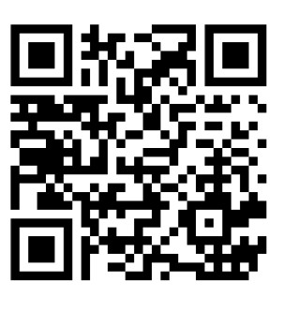
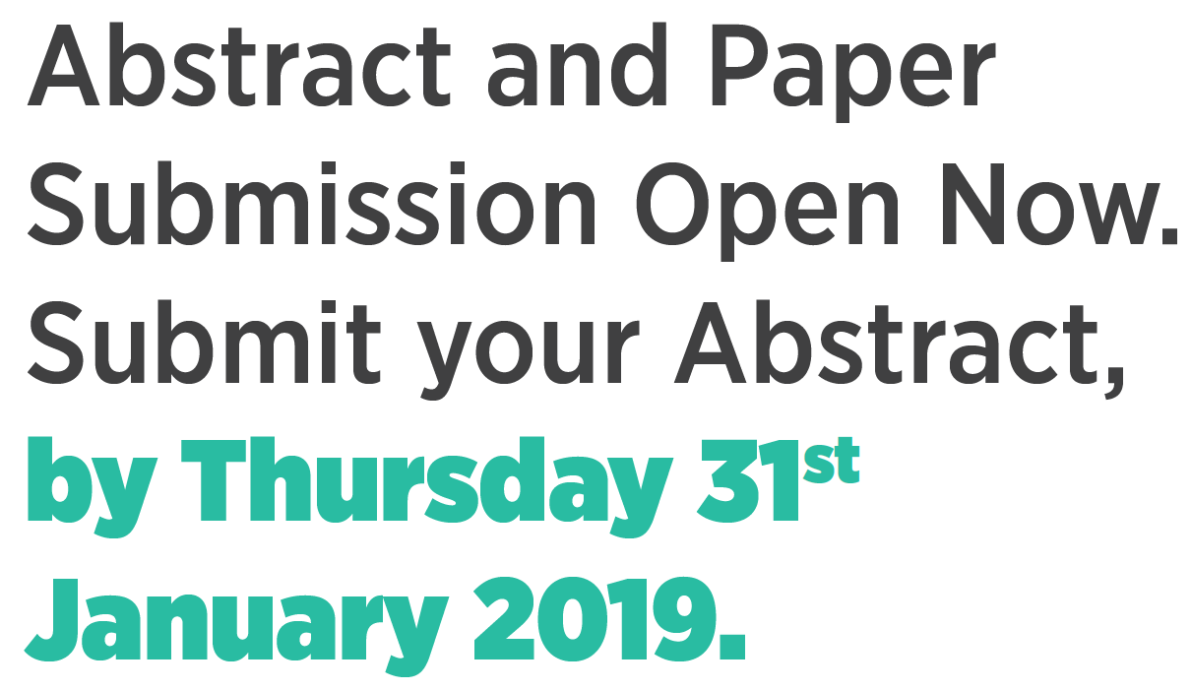


Slide 20
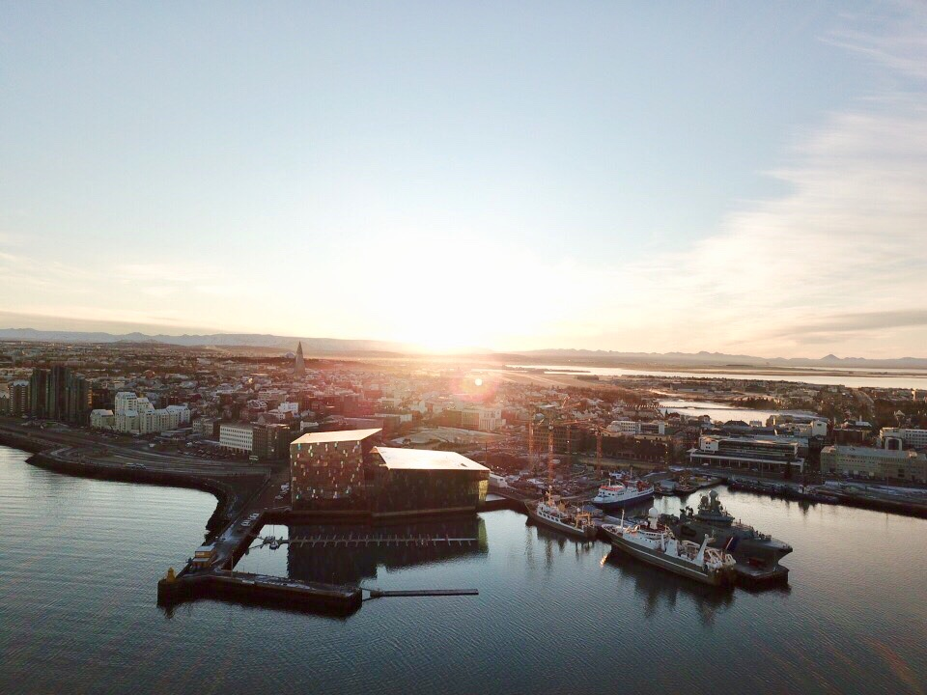

Slide 21
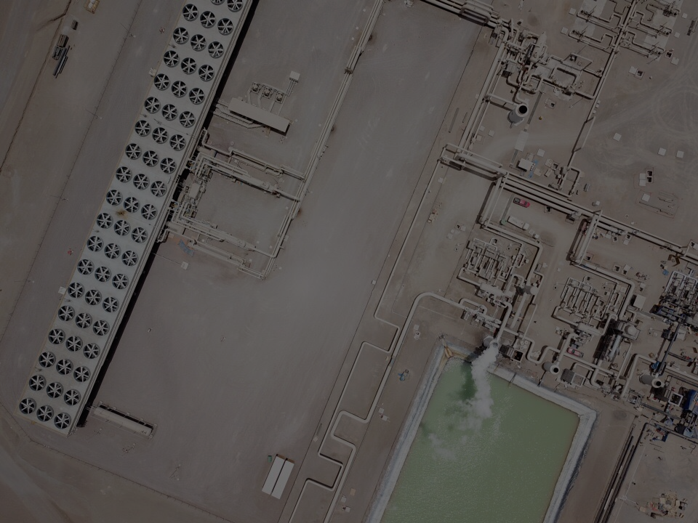
DON’T YOU @lovegeothermal?

