Slide 1
Indonesia Geothermal
Country Update 2019
Wini Rizkiningayu
NZTE Business Development Manager - Indonesia
New Zealand Geothermal Workshop
University of Auckland, Auckland, New Zealand
26 November 2019

Slide 2

2000
2014
2030
Indonesia is one of the world’s fastest growing country energy consumer
91.16%
80%
Electrification rate
by 2016.
65%
35 GW
Government program on power generation by 2024
...But it is not just business as usual

Slide 3
Renewable Energy
39.8 TW
Renewable Energy
39.8 TW
23%
Renewable Energy Mix Target by 2025.
Fossil Fuel
225 TW
7.2GW
Power generation target from Geothermal energy
*Accord de Paris, 2016
..but also about commitment to reduce emission*

Slide 4

220
2nd
Indonesia
Geothermal Projects, 8,053.5MW, 2019-2030
Biggest geothermal potential worldwide.
Geothermal
Power Generation
Direct Use
35yrs
NZ-ID Relationship in Geothermal since Kamojang powerplant. NZ is considered as technical expert and advisor for Government and private sector

Slide 5
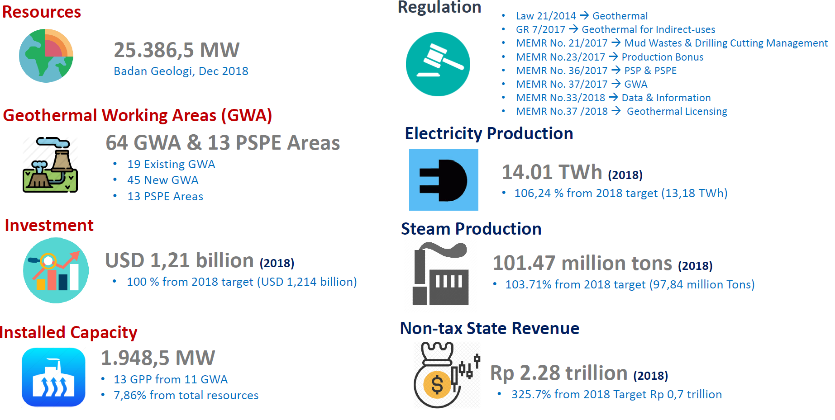
From Ministry of Energy & Mineral Resources…

Slide 6

Policy and Government Support
Environmental Challenges
Funding, Financial & Investment
Socio-Economic Challenges
Exploration Risk
Notes:
In Human Capital aspect of Geothermal development, one of the very apparent challenges is on the TTPO (Trade, Techical, Plant operator)
The first challenge is on shortage of quality technical skill. As we know, Geothermal companies in Indonesia are constrained by the shortage of quality technical skills, especially on TTPO side such as Exploration/Drilling technicians, Steam field technicians, Power plant operators, and Power plant maintenance technicians.
This can impact on their operational security and productivity, of course.
Second challenge is that many geothermal developments are relatively isolated and hence employment of local staff is both a social and a logistical necessity. Providing technical training support at isolated plants will be important to create on-going sustainable growth in the numbers of appropriately trained technical staff to support sector growth
Third challenge is the lack of regional training institutions to create local supply of TTPO, relating to the 2nd challenge of
The need to hire local staff that will be possible only if there’s a system supporting regional training institutions to provide skills for future’s TTPO.
The fourth challenge is the lack of collaboration in public private partnership that can answer the overarching needs of TTPO from the developers, contractors and energy companies (both private and SOE), and develop sustainable capacity within the Indonesian training sector based on the needs, and finally, achieve nationally recognized standard of training framework and capacity building.
The Governments of New Zealand and Indonesia have a Memorandum of Understanding regarding geothermal cooperation, which supports collaboration on geothermal development. Under this arrangement, the New Zealand Aid Programme has supported Indonesia to develop an Indonesia Geothermal Energy Human Resource Development Strategy (GEHRDS) and an associated implementation programme
New Zealand Support for Training in the Indonesian Geothermal Sector (NZSTIG) is a niche contribution to the delivery of the said Human Resource development strategy, in the form of geothermal training aimed for capacity building of TTPO - Trade, Technician and Plant Operator.

Slide 7
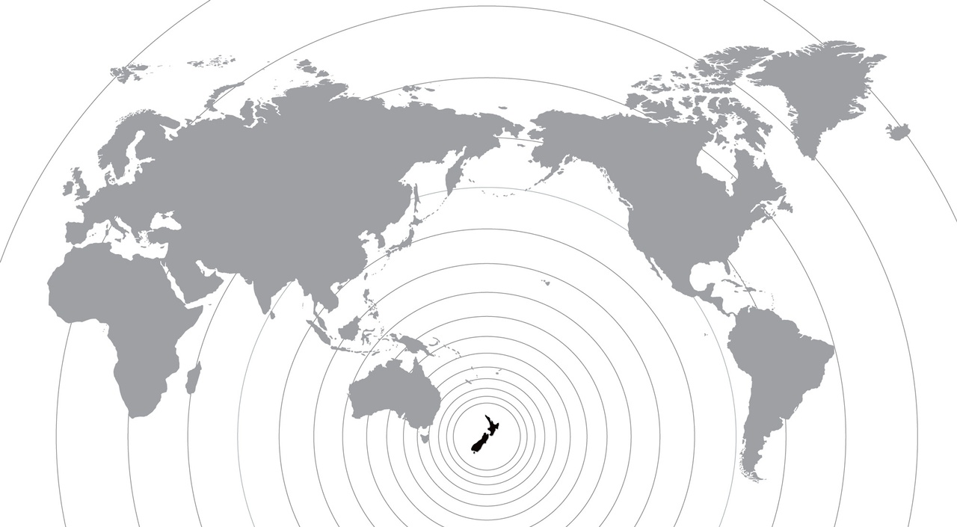
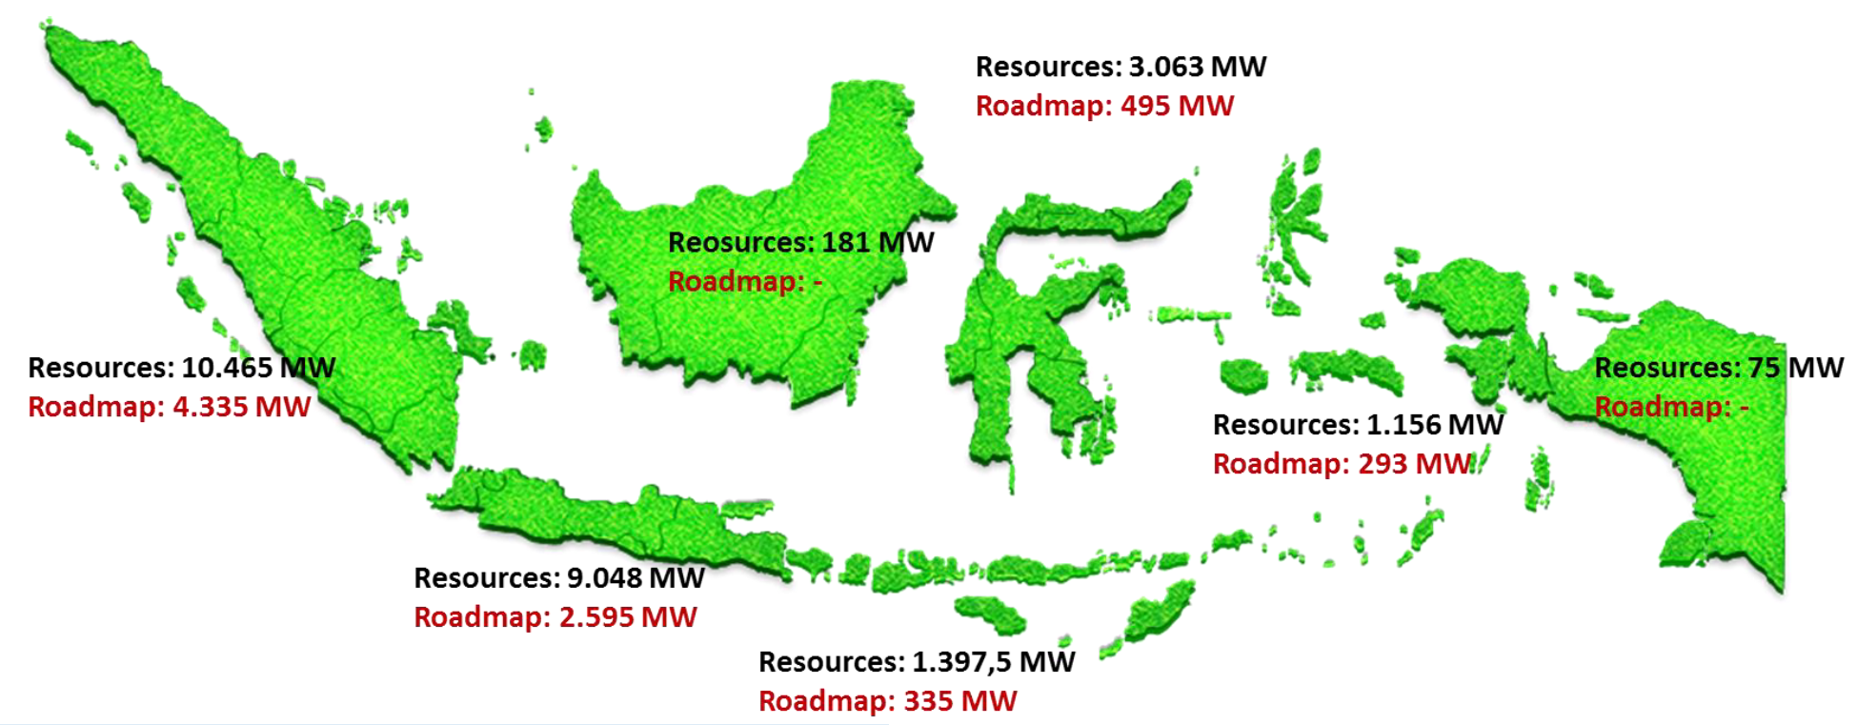
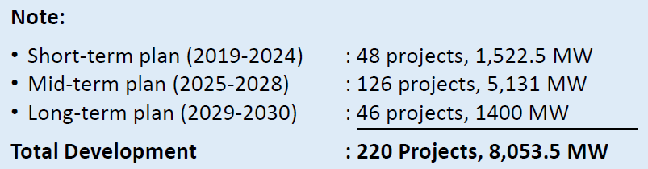
Roadmap 2019-2030

Slide 8
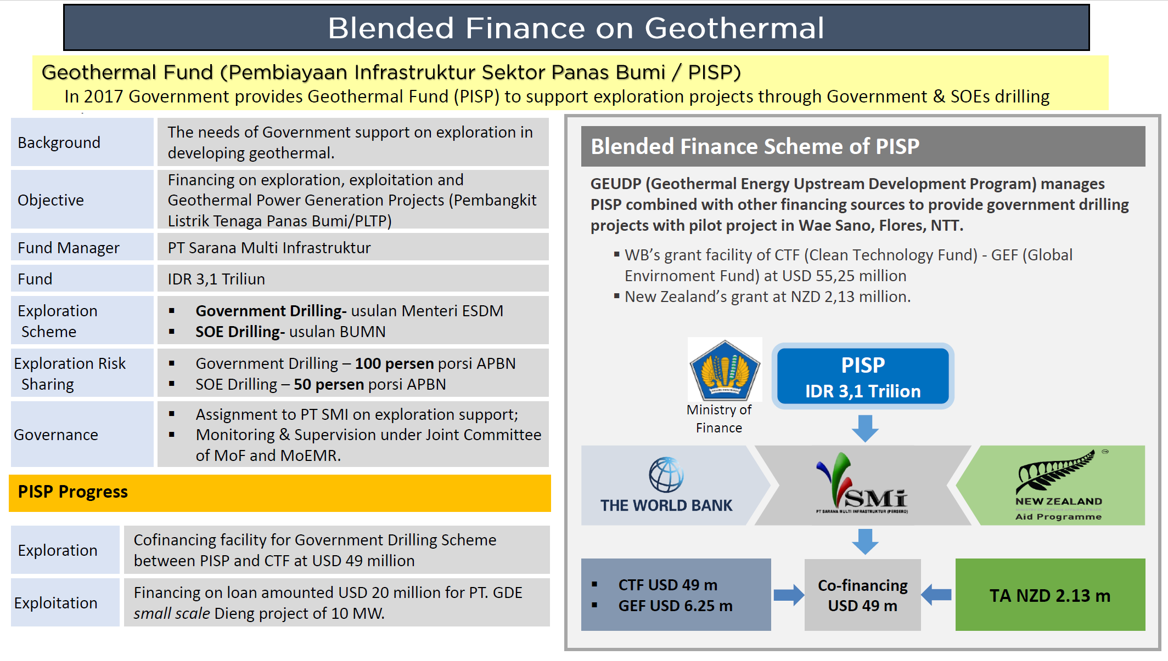
Renewable Energy
39.8 TW
Fundings

Slide 9
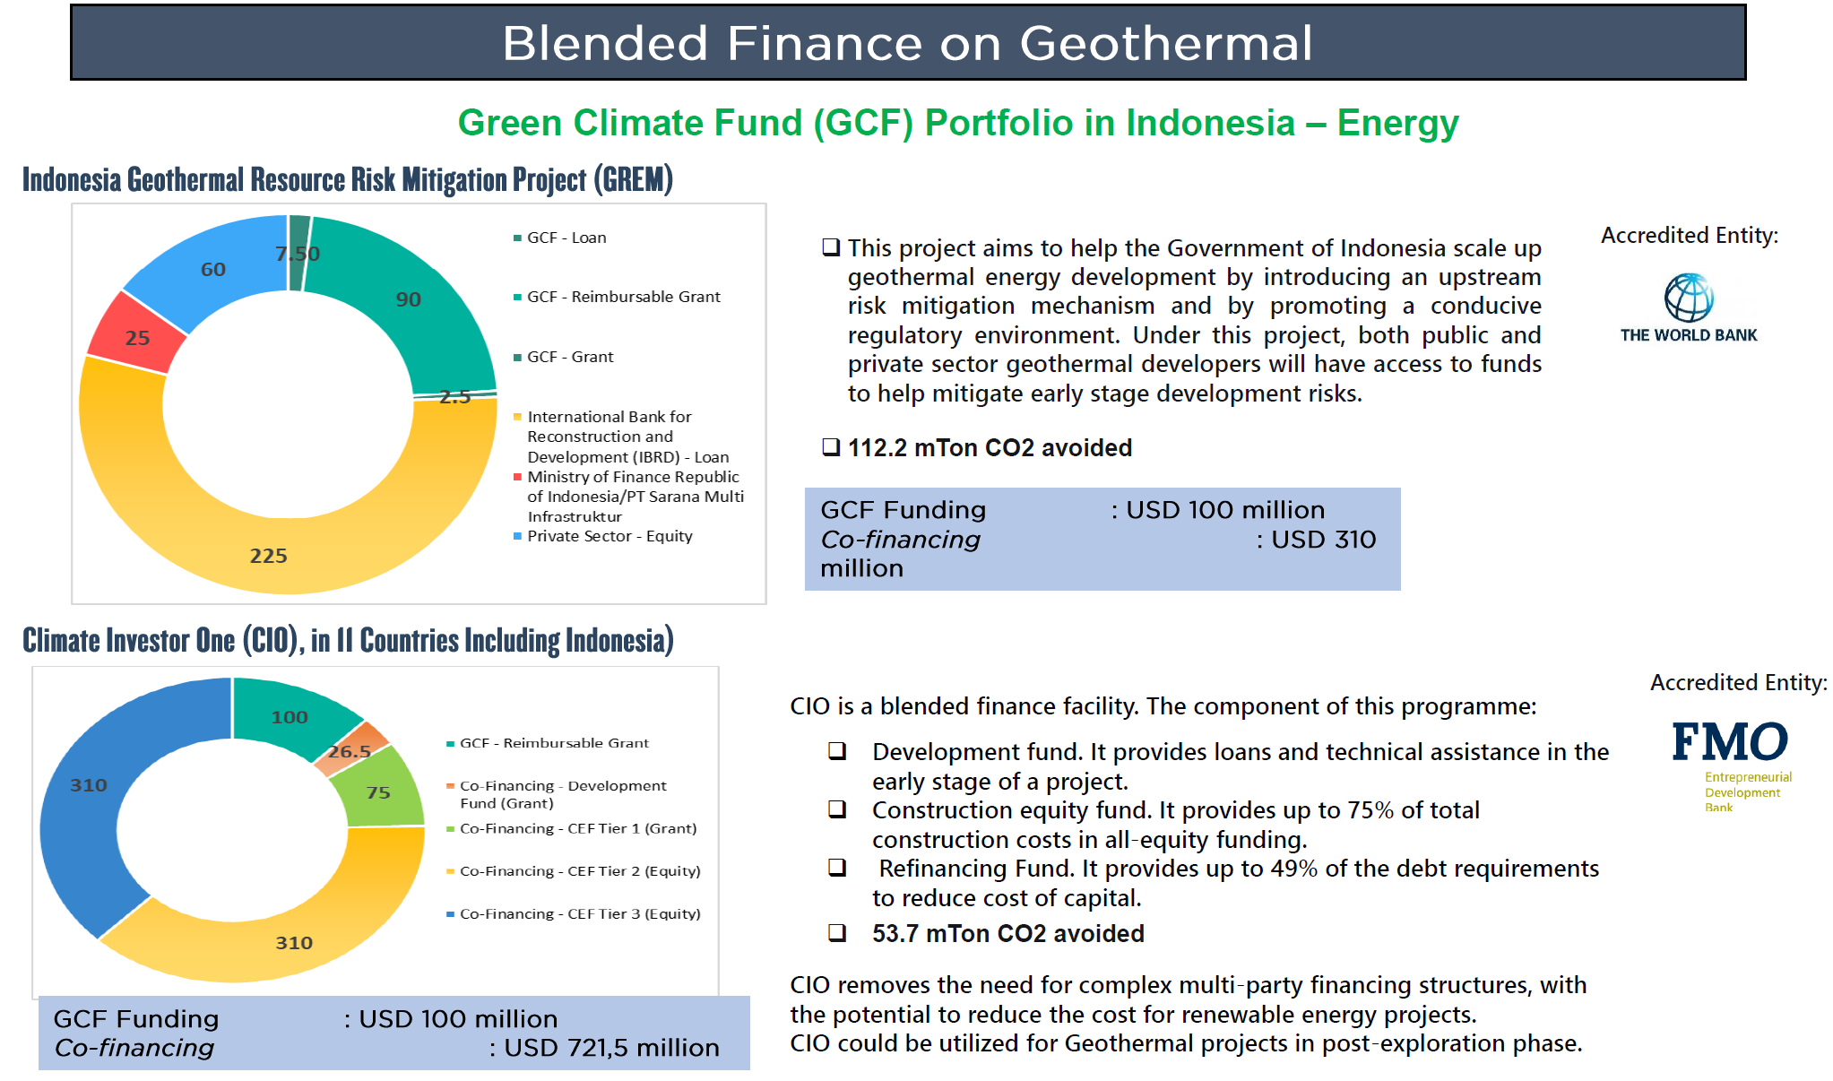
Renewable Energy
39.8 TW
Funding

Slide 10
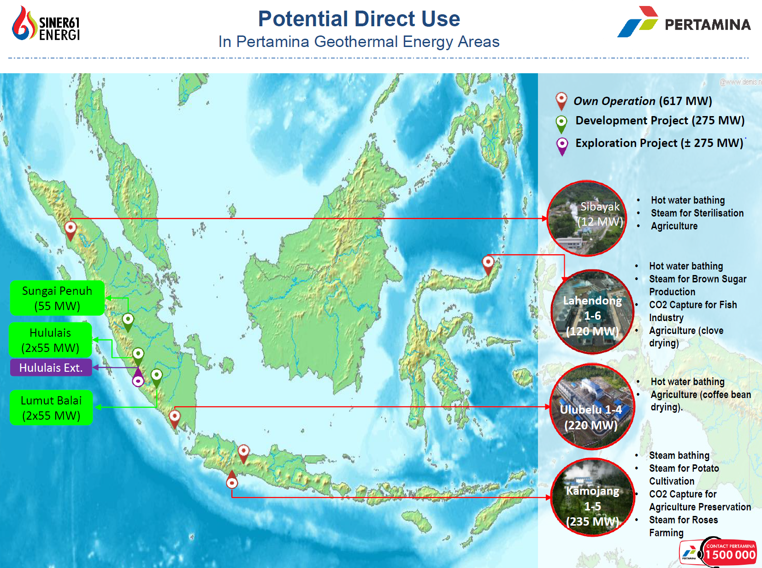
Renewable Energy
39.8 TW
Pertamina
Geothermal Energy
& World Bank on Geothermal Direct Use:
From CSR to Commercial
Direct Use Of Geothermal

Slide 11
Stakeholders Alignment
Government to treat geothermal as a national strategic project:
  Right regulations
  Improve tariff policy & non-bankable terms– (fiscal or other incentives)
  Improve PPA process & certainty prior to exploration with PLN
  Simplify bureaucratic process for permits
  Possibly providing non-recourse financing facilities for exploration
Promote Collaborative Partnerships
Technology breakthrough, Strategic Alliances/Partnerships, Cost Reduction Efforts
Renewable Energy
39.8 TW
Ways Forward

Slide 12
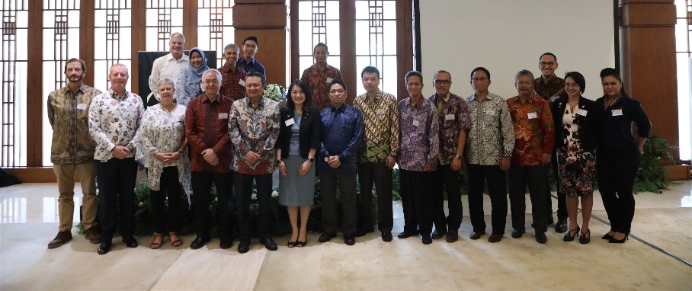
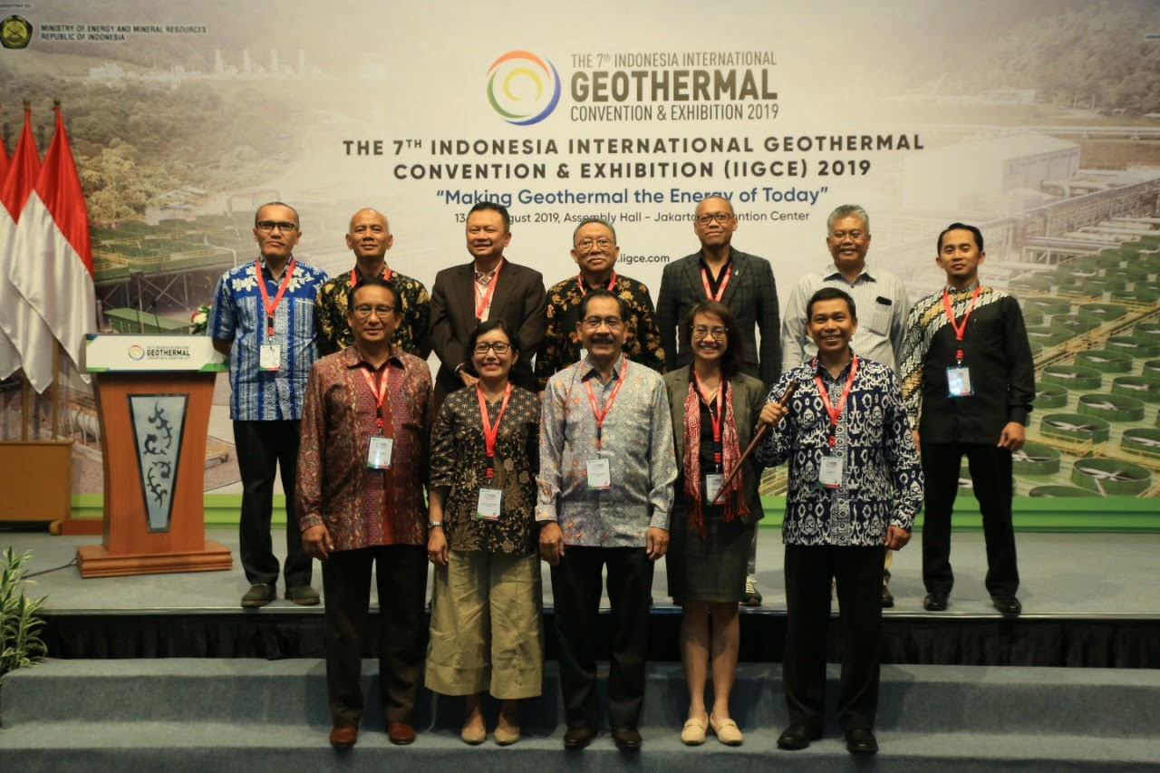
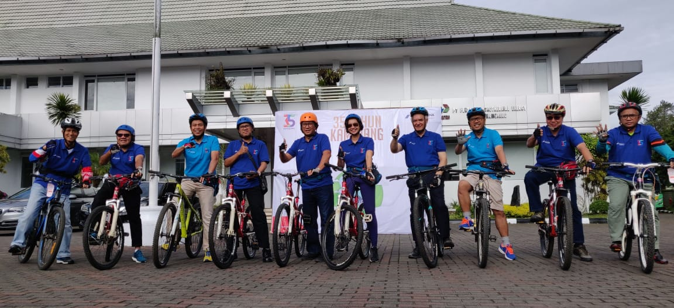

Renewable Energy
39.8 TW
NZTE : Active partner of INAGA

Slide 13
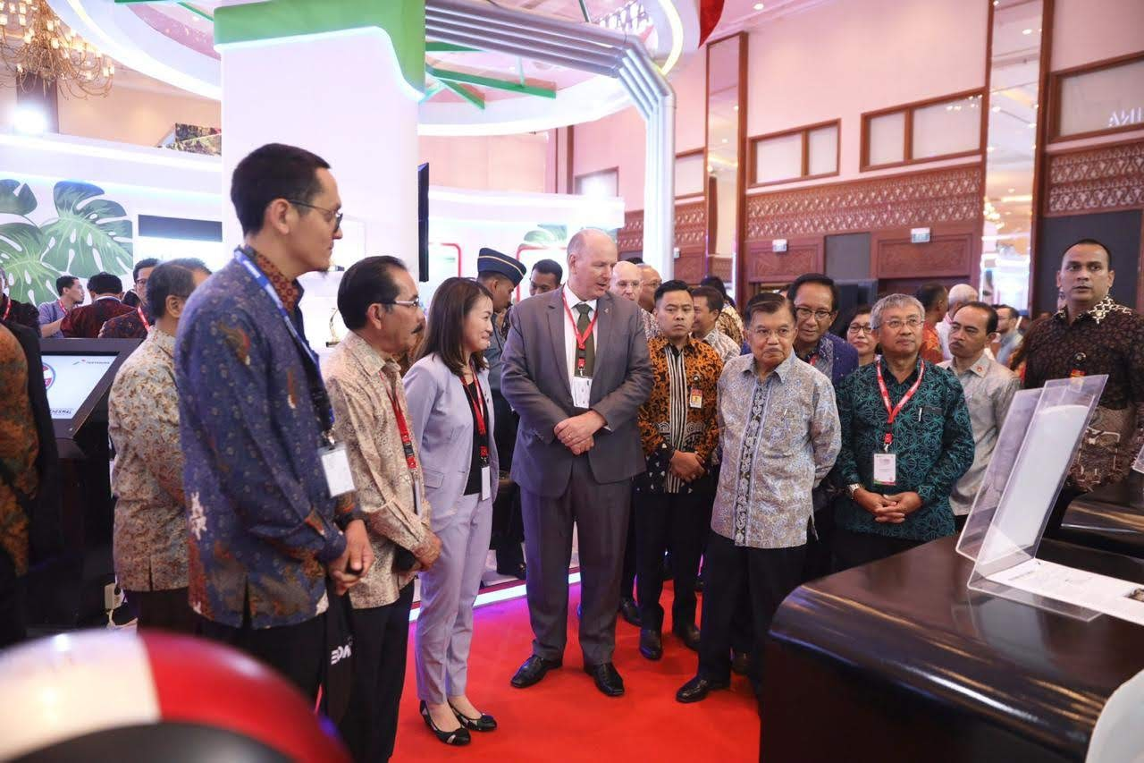
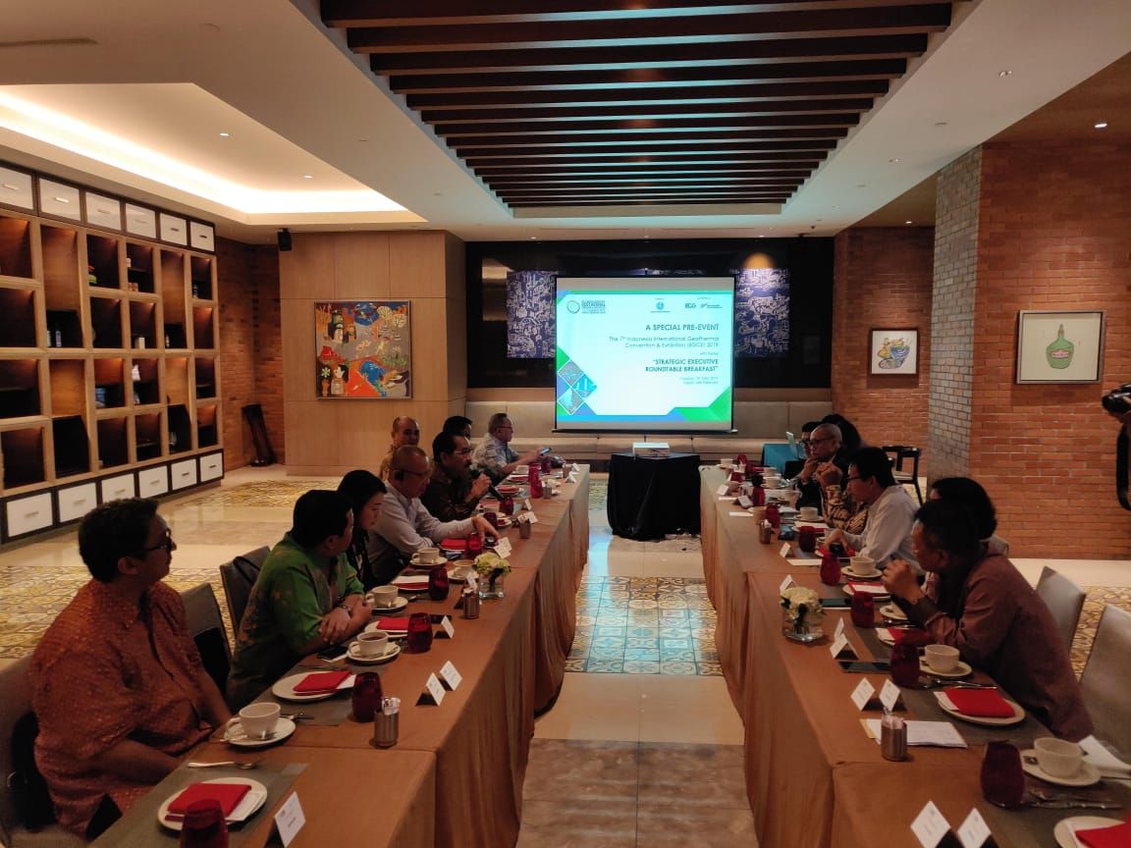
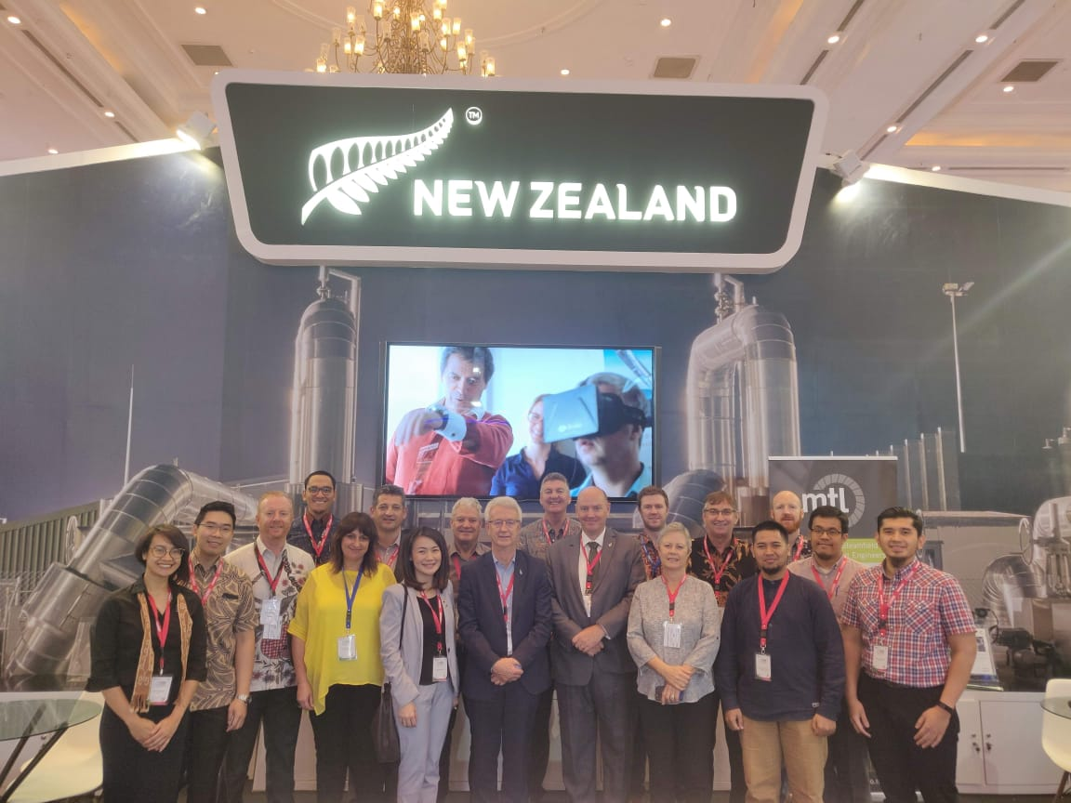
Renewable Energy
39.8 TW
From strategic breakfast meeting
to NZ Pavilion @
IIGCE 2019
NZTE Activities 2019

Slide 14
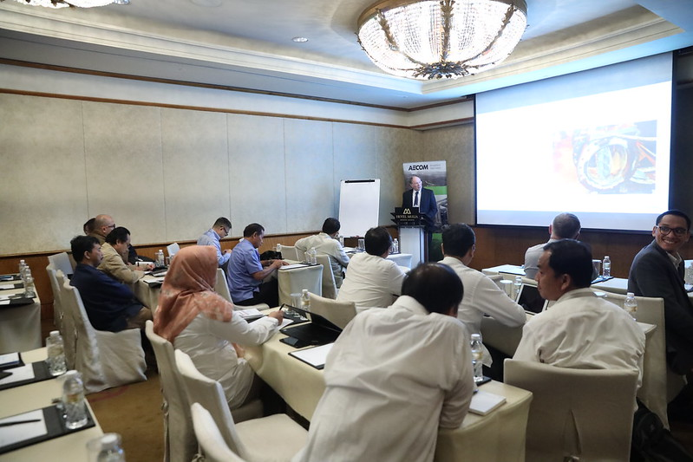
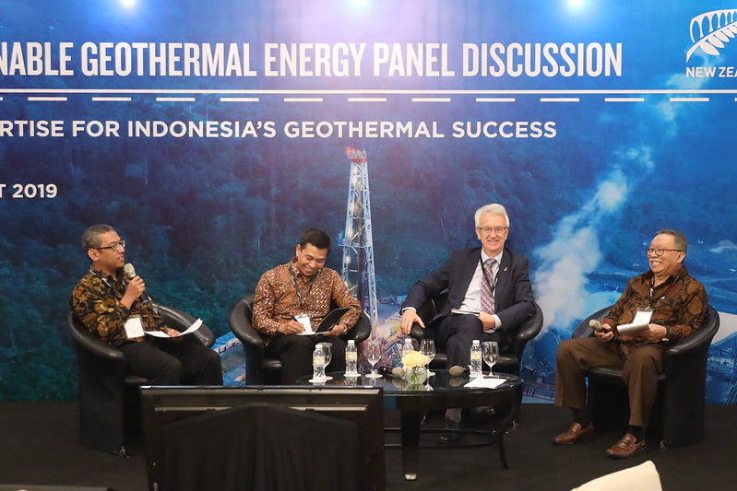
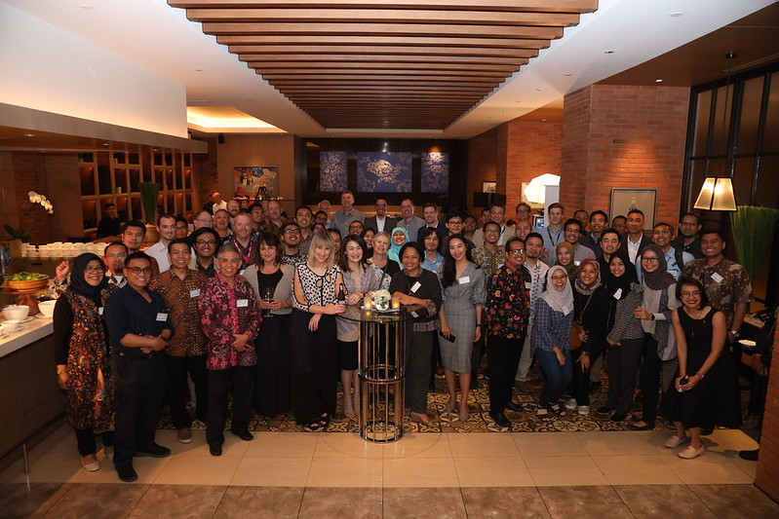
Renewable Energy
39.8 TW
With immersive breakfast, Panel discussion, Masterclasses and NZ Alumni Dinner in between
NZTE Activities 2019

Slide 15
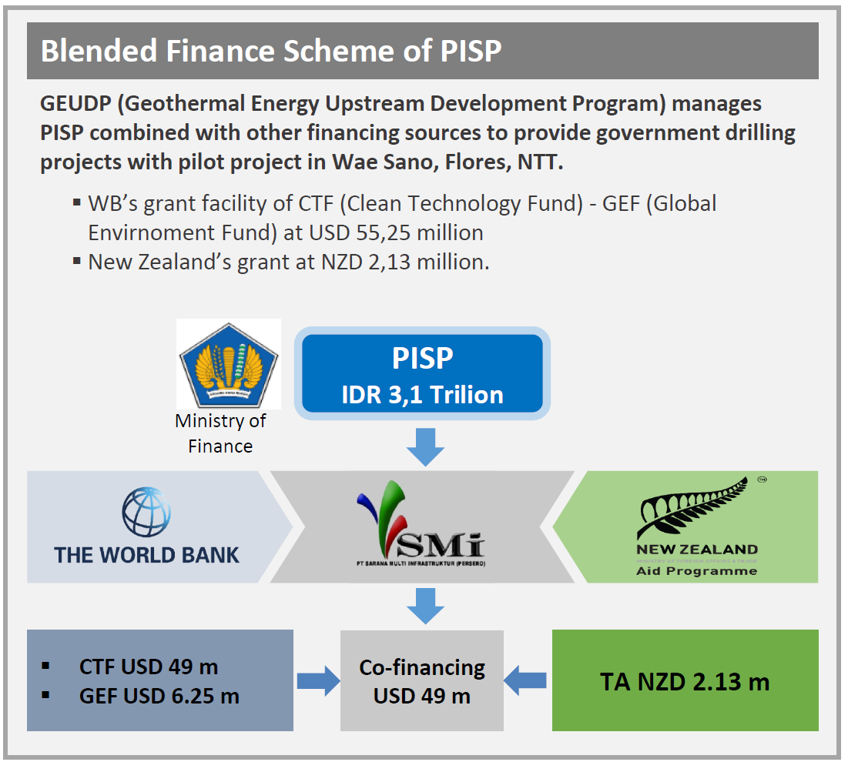

Renewable Energy
39.8 TW
Geothermal TPPO training development
NZAID Geothermal
Project Management
Short Courses
Geo-INZ
NZinc Activities 2019

Slide 16

New cabinet, new minister of energy & mineral resources – roadmap 2019-2030
MoF initiatives on incentives / subsidy
Country wide focus on capacity building
WB & other development banks funds to de-risk exploration
NZTE initiatives :
  NZ Story and NZ business directory in INAGA website
  NZTE – INAGA industry lunch 2020
  IIGCE 2020
  ….etc
Renewable Energy
39.8 TW
2020
Looking Ahead : What to expect?

