Slide 1

NZGA Industry Updates 2019
New Zealand Geothermal Workshop
25 – 27 November 2019

Slide 2
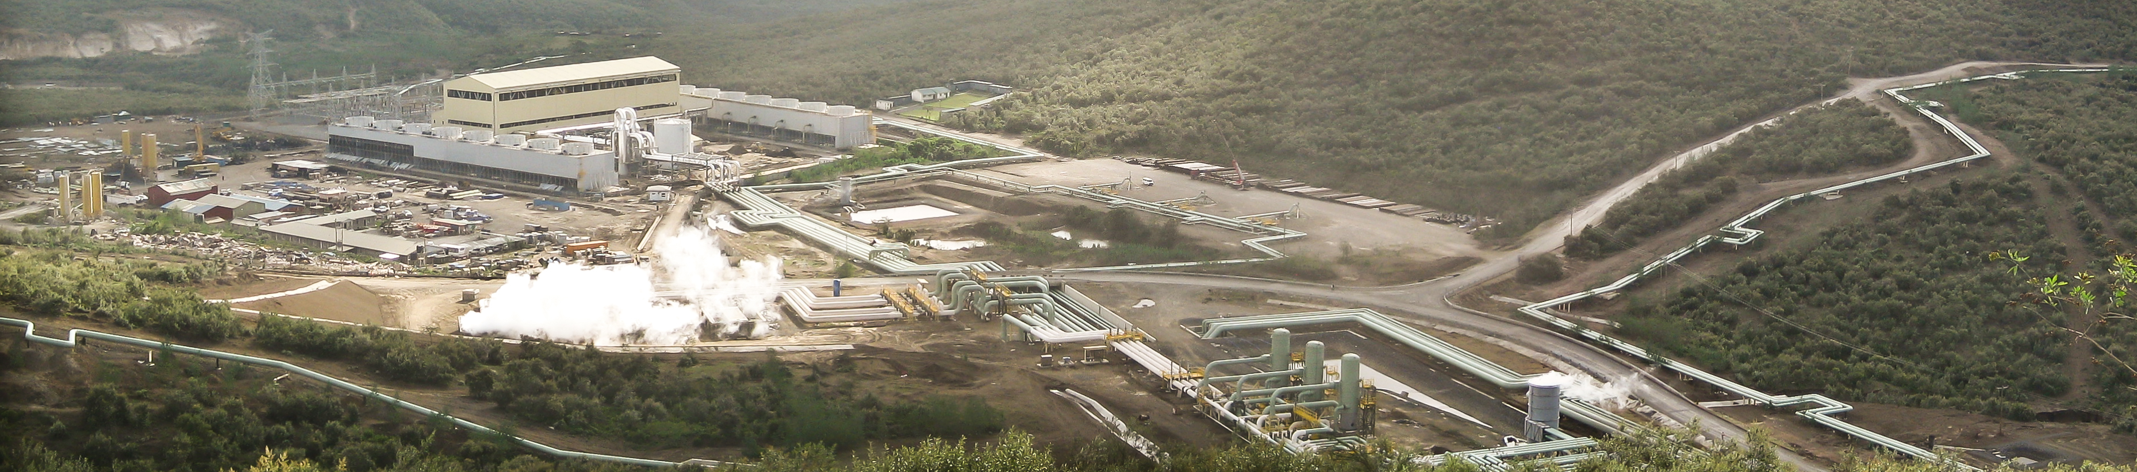
Jacobs Experience
Experience built over the past 40 years, and global capability in all aspects of geothermal exploration, development, power generation and direct use.
We have worked on more than 100 geothermal resources, over 3,000 MW of generation, in over 20 countries, comprising more than one third of the world’s geothermal power generation capacity.

Slide 3
Jacobs Capability
Our geothermal team provides a comprehensive range of services in geothermal energy development, including:
Geothermal reconnaissance and exploration investigations
Reservoir engineering and resource assessment
Environmental management
Project preparation and development management
Steamfield engineering (design, contract, documentation, construction supervision)
Power plant engineering (design, contract documentation, construction supervision)
Geothermal resource management
Steam field and power plant operations and management
Direct use applications (industrial processing, heating, space conditioning)
Asset management
Asset valuations and due diligence studies
Project risk assessment
Carbon financing
Leader’s engineer / resource advisor
Notes:
We operate across the full lifecycle of geothermal exploration, development and operation

Slide 4
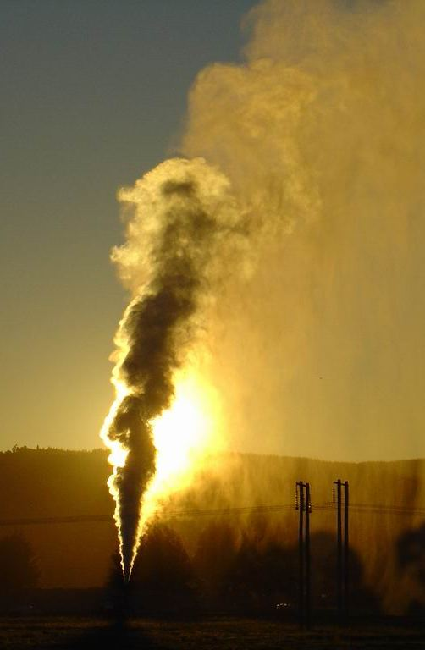
New Zealand
Contact – Tauhara
Lenders advisory
Otherwise, Jacobs Geothermal team have
had a busy year either overseas or
delivering overseas projects
Notes:
Our capability is primarily based in NZ, Indo & Phils
Working closely in support of Contact Energy on the Tauhara, Conceptual engineering, Front End Work, studies
PEI ??

Slide 5
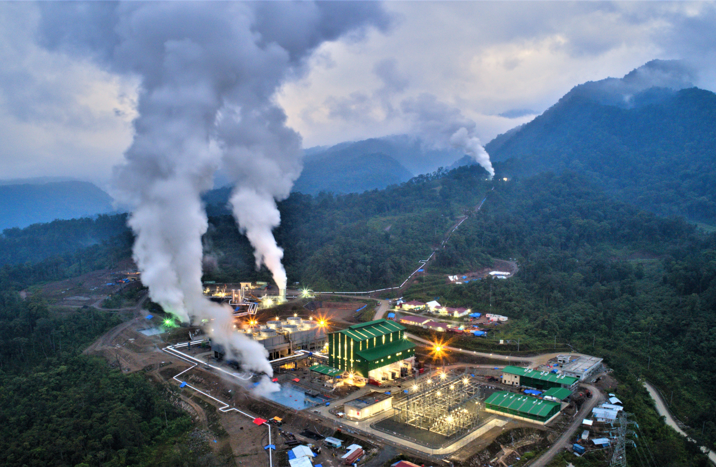
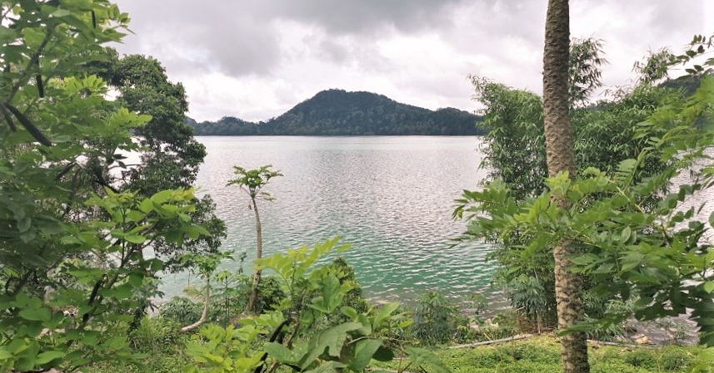
Indonesia
IIGCE
MFAT - GEOINZ
PTSMI – Waesano
Supreme Energy Muara Laboh
Notes:
Strong links between Jacobs NZ & Jacobs Indonesia, teams work as one.
Tim Anderson (ex Trade Commissioner) now our country manager.
IIGCE (INDONESIA INTERNATIONAL GEOTHERMAL CONVENTION)
Jacobs presented papers
Did a master class (well attended) on project economimcs
GEOINZ the MFAT program continues and is transitioning into the Waesano & GEUDP program for PTSMI
Waesano – looking forward to starting work in the NY
- PHOTO Sano-nggoang at Waesano, Flores, pH 3.5,
SEML, Stage 1 now in reliability run, anticipate COD prior to Christmas
- PHOTO Commissioning

Slide 6
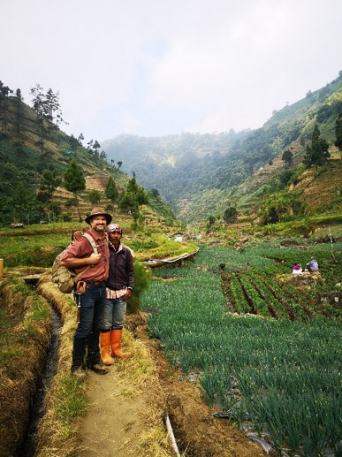
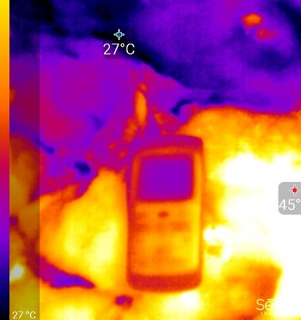
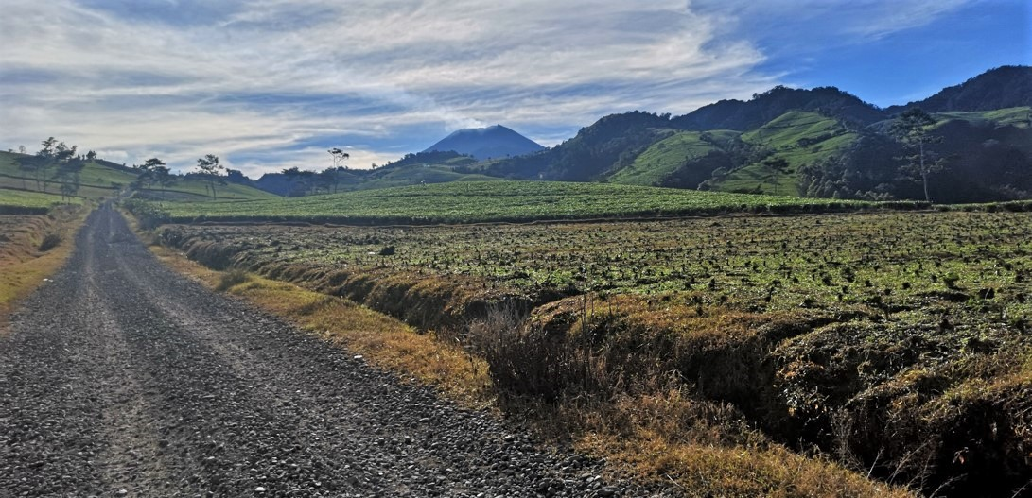
Indonesia
PGE - Sungai Penuh
“Cross fence” engagement with Star Energy &
PTIP at Darajat
Vale - Hu’u gold & copper mine
SAE on Baturaden - exploration consulting
Notes:
PGE Sungai Penuh Awarded independent peer review of resource
Star & PTIP on Equipment failure RCA. Progen helped us with this assignment.
Hu’u exploration consultant for geothermal project associated with the development of gold & copper mine
SAE Baturraden Exploration consulting (PT Sejahtera Alam Energy)
- PHOTOS from our intrepid geologist Max Wilamarth. He tells me that the thermal image is of a unit of volcanic tuff.

Slide 7
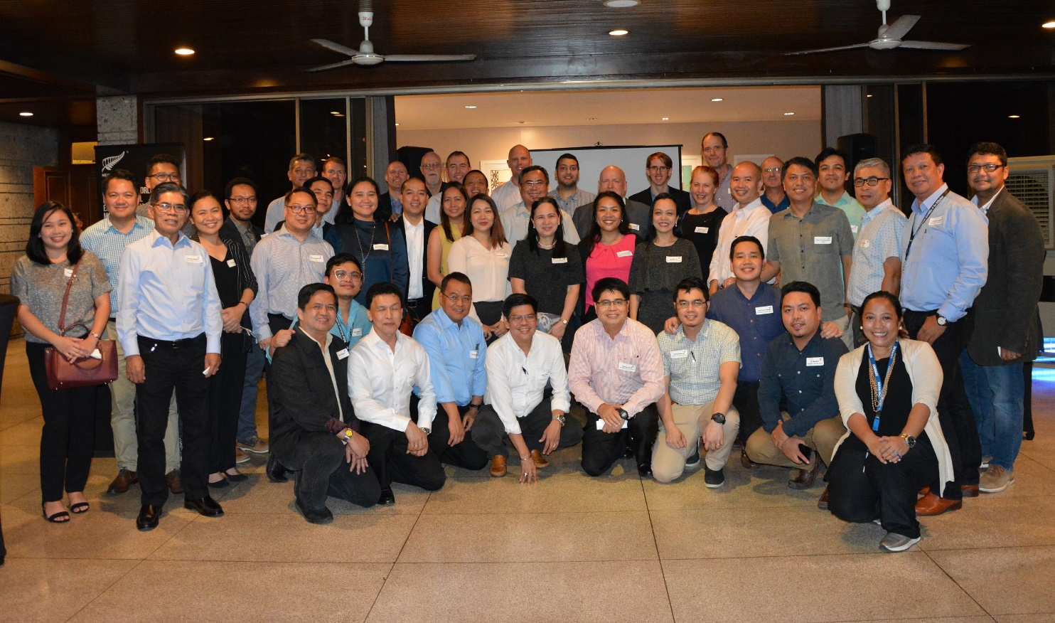
Philippines
NGAP
  Presenting & Supporting NZTE
  Engagement with NZ advisory
  companies during the event
PGPC
  Sustaining capital MakBan & Tiwi
  Steamfield studies and optimization projects at both Tiwi and Makban, including support for potential expansion projects
  Support for new field developments at Kalinga and Malinao.
Notes:
Again, strong working links between NZ
- Steve Vincent moved from Jakarta to leadership role in Manila
- Aaron Hochwimmer Returning
NGAP
Key presentations to industry as part of the Annual Philippines Geothermal Conference and in support of NZTE
Engagement with NZ advisory companies during the event
PGPC
SUSCAP works at T & M, including brine pump station upgrades, cross country piping and well connections as part of 2020 drilling program
Steamfield studies and optimization projects at both Tiwi and Makban, including support for potential expansion projects
Kalinga and Malinao. Engineering and advisory related to exploration and well testing.

Slide 8
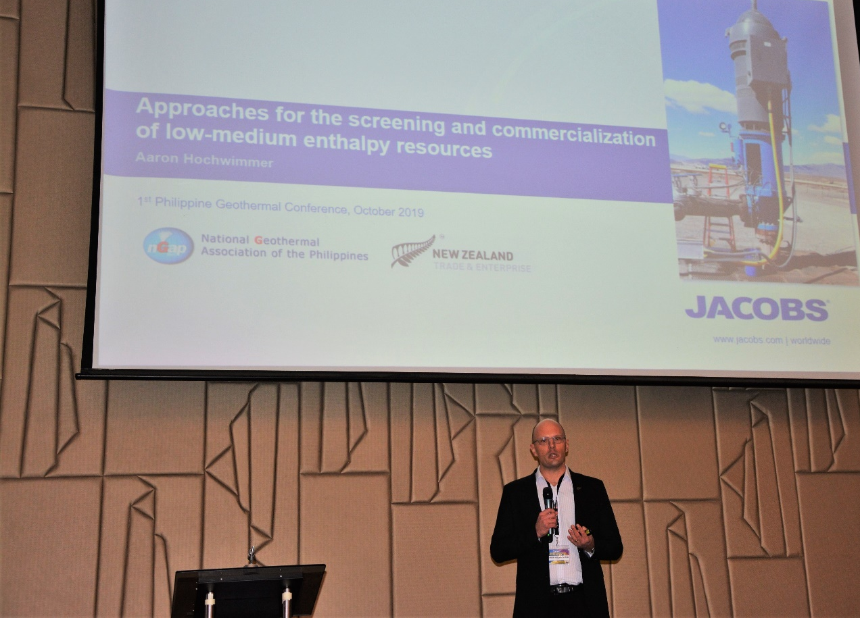
Philippines
EDC
  Studies
  New Development FEED work
  Master planning studies
  Site hazard studies and remediation
  for slope failures.
  Advisory support
APRI
  Makban GRS upgrade.
  “Cross fence” engagement with PGPC and APRI on development projects.
Notes:
EDC
Technical review and study of field and plant optimization and review of existing assets.
Front end work related to upcoming Binary Power expansion projects.
Master planning studies for existing operations at Leyte, Mt Apo, Bacman and Nigbu.
Site hazard studies and remediation for slope failures.
Advisory support for new technology deployment for off-design and stranded wells.
APRI
Makban GRS upgrade Engineering and construction services.
Cross fence engagement with PGPC and APRI on development projects.

Slide 9
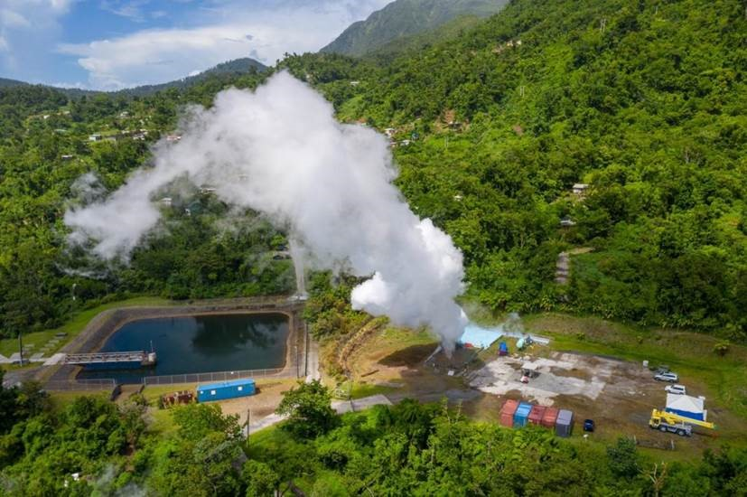
Caribbean
Dominica
  Well successfully tested
  EPC bid evaluation underway.
MFAT Caribbean Facility
  St. Vincent
  St. Lucia
  Grenada
  St. Kitts & Nevis
  Montserrat
Notes:
Dominica
Well successfully tested
EPC bid evaluation underway.
St. Vincent
First two exploration wells have no
production. Stimulating well 2 and starting drilling a third well
St. Lucia
Project on hold pending nullification of outstanding concession. WB funding $20m for 4 slimhole programme
Grenada
Progressing towards exploration drilling for 2 or 3 wells in 2020.
St. Kitts & Nevis
Developer still trying to line up funding for the development of a 9MW plant on Nevis.
Montserrat
Three wells drilled. Project on hold waiting to secure funding for development. DFID want private partner.

Slide 10
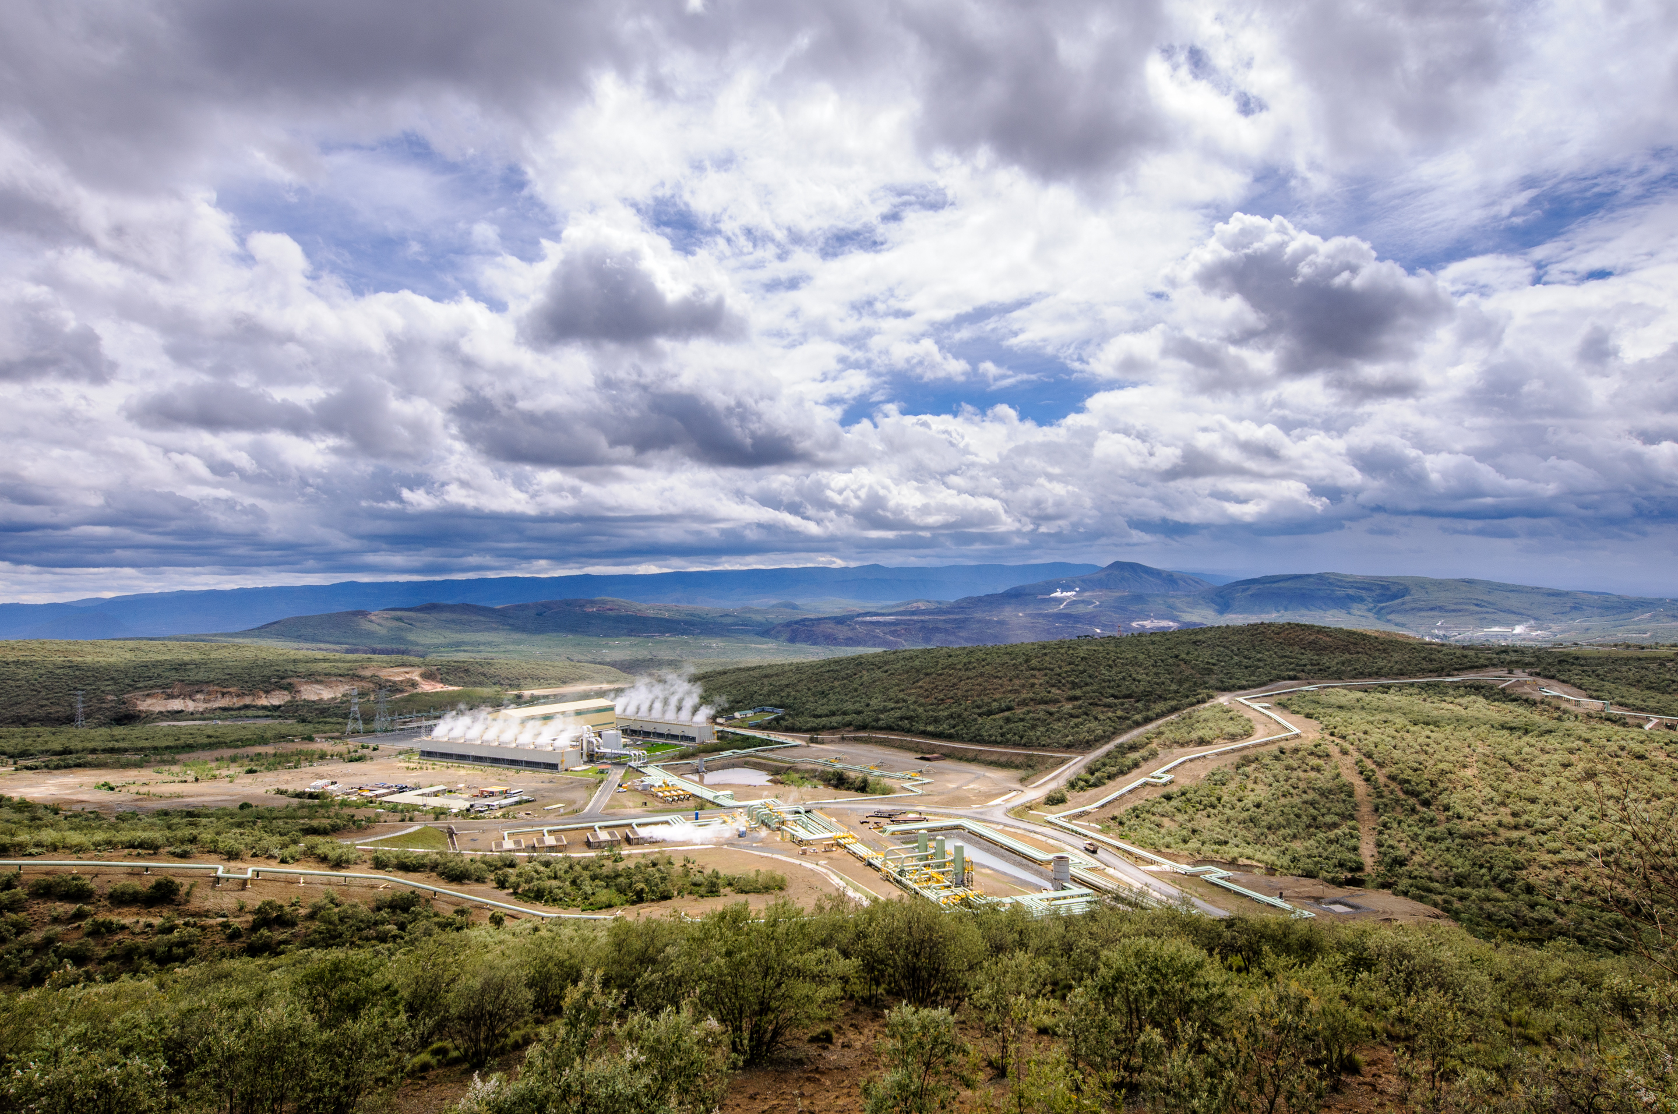
East Africa
Kenya
  Olkaria 6 IPP
  AAGCE Support
Ethiopia
  Corbetti
  Fantale
Notes:
O6 - RFP out, Jacobs supporting
AAGCE – Ongoing support to Uniservices in delivering training African Geothermal Centre of Excellence

Slide 11
NZGA Industry Updates 2019
New Zealand Geothermal Workshop
Notes:
Looking forward, most of the projects I’ve talked about here are long running. We see the bulk of opportunities in Indonesia and then the Philippines, and it is there that we see the immediate growth opportunities.
From this year, I’d like to thank Contact Energy, Uniservices and Power Engineers who, as partners have helped us deliver to our clients.
THANKYOU FOR LISTENING

