Slide 1
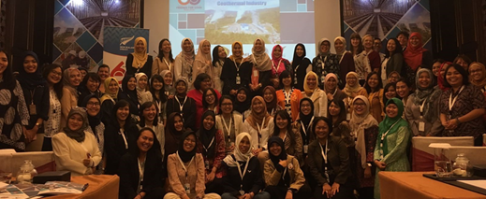
NZGA Industry Updates
New Zealand Geothermal Workshop
14-16 November 2018

Slide 2
Philippines
Owner’s Engineer to support geotechnical remediation and relocation of the Mahanagdong B electrical switchyard following the Leyte 2017 earthquake
Owner’s Engineer to repair/replace/reoptimise elements of the Leyte fluid collection and reinjection system damaged by Typhoon Urduja.
Technical Advisor on Palayan Binary Power Plant Expansion Project
Makiling-Banahaw (MakBan) Hot Brine Injection System (HBIS) concept study
Notes:
This project has progressed very well and we are currently on track for the commissioning of the Maha B replacement switch-yard to schedule. This project is multi-office and has drawn on expertise from the Philippines, Malaysia, Hong Kong, Australia, New Zealand, and Indonesia.
PGPCI have engaged Jacobs to complete a new conceptual study for the MakBan HBIS to determine how the system should respond to the changes it is currently experiencing and how it needs to change to cope with future brine production.

Slide 3
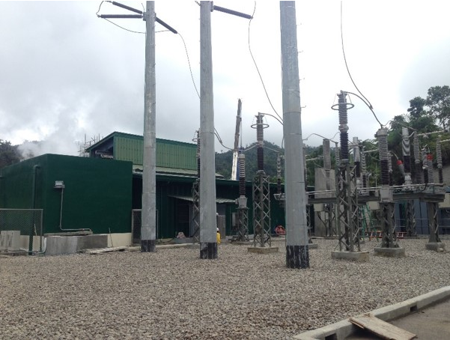
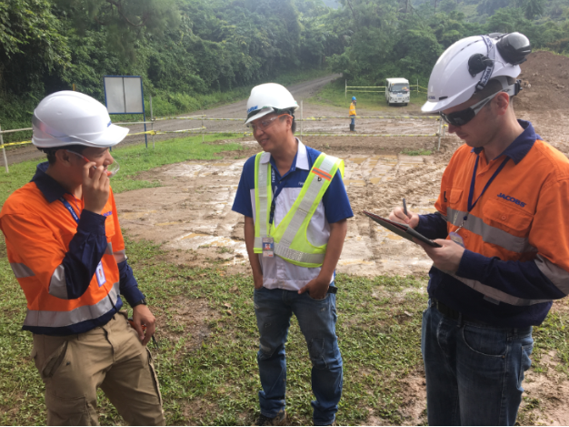

Slide 4
Indonesia
Change in Leadership
Expanding the geoscience team based in Jakarta
IIGCE 2018 & NZTE Masterclass workshop Sept
Owners Engineer to Supreme Energy Muara Laboh
Geo-INZ
Support to PT SMI to support exploration drilling at Waesano
Ijen
Notes:
TIM ANDERSON, STEVE VINCENT
Max Wilmarth - worked around the globe in geology/geochem.
International Indonesian Geothermal Conference and Exhibition held in early Sept, NZ booth great collaboration between numerous NZ companies
Geothermal Masterclass organized by NZTE (in conjunction with Empowering Renewable Energy – New Zealand technology for Indonesian Energy Sustainability) held just prior to the IIGCE. The Jacobs Masterclass was an interactive presentation on innovation in exploration, development in operation where small groups had breakout sessions subsequent to the presentations in which they ranked innovations in respect to cost savings and potential change in tariff.
Following from MFAT support to PT SMI, Jacobs will support Waesano through exploration drilling
Muara Laboh FS for SEML
Review of Ijen on behalf of potential buyer

Slide 5
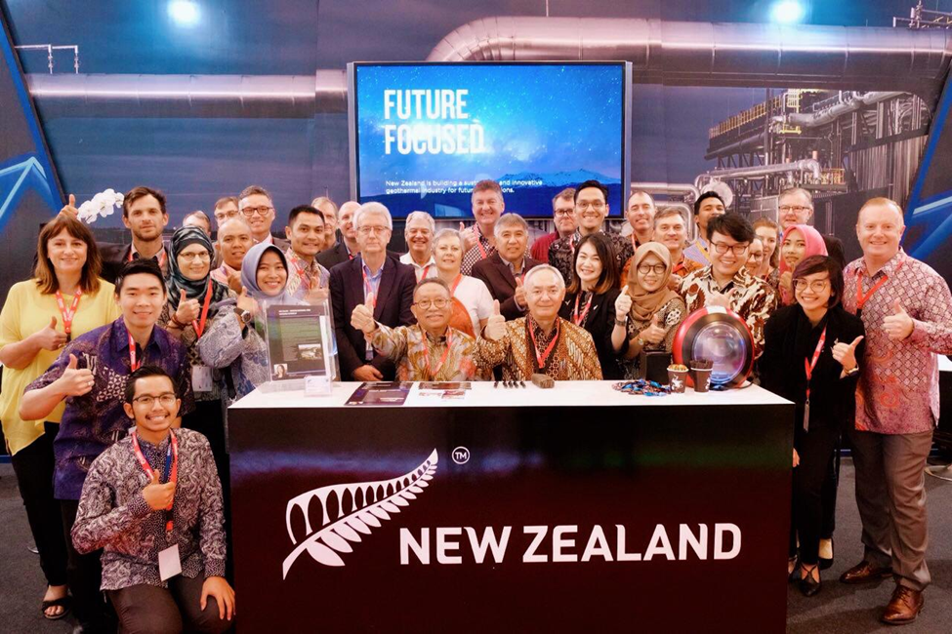
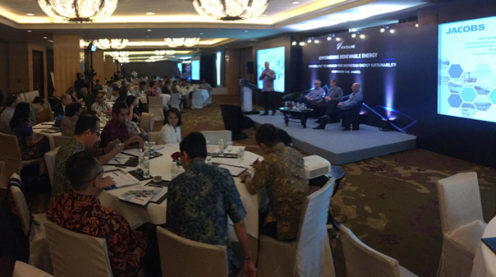
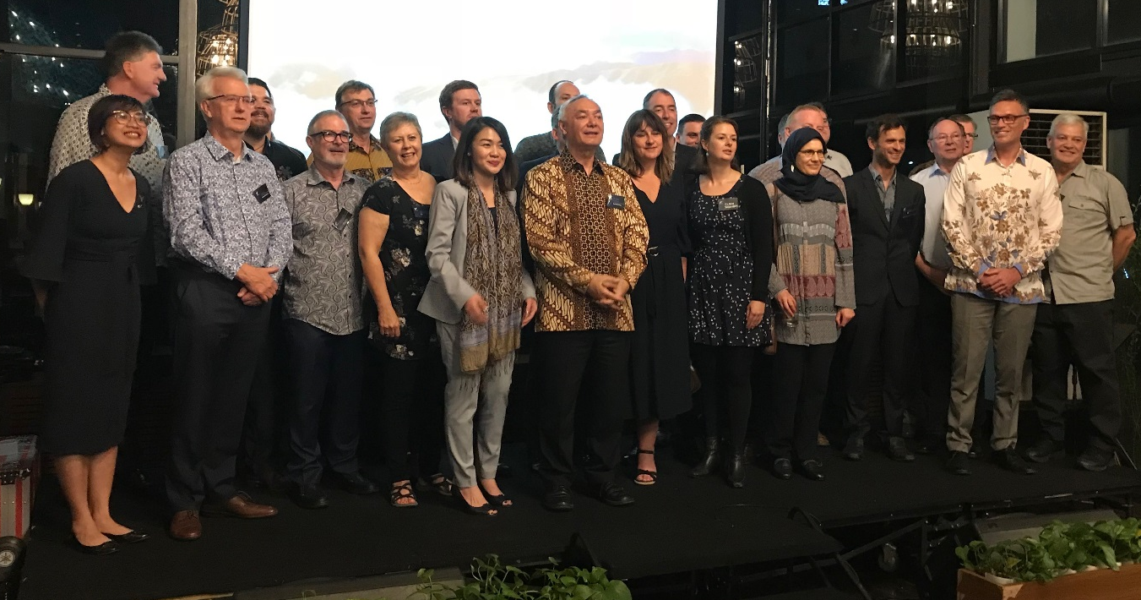
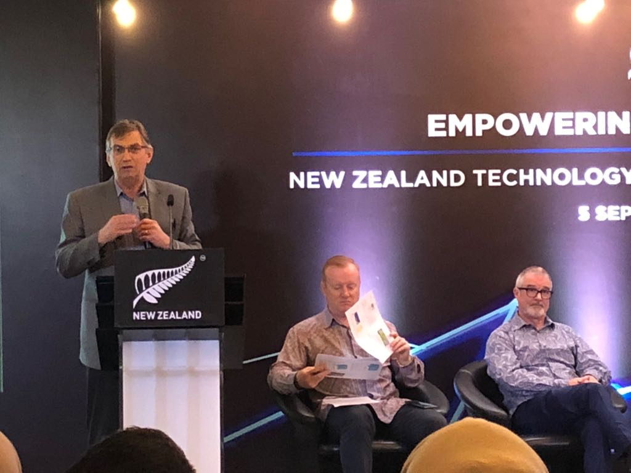
Notes:
Photos – (clockwise top left) GeoNZ stand at IIGCE, Jacobs Masterclass, NZ Ambassador Bruce Matheson with NZ contingent

Slide 6
GEO-INZ
New Zealand Aid Programme funded support to Government of Indonesia to accelerate geothermal development
Run jointly between Jacobs New Zealand and PT Jacobs Indonesia
Phase 1 (15 months) completed, Phase 2 (3 years) will kick off in new year
Support to Badan Geologi (Geological Agency), EBTKE (Regulator), PT SMI (SOE)

Slide 7
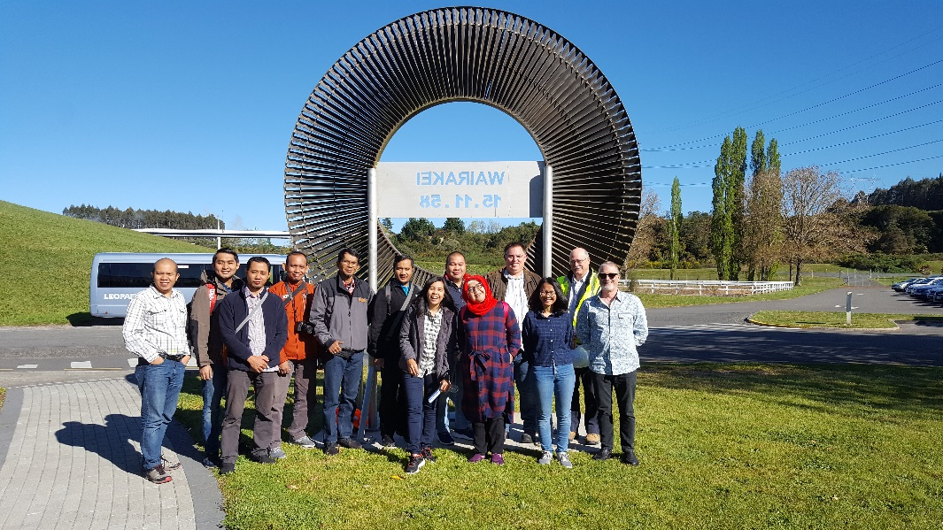
Geo-INZ
Dual programme objectives of delivering Technical Assistance and Capacity Development
In addition, cross-industry workshops/events including use of slimholes, the International Women’s Day Event, and launch of women’s mentoring programme
Most recently, training in New Zealand for mid-level managers at PLN on geothermal risk mitigation
Notes:
As part of Capacity Development we have made it a point to work alongside the partners, rather than just deliver reports, and involved industry as much as possible.
Women’s mentoring network commenced with 14 sets of mentors/mentees.
PLN training – 9 people from PLN to Auckland for risk mitigation training (one week course including field trip to Wairakei)

Slide 8
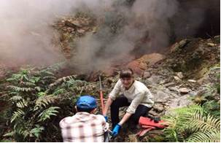
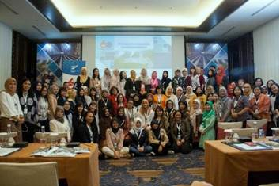
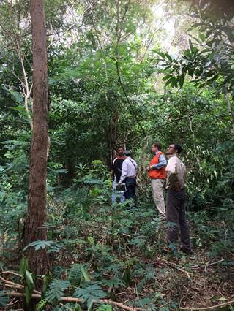
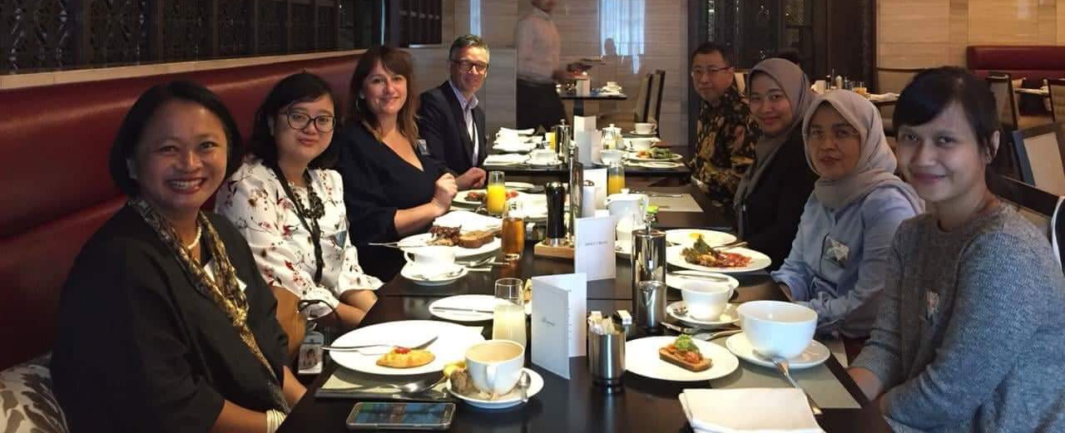
Notes:
Clockwise top left
Jacobs team helping Badan Geologi with geochemical sampling
International Women’s Day Event
Some of the team of the mentoring programme
Surveying at Waesano (Flores)

Slide 9
Caribbean
Dominica – project fully prepared for funding, appraisal completed by WB
St Lucia – completion of ESIA for 4 SH wells. Expl Management consultant appt in 2019
Grenada - Project Co-ordinator was appointed and is based in country. Drilling plan for 2 deep SH wells
St Vincent - Three deep deviated wells and reinjection well are planned
St Kitts & Nevis – expl. SH well drilled at Nevis, looking for funding to progress, likewise St Kitts
Notes:
Delivered under the Geothermal Facility Management role, NZ Aid funded program to facilitate geothermal development in the Caribbean
Dominica:
The project has been fully prepared for funding including selection of the reinjection line route, land acquisition and completion of the ESIA.
Project appraisal has been completed by the World Bank with Board approval early 2019. The Request for Bid for EPC contractors for 2 x 3.5MW plant has been prepared and will be issued shortly.
St Lucia:
Completion of the ESIA for drilling up to 4 slimhole wells. World Bank is organising funding for exploration drilling and a Board meeting is expected in Spring 2019 to approve the projects. The Exploration Management Consultant will be appointed in 2019.
Grenada: The Project Co-ordinator was appointed and is based in Grenada. The Drilling Plan has been prepared under MFAT funding and will comprise two deep slim holes.
A consultant has been appointed for the ESIA.
St Vincent: Changes to the project company structure have delayed signing of the drilling contract. Funds have been secured for drilling and all other services. Well pads have been prepared. Three deep deviated wells and reinjection well are planned.
St Kitts & Nevis: A single exploration slim hole was drilled in Nevis to verify resource temperatures. Full size wells and construction of the power plant are expected to occur concurrently once funding has been secured.
St Kitts has not yet been able to secure funds for drilling although funding for an ESIA has been approved by CDB.

Slide 10
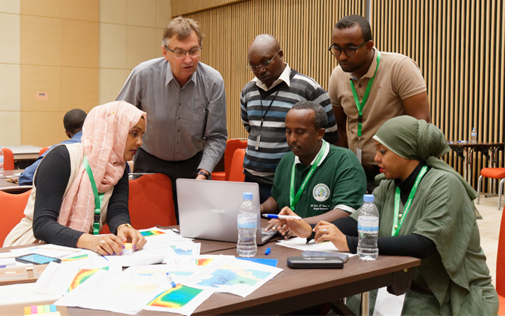
East Africa
Ongoing role in Corbetti
Geothermal Training with AGCE – consortium led by UoA Geothermal Institute
Notes:
Corbetti – Lenders (InfraCoAfrica) technical advisor
As part of MFAT Africa Geothermal facility (AGF) this is a two-year geothermal training modules supporting the African Geothermal Centre of Excellence (AGCE). This project lead by the University of Auckland with a consortium of partners – Jacobs, Contact Energy, Seequent, MitchellDaysh. Just completed kick-off mission to the region (Rosalind Archer & Greg Ussher)

Slide 11
Other Geographies
Ongoing engineering, geoscience & drilling support at San Jacinto (Nicaragua)
Silica scaling testing at Hokkaido (Japan)
Support to Owners at Apas Kiri (Malaysia)
Due Diligence - Review of Thermo-1 (USA) for Cyrq Energy

Slide 12
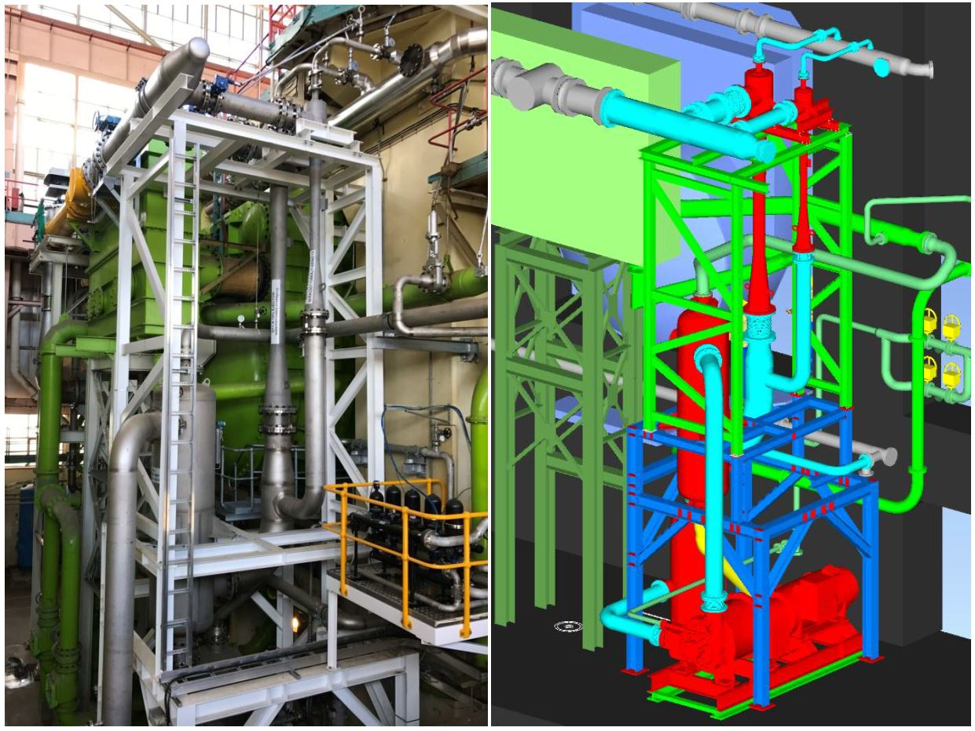
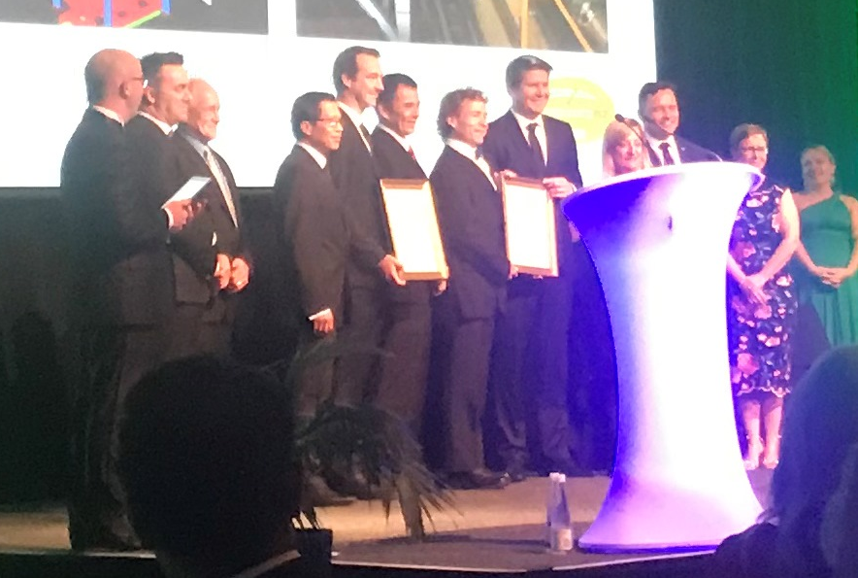
New Zealand

