Slide 1
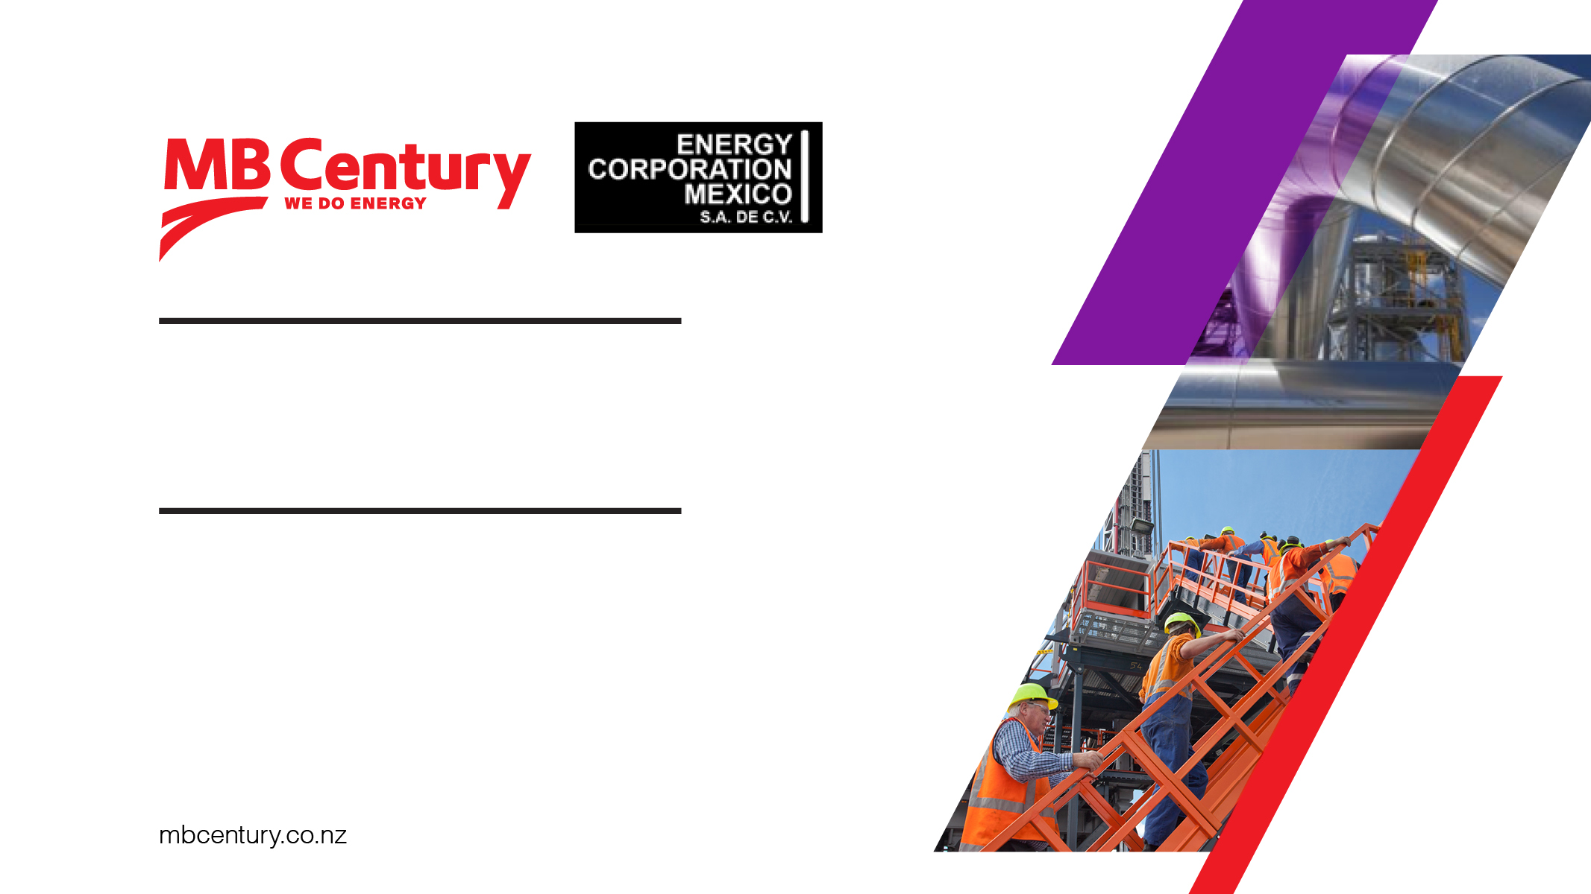
COMPANY UPDATE
November 2018

Slide 2
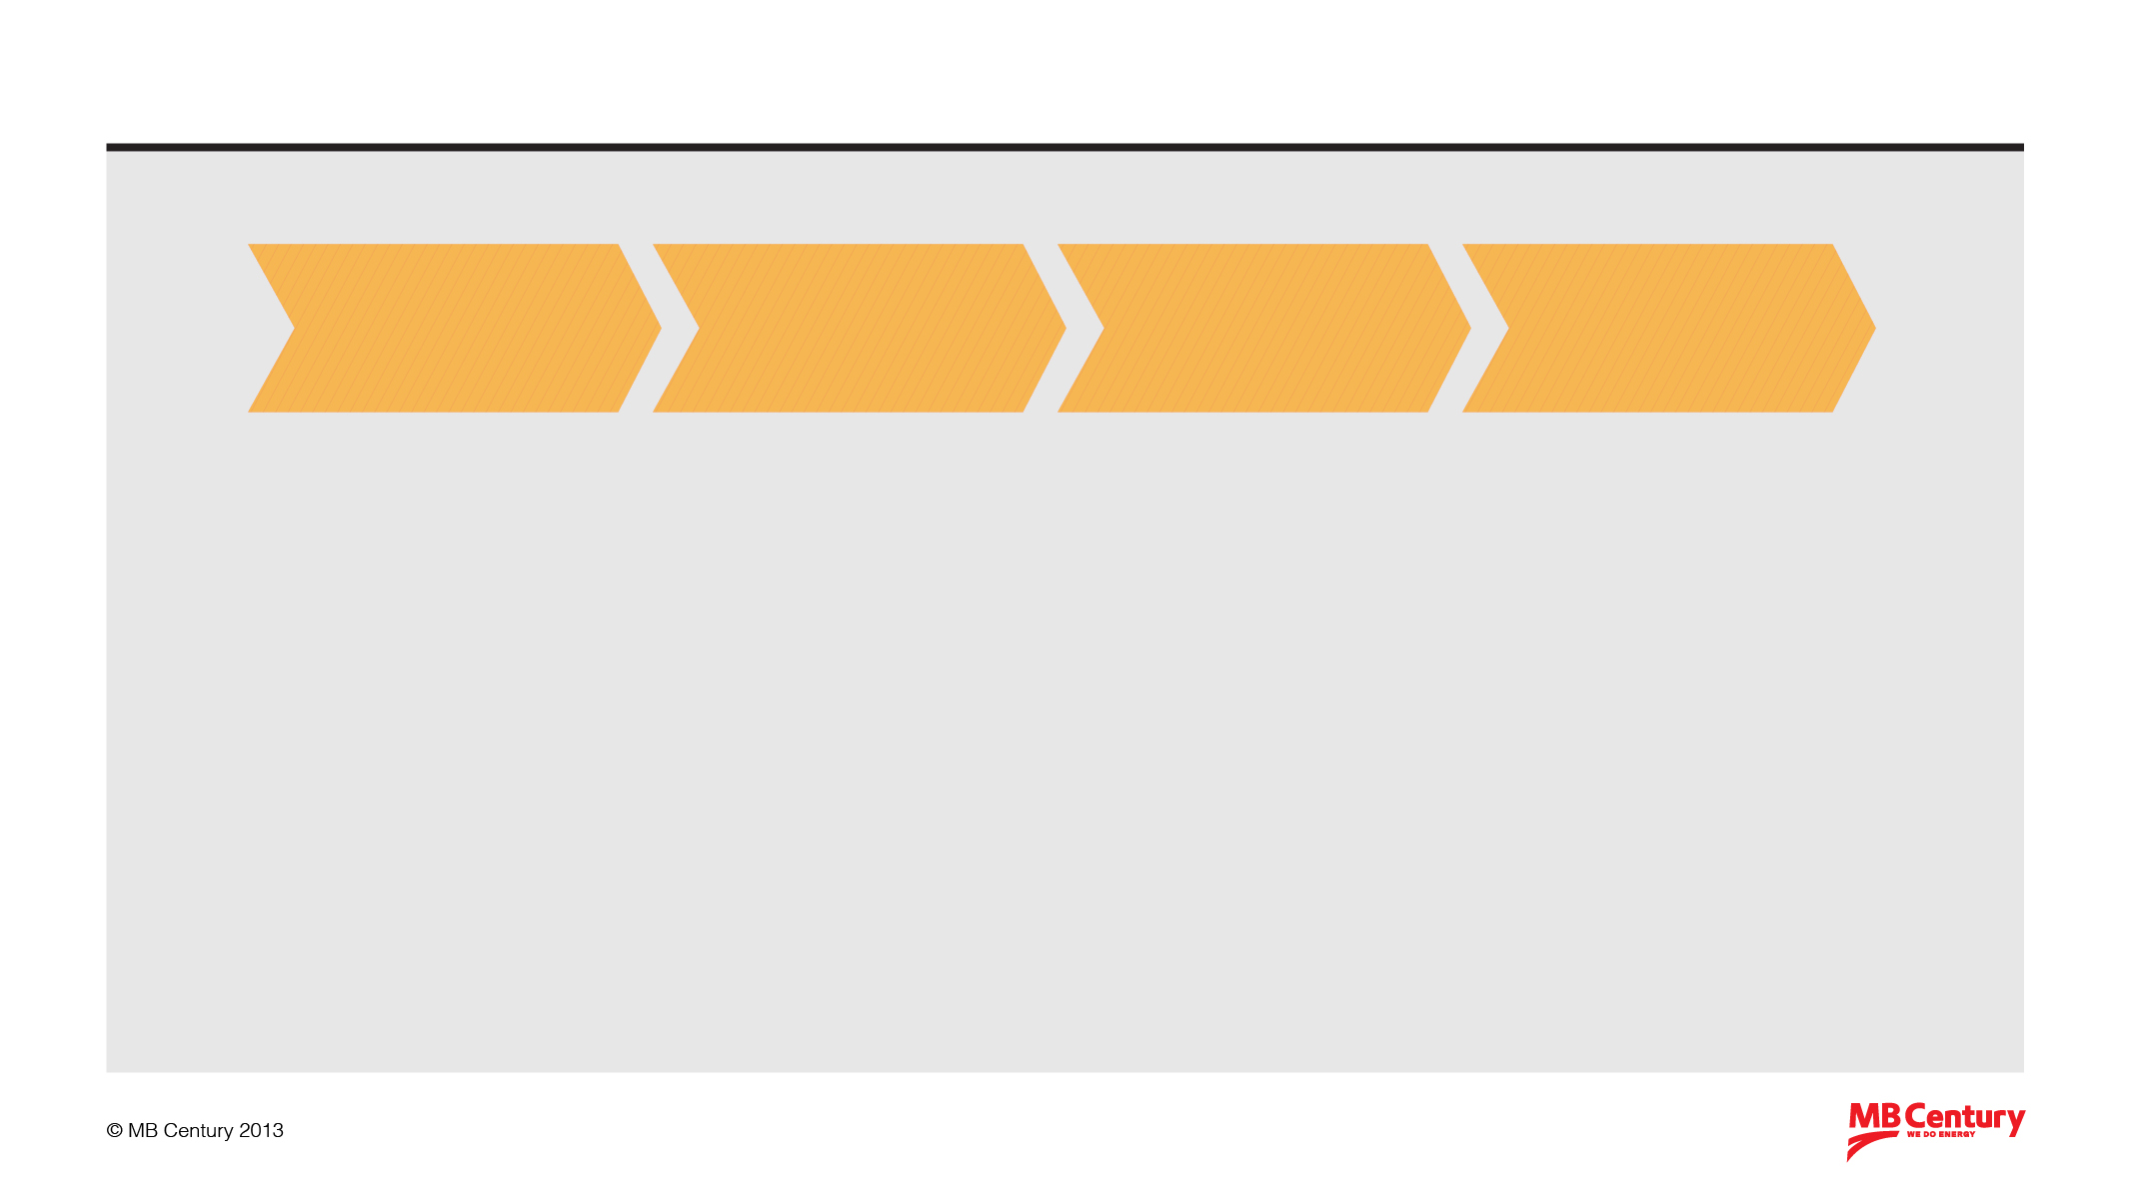
MB Century is…
Resource
Evaluation
Exploration / Production Drilling
Plant
Construction
Plant
Operation
• Reservoir Chemistry
• Geothermal Evaluation
• Geothermal Drilling
• Reservoir Logging
• Reservoir Chemistry
• Drilling Engineering
• Drilling Logistics
• Health & Safety training
• Steamfield Design
• Steamfield Construction
• Heavy Fabrication
• Precision Machining
• Industrial Coating
• Health & Safety Training
• Project Management
• Power Systems & Commissioning
• Hydro Engineering/Design
• Plant Operation
• Maintenance & Overhaul
• Reservoir Management
• Reservoir Logging
• Power Systems & Commissioning
• Hydro Engineering/Design
MB Century awards include:
• Excellence in Health and Safety – Deloittes Energy Excellence Awards
• Finalist Safeguard Health and Safety Awards
• Practitioner of the Year 2014 Finalist Safeguard Health and Safety Awards
• Energy Innovation of the Year 2016 – Deloittes Energy Excellence Awards

Slide 3
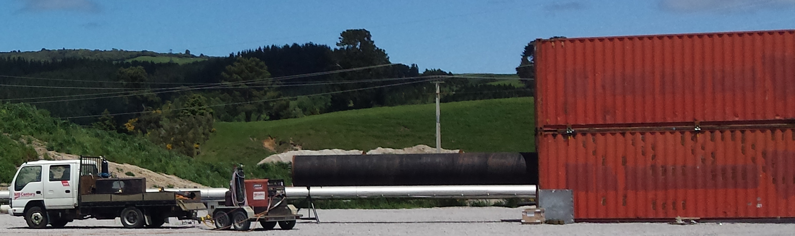

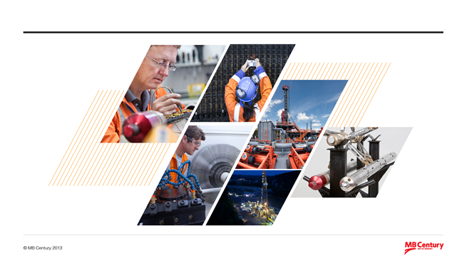

Company Update
Strong Health & Safety Performance
Competency Assurance program for all employees: 7,900+ assessments completed to date.
Generation 2 HTCC-MF tool: International work
Rig 32 active NZ drilling campaign. Big Ben mobilising
Introduction of Well Completions equipment and capability
In collaboration with successfully introduced the Geothermal Wellhead Repair Tool (GWERT) to NZ.
Agency support to for tailored chemical solutions to remove/prohibit geothermal well scale

Slide 4
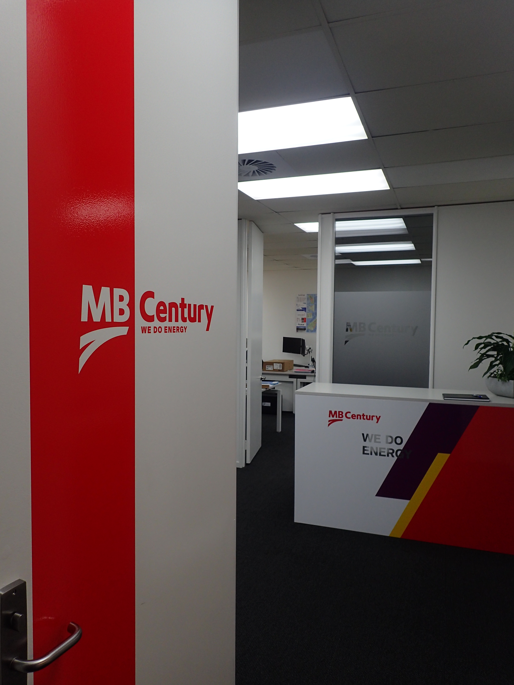
Company Update
Hamilton Office
South Island Office
Kawerau Office pending
Power station maintenance/overhauls – Geothermal, Hydro and Thermal. Nationally and Internationally. Consolidating expertise.
Expansion of Mechanical Services to Australia, Philippines and Japan ( including Toshiba TA’s)
Increased Project Management capability
Expansion of Hydro Engineering resource
Steam field and design support to domestic & international market

Slide 5


Company Update - International
Japan - Relationship Venture with Obayashi Corporation. Geothermal drilling, reservoir logging and steam field design.
Mexico – Entity and office. Undertaking reservoir logging and steam field design works.
Philippines – Further expansion of reservoir logging and hydro design services.
Australia – Establishment of entity. Hydro engineering, project management and mechanical support

Slide 6
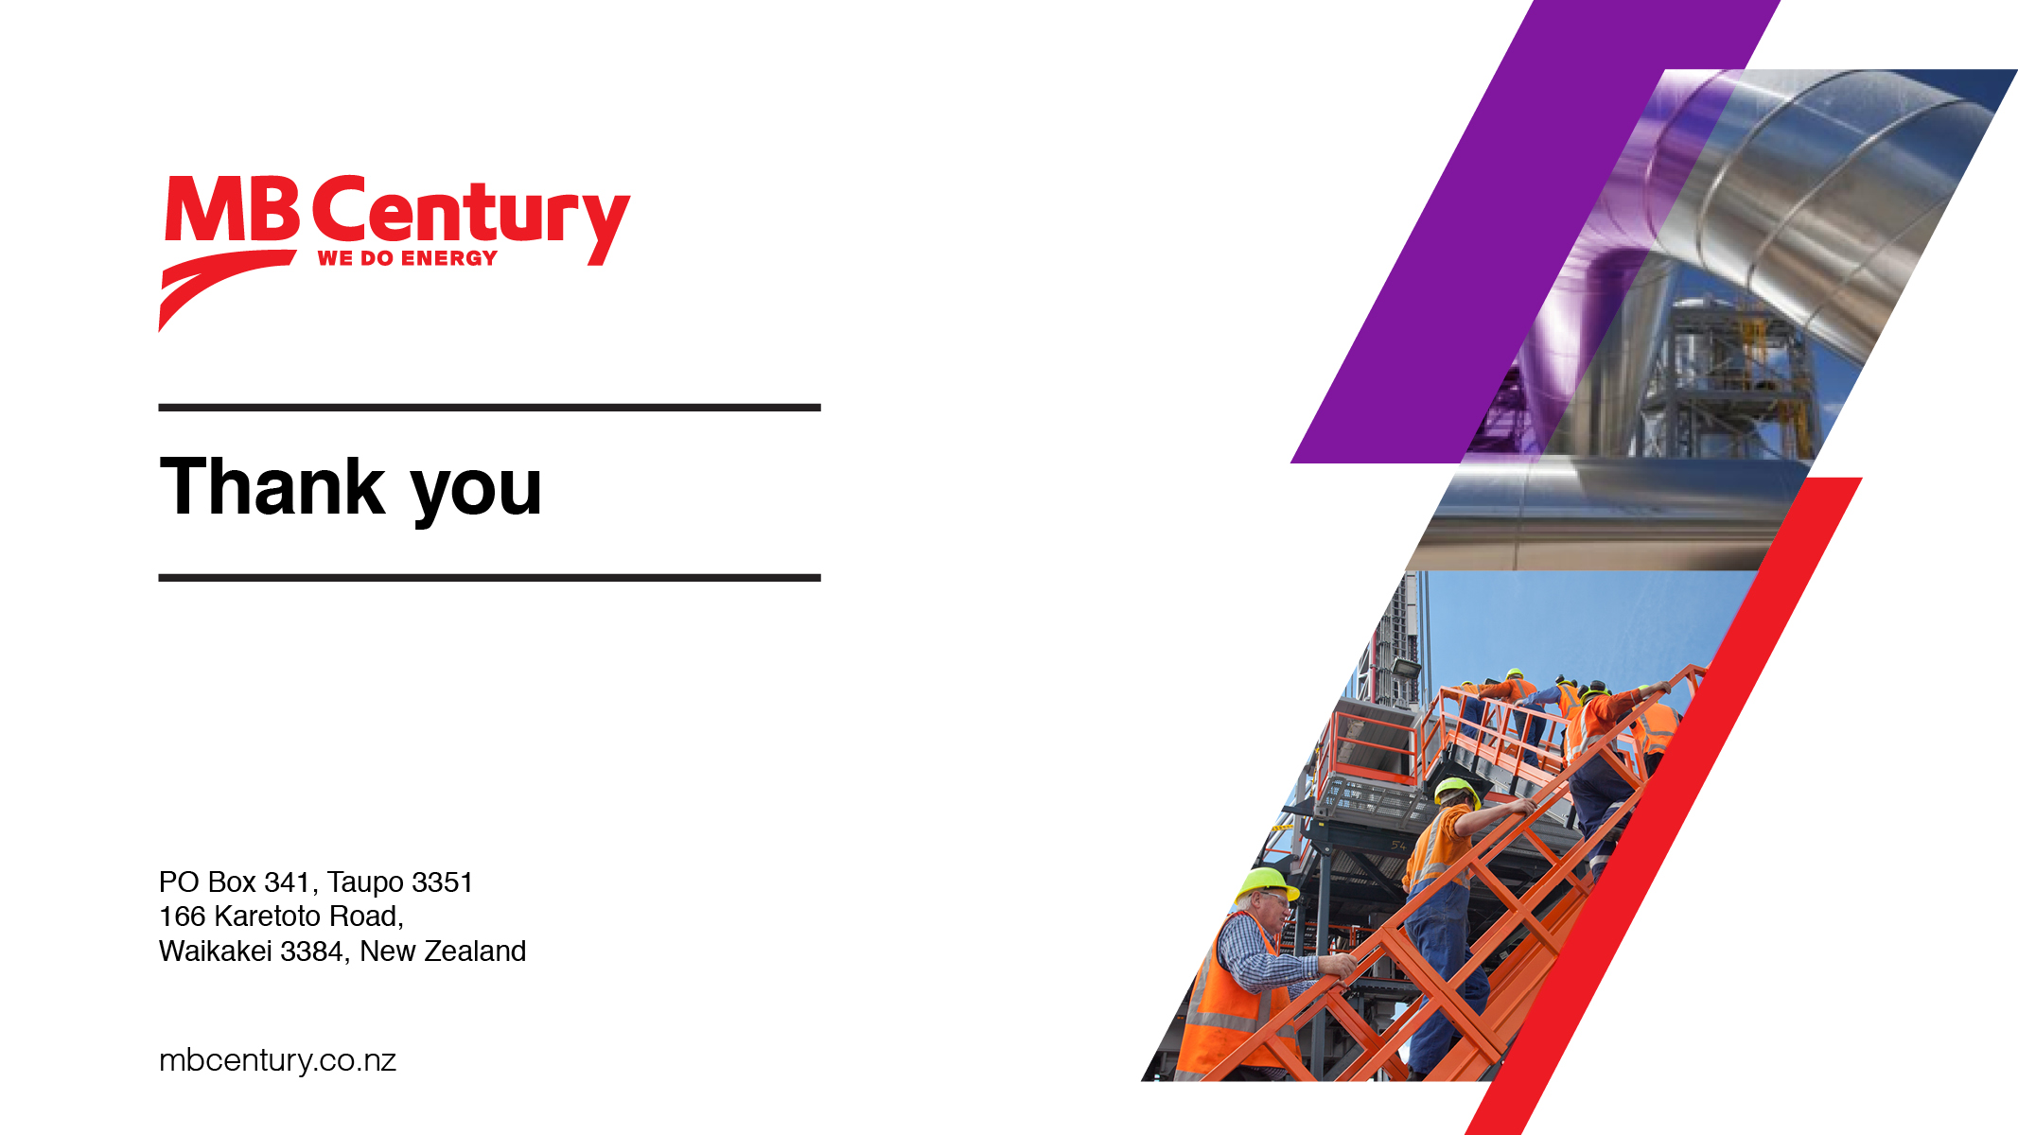
For more information please contact:
Marcel Manders
Chief Executive
Email: mmanders@mbcentury.com

