Slide 2
MTL Geothermal Update
2018

Slide 3
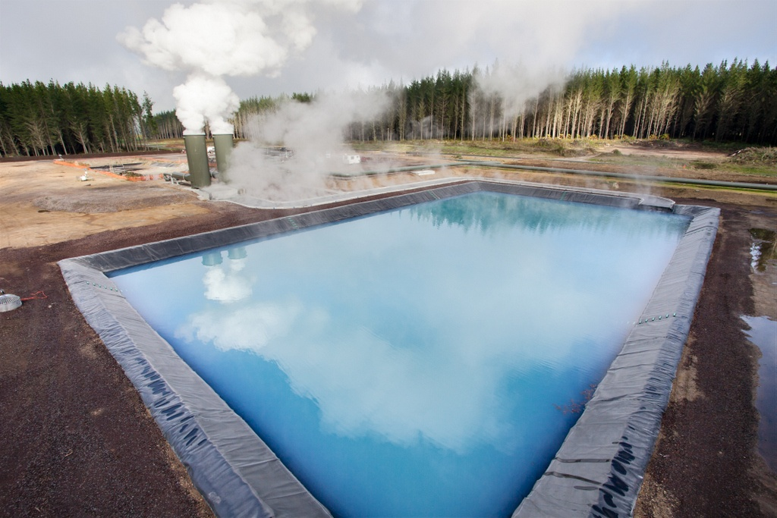
MTL
Renewable Power Project
Design Specialists

Slide 4
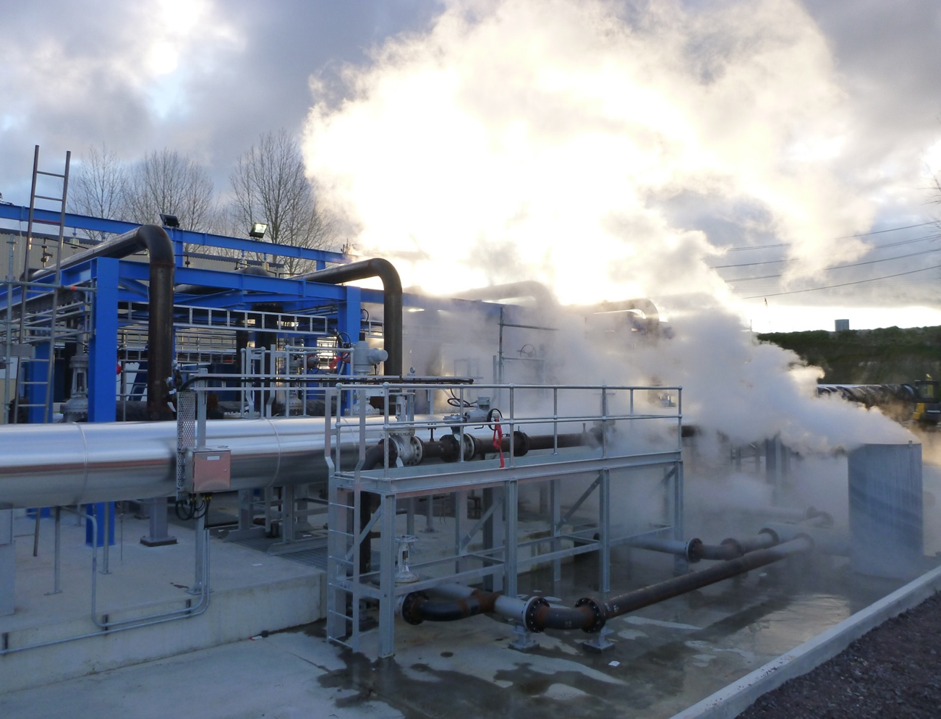
MTL Overview
2018

Slide 5
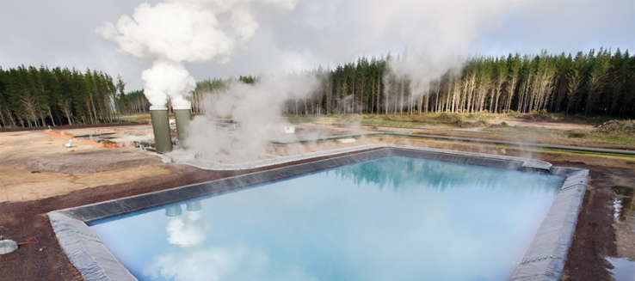
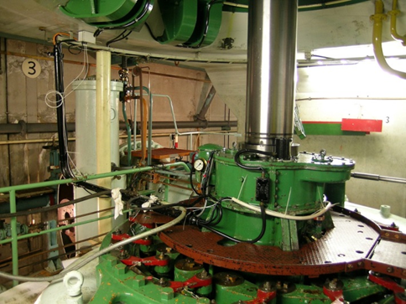
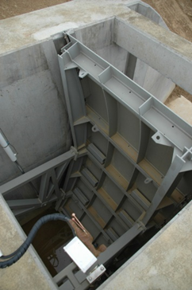
MTL Core Industries
Geothermal
Steamfield and Power Plant
Hydro
Power Plant

Slide 6
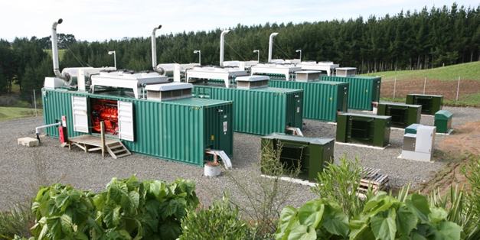
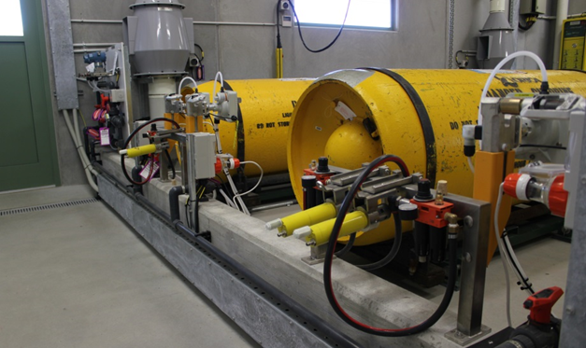
MTL Core Industries
Thermal
Power Plant, LFG to Electricity, Boiler Plant
Water
Water Treatment
Industrial
Dairy, Process Plant

Slide 7
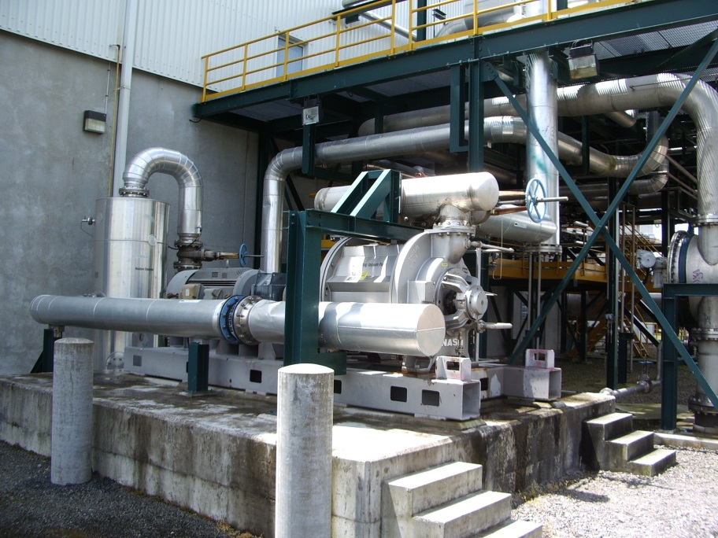
MTL
Consulting Engineers
Specialist Fields
Mechanical Engineering
Process Engineering
Civil/Structural Engineering
Project Management
Electrical & Controls(MECL)

Slide 8
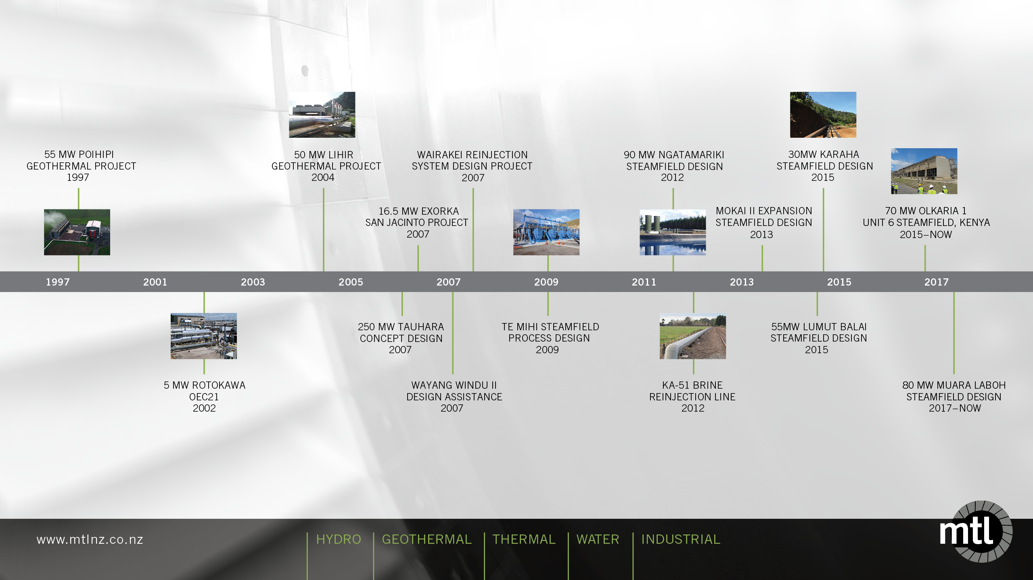
Our Geothermal Story - 20 Years +

Slide 9
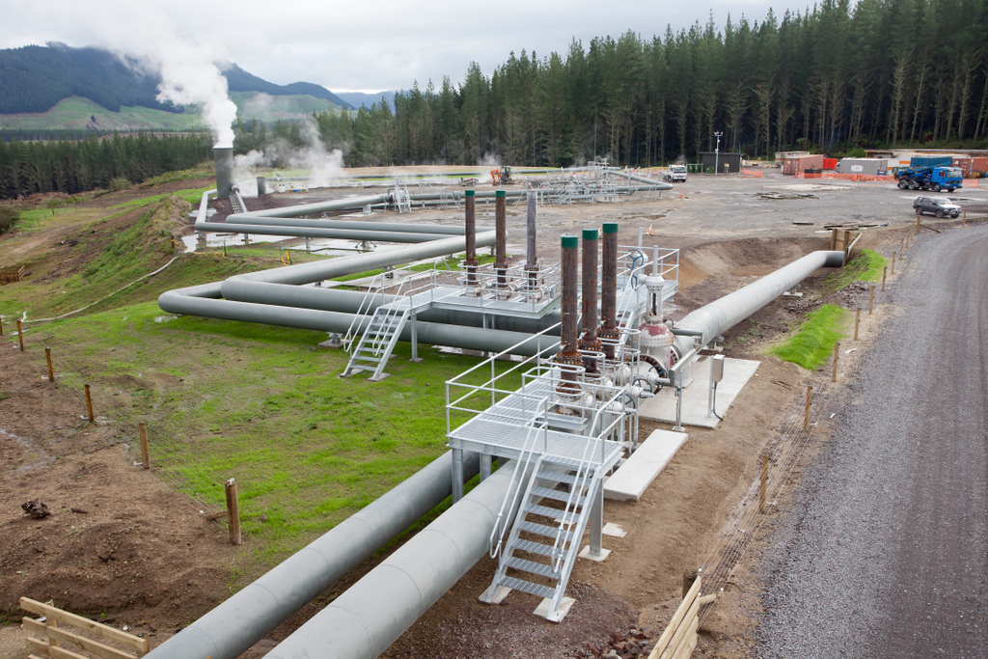
Ngatamariki Steamfield Design

Slide 10
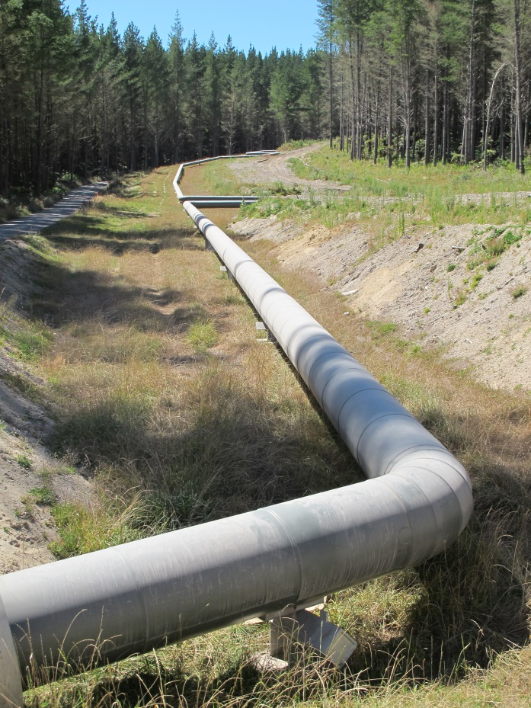
Ngatamariki Steamfield
MTL were part of a design build team for the steamfield serving the 82MW Power Station which recently won the Winner World GeoPower Market Award – “Best Power Project” 2013
MTL completed the detailed design of over 7.5km of steamfield including 2 phase pipework, brine pipework, production and hot reinjection well pad piping, flash vessels and condensate injection pumping system.
The design was completed under tight time constraints to ensure that project objectives were met.
The asset owner Mercury NZ commented on the high quality of design and lack of physical re-work as a result.

Slide 11
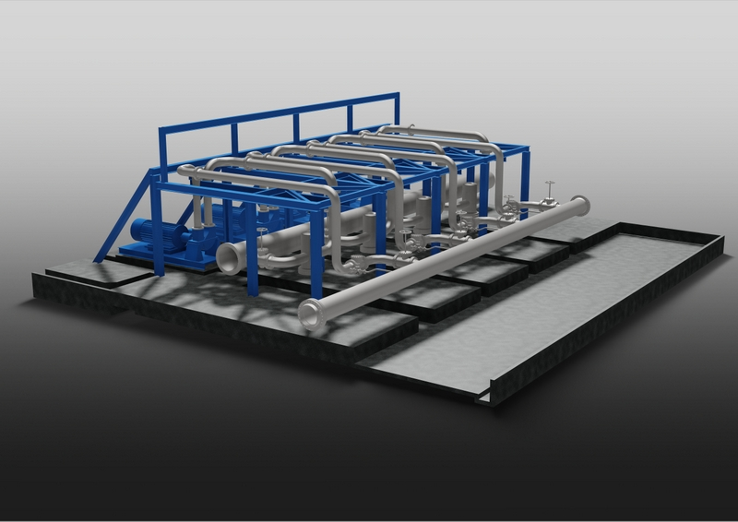
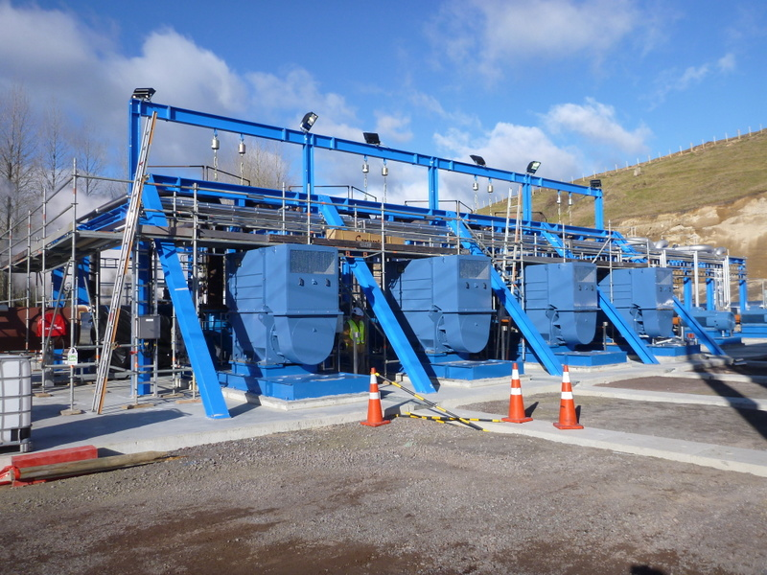
Te Mihi Power Project
Steamfield Process Design
Karapiti Reinjection pump station detailed design

Slide 12
2018 – It’s been a busy year..
Industrial/Water
Warkworth Water Treatment Plant
Ardmore UV
Ongas Bottle Swap
Golden Bay Cement Silo 9
Huntly Power Station HSNO
Geothermal
Olkaria 1 Unit 6
Muara Laboh
Karaha
IIGCE Indonesia

Slide 13
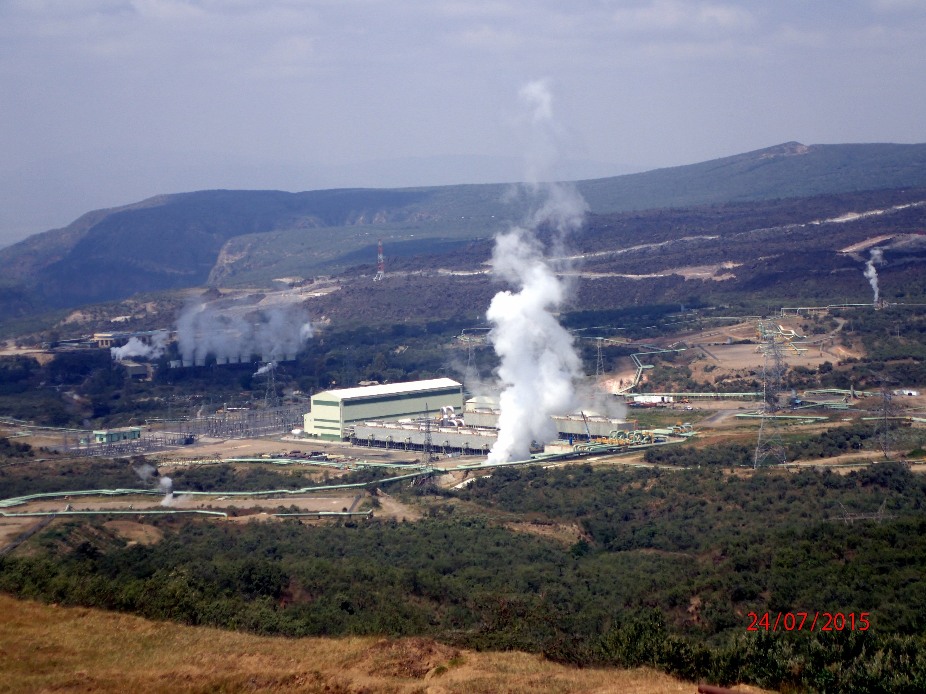
Olkaria 1 Unit 6

Slide 14
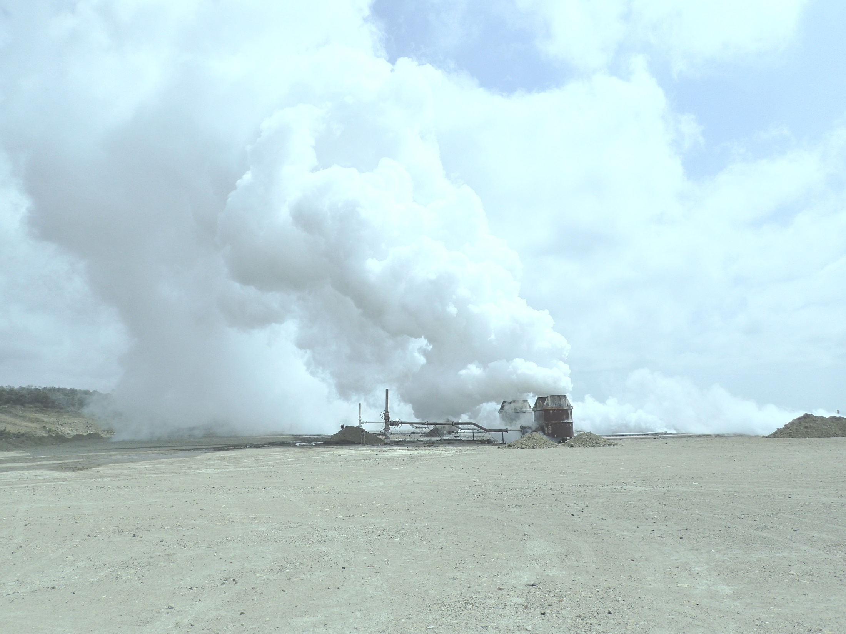
Olkaria 1 Unit 6
70MW Geothermal Steamfield
Olkaria, Kenya
Owner - KenGen
MTL - Owners Engineer role for Steamfield
Working with Fichtner, Stuttgart
Tendering completed

Slide 15
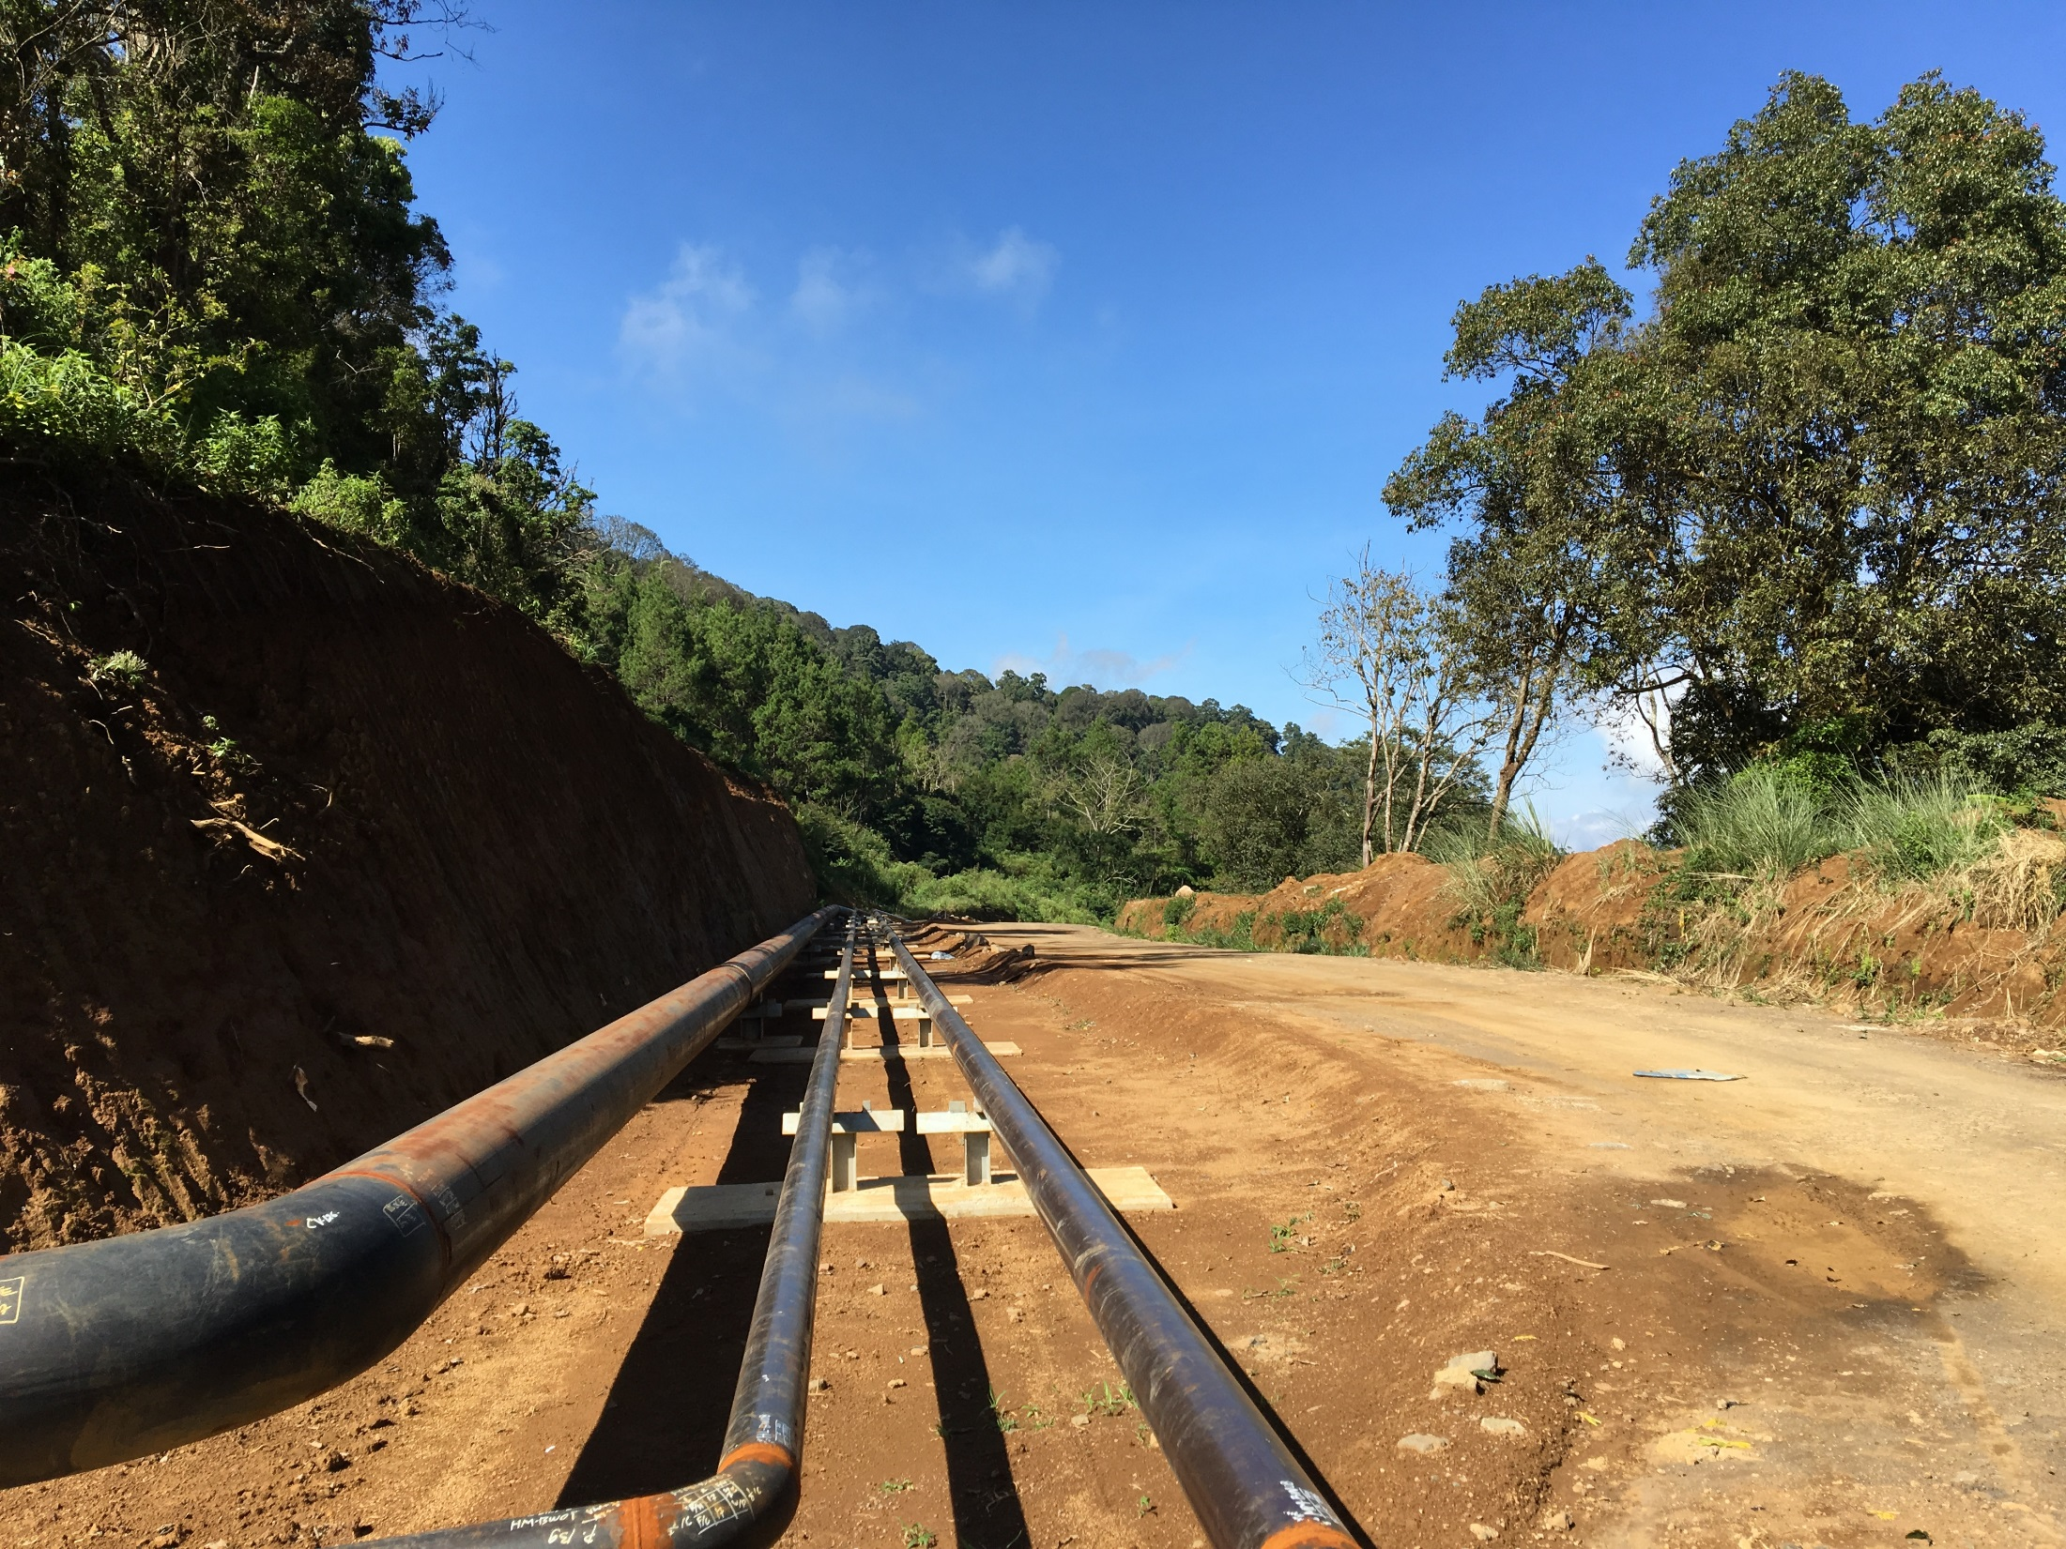
Karaha Geothermal
Steamfield

Slide 16
Karaha Geothermal Steamfield
30MW geothermal power plant
Central Java, Indonesia
Owner - PGE
MTL – detailed design of Steamfield, completed in 2016
Construction support in 2017/2018

Slide 17
Thank you

