Slide 2

MTL - 25 Years In The Making
Notes:
25 Years of projects we are proud of.

Slide 3
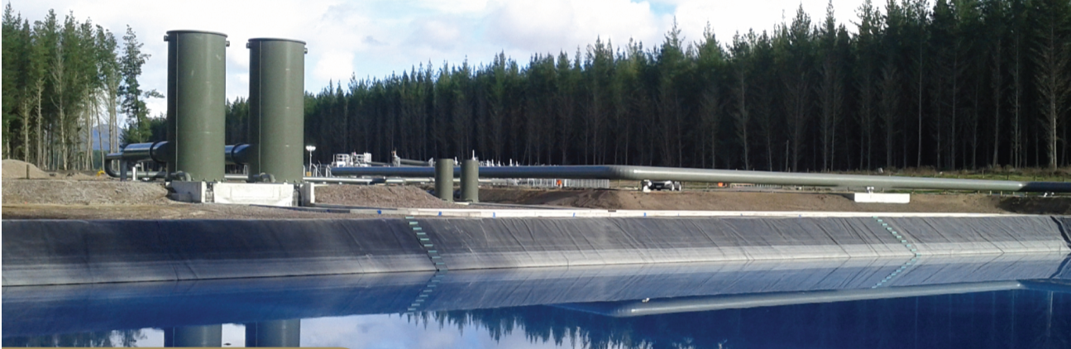
25 Years of Renewable Energy
25 Years of Clean Water
Notes:
25 years of Renewable energy
Throughout the 25 years MTL have been involved in Renewable energy with Hydro and Geothermal
These projects are still running
We appreciate the sustainability and longevity of renewable energy assists and provide a design that the owner is satisfied with for life of the project.
25 Years of safe water for communities
Much like renewable energy these projects must be sustainable and have longevity as the water treatment assets are critical infrastructure.
Detailed focused designs ensure the smooth operation and maintenance of these to ensure they are operating with continual success.
25 years of ensuring our designs are safe for the environment they are designed.
This is what we are proud to be involved with.

Slide 4
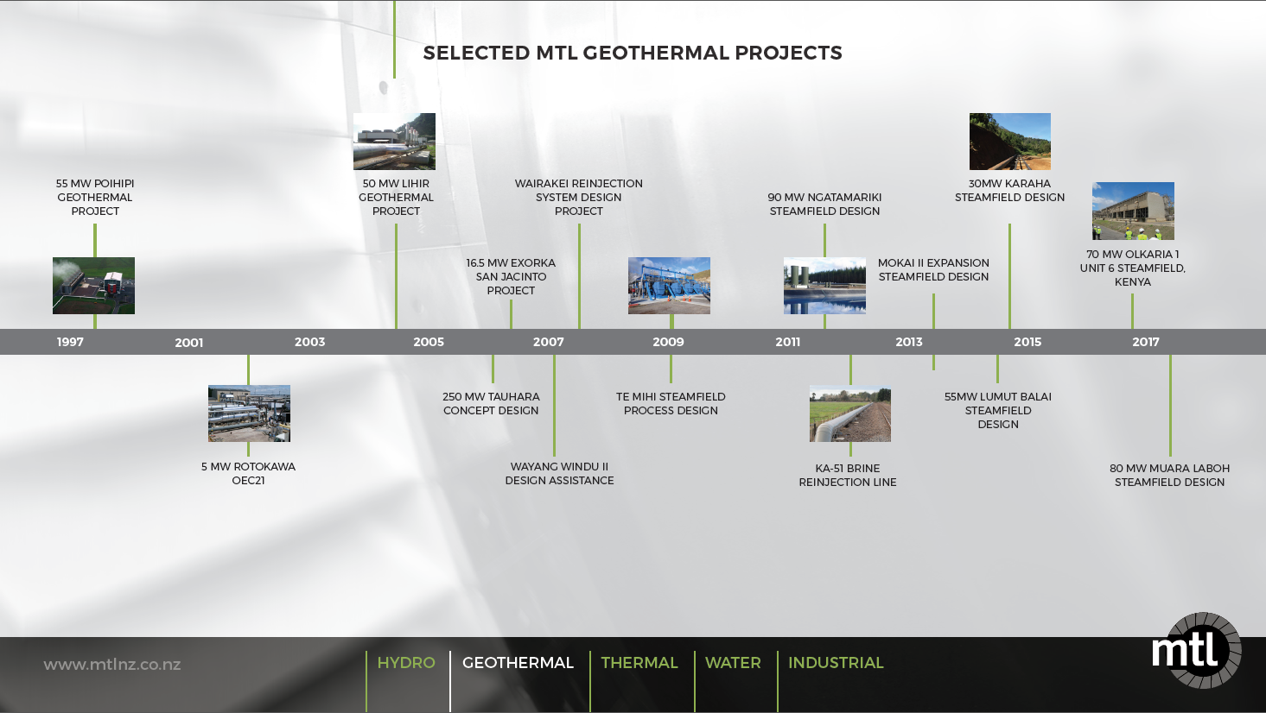
Geothermal Timeline
Notes:
Here is a snapshot of our geothermal projects
All Started in Poihipi
Continued into a number of geothermal jobs in NZ and in later years we have worked overseas. In particular Indonesia and Kenya

Slide 5
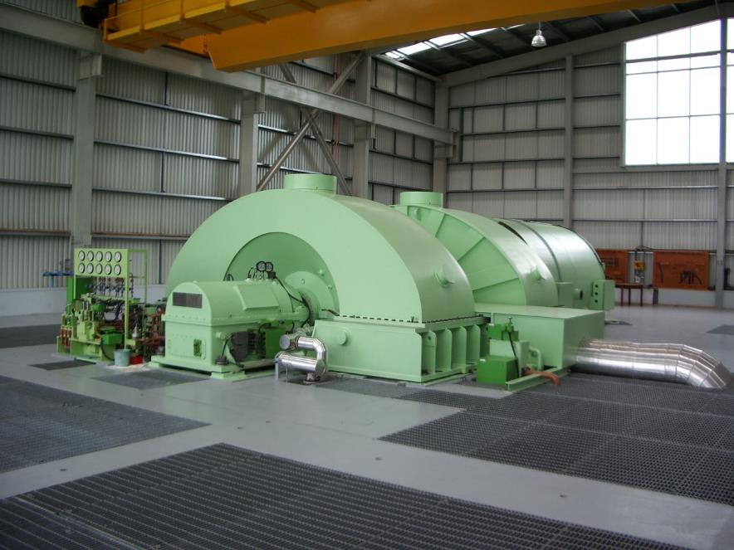
Poihipi
MTL’s First Large Geothermal Project
Worked alongside McMahons
55 MW
3 year project
Concept design to commissioning
The start of MTL Geothermal
Notes:
Poihipi is where MTL started in he Geothermal Industry
Chris man

Slide 6
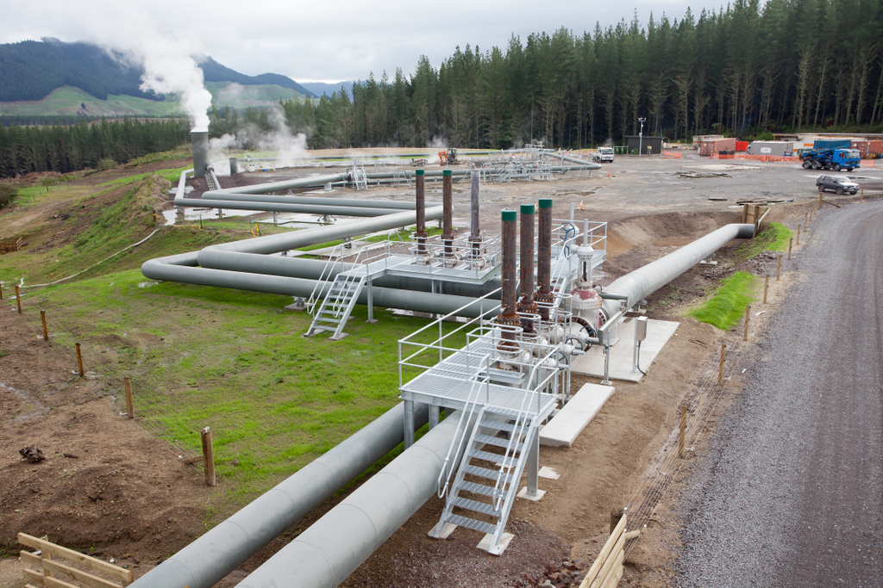
Ngatamariki Steamfield Design

Slide 7
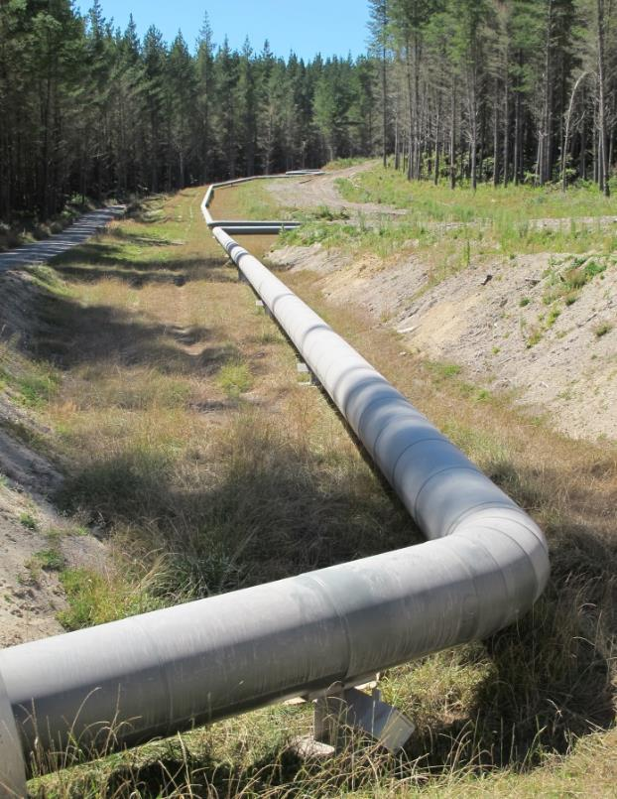
Ngatamariki Steamfield Design
82MW Power Station which won the Winner World GeoPower Market Award – “Best Power Project” 2013
MTL designed over 7.5 km of Steamfield pipework
High quality design with a lack of physical re-work as a result.
Notes:
Part of the design build team to deliver the Ngatamariki Steam filed
Two phase and brine lines
Challenging project as all discharges must be captured – environmental

Slide 8
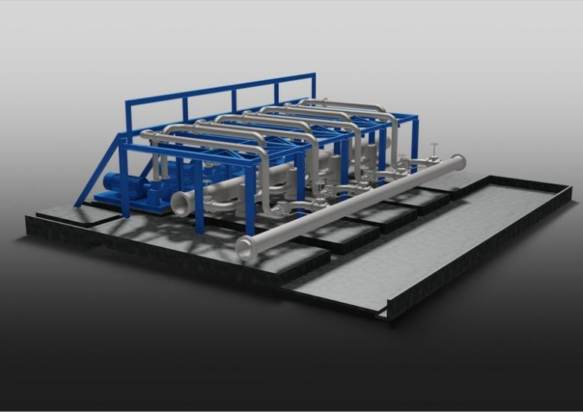
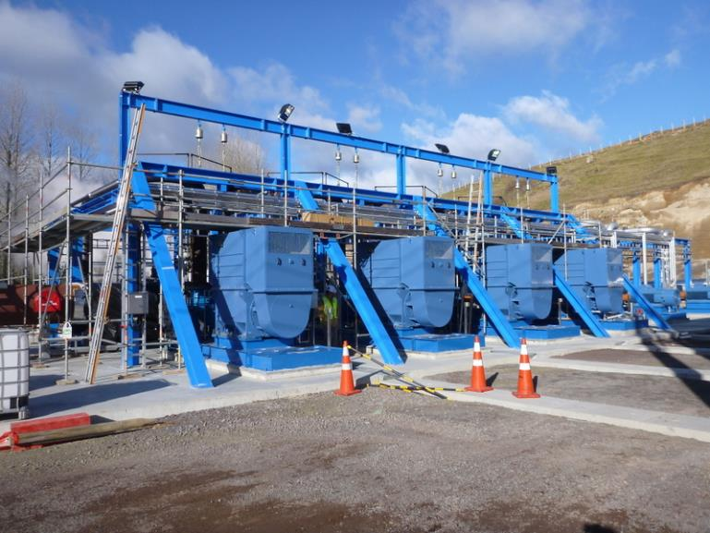
Te Mihi Power Project - Karapiti Pump Station
Steamfield Process Design
Karapiti Reinjection pump station detailed design
Notes:
Karpiti pump station
Energy efficient pumps with VSD
Design takes into account the maintenance requirements

Slide 9
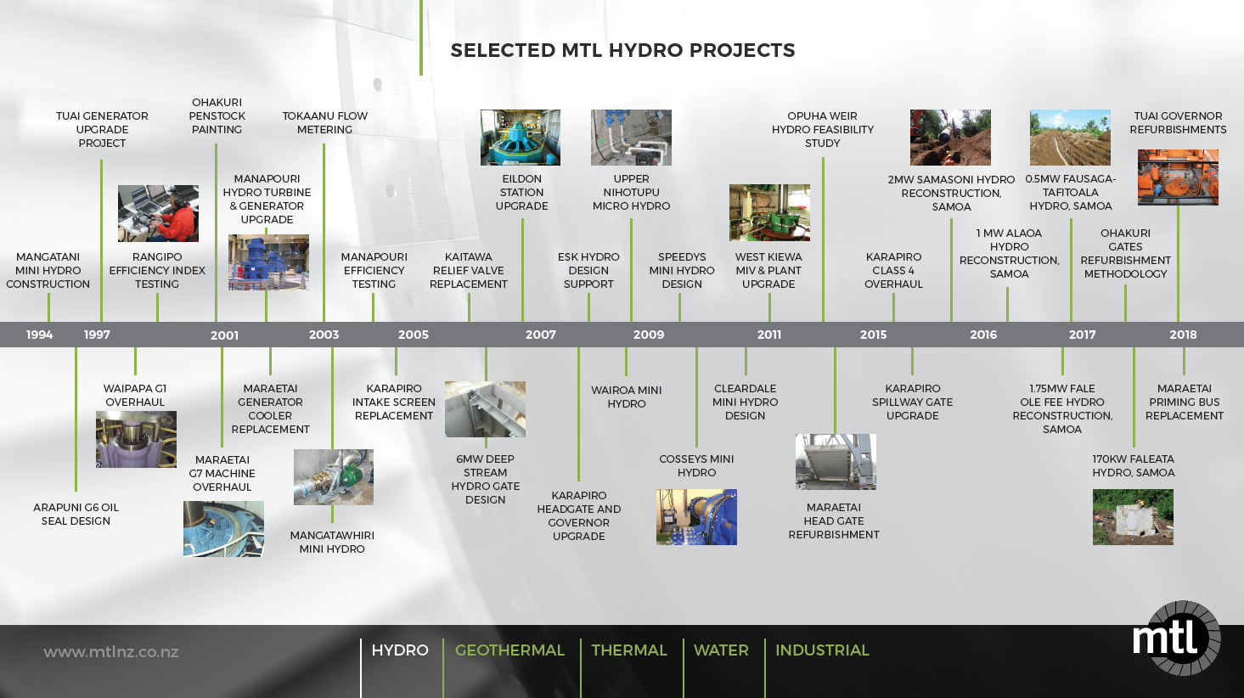
Notes:
There has been a resurgence in hydro in recent years with the drive to minimise carbon discharges for power generation.
We are currently working in Nelson with the Waimea dam projects and there are new run of rivers being develop .

Slide 10
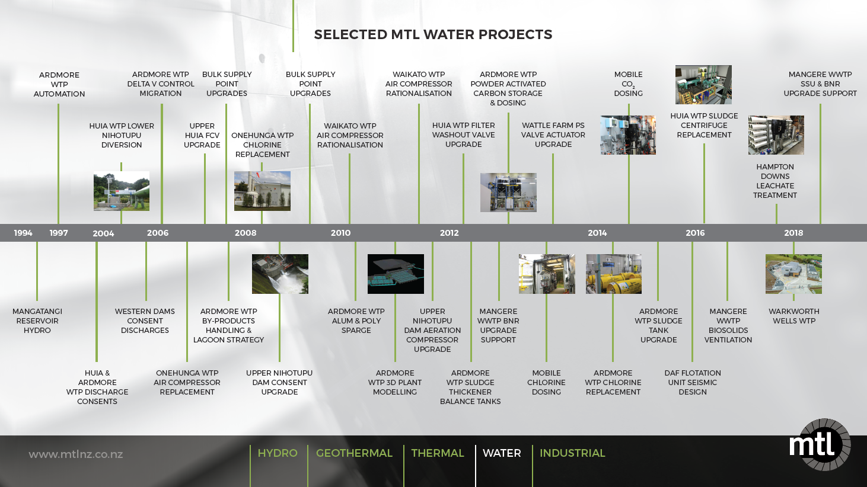
Notes:
Many of these jobs are retrofits at watercare assets
Watercare appreciate the attention to detail that MTL does with their design.
Understand the constraints and the construction process to install in limited space retrofits.

Slide 11
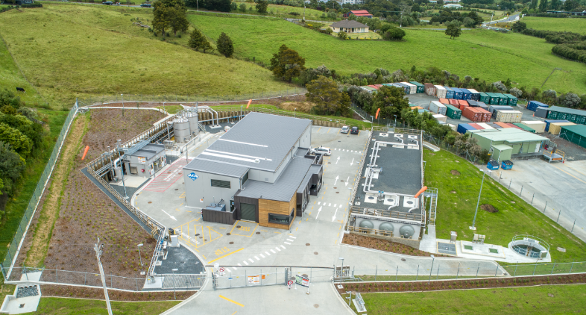
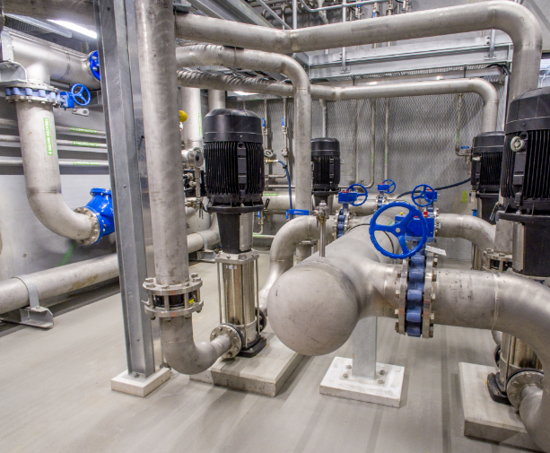
Warkworth Wells
Watercare’s Gold Standard Water Treatment Plant
  Chlorine Dosing
  30 Minute Chlorine Contact time
  Sand Filtration
  UV Dosing
3MLD – Designed for expansion to 8.4 MLD
Complete design by MTL
  Tight time frame and urgent delivery
Notes:
MTL and Neo did the entire design
MTL – process design, Civil, structural, mechanical
Neo support for electrical.
Short time frame

Slide 12
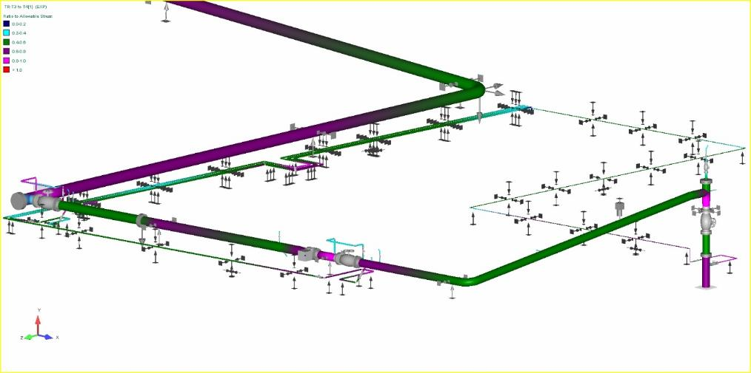
MTL Services
Preliminary Design
Process Design
Detailed Design
Project Management
HSNO & Pressure Equipment Compliance
Construction Monitoring
Commissioning
Notes:
MTL can provide a range of services throughout a design and construction of a project

Slide 13
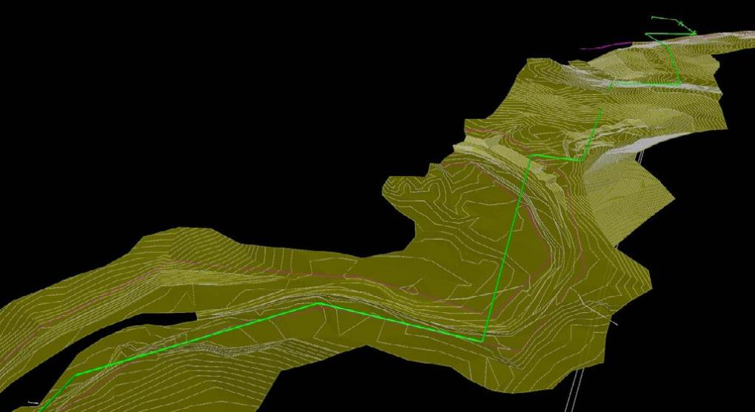
MTL Design Process
MTL produces high quality, accurate engineering documents:
  Drawings
  Engineering Lists
  Specifications
  Datasheets
Notes:
MTL are a detailed focused company and produce high quality Engineering documents for our clients.

Slide 14
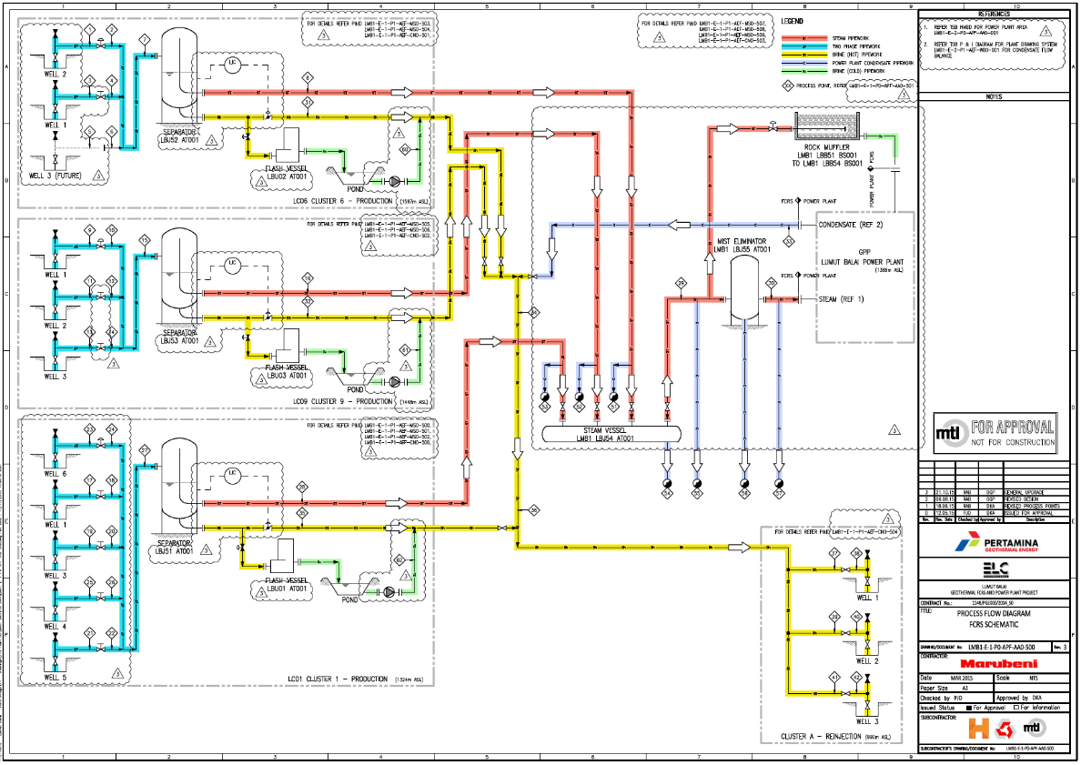
Process Flow Diagram
Notes:
PFD is an excellent visual Aid to explain the entire process
Used early in our projects to visual the process and connect into the heat and mass balance

Slide 15
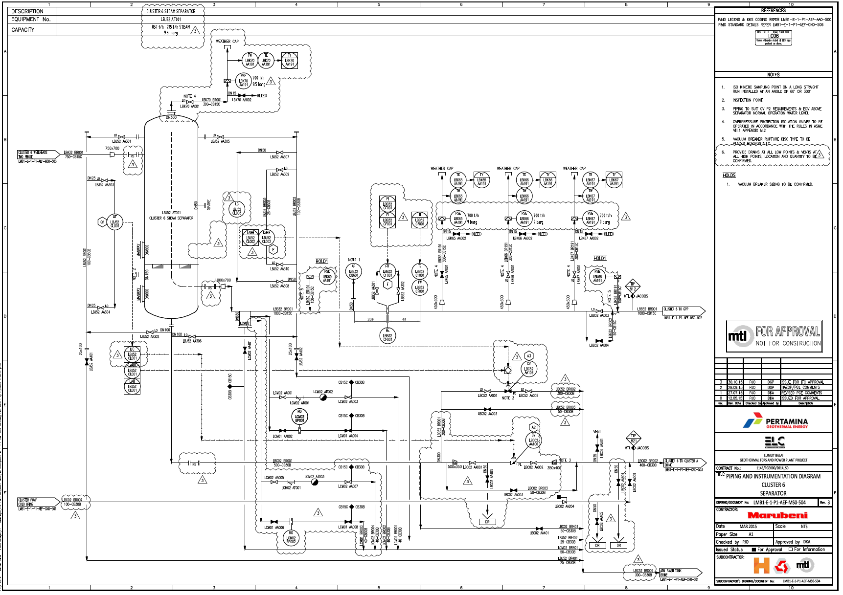
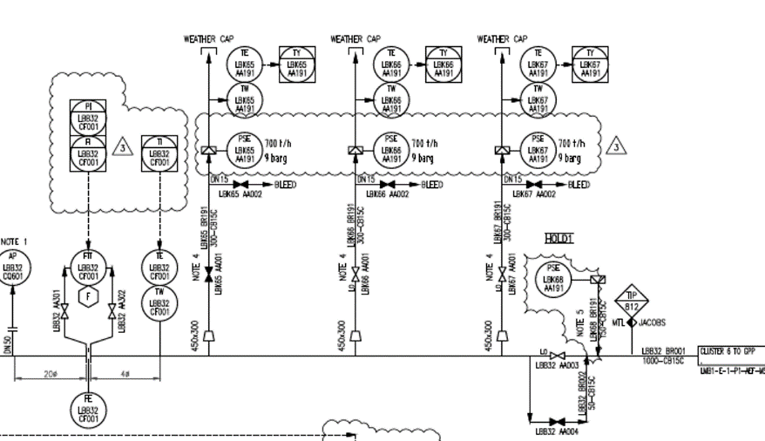
Piping and Instrument Drawing
Notes:
P&IDs
MTL put significant effort and attention to detail into the P&IDS as the divisions made on these are carried through the entire project and into the life cycle of the assets.

Slide 16
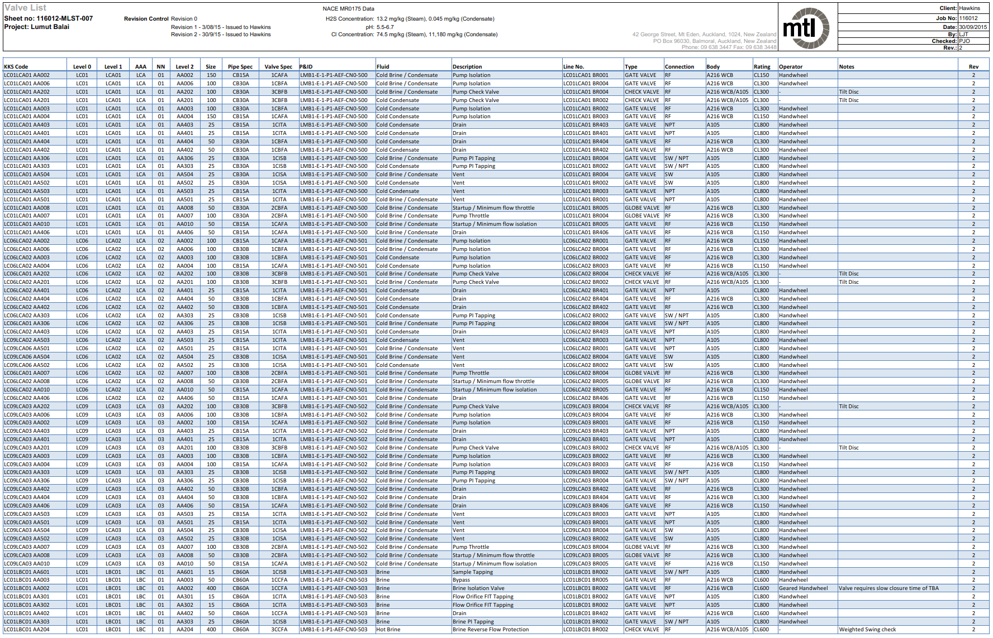
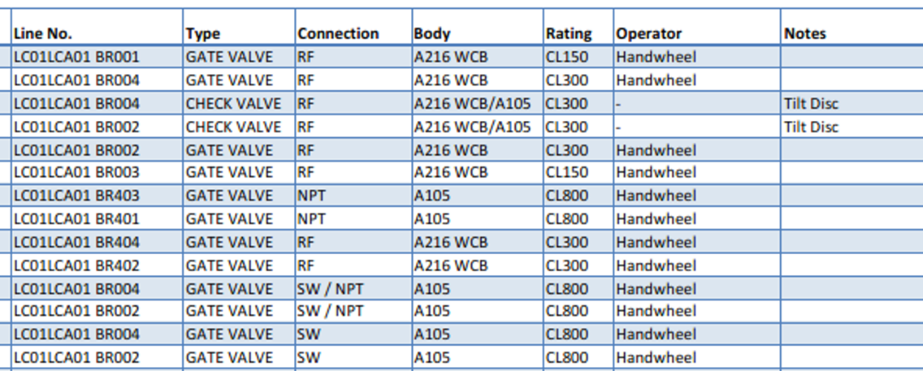
Engineering Lists
Notes:
Engineering Lists
MTL develop the engineering lists along side the P&IDs and are completed as equipment is selected and procured.
The detail in the lists is appreciated during commissioning and the starting point for asset management

Slide 17
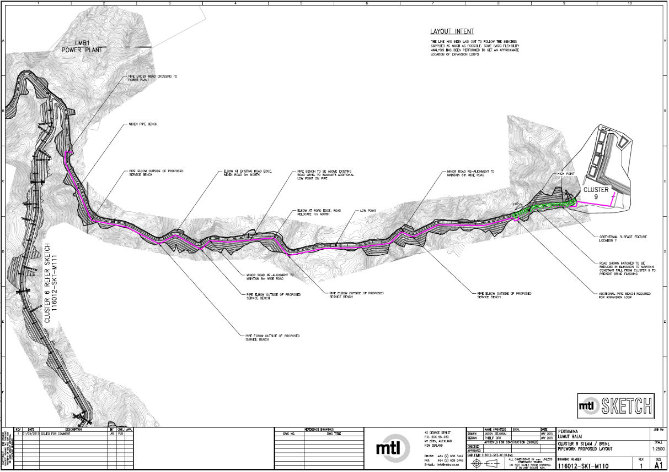
Preliminary Drawings and Layouts
Notes:
Preliminarily drawings are developed early as a tool to discuss design decisions with the client and other parties involved.

Slide 18
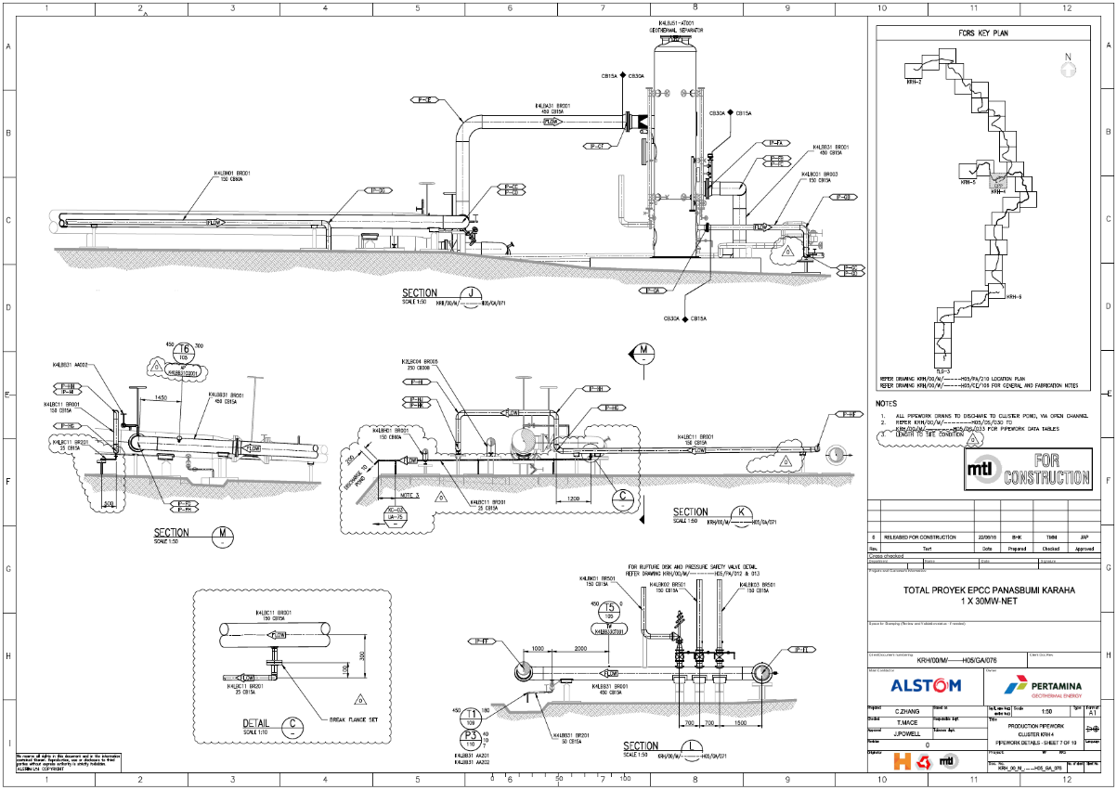
Detailed Drawings
Notes:
Detailed drawings are use for construction and installation.
Feedback from contractors is that they are well laid out and easy to follow and only have minimal questions back from the contractor.

Slide 19
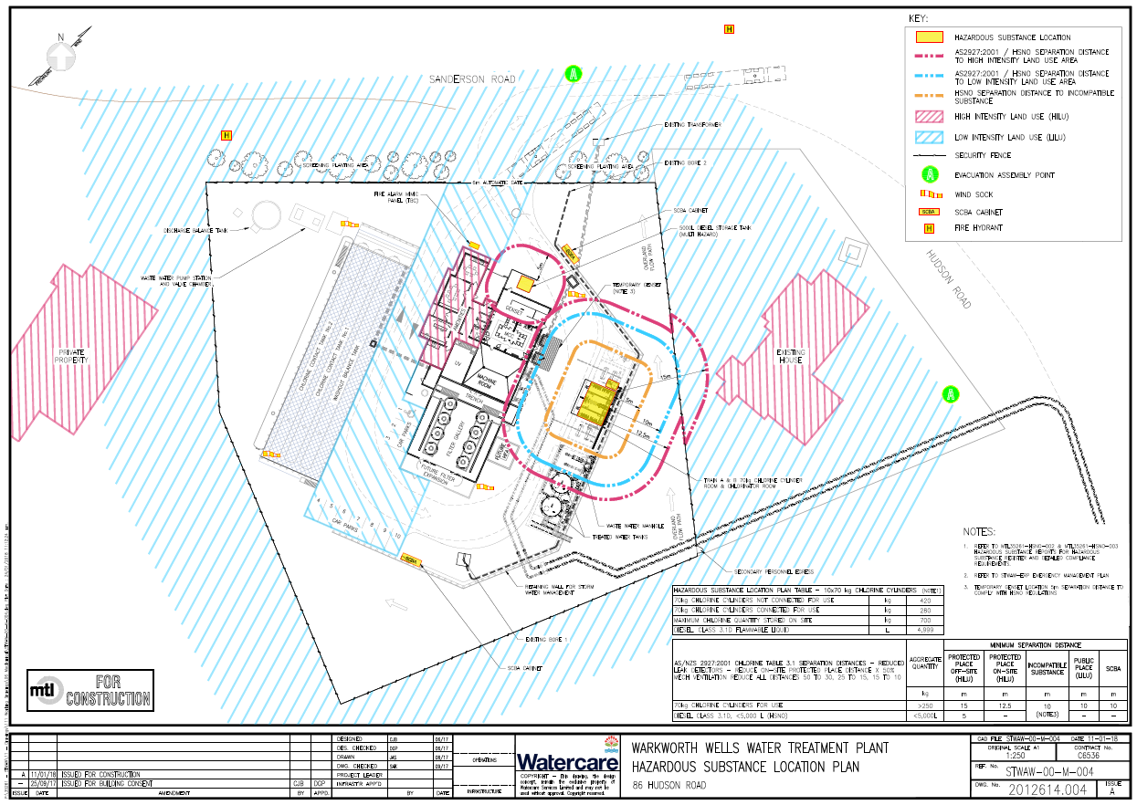
HSNO and Pressure Vessel Compliance
Supporting Clients with their legal obligations
  HSNO Compliance Support
  Pressure Equipment Compliance
    Hazard Level Assessment
    Inspection Requirements
    Seismic Restrains Verification
Notes:
Actively involved in all our projects with HSNO and pressure vessel compliance.
HSNO location test certifiers are impressed with the level of documentation provided for jobs we have assisted with and have said this is the standard the aim to see elsewhere.
We continuously support overseas pressure vessel suppliers and we commonly find that they are not aware of the seismic restraint requirements for new Zealand

Slide 20
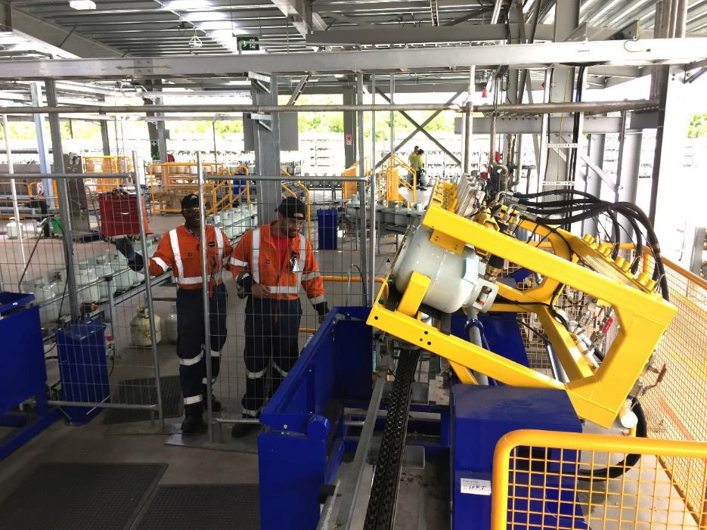
OnGas Bottle Swap Facility
1st Registered New Build Major Hazard Facility
Supported equipment suppliers to meet NZ pressure equipment regulations
Commissioning
  Safety Critical Elements
Notes:
Bottle swap was the 1st new build Major Hazard facility
We ensured the supplier of equipment from Denmark would meet their obligations with pressure equipment in NZ. Seismic verification was new to them and we guided them through their requirements.
This work led into commissioning the LPG plant and ensure all the safety critical elements for the Major Hazard faculty were all tested and document for the safety case submission.

Slide 21
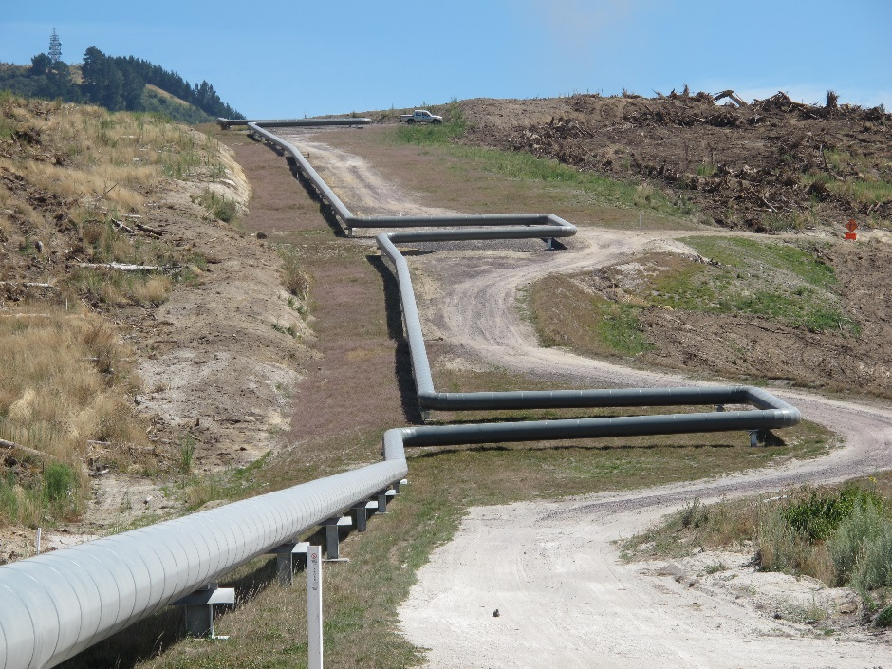
Geothermal Services
Preliminary Design
Detailed Design
Owners Engineer
Project Risk Services
  HAZOP
  Safety in Design
Project Management
Construction Management
Commissioning
Notes:
As this is a geothermal conference I should also highlight our geothermal services. As you can see we are involved throughout the design and construction of geothermal projects.

Slide 22
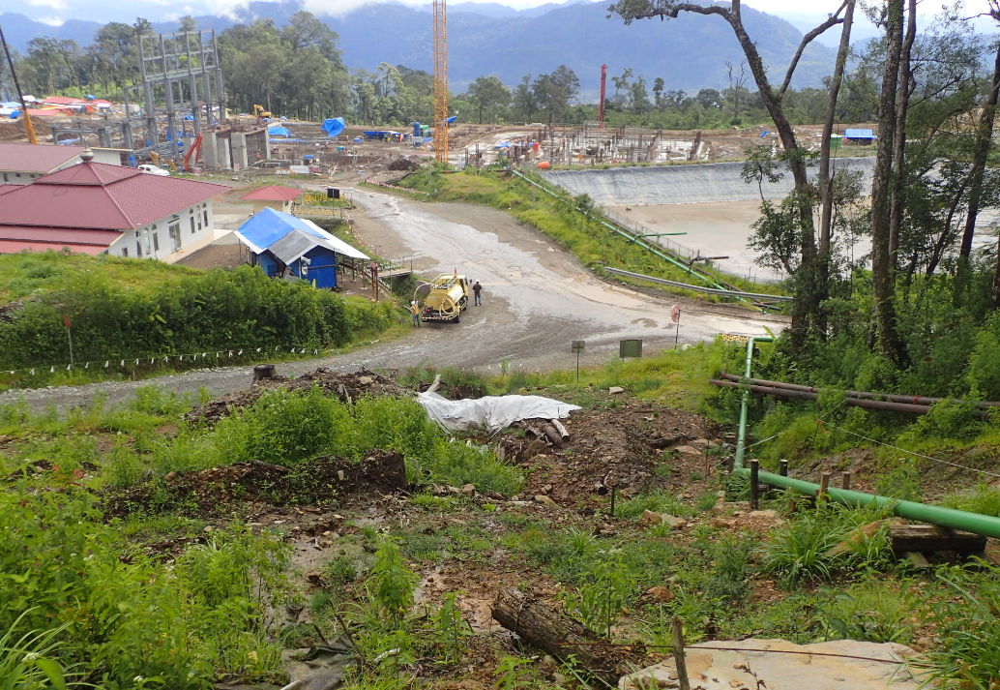
Muara Laboh 2018 – Present
Sumatra Indonesia
MTL engaged by the designer to complete a preliminary design
  Site Visit
  Preliminary Geotechnical
  Concept Pipe Route
    Preliminary Drawings
    3D Model
    Preliminary Stress Analysis
Notes:
MTL have been working with Rekayasa on Muara Laboh
Selamat Siang to anyone from Supreme here today.
MTL were engaged by the designer to assist with the preliminary design of a new line on a project under construction .

Slide 23
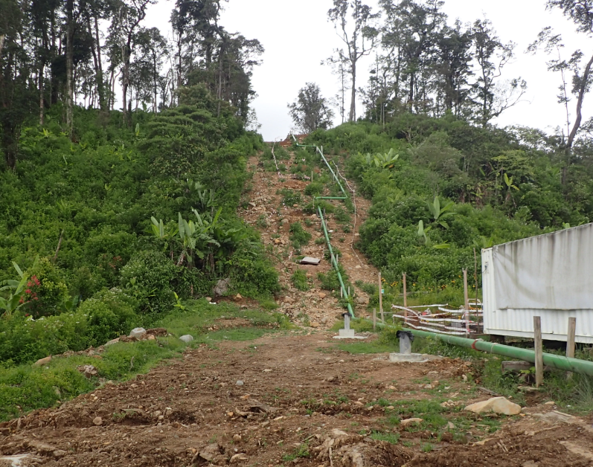
Muara Laboh Site Visit
Walked the line with the designer
  Mechanical Engineer
  Mechanical Designer
  Geotechnical Engineer
Identified critical areas of concern
Notes:
The site visit was used to understand the areas of concern for the design and the constructability of the new line within the constraints of existing plant.

Slide 24
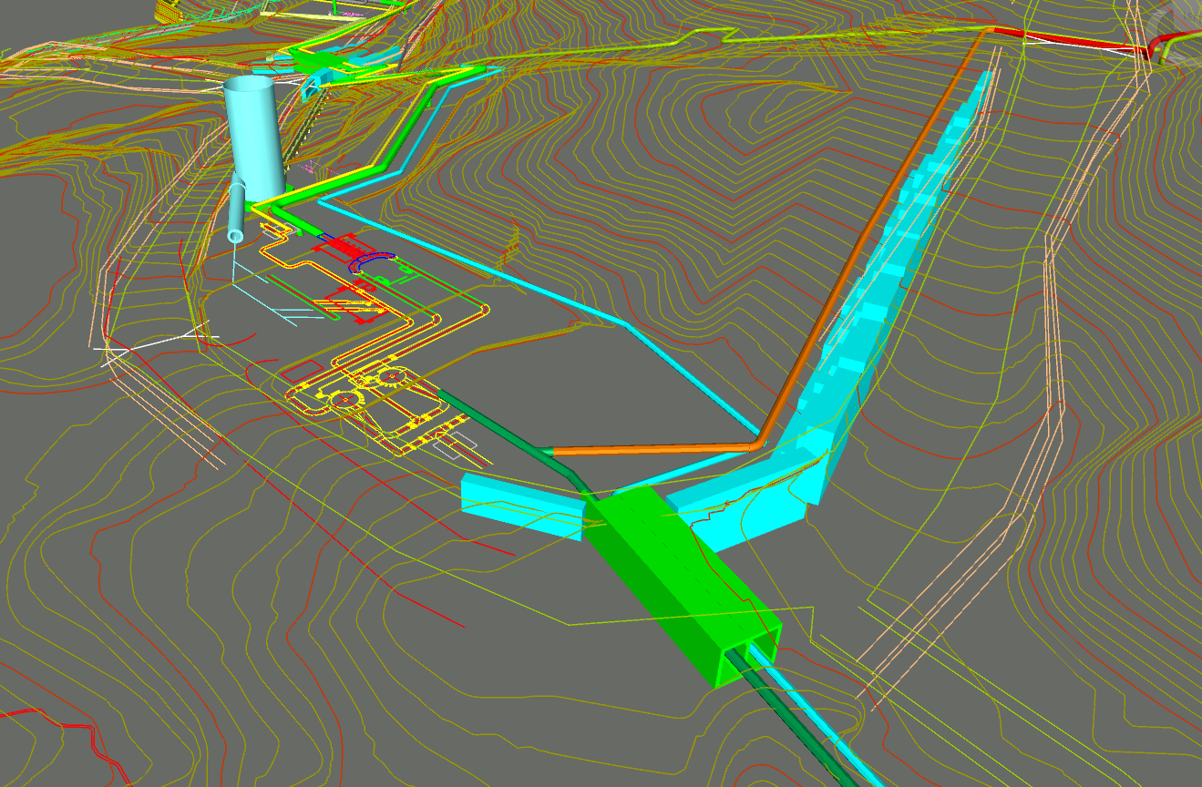
Preliminary Design
Survey
Geotechnical Recommendation
Pipe Route
  3D Model integration
  2D Pipe Route drawings
  Preliminary Stress Analysis
MTO
Notes:
Following this preliminary design was quickly developed
A aerial survey was done and a pipe route was proposed taking into account the geotechnical observations on site and areas to avoid.

Slide 25
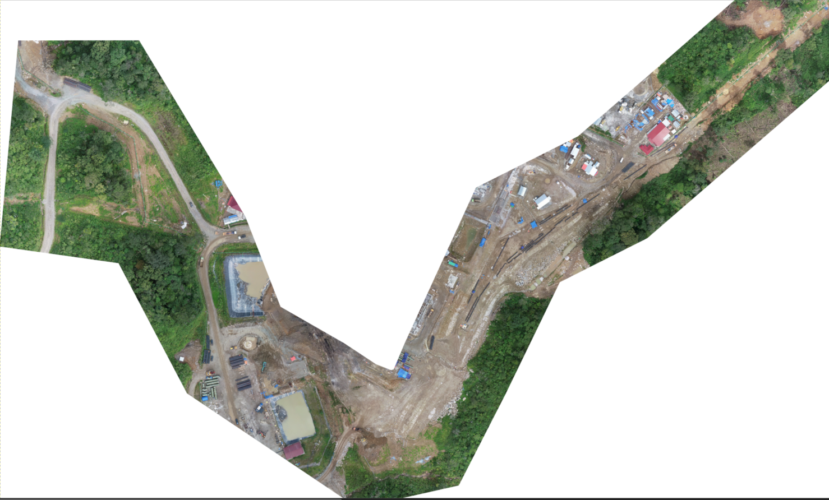
Drone Survey
Notes:
Here you can see the drone survey with high definition images to see any installed infrastructure to avoid.

Slide 26
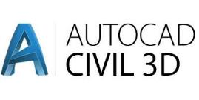
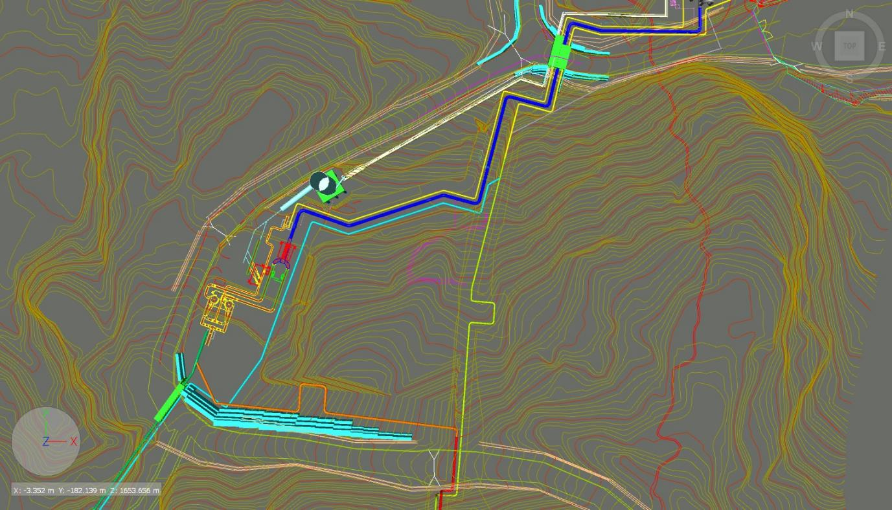

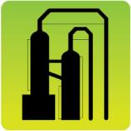


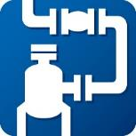

3D CAD Modelling
Notes:
This information was used in 3D CAD model.
MTL have a number of software packages that are used for designs. Here are just a number which are used for the engineering and design.

Slide 27
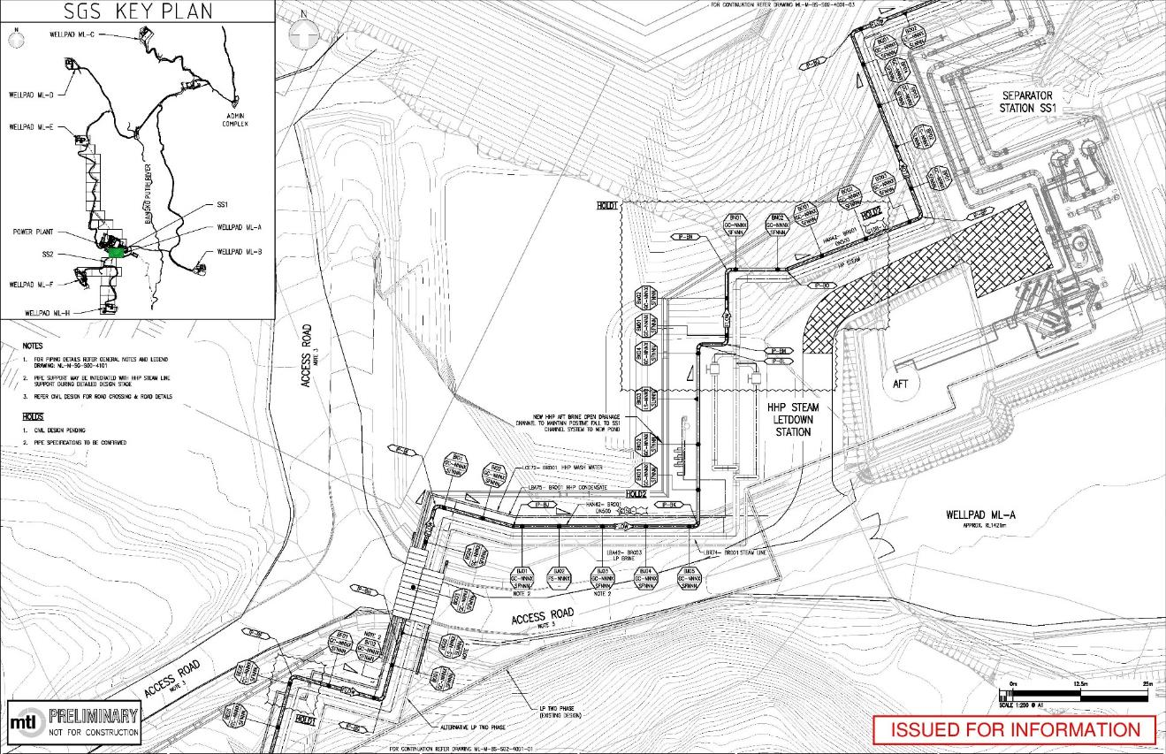
Preliminary Pipe Route
Notes:
From the 3D model 2D preliminary drawings are developed for the client.

Slide 28
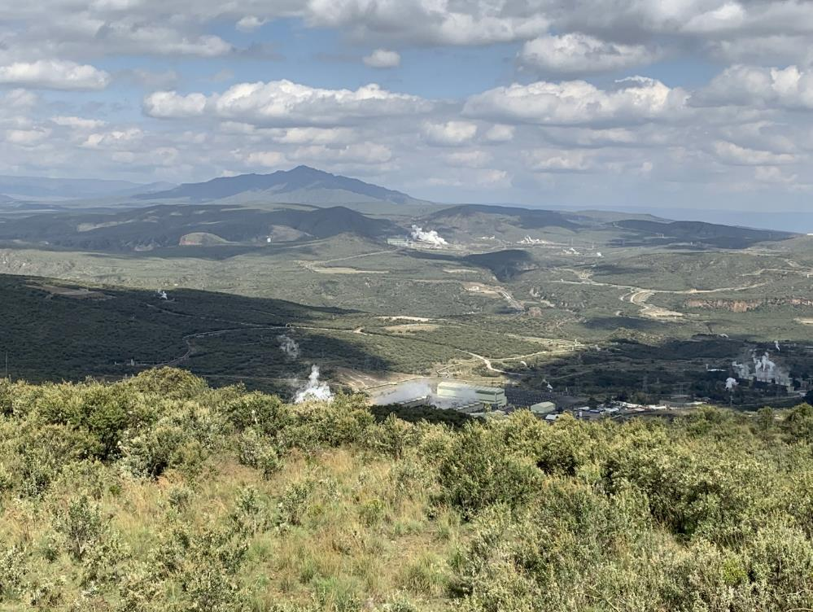
Olkaria 1 Unit 6, Kenya, 2017 – Present
MTL engaged to be the owners engineer of the Steamfield
  Preliminary Steamfield Design
  Work alongside Power Plant Owners Engineer Fichtner, Stuttgart
  Project Scope and Specification
  Tendering
Notes:
MTL are the owners engineer for Olkaria 1 Unit 6 in Kenya.
We are working along side the power plant owners engineer Fitchner and were responsible for all tendering documents for the steamfield.

Slide 29
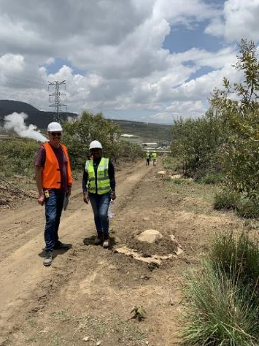
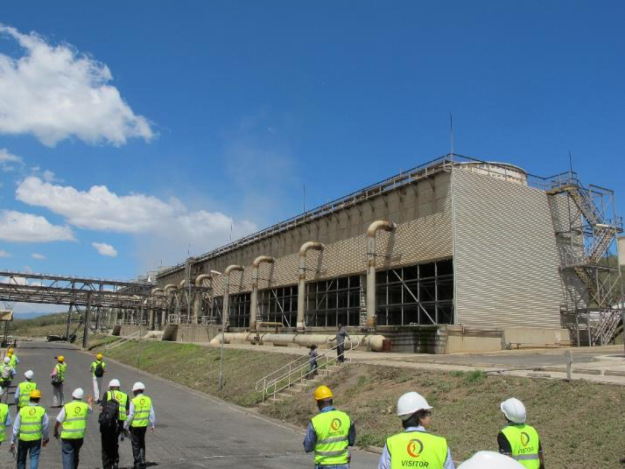
Olkaria Design Review
Process Design review
  Heat and mass balance
  Pressure loss models
Mechanical / Electrical Design Review
  Detail pipe drawings
  Pipe Stress reports
  Working with McMahon’s
Civil / Structural Design Review
Notes:
This project has moved onto the design review.
We are working along side Mc Mahon’s electrical to complete the Mechanical Electrical, civil structural design review of the steam flied.

Slide 30














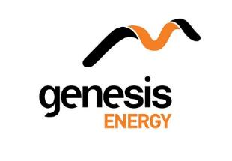












Notes:
Here is a snapshot of the other companies we have been involved with over the last 25 years.

Slide 31
Notes:
25 years ago the 1st projects MTL were involved with were done on drawing boards and calculation pad.
Now we with 3D imaging and Modelling and computer software. We don’t know how this will change going forward. However we know that we will continue to ensure the projects we are involved with a sustainable and be proud of.

