Slide 1
Ormat company update
Simon Addison
Resource manager – Indonesia
NZ Geothermal Workshop 2019

Slide 2
Safe Harbor Statement
This presentation includes Forward-Looking Statements and the disclaimer should be read carefully
Forward-Looking Statements
This presentation, and information provided during any discussion accompanying this presentation, may contain “forward-looking statements” within the meaning of the Private Securities Litigation Reform Act of 1995. These statements involve estimates, expectations, projections, goals, objectives, assumptions and risks, and activities, events and developments that may or will occur in the future. When used in or during the course of this presentation, the words “may”, “will”, “could”, “should”, “expects”, “plans”, “anticipates”, “believes”, “estimates”, “predicts”, “projects”, “thinks”, “forecasts”, “guidance”, “continue”, “goal”, “outlook”, “potential,” “prospect” or “target”, or the negative of these terms or other comparable terminology are intended to identify forward-looking statements, although not all forward-looking statements contain such words or expressions. Such forward-looking statements include, but are not limited to:
statements about Ormat Technologies, Inc.’s and its affiliates’ (“Ormat”) business strategy;
statements about Ormat’s competitive strengths;
statements about Ormat’s development and operation of electricity generation, storage and energy management assets, including distributed energy resources;
statements about Ormat’s other plans, expectations, objectives and targets;
statements about Ormat’s views on market and industry developments and economic conditions, and the growth of the markets in which Ormat conducts its business; and
statements about the growth and diversification of Ormat’s customer base and Ormat’s future revenues, expenses, earnings, capital expenditures, regional market penetration, electricity generation, and other operational performance metrics, including statements about “target” or “targeted”
amounts for 2020 growth (MW) or 2022 operational performance metrics such as growth (MW), revenue by segment, segment breakdown and domestic/international geographic breakdown, among others. All of these and other forward-looking statements made in or during the course of this presentation are made only as of the date hereof and Ormat undertakes no obligation to update or revise any forward-looking statements, whether as a result of new information, future developments or otherwise, except as required by law. Forward-looking statements about “target” or “targeted” amounts represent current goals of Ormat’s management and are neither estimates of Ormat’s actual results nor financial projections or forecasts that have been prepared in accordance with Securities and Exchange Commission (“SEC”) rules or guidelines adopted by the American Institute of Certified Public Accountants. These forward-looking statements are not intended to be a guarantee of future results, but instead constitute Ormat’s current expectations based on assumptions that Ormat currently believes are reasonable. You are cautioned not to place undue reliance on the expectations, projections and other forward-looking statements made in or during the course of this presentation as actual future results and developments may differ materially from such expectations, projections and forward-looking statements due to a number of risks, uncertainties and other factors, many of which are beyond Ormat’s control.
These risks, uncertainties and other factors include, but are not limited to, the risks, uncertainties and other factors described in Ormat Technologies, Inc.'s Form 10-K filed with the SEC on March 01, 2019 and from time to time, in Ormat’s quarterly reports on Form 10-Q that are filed with the SEC.

Slide 3
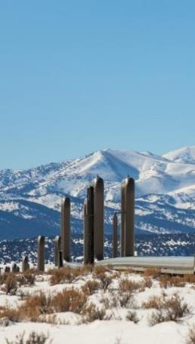
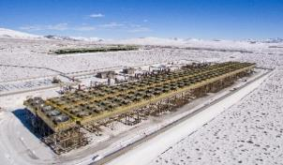
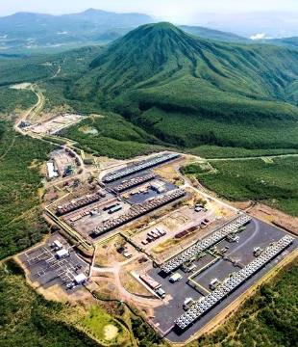
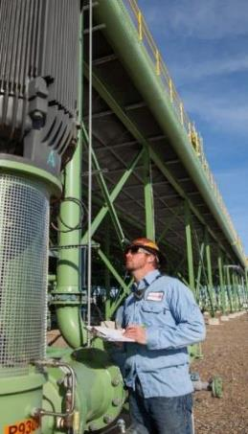
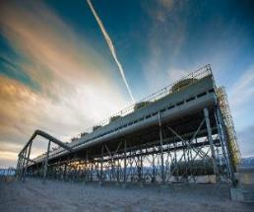
Introduction to Ormat
Market leader with proven track record in the geothermal energy sector
Our mission is to become a leading global renewable energy provider
US$3.9B Market Cap*
~1,400 Employees
Own & Operate
917 MW
54 Years of Experience
*November 18, 2019
Notes:
40 Years experience in Geothermal
Traded on NYSE, listed
600 employees USA, 600 employees Israel, 200 otherwise
Own and operate 917 MW – mostly geothermal, lesser recovered, and some solar

Slide 4
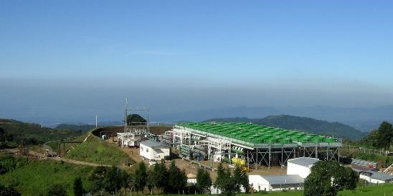
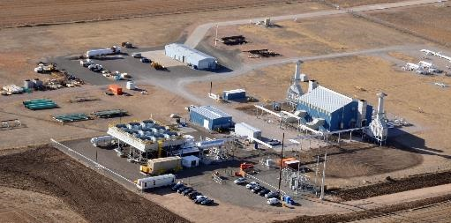



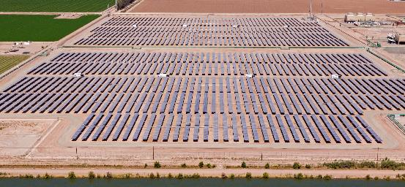
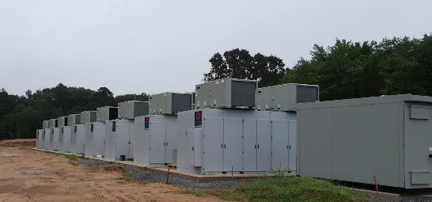
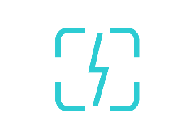

OVER 50 YEARS OF ORMAT: successful track record, worldwide
Geothermal Power Plants
2,700 MW, 140 power plants
Recovered Energy Generation
180 MW, 40 power plants
Amatitlan geothermal power plant, Guatemala
OREG IV (Peetz) REG power plant, Colorado, USA
Energy Storage
84 MW*, 6 projects
Solar PV
Plumsted Battery Energy Storage Facility, New Jersey, USA
Heber Solar Power Plant, California, USA
* Including 41 MW that we own and operate, 22 MW under construction/development and 21 MW of 3rd party assets that we operate
Notes:
Geothermal is our main work
Solar PV – slide at the end, will discuss then
Energy storage – in the last 3 years have entered, trying to be a developer and operator

Slide 5
GEOTHERMAL MARKET
Geothermal History – Ormat History
Source: Ormat analysis, IGA “World Geothermal Installed YE2018”
Notes:
Want to emphasise market share
Entire geothermal market on left, installed capacity, mostly steam – historically the dominant technology
Binary market 83% market share, ormat is very dominant – very successful

Slide 6
Worldwide Geothermal installed capacity 2009-2019
5053 MW
Total
Notes:
Last 10 years - approximately 50% steam turbines, 50% binary
Main markets in the World – Indonesia, Kenya, Turkey, USA and New Zealand
Ormat very dominant in Turkey and the US (own power plants)
Will show NZ in a different slide

Slide 7
Worldwide Geothermal installed capacity 2015-2019
2,640 MW TOTAL
Notes:
Last 5 Years, the share of steam turbines has reduced, binary has increased
Reason for it we will discuss in the next slide – dominant market – Turkey, USA, Indonesia – not much in NZ!
Note first ever geothermal plant in Honduras

Slide 8
High enthalpy geothermal power plants using binary technology
Notes:
Showing how the binary market is growing
Pure binary 27% has now increased to 42% - we are seeing growth in the amount of pure binary at the expense of steam turbines. The ratio of binary where you could choose technology has increased.

Slide 9







The Only Vertically Integrated Geothermal Player
Development
Exploration
Drilling
Engineering
Manufacturing
Construction
Operation
Notes:
We believe this has mainly happened because of Ormat – only vertically integrated in the World – we took it upon ourselves to develop and install binary technology.
Many companies talk about what potential they have – our track record shows we are proven, very active and doing many things.
Technology wise - used to be focused on low and medium enthalpy, now it is a real option for high enthalpy
Geothermal is a niche market so opportunity to do it.

Slide 10
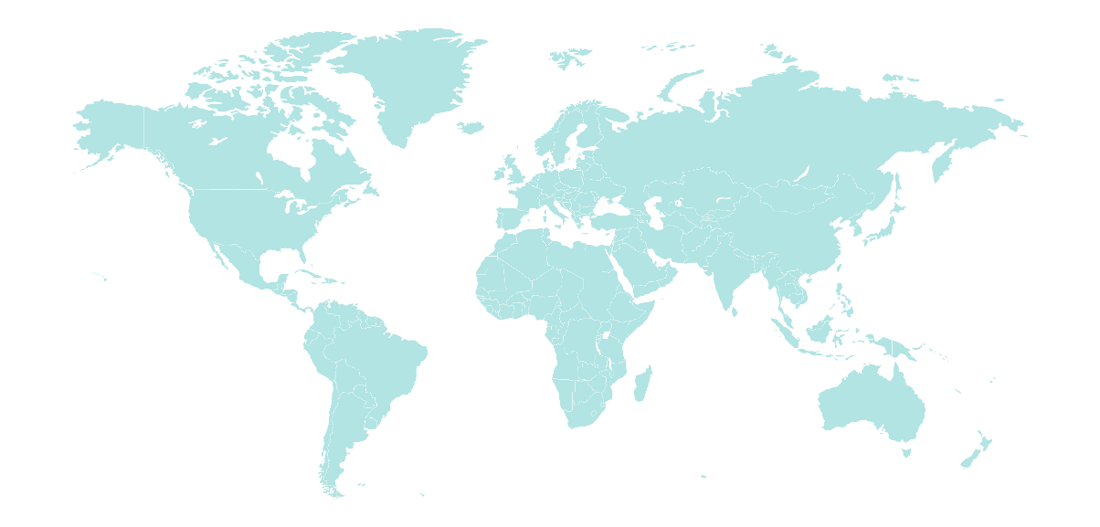

Electricity Segment Overview
Stable, well managed, cash generating assets
Global operation of 917 MW at 25 sites
94% geothermal and 6% REG
Weighted average PPA life: 18 years⁽¹⁾
67% of total revenues⁽⁵⁾
Annual revenue ($M)
Annual revenue ($M)
Global portfolio (917 MW)
CAGR: 7.5%
⁽²⁾
⁽⁴⁾
U.S.
629 MW
Guadeloupe
15 MW
Indonesia
42 MW
Guatemala
43 MW
⁽³⁾
Kenya
150 MW
Honduras
38 MW
Including re-contracting under the SCPPA Portfolio PPA.
2017 FY revenue is exclusive of $2.7M revenues related to our Viridity business from the provision of energy storage and demand response services.
Ormat owns a 12.75% minority interest at Sarulla, which is accounted for under the equity method.
Electricity segment revenues were impacted by the shutdown of Puna during 2018.
2014-2018 average.
Notes:
Worldwide activities across many geological settings – exciting.
Kenya started 8 MW, 1999 and now grown to 150 MW
Sales of electricity is with long-term PPA’s – income is over a long horizon, helps with financial
Chasing a lot of opportunities all around the World to create the project pipeline, for example I’m responsible for resource exploration and development in Indonesia – great to be able to take our worldwide expertise to develop these projects
I would maybe add mention of
First ever Honduras powerplant in 2017
Ormat’s first hybrid solar/geothermal at Tungsten Mountain 2019
McGinniss Hills expansions to miniminze reservoir risk (138 MW capacity)
2012 Phase 1
2015 Phase 2
2018 Phase 3

Slide 11
Product Segment Overview
Backlog of $201M as of August 7, 2019⁽¹⁾
Continued improvement in costs, technology and delivery lead-time
32% of total revenues⁽²⁾
Built approx. 180 power plants and installed over 2,900 MW of geothermal & REG over the years
Revenue from 3rd party sales ($M)
Backlog breakdown
$210M - 5 yr. Average
  The backlog is as of August 7, 2019 and includes revenues for the period between July 1, 2019 and August 7, 2019.
  2014-2018 average.
Notes:
Selling equipment successfully
What we do is match our customers needs - Turkey supplying equipment, NZ EPC contracts
Lots of experience with pumps, we are now open for business for pumps

Slide 12
Geothermal market and potential
Notes:
Mix of gross and net in here
Key theme is: a few large steam turbine developments, but Ormat has enabled a lot of development in NZ in staged manners – with fast build times.

Slide 13
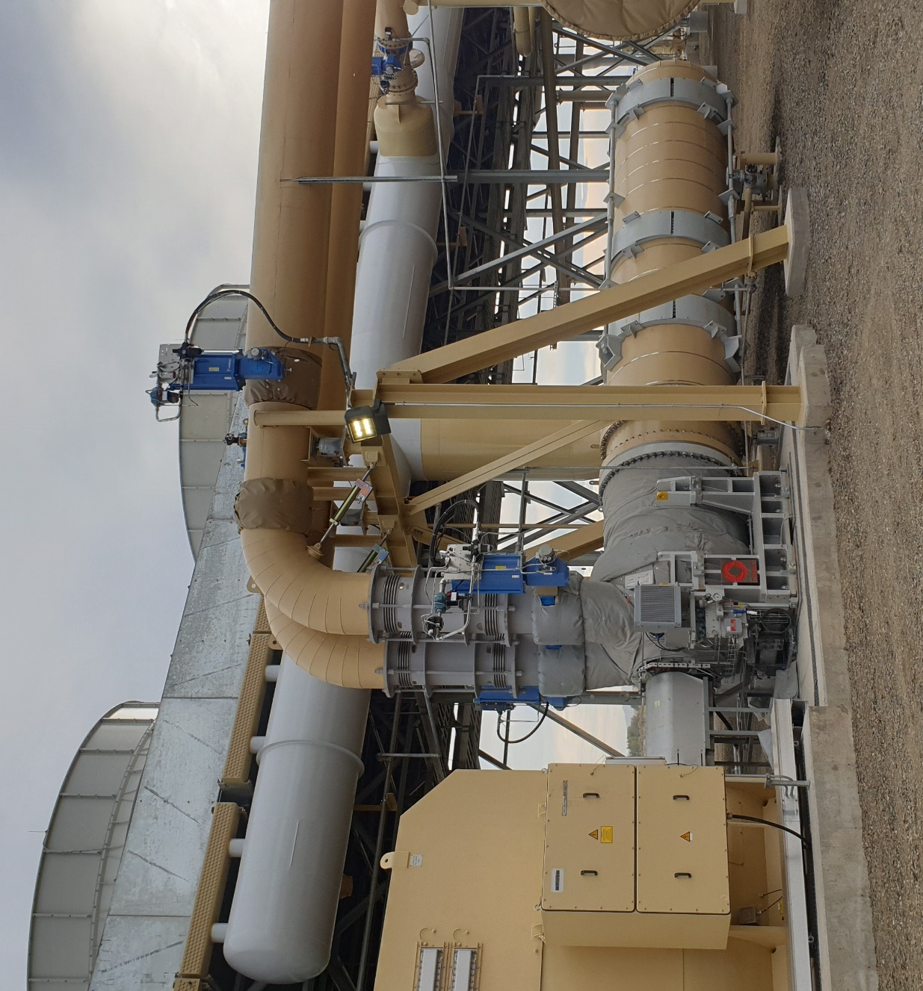
Technological advances
Turbines:
  Efficiency grew up by 2.5%.
  A “between bearing” turbine that allows more stages and higher capacity, up to 25 MW per turbine.
  New blades geometry
Heat Exchangers
  Design improvement resulted in increased efficiency of 1.25%
Air cooled condenser
  Design improvement resulted in increased efficiency of 1.25%
Notes:
Ormat has always been at the forefront of binary geothermal technology. In the last five years Ormat excelled in its OEC size and efficiency. The size of a single OEC grew from 25 MW to 50 MW while also being able to utilize efficiently any possible geothermal heat source. The main improvements were:
Turbine:
Turbine efficiency grew up by 2.5%. On top of our well-established overhang turbine, we developed a “between bearing” turbine that allows more stages and higher capacity, up to 25 MW per turbine. New blades geometry was implemented for better turbine efficiency
Heat exchangers design improvement resulted in increased efficiency of 1.25%
Air cooled condenser design improvement resulted in increased efficiency of 1.25%

Slide 14
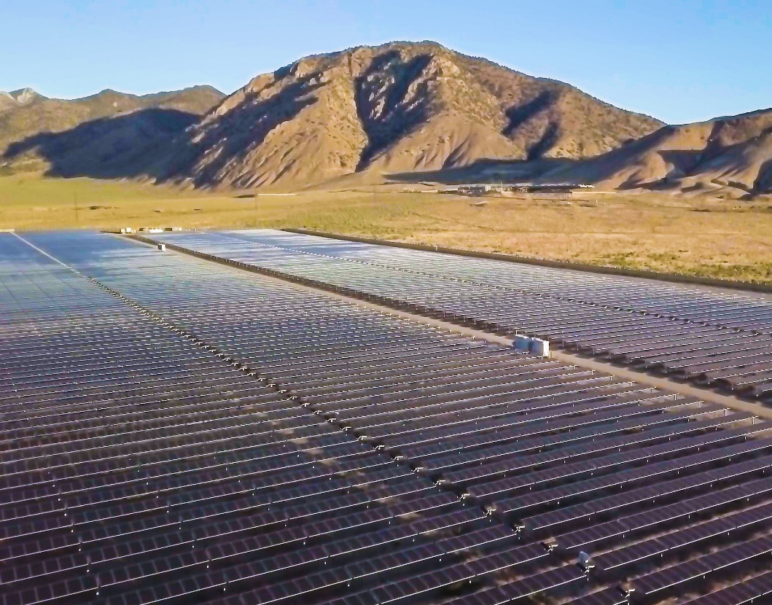
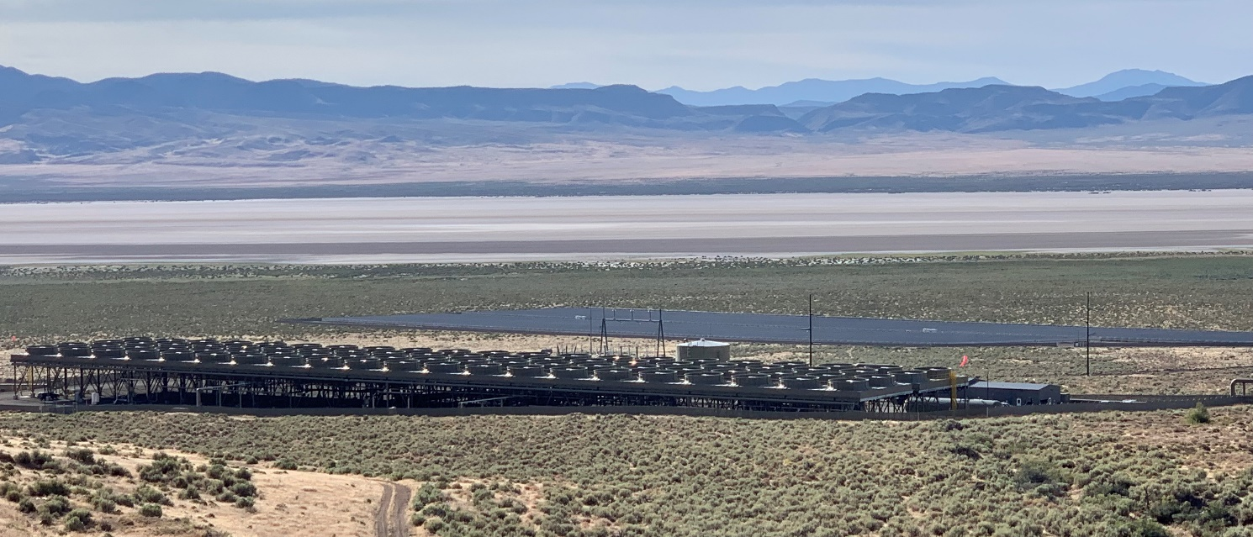
Hybrid solar-geothermal power plant
The electricity generated from the solar plant is used to offset the equipment’s auxiliary power
The Tungsten Solar power plant
  7MW AC
  Commercial operation in July 2019
  Ormat’s first-ever geothermal and solar hybrid project
Notes:
During the day produce less geothermal power whilst it is hot – helps supply high-value PPA geothermal supply by powering auxiliary.

Slide 15
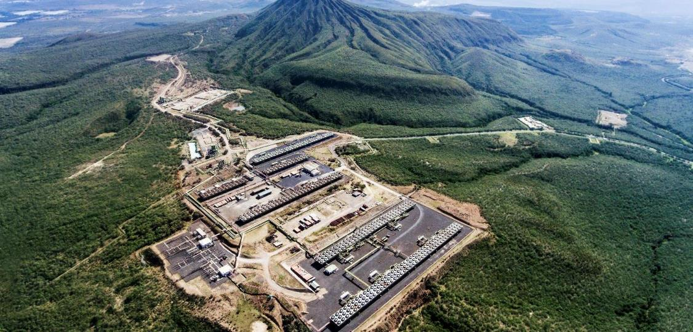
Thank you
Ormat’s Olkaria III Geothermal Power Plant Complex
Provides 150 MW of Base-load Electricity in Kenya

