Slide 1
Update on the Philippine Geothermal Industry
NZGW
Wairakei Resort Taupo
November 2018
Hernando Banal II
Trade Commissioner – Philippines
New Zealand Trade & Enterprise

Slide 2
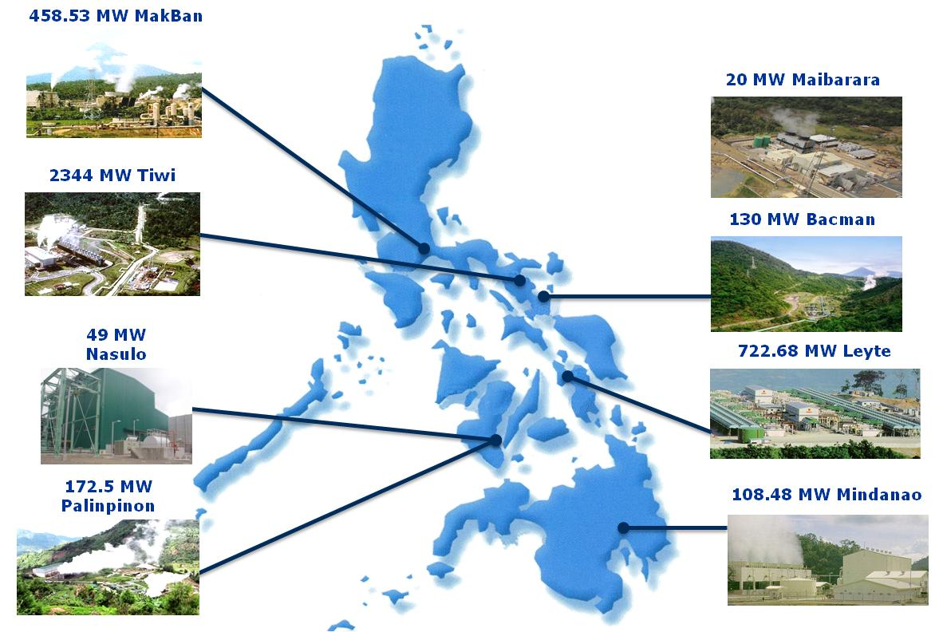
Geothermal Power Plants
32
140
140
1,918 MW
Total Installed Capacity
(as of April 2018)

Slide 3
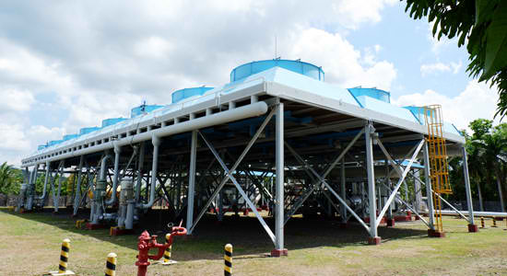
2017 Geothermal Sector Highlights
The rehabilitated 6 MW Makban - Binary Power Plant.
Inauguration on 27 April 2017

Slide 4
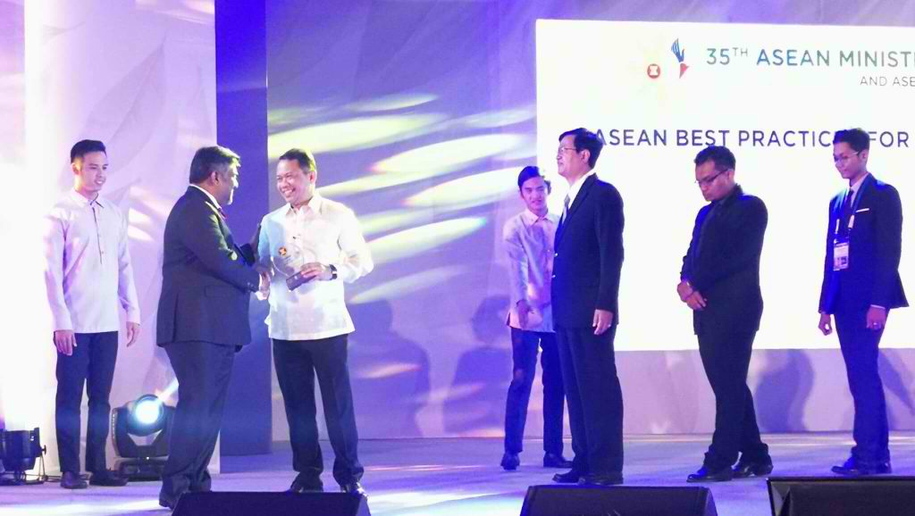
2017 Geothermal Sector Highlights
On 27 September 2017, the 20 MW geothermal plant of Maibarara Geothermal, Inc. was recognized in ASEAN Energy Awards 2017 as the Best Renewable Energy Project in the National Grid Category.

Slide 5
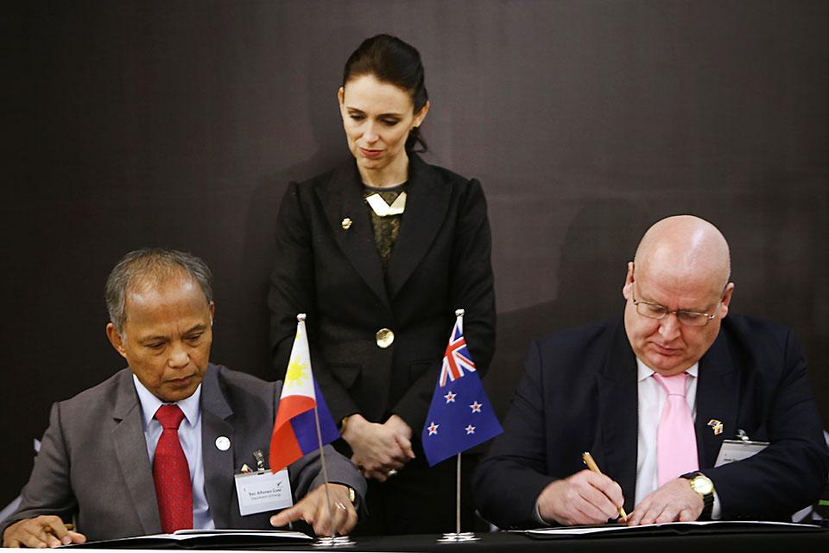
2017 Geothermal Sector Highlights
The government of the Philippines and New Zealand signed the Amendment on the Bilateral Arrangement on geothermal energy cooperation on 14 November 2017 during the ASEAN Summit

Slide 6
Investment landscape - Opportunities and Challenges

Slide 7
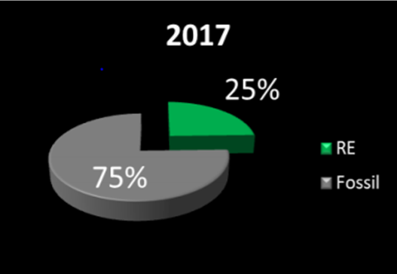
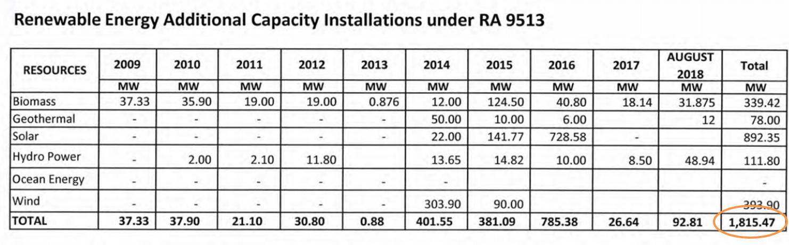
Renewable Energy Growth
RE Law ushered in fresh investments, Php375 billion, and additional generating capacity, 1,815 MW, to address growing demand for power supply

Slide 8
New Mechanism to Spur RE Market
    Renewable Portfolio Standards (RPS) mandates DUs/ECs to source supply from RE
    Green Energy Option Program (GEOP) gives end-users power to choose RE as their supply source
    Conduct of Open Bid/Competitive Selection Process in power supply procurement among DUs/ECs
    Competitive RE Zones (CREZ) to further promote RE in areas abundant with the resources
    Energy Projects of National Significance (EPNS) streamlines government permitting processes

Slide 9
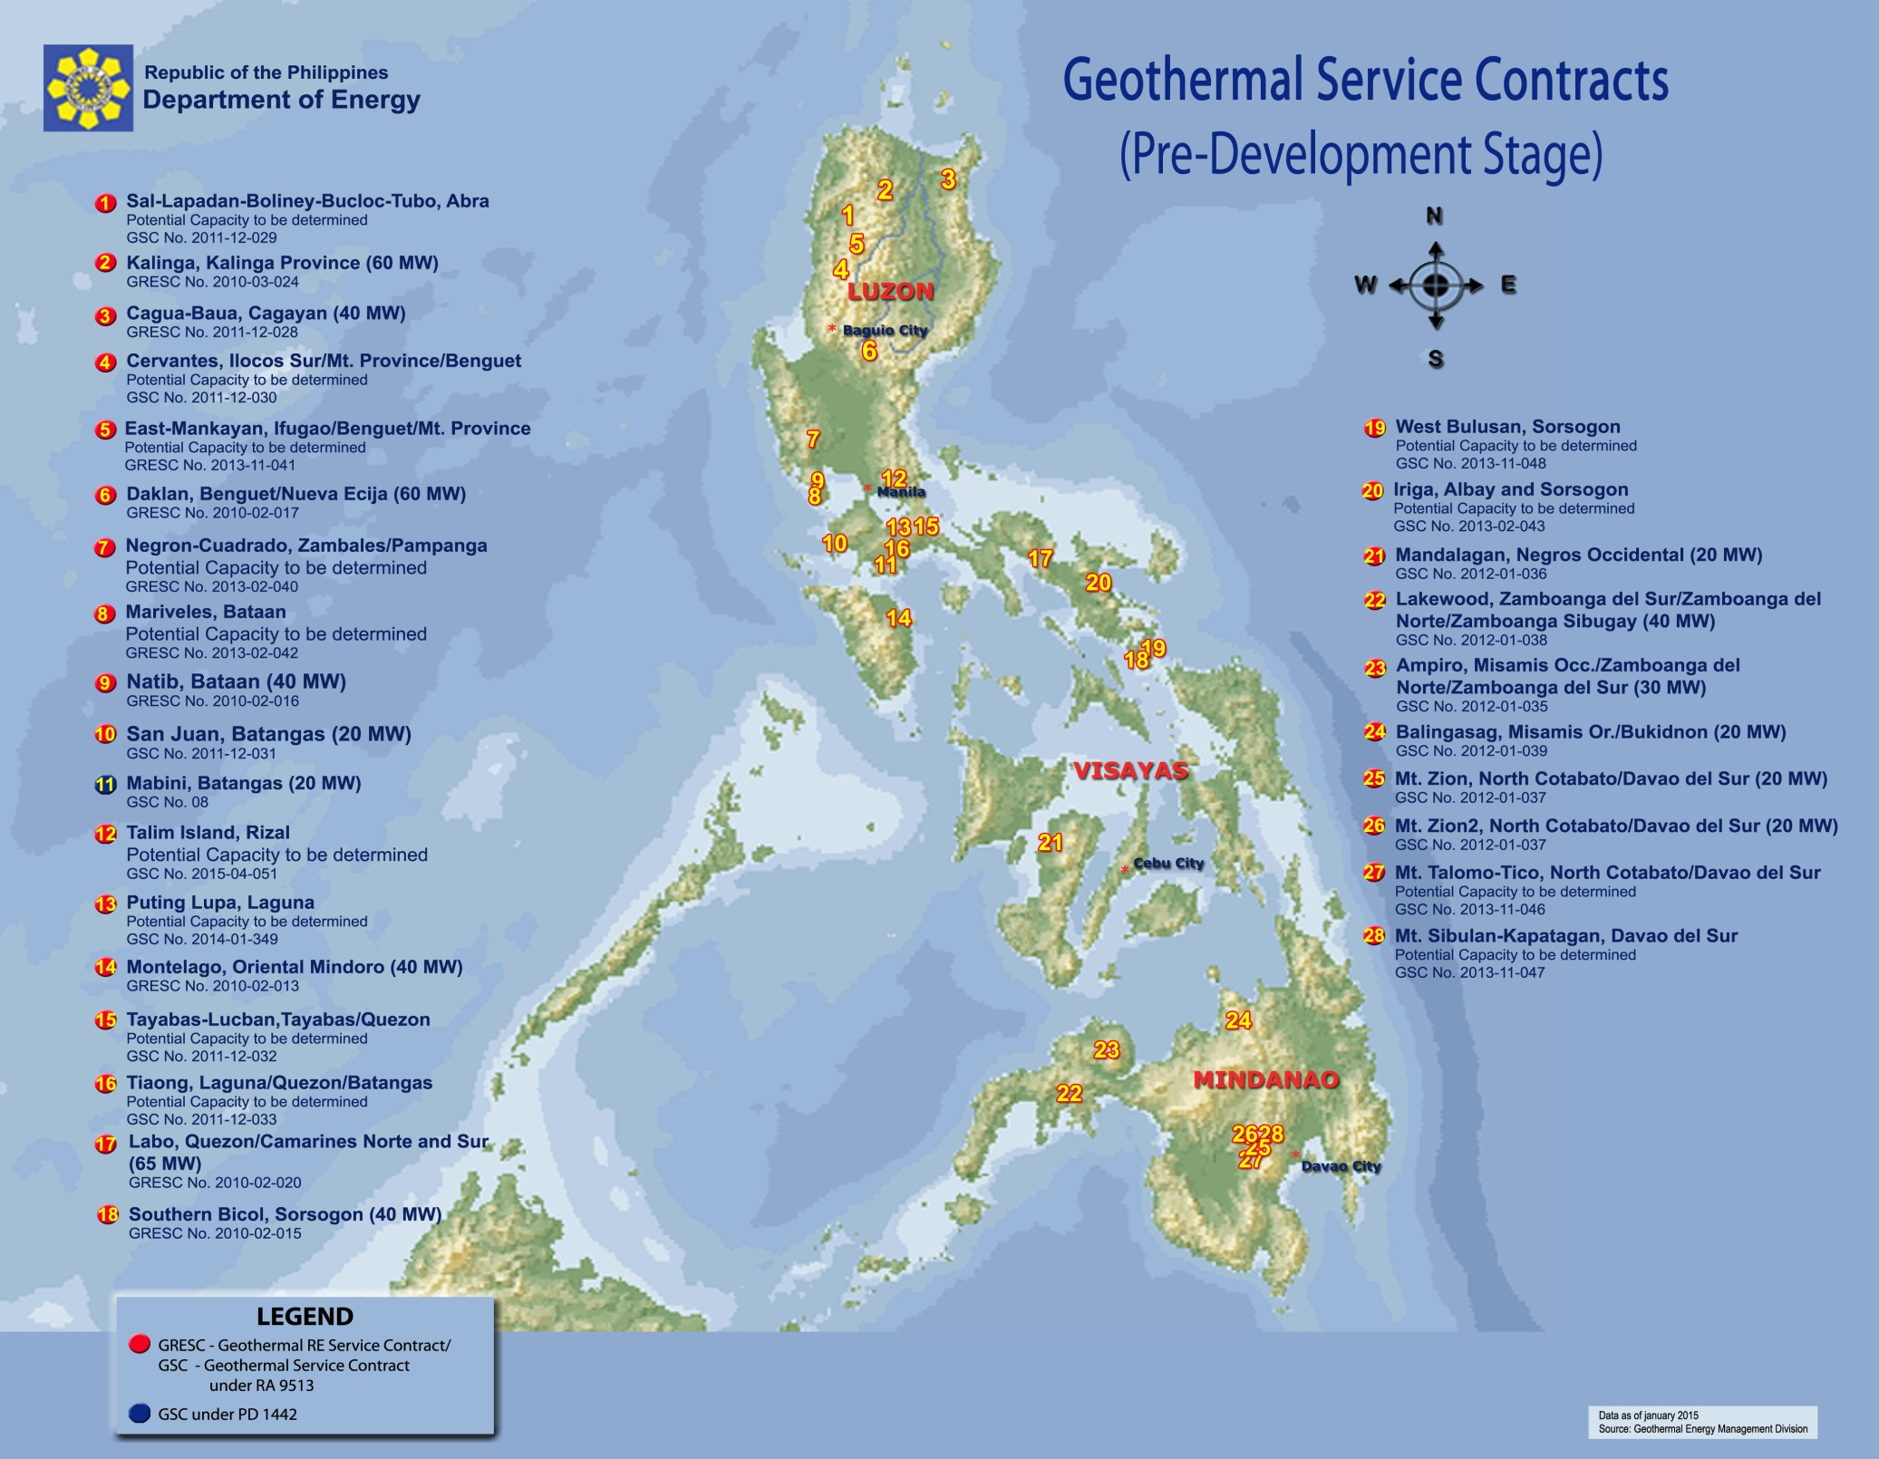
28 projects on pre-development stage

Slide 10
Geothermal Industry Realisation
  Big ticket geothermal projects thing of the past
  Remaining untapped resources still abundant but deeper and more difficult to drill
  Geothermal projects now at smaller sizes, from 200 MW to 20-40 MW capacity
  Existing geothermal firms scrambles to keep afloat
  Stiff competition with the other Renewable e.g. Solar

Slide 11
Impact of Comprehensive Tax Reform 2
Income tax holiday - 5 years of commercial operations, < 3 years
Only new investments/activities deserve income tax incentives
Reduced Corporate Income Tax ("CIT") rate of 15%
Duty-free importation on raw materials and capital equipment will be made to apply only to initial investments for the first 5 years;
Removal of the VAT incentives and special realty tax rates

Slide 12
Areas of Opportunities
Resource assessment; detailed engineering design
FS preparation; FS Review/Validation
Project Management
Technology Supply; O&M
Direct-use proposals
Disaster Resiliency

