Slide 1
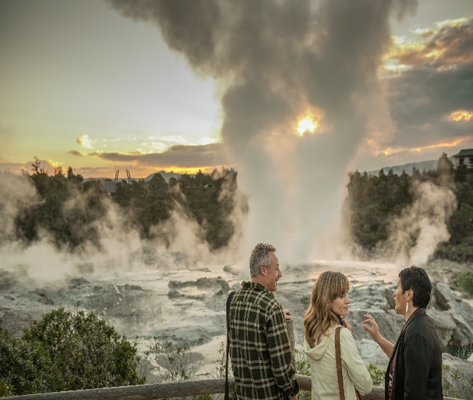

Geothermal Development in Indonesia
NZGW 2018
Prepared by Wini Rizkiningayu
Business Development Manager, NZTE Indonesia

Slide 2
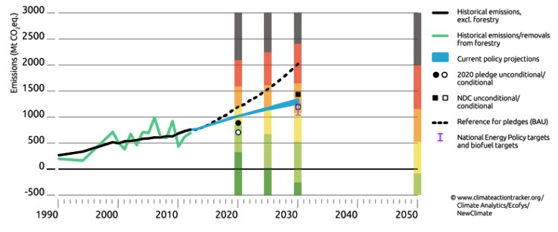
Reducing Carbon Emission + Energy Mix
The objectives of geothermal energy development are first, to reduce carbon emission. Secondly, to provide cushion to support system economics if fossil energy price increases. In 2027, the total generation capacity will be 500 TWh where 10% will be supplied by geothermal energy. This policy will support Indonesia to achieve 1,200 Mt. CO2 eq. in 2030.
Hydro
9%
Geothermal
10%
Coal 59%
2027
Other RE 1%
Gas
8%
LNG 12%
Oil 1%
source: RUPTL 2018 – 2027, www.climatetracker.org
|

Slide 3
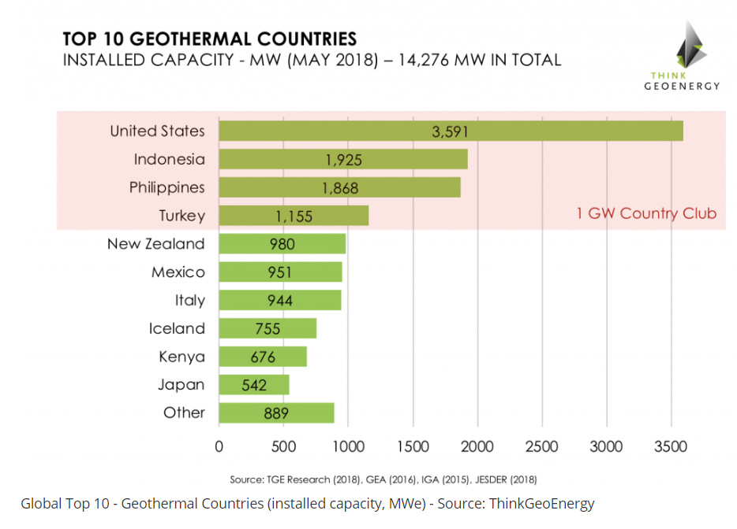
Indonesia : A Glimpse
2nd world largest geothermal producer, possesses 40% of the world’s geothermal resource with 27,000 MW potential resource
1,925 MW of total installed capacity as of March 2018
  Additional 110 MW to come online by yearend
    PLTP Sorik Marapi Modullar Unit 1 (20 MW)
    PLTP Sorik Marapi Marapi Modular Unit 2 (30 MW)
    PLTP Lumut Balai Unit 1 (55 MW)
Indonesia Targets up to 7,200 MW capacity by 2025 based on Presidential Regulation No. 22 of 2017

Slide 4








Current Condition of Geothermal Development
Resources
Electricity Production
28.508,5 MW
Badan Geologi, Dec 2017
6,72 GWh (June 2018)
50,98 % from 2018 target (13,18 GWh)
Geothermal Working Areas (GWA)
Regulation
Law 21/2014 → Geothermal
GR 7/2017 → Geothermal for Indirect-uses
MEMR No. 21/2017 → Mud Wastes & Drilling Cutting Management
MEMR No.23/2017 → Production Bonus
MEMR No. 36/2017 → PSP & PSPE
MEMR No. 37/2017 → GWA
MEMR No.33/2018 → Data & Information
MEMR No.37 /2018 → Geothermal Licensing
65 GWA & 10 PSPE Areas
19 Existing GWA
46 New GWA
10 PSPE Areas
Investment
Steam Production
USD 573 Million (June 2018)
47,2 % from 2018 target (USD 1,214 M)
48,63 Million Tons (June 2018)
49,70% from 2018 target (97,84 million Tons)
Installed Capacity
Non-tax State Revenue
1.948,5 MW
13 GPP from 11 GWA
6,8% from total resources
Rp 661 Billion (June 2018)
93,8 % from 2018 Target Rp 700 Billion

Slide 5
Geothermal Installed Capacity as per March 2018
No | PLTP | WKP | Developer | Location | Unit Capacity | Start Operated | Installed Capacity (MW)
1 | PLTP Sibayak | Gunung Sibayak - Gunung Sinabung | Pertamina Geothermal Energy, PT | Semangat Gunung - Doulo Villages, Brastagi, North Sumatra | Monoblock, 2 MW | 1998 | 12
 |  |  |  |  | Unit I, 5 MW | 2008
 |  |  |  |  | Unit II, 5 MW | 2008
2 | PLTP Sarulla | Gunung Sibual-buali | Sarulla Operation, Ltd | Silangkitang, North Tapanuli, North Sumatra | Unit I, 110 MW | 2017 | 330
 |  |  |  | Namorailangit, North Tapanuli, North Sumatra | Unit II, 110 MW | 2017
 |  |  |  | Silangkitang, North Tapanuli, North Sumatra | Unit III, 110 MW | 2018
3 | PLTP Ulubelu | Gunung Way Panas | Pertamina Geothermal Energy, PT | Ulubelu, Tanggamus, Lampung | Unit I, 55 MW | 2012 | 220
 |  |  |  |  | Unit II, 55 MW | 2012
 |  |  |  |  | Unit III, 55 MW | 2016
 |  |  |  |  | Unit IV, 55 MW | 2017
4 | PLTP Gunung Salak | Cibeureum - Parabakti | Star Energy Geothermal Salak, Ltd | Purwabakti, Bogor, West Java | Unit I, 60 MW | 1994 | 377
 |  |  |  |  | Unit II, 60 MW | 1994
 |  |  |  |  | Unit III, 60 MW | 1997
 |  |  |  | Kebandungan, Sukabumi, West Java | Unit IV, 65.6 MW | 1997
 |  |  |  |  | Unit V, 65.6 MW | 1997
 |  |  |  |  | Unit VI, 65.6 MW | 1997
5 | PLTP Patuha | Pangalengan | Geo Dipa Energi, PT | Sugihmukti, Bandung, West Java | Unit I, 55 MW | 2014 | 55
6 | PLTP Wayang Windu | Pangalengan | Star Energy Geothermal Wayang Windu, Ltd | Margamukti, Bandung, West Java | Unit I, 110 MW | 2000 | 227
 |  |  |  |  | Unit II, 117 MW | 2008
7 | PLTP Kamojang | Kamojang-Darajat | Pertamina Geothermal Energy, PT | Laksana, Ibun, Bandung, West Java | Unit I, 30 MW | 1983 | 235
 |  |  |  |  | Unit II, 55 MW | 1988
 |  |  |  |  | Unit III, 55 MW | 1988
 |  |  |  | Loa, Paseh, Bandung, West Java | Unit IV, 60 MW | 2008
 |  |  |  | Laksana, Ibun, Bandung, West Java | Unit V, 35 MW | 2015
8 | PLTP Darajat | Kamojang-Darajat | Star Energy Geothermal Darajat, Ltd | Karyamekar, Pasirwangi, Garut, West Java | Unit I, 55 MW | 1994 | 270
 |  |  |  |  | Unit II, 94 MW | 2000
 |  |  |  |  | Unit III, 121 MW | 2007
9 | PLTP Dieng | Dataran Tinggi Dieng | Geo Dipa Energi, PT | Batur, Banjarnegara, Central Java | Unit I, 60 MW | 2002 | 60
10 | PLTP Ulumbu | Ulumbu | PLN (Persero), PT | Wewo, Satar Mese, Manggarai, East Nusa Tenggara | Unit I, 2.5 MW | 2012 | 10
 |  |  |  |  | Unit II, 2.5 MW | 2012
 |  |  |  |  | Unit III, 2.5 MW | 2016
 |  |  |  |  | Unit IV, 2.5 MW | 2016
11 | PLTP Mataloko | Mataloko | PLN (Persero), PT | Todabelu, Golewa, Ngada, East Nusa Tenggara | Unit I, 2.5 MW | 2010 | 2,5
12 | PLTP Lahendong | Lahendong | Pertamina Geothermal Energy, PT | Leilem Dua, Sonder, Minahasa, North Sulawesi | Unit I, 20 MW | 2001 | 120
 |  |  |  |  | Unit II, 20 MW | 2007
 |  |  |  | Tondangon, Tomohon, North Sulawesi | Unit III, 20 MW | 2009
 |  |  |  |  | Unit IV, 20 MW | 2011
 |  |  |  | Talikuran, Tompaso, Minahasa, North Sulawesi | Unit V, 20 MW | 2016
 |  |  |  |  | Unit VI, 20 MW | 2016
13 | PLTP Karaha | Karaha-Cakrabuana | Pertamina Geothermal Energy, PT | Citamba, Ciawi, Tasikmalaya, West Java | Unit I, 30 MW | 2018 | 30
Total Installed Capacities |  |  |  |  |  |  | 1948,5

Slide 6
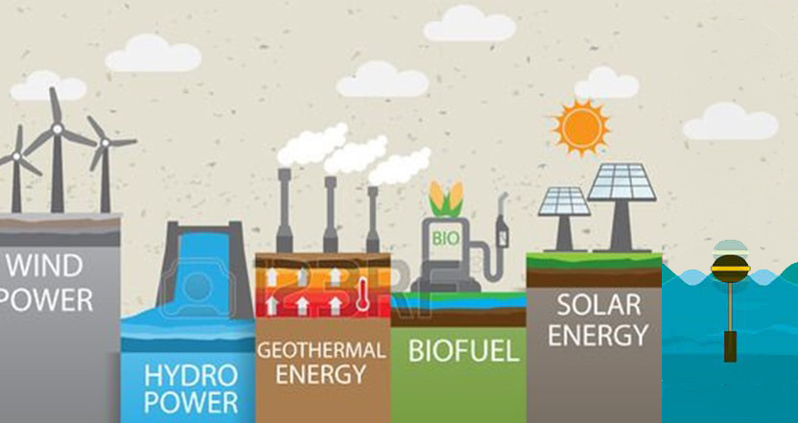
Progress Towards 2025?
There will be 80-100MW to COD by the end of this year
Approximately 10 developers are currently in the exploration and exploitation stages
Issued 10 assignments to SOE to develop geothermal prospects
Issued 8 PSPE assignments to Private Developers
Plans to launch 3 (three) WKPs tenders this year
Plans to commence government drilling on 2 WKPs
2 (two) WKPs resulted from competitive tenders are still not progressing. It requires government to step in
Some more are still in tariff negotiations stage
Most all of the above are targeted to COD at the latest by 2025
OCEAN

Slide 7
High Risk Investment and require large amount of Risk Capital up front; Most of geothermal prospects are located in remote area with challenging topography and limited infrastructure
Only Equity Financing available for Exploration
Long lead time from exploration to production (7 to 8 years)
Regulated Industry (involved many players / stakeholders and Regulation risks)- sometimes require long chain of bureaucracy
B to B negotiation with Single Buyer – Utility Company (PLN); links the selling price of Geothermal with the average of PLN production cost and proven reserve is required to enter into PPA
Upstream Exploration risk VS
“Utility Economic Return”
Land acquisition and community relations ; Socio Economic Challenges
Geothermal Challenges

Slide 8
NZ Opportunity & Progress
  Cooperation agreement with New Zealand
    MoU between Indonesia’s Ministry of Energy and Mineral Resources and New Zealand’s Ministry of Trade signed in 2012 for joint development of geothermal projects
    NZ Aid Programme Geothermal Energy for Indonesia
      5 year, $10.5 million technical assistance for Pertamina Geothermal Energy (PGE)
    Cooperation increased capacity of geothermal plants operated by PGE in Ulubelu by 79 MW and in Lahendong in North Sulawesi by 22 MW (since 2011)
      NZ provided US$6.95 million to support development of two projects
      Cooperation trained 124 people in geothermal production skills, in partnership with the University of Gadjah Mada
    Partnership Agreement signed in March 2017 on geothermal drilling project development (ongoing with PT SMI)
    NZSTIG program on vocational level training of Geothermal Human Capacity building with ESDM
Notes:
Source: MEMR, Directorate General of New, Renewable Energy and Conservation Energy Presentation, 2 Dec 2015

Slide 9




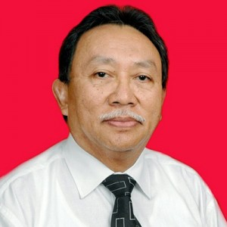
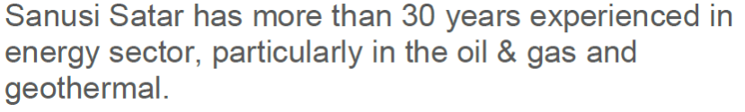
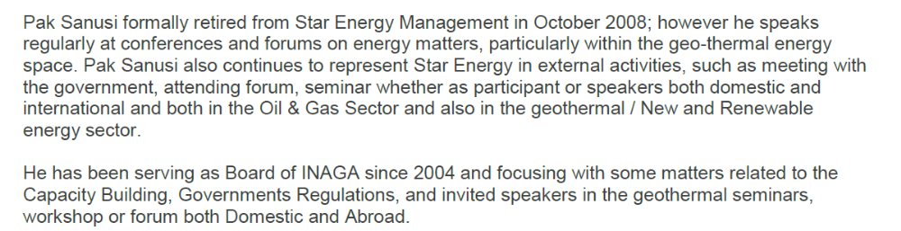
NZTE RE Resources in Indonesia
Diana Permana
Wini Rizkiningayu
Trade Commissioner
NZTE Jakarta
Business Development Manager
NZTE Jakarta
Sanusi Satar
Beachhead Advisor for Renewable Energy
NZTE Jakarta

Slide 10
NZTE Activities 2018
  Hosting VIP Geothermal Breakfast ( August 2018)
  Hosting “Empowering Renewable Energy : New Zealand Technology for Indonesia Energy Sustainability” with Geothermal panel discussion
  Hosting 3 Masterclasses for: Jacobs, Aecom, Seequent as part of Empowering Renewable Energy event
  NZ Pavilion on the 8th Indonesia International Geothermal Convention & Exhibition (IIGCE) with 9 NZ companies participating (Jacobs, Aecom, Seequent, Wintec, Auckland Uniservice, Progen, MTL, IESE, Geothermal NZ)
  Assisting Indonesian Delegation from Indonesia Geothermal Association (INAGA) to the New Zealand Geothermal Workshop
  2019: Industry Luncheon with INAGA
  2019 : IIGCE 2019
Notes:
Source: MEMR, Directorate General of New, Renewable Energy and Conservation Energy Presentation, 2 Dec 2015

Slide 11
Question?

Slide 13
Geothermal business trends
The Ministry of Energy and Mineral Resources of the Republic of Indonesia (MEMR) recently issued regulation No. 12 of 2017 on the utilisation of renewable energy sources for electricity supply (Regulation 12/2017).
Some industry participants have voiced concern at the way Regulation 12/2017 sets ceiling prices for the purchase of renewable energy by reference to the “average cost of generation” which, in some regions, is substantially lower than the typical generation cost of most types of renewable energy plants.
New regulations on power purchase agreements Developers to follow requirement for PLN to only purchase power in accordance with proven reserves after exploration.
The trend of Indonesian mining companies start to expand their business for renewable energy development. Opportunity : 101 Geothermal training opportunities
Additional installed capacity in 2017 from:
Ulubelu Unit 4 (55MW) – COD 25 April 2017
Sarulla Unit 2 (110 MW) – COD 2 Oct 2017
Karaha Unit 1 (30 MW)
New geothermal project:
The first 110-MW unit of the Sarulla geothermal project began commercial operations in late March.
When completed, the full project in Indonesia’s North Sumatra will have a capacity of about 380 MW. The project combines flash and binary geothermal technologies.

Slide 14
Geothermal Challenges in Indonesia
Price is one of important factor for geothermal development in Indonesia
The geothermal project is very risky, with the risk of geological exploration (resource risk) as the highest risk.
Economic Challenges
GEOTHERMAL
Resources Challenges
Location Challenges
Social Challenges
Regulation & Politics
Geothermal locations are located in mountainous areas. Infrastructure access and conditions become challenges
Public education on the development of geothermal activities still needs to be improved.
Government Rules & Regulation sometimes are uncondusive, 2018-2019 is political year

Slide 15
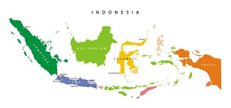



Indonesia Government breakthrough for geothermal development
Focus geothermal development in Eastern Indonesia
Assignment to SOE - The Government will give particular assignment for Geothermal SOE to develop concession including upstream and downstream based on Geothermal Law No. 21/2014.
Ideas on establishment Indonesia Geothermal Center of Excellence – they see GNS as one good example for Indonesia to follow.
Simplification of licensing - One-Stop Service Center (PTSP) at Investment Coordinating Board (BKPM), eliminating unnecessary licences, shorten the time period
Preliminary Survey Assignment + Exploration - Investors who meet the requirements allowed to have opportunity to obtain a Preliminary Survey + assignment up to exploration stage. As the incentive, concession will be tendered using direct selection mechanism.
Geothermal Fund – Allocate USD 300 million on national budget for geothermal explorationcurrently managed by PT SMI

Slide 16
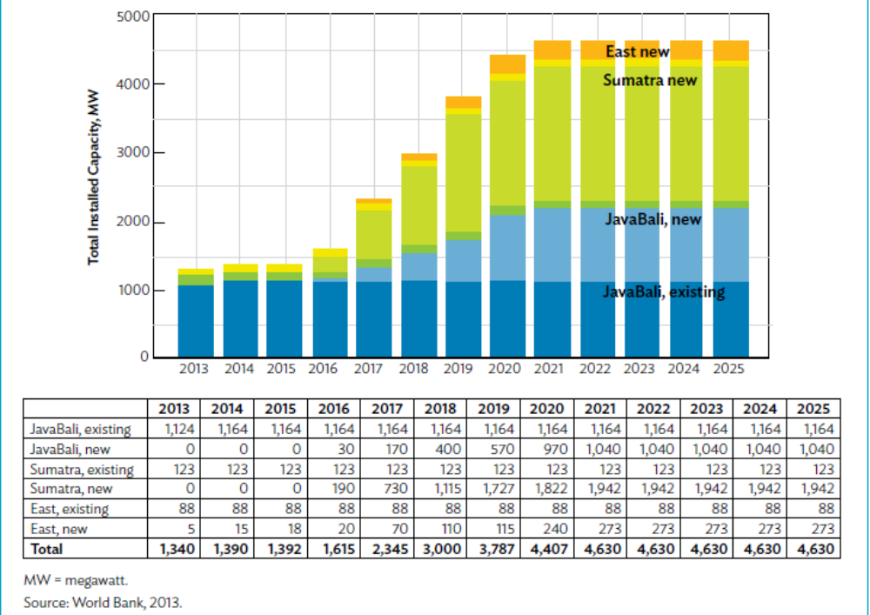
Indonesia: Scaling-up geothermal capacity
Indonesia possesses 40% of the world’s geothermal resource
  27,000 MW potential resource
Targets up to 7,200 MW capacity by 2025 based on Presidential Regulation No. 22 of 2017
Distribution of Geothermal Projects
Notes:
Notes:
With the target, geothermal is seen to account for 90% of Indonesia’s total renewable installed capacity by 2024, making the country as Asia’s largest geothermal market.
Indonesia’s goal:
increase RE contribution in the national energy mix to 23% by 2025. Geothermal to account for 7.1% share in the RE goal.
Indonesia’s Fast Track Program II (10,000MW of Additional capacity), geothermal project to account for 4,800 MW capacity or a total of 52 projects
Sources:
MEMR, Directorate General of New, Renewable Energy and Conservation Energy Presentation, 2 Dec 2015
Unlocking Indonesia’s Geothermal Potential, ADB, World Bank, MEMR, 2015

Slide 17
Indonesia: Scaling-up geothermal capacity
Indonesia now ranks 2nd world largest geothermal producer, replacing the Philippines
  1,925 MW of total installed capacity as of March 2018
  Additional 110 MW to come online by yearend
    PLTP Sorik Marapi Modullar Unit 1 (20 MW)
    PLTP Sorik Marapi Marapi Modular Unit 2 (30 MW)
    PLTP Lumut Balai Unit 1 (55 MW)
Notes:
Notes:
With the target, geothermal is seen to account for 90% of Indonesia’s total renewable installed capacity by 2024, making the country as Asia’s largest geothermal market.
Indonesia’s goal:
increase RE contribution in the national energy mix to 23% by 2025. Geothermal to account for 7.1% share in the RE goal.
Indonesia’s Fast Track Program II (10,000MW of Additional capacity), geothermal project to account for 4,800 MW capacity or a total of 52 projects
Sources:
MEMR, Directorate General of New, Renewable Energy and Conservation Energy Presentation, 2 Dec 2015
Unlocking Indonesia’s Geothermal Potential, ADB, World Bank, MEMR, 2015

Slide 18
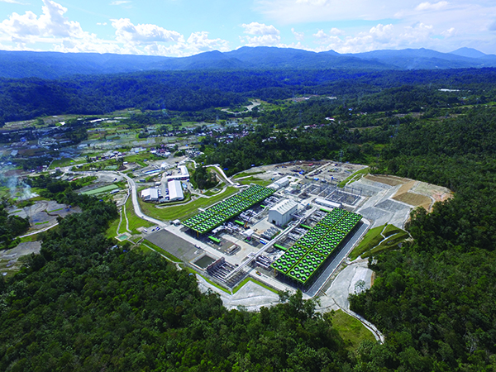
Indonesia: Scaling-up geothermal capacity
Bulk of geothermal projects are located in Sumatra at 1,820 MW, Java-Bali at 570 MW and Eastern Islands at 240 MW by 2020
  330 MW (3 x 110 MW) Suralla Geothermal Project in North Sumatra in full commercial operation by March 2018
Suralla Geothermal Power Plant
Notes:
Notes:
With the target, geothermal is seen to account for 90% of Indonesia’s total renewable installed capacity by 2024, making the country as Asia’s largest geothermal market.
Indonesia’s goal:
increase RE contribution in the national energy mix to 23% by 2025. Geothermal to account for 7.1% share in the RE goal.
Indonesia’s Fast Track Program II (10,000MW of Additional capacity), geothermal project to account for 4,800 MW capacity or a total of 52 projects
Sources:
MEMR, Directorate General of New, Renewable Energy and Conservation Energy Presentation, 2 Dec 2015
Unlocking Indonesia’s Geothermal Potential, ADB, World Bank, MEMR, 2015

Slide 19
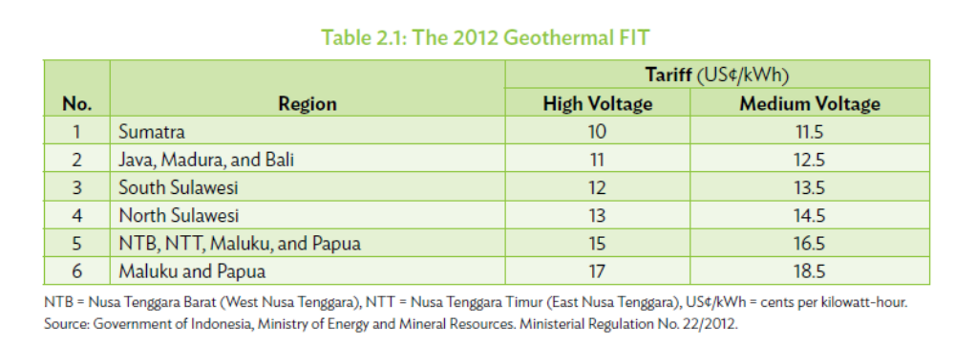
Indonesia: Scaling-up geothermal capacity
Growth Enablers
  Geothermal Law passed in 2003, the only RE governed by own law
  Issued FIT policy for geothermal in 2012
    135 MW installed in 2010-2013
    Additional 190 MW by 2015-2017
    Yet, still way below target
2012 Geothermal FIT
Notes:
Notes:
Growth Enablers:
In 2003, the Geothermal Law (Law 27/2003) was promulgated, making geothermal the only
renewable energy governed by its own law. The law mandated that future geothermal fields must
be transparently and competitively tendered for development. It also permitted operators of the
fields previously allocated to EMR) issued the “Blueprint for Geothermal Development in Indonesia,”
which was intended as a roadmap to develop 6,000 MW of geothermal power capacity by
2020. In 2005, the Directorate of Geothermal Enterprise Supervision and Groundwater
Management were established by MEMR to strengthen sector management and support. This
became the Directorate of Geothermal Energy in November 2010. In 2006, MEMR initiated
the Master Plan Study for Geothermal Power Development in Indonesia funded by the Japan
International Cooperation Agency (JICA), further solidifying knowledge and understanding
about developing Indonesia’s geothermal resources.
In 2012, the Ministry of Finance (MoF) established a geothermal fund with more than
$200 million of initial capitalization to mitigate resource risks related to geothermal
development. The Asian Development Bank (ADB) provided early technical inputs on the
fund’s scope and design.
Geothermal Law 2014
A non-mining activity – producers of geothermal power can more easily work in forest conservation areas, where most geothermal reserves are located. Indonesia’s existing Forestry Law ostensibly prohibits mining operations in protected areas due to the environmental impact they typically cause.
However, it was agreed that geothermal does not cause the same environmental damage as mining, paving the way for geothermal to be now legally considered a non-mining activity.
Regulation 17/2014
The ceiling price is applied during the tender process for the Geothermal Business License (IUP). During this process (typically run by the Regional Government where the IUP concession is located), bidders will be obliged to bid an electricity tariff. Regulation 17 provides that the tariff bid must not exceed the applicable ceiling price under Regulation 17.
Regulation 17/2014 was welcomed by investors and stimulated investment as it provided for higher tariffs to cover exploration risks. Many projects, especially those that were stalled in 2012, moved forward.
Sources:
MEMR, Directorate General of New, Renewable Energy and Conservation Energy Presentation, 2 Dec 2015
Unlocking Indonesia’s Geothermal Potential, ADB, World Bank, MEMR, 2015
Indonesian Geothermal Tariffs Revised…Again, Baker & McKenzie, June 2014

Slide 20
Indonesia: Scaling-up geothermal capacity
Growth Enablers
  Geothermal Law revised in 2014
    Reclassifies geothermal as non-mining activity
    Generation output to be sold to PLN
    Allows assigning of geothermal work areas to state enterprises without auction
      PT Pertamina Geothermal Energy to build 907 MW of geothermal capacity by 2015-2019, costing US2.5 billion
        USD6.95M technical assistance grant from New Zealand
        USD300 M financing from WB for the 150 MW Sumatra and Sulawesi geothermal projects
Notes:
Notes:
Growth Enablers:
In 2003, the Geothermal Law (Law 27/2003) was promulgated, making geothermal the only
renewable energy governed by its own law. The law mandated that future geothermal fields must
be transparently and competitively tendered for development. It also permitted operators of the
fields previously allocated to EMR) issued the “Blueprint for Geothermal Development in Indonesia,”
which was intended as a roadmap to develop 6,000 MW of geothermal power capacity by
2020. In 2005, the Directorate of Geothermal Enterprise Supervision and Groundwater
Management were established by MEMR to strengthen sector management and support. This
became the Directorate of Geothermal Energy in November 2010. In 2006, MEMR initiated
the Master Plan Study for Geothermal Power Development in Indonesia funded by the Japan
International Cooperation Agency (JICA), further solidifying knowledge and understanding
about developing Indonesia’s geothermal resources.
In 2012, the Ministry of Finance (MoF) established a geothermal fund with more than
$200 million of initial capitalization to mitigate resource risks related to geothermal
development. The Asian Development Bank (ADB) provided early technical inputs on the
fund’s scope and design.
Geothermal Law 2014
A non-mining activity – producers of geothermal power can more easily work in forest conservation areas, where most geothermal reserves are located. Indonesia’s existing Forestry Law ostensibly prohibits mining operations in protected areas due to the environmental impact they typically cause.
However, it was agreed that geothermal does not cause the same environmental damage as mining, paving the way for geothermal to be now legally considered a non-mining activity.
Regulation 17/2014
The ceiling price is applied during the tender process for the Geothermal Business License (IUP). During this process (typically run by the Regional Government where the IUP concession is located), bidders will be obliged to bid an electricity tariff. Regulation 17 provides that the tariff bid must not exceed the applicable ceiling price under Regulation 17.
Regulation 17/2014 was welcomed by investors and stimulated investment as it provided for higher tariffs to cover exploration risks. Many projects, especially those that were stalled in 2012, moved forward.
Sources:
MEMR, Directorate General of New, Renewable Energy and Conservation Energy Presentation, 2 Dec 2015
Unlocking Indonesia’s Geothermal Potential, ADB, World Bank, MEMR, 2015
Indonesian Geothermal Tariffs Revised…Again, Baker & McKenzie, June 2014

Slide 21
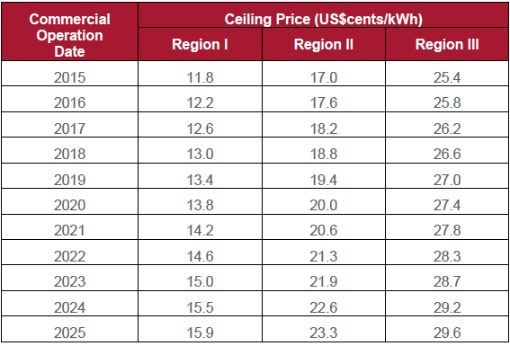
Indonesia: Scaling-up geothermal capacity
Growth Enablers
  MEMR Regulation 17/2014
    Revised tariff based on ceiling price, location and COD
    Allows escalation starting from date of COD of first unit
    Construction of transmission under PLN
2014 Geothermal Ceiling Price
Notes:
Notes:
Growth Enablers:
In 2003, the Geothermal Law (Law 27/2003) was promulgated, making geothermal the only
renewable energy governed by its own law. The law mandated that future geothermal fields must
be transparently and competitively tendered for development. It also permitted operators of the
fields previously allocated to EMR) issued the “Blueprint for Geothermal Development in Indonesia,”
which was intended as a roadmap to develop 6,000 MW of geothermal power capacity by
2020. In 2005, the Directorate of Geothermal Enterprise Supervision and Groundwater
Management were established by MEMR to strengthen sector management and support. This
became the Directorate of Geothermal Energy in November 2010. In 2006, MEMR initiated
the Master Plan Study for Geothermal Power Development in Indonesia funded by the Japan
International Cooperation Agency (JICA), further solidifying knowledge and understanding
about developing Indonesia’s geothermal resources.
In 2012, the Ministry of Finance (MoF) established a geothermal fund with more than
$200 million of initial capitalization to mitigate resource risks related to geothermal
development. The Asian Development Bank (ADB) provided early technical inputs on the
fund’s scope and design.
Geothermal Law 2014
A non-mining activity – producers of geothermal power can more easily work in forest conservation areas, where most geothermal reserves are located. Indonesia’s existing Forestry Law ostensibly prohibits mining operations in protected areas due to the environmental impact they typically cause.
However, it was agreed that geothermal does not cause the same environmental damage as mining, paving the way for geothermal to be now legally considered a non-mining activity.
Regulation 17/2014
The ceiling price is applied during the tender process for the Geothermal Business License (IUP). During this process (typically run by the Regional Government where the IUP concession is located), bidders will be obliged to bid an electricity tariff. Regulation 17 provides that the tariff bid must not exceed the applicable ceiling price under Regulation 17.
Regulation 17/2014 was welcomed by investors and stimulated investment as it provided for higher tariffs to cover exploration risks. Many projects, especially those that were stalled in 2012, moved forward.
Sources:
MEMR, Directorate General of New, Renewable Energy and Conservation Energy Presentation, 2 Dec 2015
Unlocking Indonesia’s Geothermal Potential, ADB, World Bank, MEMR, 2015
Indonesian Geothermal Tariffs Revised…Again, Baker & McKenzie, June 2014

Slide 22
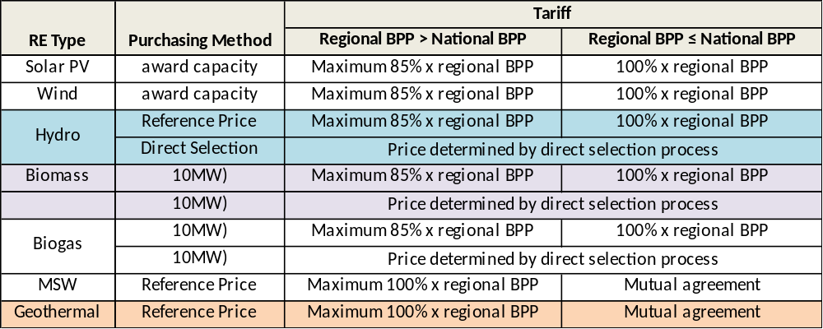
Indonesia: Scaling-up geothermal capacity
Growth Enablers
  MEMR Regulation 12/2017 issued in January 2017
    Obligates PLN as purchaser of RE power supply
Regulation 12/2017
BPP: Average Cost of Generating Electricity
Notes:
Notes:
Growth Enablers:
In 2003, the Geothermal Law (Law 27/2003) was promulgated, making geothermal the only
renewable energy governed by its own law. The law mandated that future geothermal fields must
be transparently and competitively tendered for development. It also permitted operators of the
fields previously allocated to EMR) issued the “Blueprint for Geothermal Development in Indonesia,”
which was intended as a roadmap to develop 6,000 MW of geothermal power capacity by
2020. In 2005, the Directorate of Geothermal Enterprise Supervision and Groundwater
Management were established by MEMR to strengthen sector management and support. This
became the Directorate of Geothermal Energy in November 2010. In 2006, MEMR initiated
the Master Plan Study for Geothermal Power Development in Indonesia funded by the Japan
International Cooperation Agency (JICA), further solidifying knowledge and understanding
about developing Indonesia’s geothermal resources.
In 2012, the Ministry of Finance (MoF) established a geothermal fund with more than
$200 million of initial capitalization to mitigate resource risks related to geothermal
development. The Asian Development Bank (ADB) provided early technical inputs on the
fund’s scope and design.
Geothermal Law 2014
A non-mining activity – producers of geothermal power can more easily work in forest conservation areas, where most geothermal reserves are located. Indonesia’s existing Forestry Law ostensibly prohibits mining operations in protected areas due to the environmental impact they typically cause.
However, it was agreed that geothermal does not cause the same environmental damage as mining, paving the way for geothermal to be now legally considered a non-mining activity.
Regulation 17/2014
The ceiling price is applied during the tender process for the Geothermal Business License (IUP). During this process (typically run by the Regional Government where the IUP concession is located), bidders will be obliged to bid an electricity tariff. Regulation 17 provides that the tariff bid must not exceed the applicable ceiling price under Regulation 17.
Regulation 17/2014 was welcomed by investors and stimulated investment as it provided for higher tariffs to cover exploration risks. Many projects, especially those that were stalled in 2012, moved forward.
Sources:
MEMR, Directorate General of New, Renewable Energy and Conservation Energy Presentation, 2 Dec 2015
Unlocking Indonesia’s Geothermal Potential, ADB, World Bank, MEMR, 2015
Indonesian Geothermal Tariffs Revised…Again, Baker & McKenzie, June 2014

Slide 23
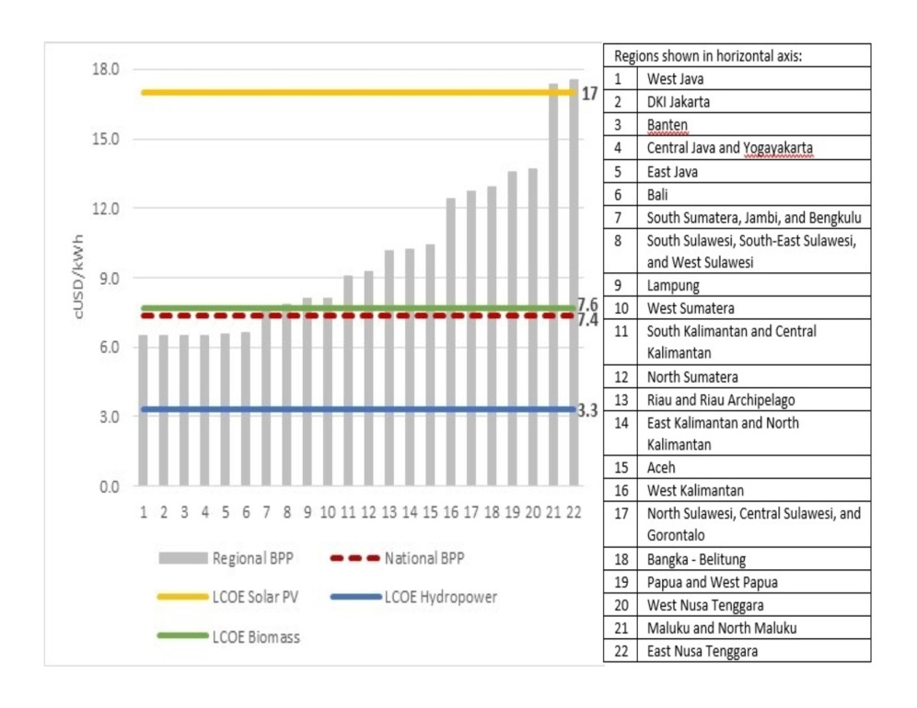
Indonesia: Scaling-up geothermal capacity
  MEMR Regulation 12/2017 issued in Jan 2017
    Benchmarked Tariff based on the average cost of generation where the plant is to be located
      Maximum 85% of the average generation cost in the area if it is above the national average
      100% of the average generation cost in the area if it is lower than the national average
    New tendering schemes depending on RE technology
Average Generation Cost
23
23
Notes:
Notes:
Indonesian Government revised anew RE tariff in Jan 2017 as previous rates were considered too high and the negative impact on PLN. Indonesian government sees that the revised tariff is expected to push PLN to purchase more RE power in growth centers like Java and Bali and make it competitive with other fuels. It is also seen to bring RE investments in other areas where electricity rates are higher.
Sources:
MEMR, Directorate General of New, Renewable Energy and Conservation Energy Presentation, 2 Dec 2015
Unlocking Indonesia’s Geothermal Potential, ADB, World Bank, MEMR, 2015
ASEAN Centre for Energy

Slide 24
Indonesia: Scaling-up geothermal capacity
  MEMR Regulation 37/2018
    Provides for clearer guidelines in the tender process
    2-stage process
      Stage 1: Pass or fail based on the completeness of the administrative requirements; if pass, then moves on to technical and financial evaluation
      Stage 2: 2-Envelop system
        1st Envelop: Project Development Proposal
        2nd Envelop: Amount of Exploration Commitment
          USD10 million for geothermal projects greater or equal to 10 MW
          USD5 million for geothermal projects less than 10 MW
    Bidder is an Indonesian entity but foreign companies welcome as part of a consortium
    Winning bidder is determined by the highest exploration commitment
24
24
Notes:
Notes:
Indonesian Government revised anew RE tariff in Jan 2017 as previous rates were considered too high and the negative impact on PLN. Indonesian government sees that the revised tariff is expected to push PLN to purchase more RE power in growth centers like Java and Bali and make it competitive with other fuels. It is also seen to bring RE investments in other areas where electricity rates are higher.
Sources:
MEMR, Directorate General of New, Renewable Energy and Conservation Energy Presentation, 2 Dec 2015
Unlocking Indonesia’s Geothermal Potential, ADB, World Bank, MEMR, 2015
ASEAN Centre for Energy

Slide 25
Indonesia: Scaling-up geothermal capacity
Opportunities
  Cooperation agreement with New Zealand
    MoU between Indonesia’s Ministry of Energy and Mineral Resources and New Zealand’s Ministry of Trade signed in 2012 for joint development of geothermal projects
    NZ Aid Programme Geothermal Energy for Indonesia
      5 year, $10.5 million technical assistance for Pertamina Geothermal Energy (PGE)
      GNS Science delivering 5 year geothermal energy training
    Cooperation increased capacity of geothermal plants operated by PGE in Ulubelu by 79 MW and in Lahendong in North Sulawesi by 22 MW (since 2011)
      NZ provided US$6.95 million to support development of two projects
      Cooperation trained 124 people in geothermal production skills, in partnership with the University of Gadjah Mada
    Partnership Agreement signed in March 2017 on geothermal drilling project development
Notes:
Source: MEMR, Directorate General of New, Renewable Energy and Conservation Energy Presentation, 2 Dec 2015

