Slide 1
R&D advances in Geothermal
Dr Logan Muller, Solenis R&D team

Slide 2
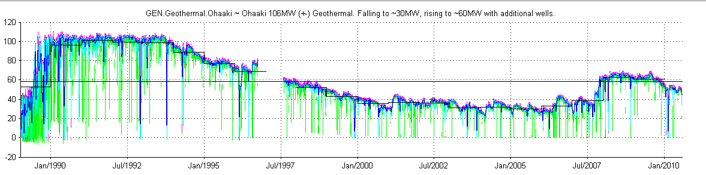
The motivation
A typical example is Ohaaki decline from 106 MW to 43MW in 2015
Long term implications across all Geothermal sites and ROI globally
The reasons are largely SOLVABLE !!!

Slide 3
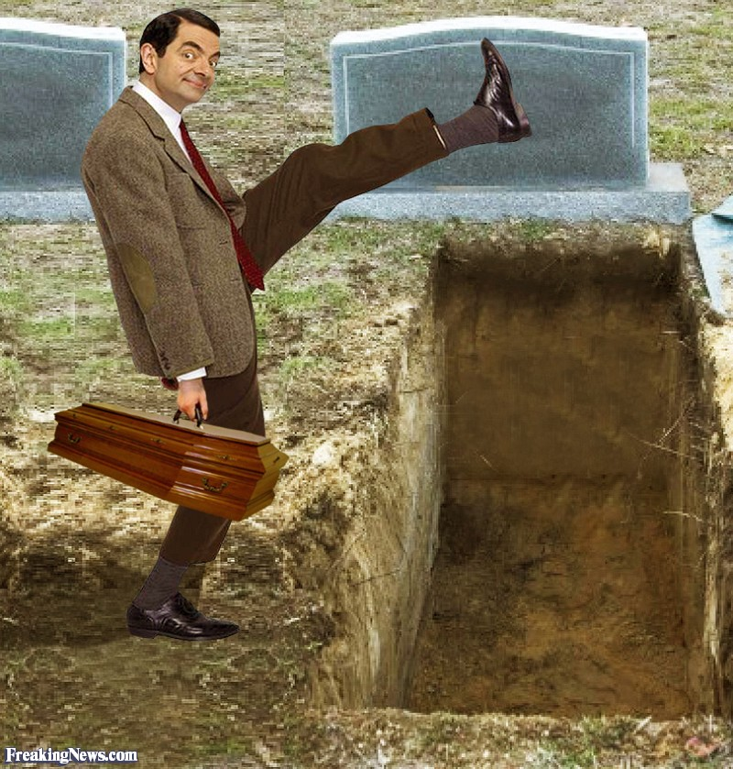
My personal project to make a difference
But I don’t have forever… started 35 years ago!!!
So these breakthroughs are significant for many reasons ☺

Slide 4

First, who is Solenis?
A history of trusted partners
Betz Paperchem acquires Dearborn division of W.R. Grace
Hercules founded 1912
Betz Laboratories founded 1925
Drew Industries founded 1907
BetzDearborn acquired
by Hercules Inc.
Hercules acquires
Houghton
Solenis acquires
Clearwater Specialties LLC
Quimatec Produtos Químicos Ltda.
Ashland acquires
Hercules
PULP & PAPER
2008
2015
1907-1925
1996
1998
2000
WATER
1981
2007
2014
2016
Ashland acquires Drew Industrial Division
Stockhausen Utility Water Group and Wastewater Polymer Division
Solenis
is launched
Solenis acquires Nuplex Pulp & Paper Lostris International B.V. Wester Blend B.V. NOPCO
Notes:
Timeline is self explanatory, typically focus on the Solenis end of it and emphasize that we are growing in the paper space globally and continuing a well considered M&A focus to add additional capability to serve our paper customers as a full spectrum solutions provider and business partner.

Slide 5
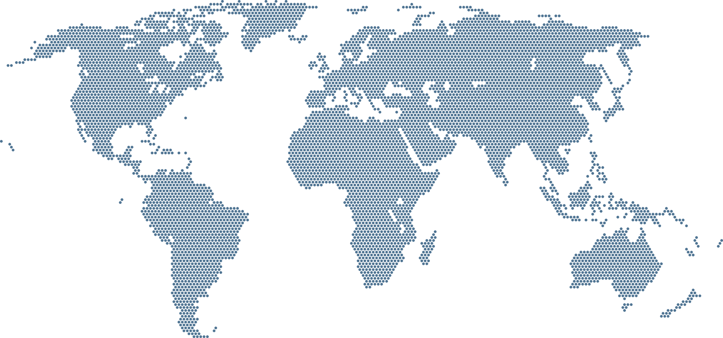
Our global presence
3,500
Employees
118
Countries
35
Manufacturing Facilities
3
Research
Facilities

Slide 6
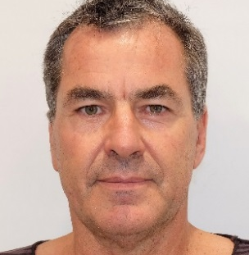
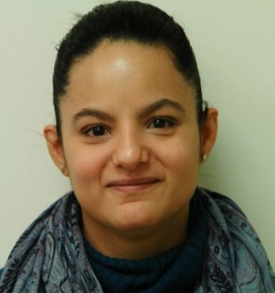
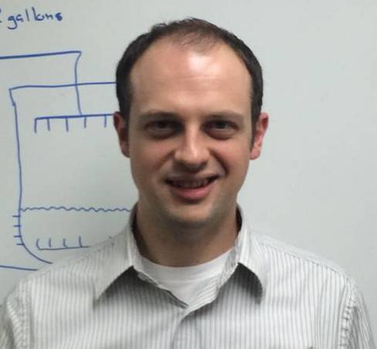
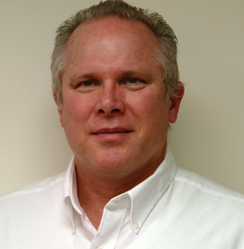
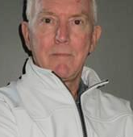
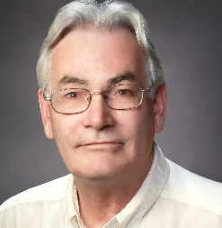
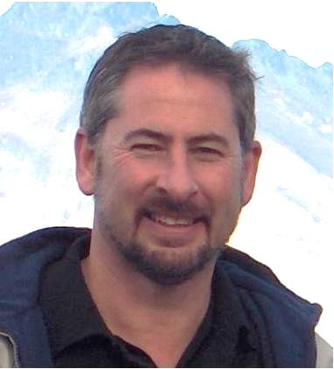
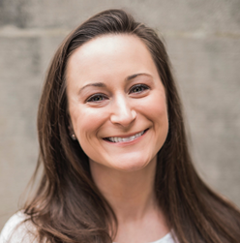
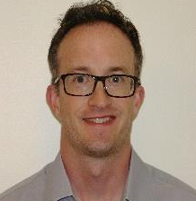
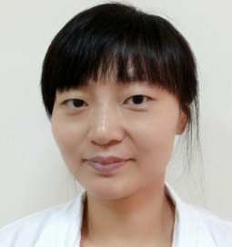
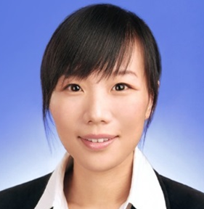
Who’s who in Solenis Geothermal R&D?
GEOTHERMAL GLOBAL DEVELOPMENT TEAM
Dr Logan Muller
Geothermal Consultant
Bay of Islands,
New Zealand
Dr Nydia Lynch
Research Scientist Wilmington,
US
Dr Mike Bluemle
Senior Team Leader Wilmington,
US
Dr William Carey
Director Technology
IWT R&D
Wilmington, US
Clive Roscoe
Director IWT
Technical Services
Sydney, Australia
Ted Beardwood
Global Applications Consultant
Ontario, Canada
Peter Slijp
IWT Applications
Specialist Chemist
Corinne Consalo
Research Microbiologist
Wilmington, US
Dr Michael Todd
Research Scientist
Wilmington, US
Dr Amy Cai
Research Scientist
Shanghai, China
Dr Xiaohui Li
Research Scientist
Shanghai, China

Slide 7
Geothermal companies
Were small and
attracted insignificant
attention during the
Carbon Growth years
Now are coming
more important as
clean alternative base
load power is sought
Little
support from
suppliers
Serious R&D
is needed to
plug the gap...

Slide 8
Current R&D and successfully piloted projects
01
Calcite inhibition: improvement in performance, cost effectiveness and predictability
02
Silica and Silicate inhibition: understanding the mechanisms better, then looking for cost effective solutions
03
Online cleaning and stimulation
04
Corrosion inhibition, continuous and for cleaning
05
Sulphur dispersion and inhibition
06
Microbio control in cooling towers

Slide 9

Ohaaki in another 60 years? ☺

