Slide 1
Industry Update SOLENIS
Logan Muller

Slide 2
SOLENIS
Parent company around since 1907
Now solely focused on Heavy industry
Recent purchase of BASF Chemical division

Slide 3
APPROACH
R&D on unresolved Geothermal issues
Pre-empting new challenges for the industry: EGS
Collaboration is the key.

Slide 4
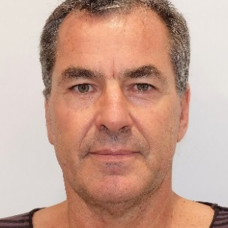
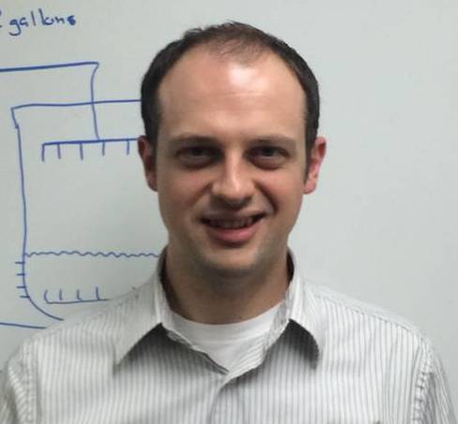
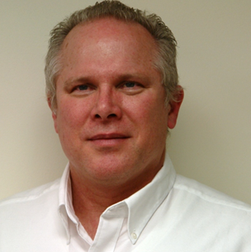
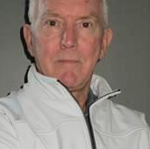
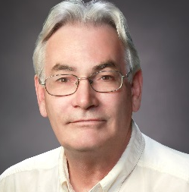


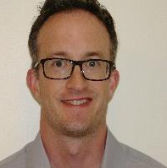
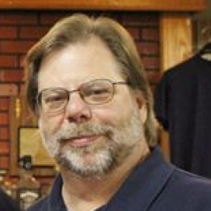
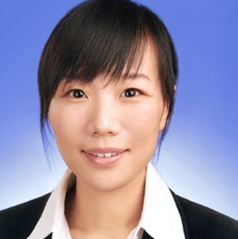
Who’s who in Solenis Geothermal R&D?
Geothermal global development team
Dr Logan Muller
Geothermal Consultant
Dr Mike Bluemle
Senior team leader Wilmington, USA
Dr William Carey
Director Technology
IWT R&D
Wilmington, USA
Clive Roscoe
Director IWT
Technical Services
Sydney, Australia
Ted Beardwood
Global Applications Consultant
Ontario, Canada
Dr Christina Geissler
IWT Applications
Specialist chemist
Corinne Consalo
Research Microbiologist
Wilmington, USA
Dr Michael Todd
Research Scientist
Wilmington, USA
Dr John Chapman
Research Microbiologist
Wilmington, USA
Dr Xiaohui Li
Research Scientist
Shanghai, China

Slide 5
Measurable Results
Since last year over $20,000,000 of measurable savings have been made in four companies
Some of these in improved production, some in reduced asset spend
That’s $20million that can go into further in house development of those companies.
A direct result of focused collaboration

Slide 6

Time to Collaborate
As the importance of the challenges facing the planet we are seeing more and more collaboration.
Our challenges are common ones.

Slide 7
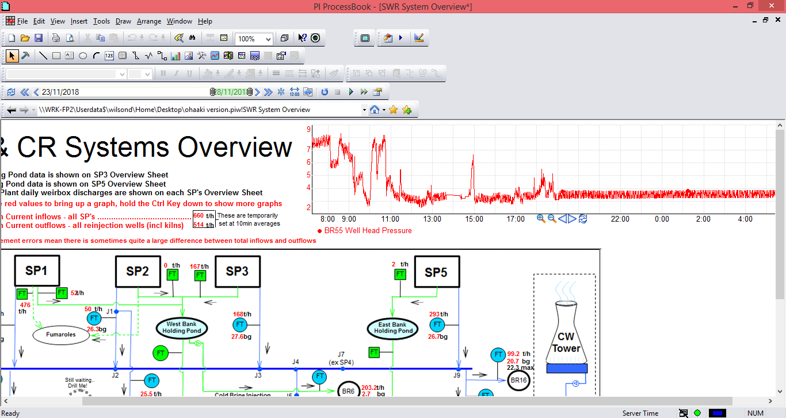
BR 55 + BR41 Quick cleans
Established that significant deposit can be removed quickly and effectively
Good signs and correlation for Binary

Slide 8
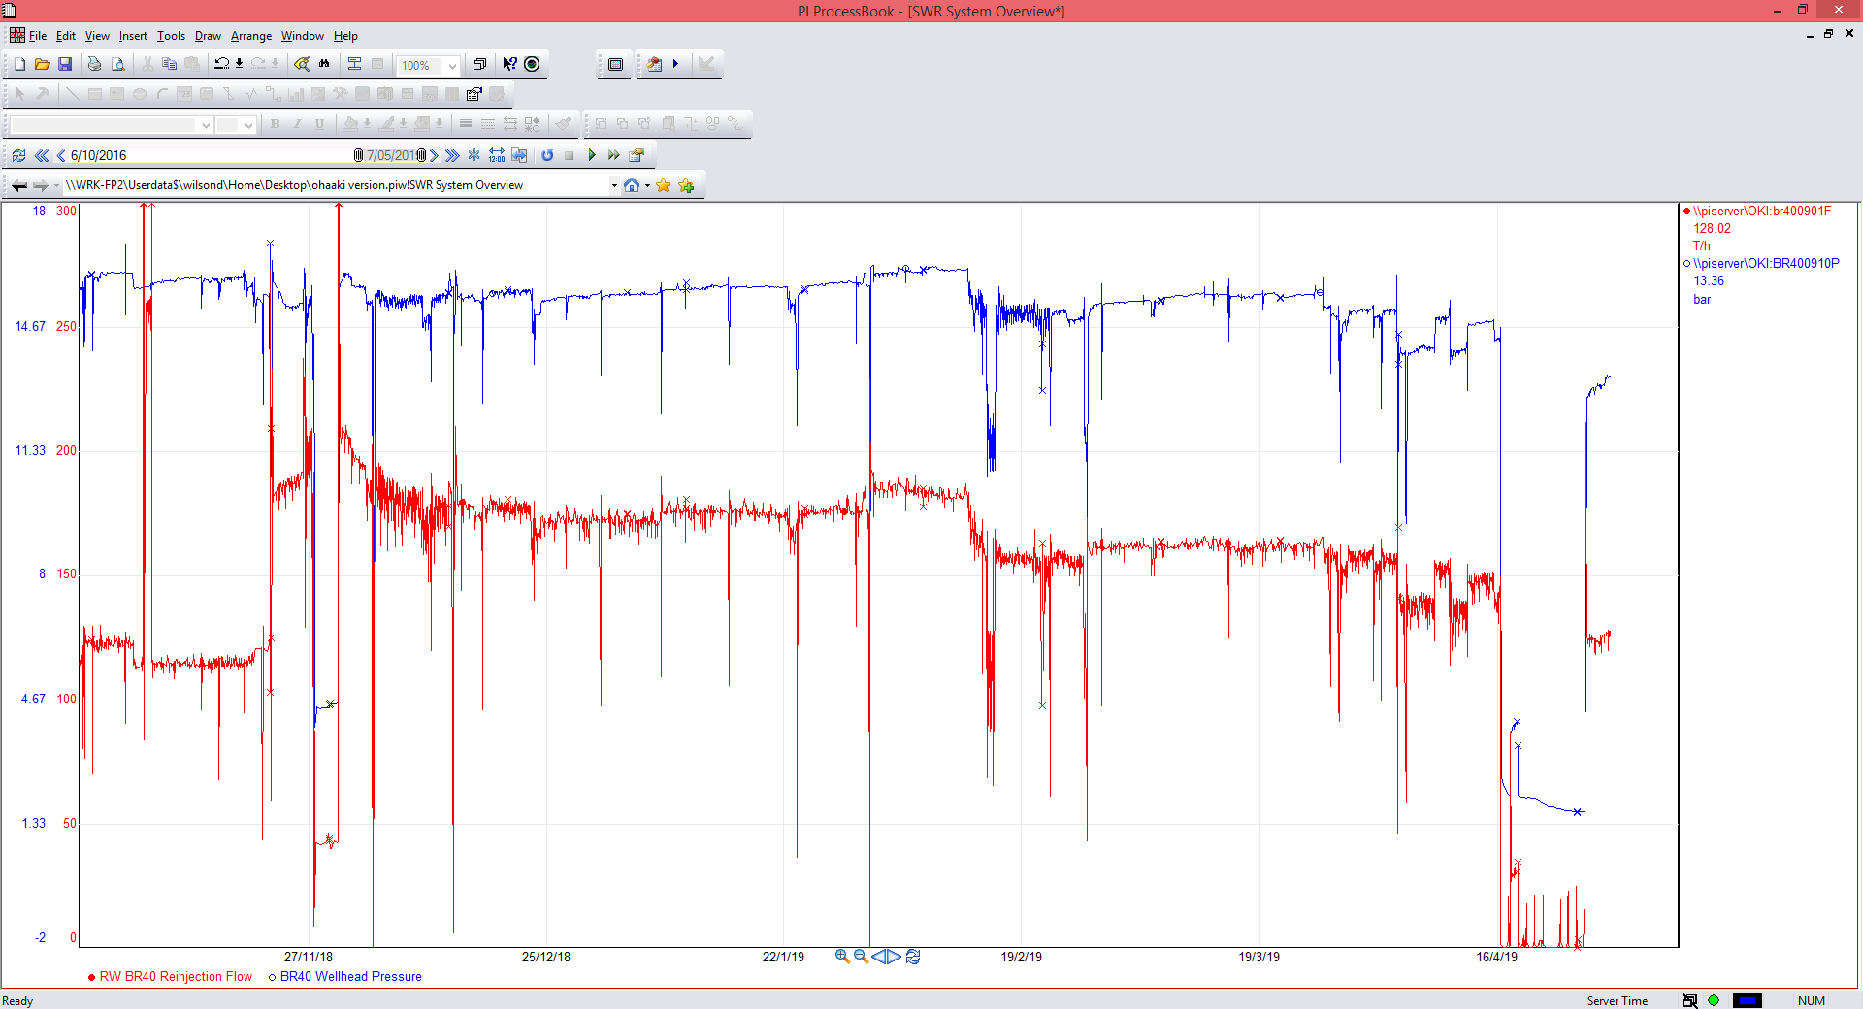
BR40. 5 months post clean
Results repeated at BR40 but clean has lasted much longer
Good evidence for Binary
Need to understand difference in longevity between BR40 and BR41

Slide 9
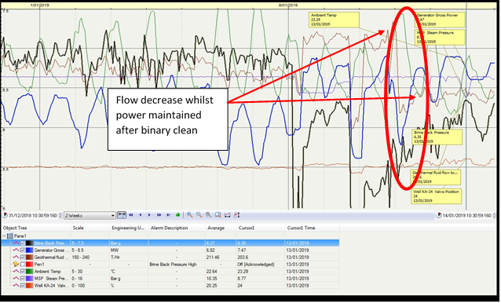
Online Binary Clean Result. GDL 1 hour clean.

Slide 10
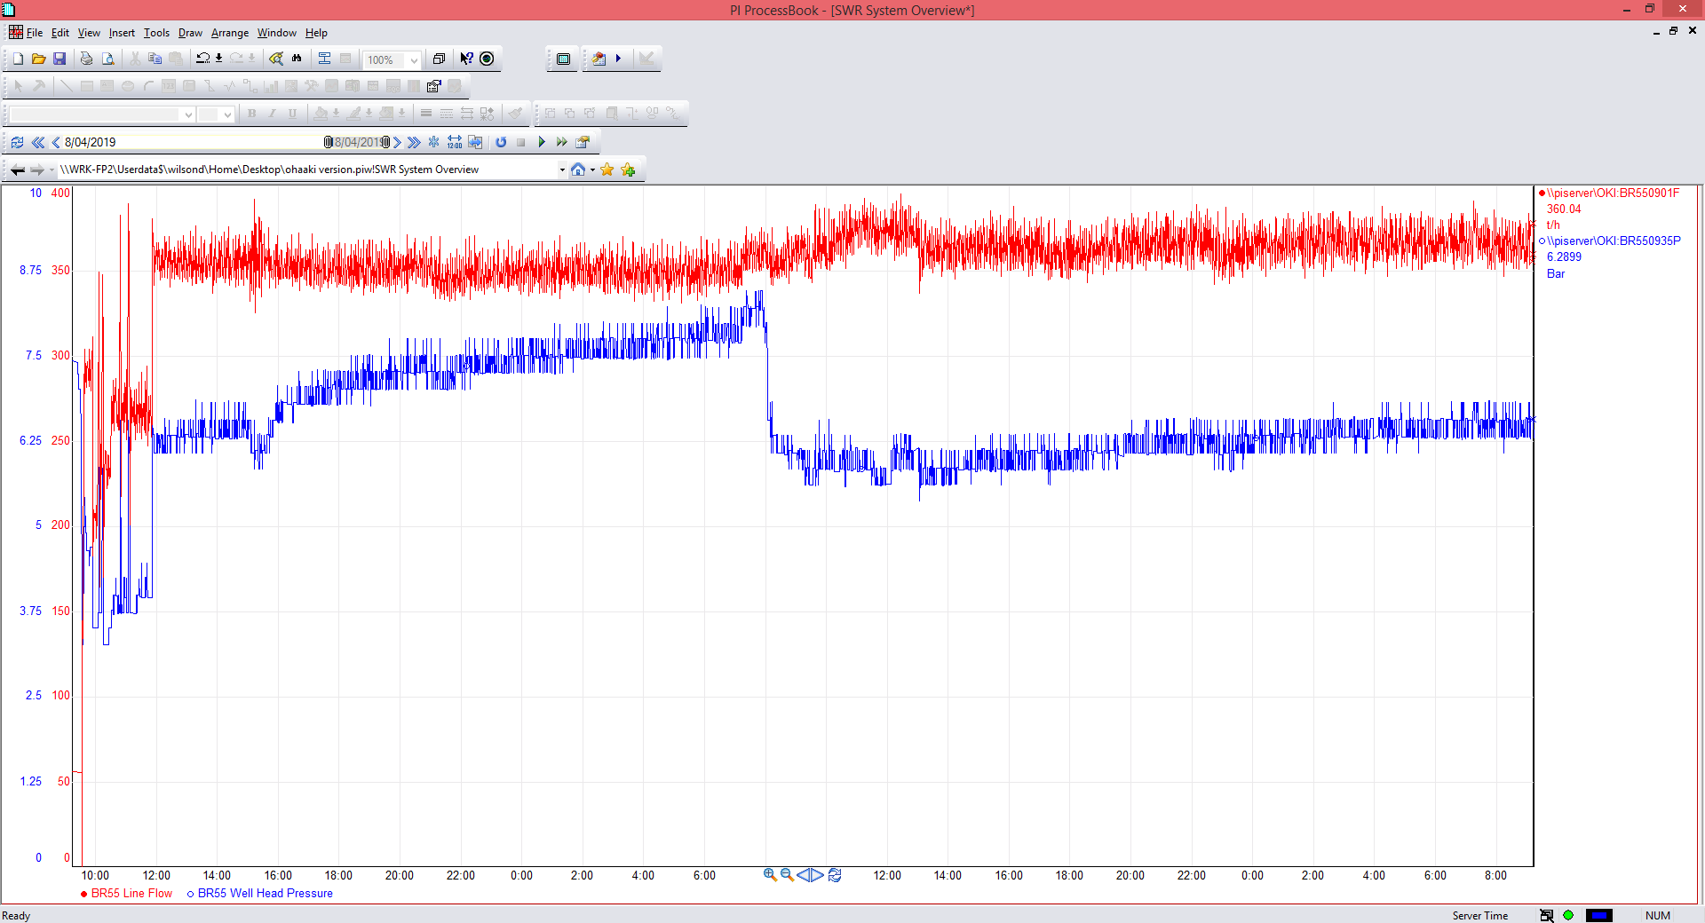
Trialed Deep clean on BR55
Increased from 20t/hr to 370t/hr in 2 hours
Stabilised after 3 weeks at 80 t/hr

Slide 11
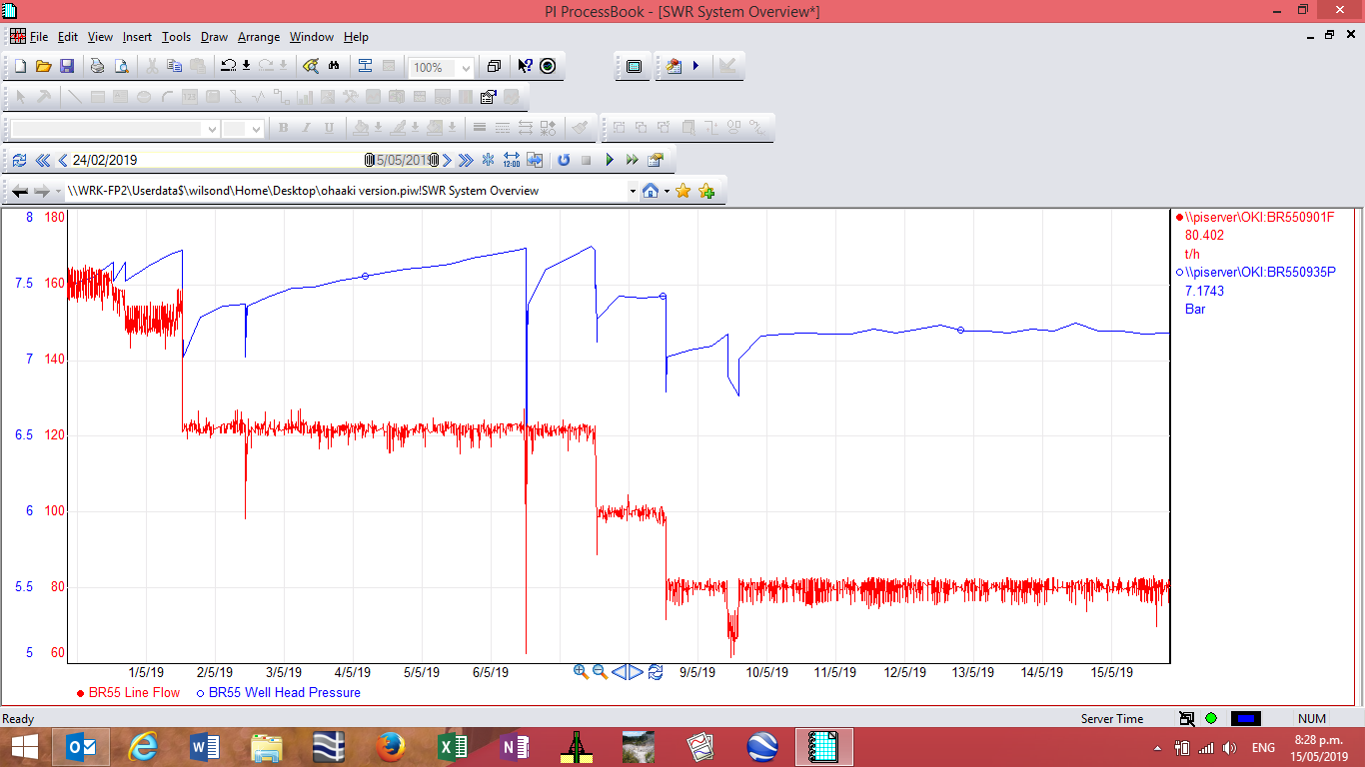
Trialed Deep clean on BR55
Stabilised after 3 weeks at 80 t/hr

Slide 12
Takeaways
The GS1014 and DPI824 clearly remove silica rapidly at 130C.
Bounce back could be a result of pressure build in the reservoir, or near bore re-deposition.
Bounce back more pronounced on throttled wells. Which I suspect is forming finally dispersed amorphous silica. This would explain the rapid improvement when we dose.
The BR40 well cleaned in November is maintaining a good flow. The difference being there is very little throttling of this well. It is however in a different location so it could be a higher permeable reservoir.
Wells like BR55 are candidates for short more frequent cleans. Comes down to ROI for CEL. Fortunately we get good quick results clean price <$20.

Slide 13
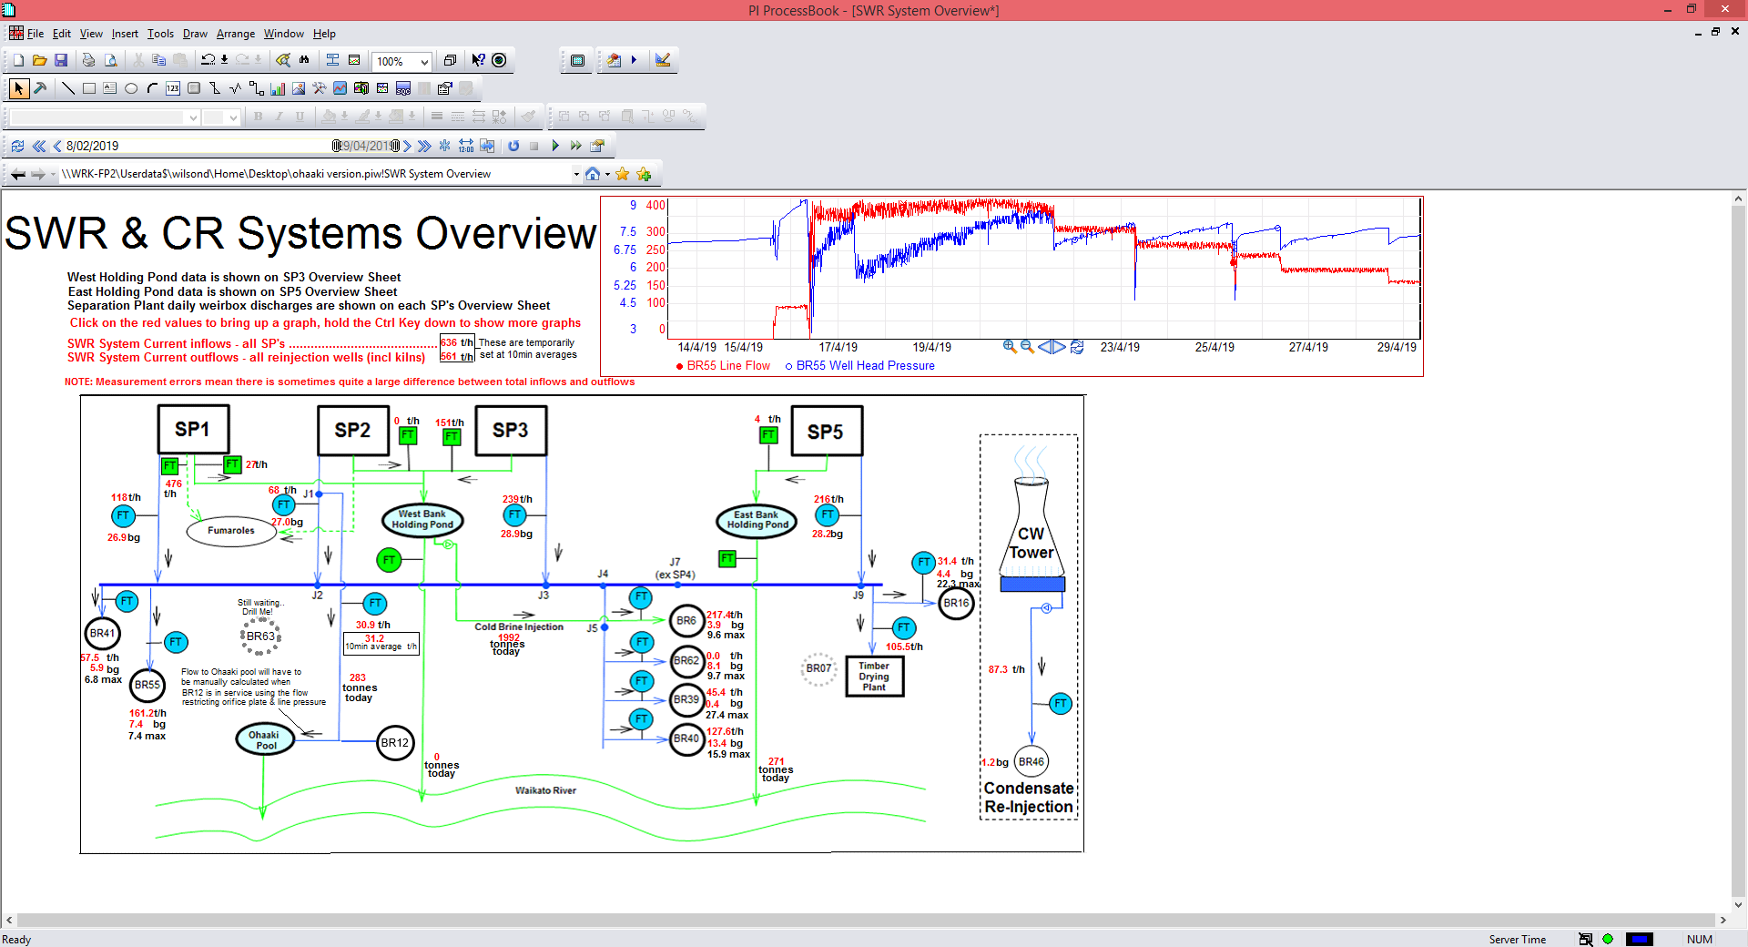
Suggestions- Recommendations
Wells with higher ECPs are good candidates for cleans with maintained flow increases.
‘Throttled wells’ ( for want of better characterization) respond very quickly (within an hour) so are candidates to frequent short cleans.
Maintaining reinjection capacity is good ROI
Possible application for pipeline clean in hard to access areas. ( option to compliment mechanical options).

Slide 14
Corrosion
Wells – Mild steel K55 Options
Mixing study ( CFD) in process to determine risk of hot spots
Dose inhibitor results next slide
Replace acid with non aggressive acid. See results
Binary
Established deposits can be removed online
Corrosion dealt with two safe options found

Slide 15
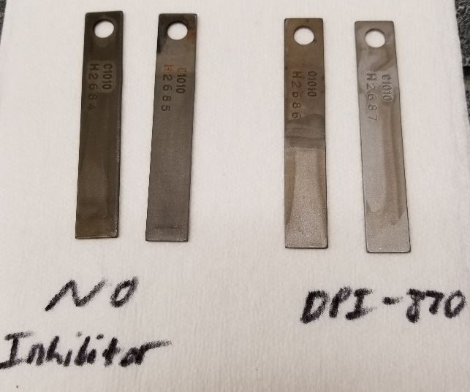
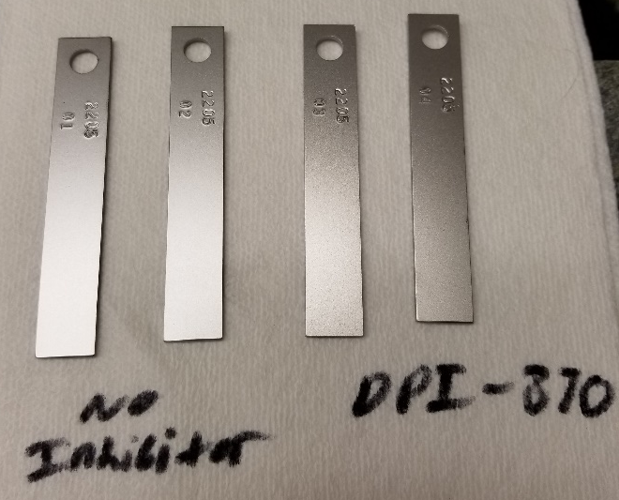
Inhibitor DPI-870 in 0.5% H₂SO 140C 3 hours
C1010 Steel
2205 Duplex Stainless Steel
0.0164 mm corrosion over 3 hours without inhibitor
0.0013 mm corrosion over 3 hours with DPI-870
(92% reduction)
No corrosion in any 2205 duplex SS coupons under these conditions
(photos are after autoclave test)

Slide 16
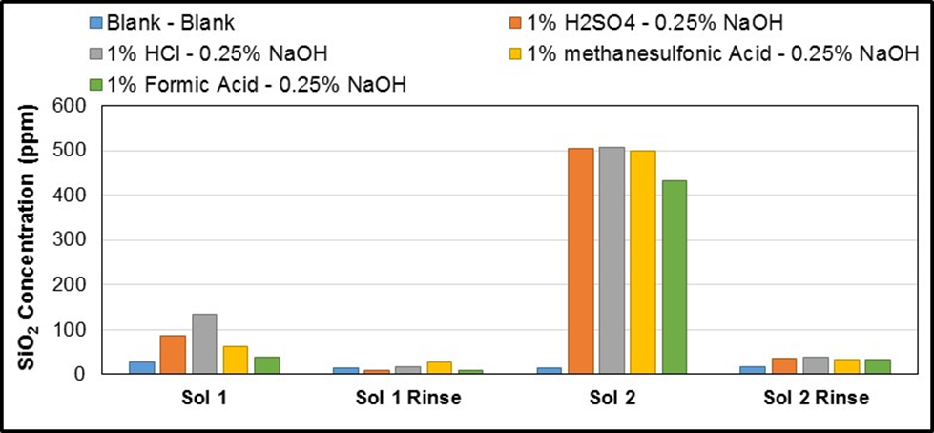
Results Using Alternative Acids
Methanesulfonic best for K55 and 2205

Slide 17
Binary Challenges and solutions
Established fairly conclusively that deposits can be removed without shutting the binary plant down and without the use of aggressive acids.
  Ability to maintain power output
  No need to shut
  No need for mechanical HP blasting
  No need for aggressive acids to Binary metallurgy
Must solve the challenge of the by pass.
Dosing points installed so we are all set to go, save the bypass issue.

Slide 18
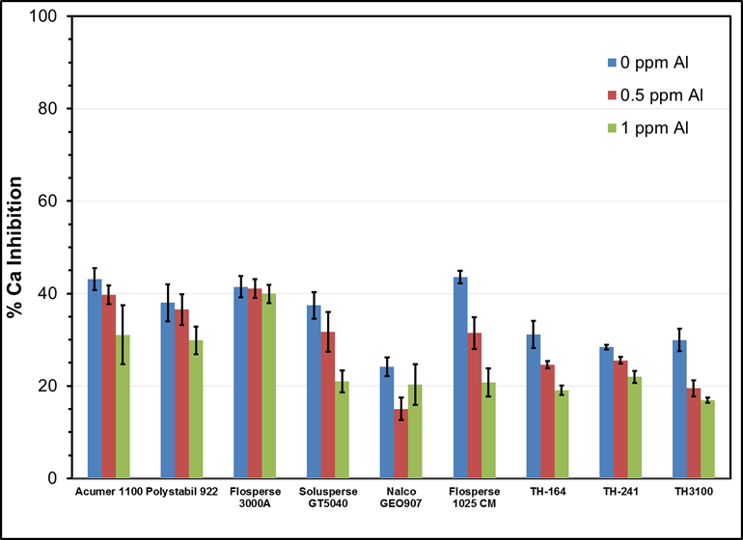
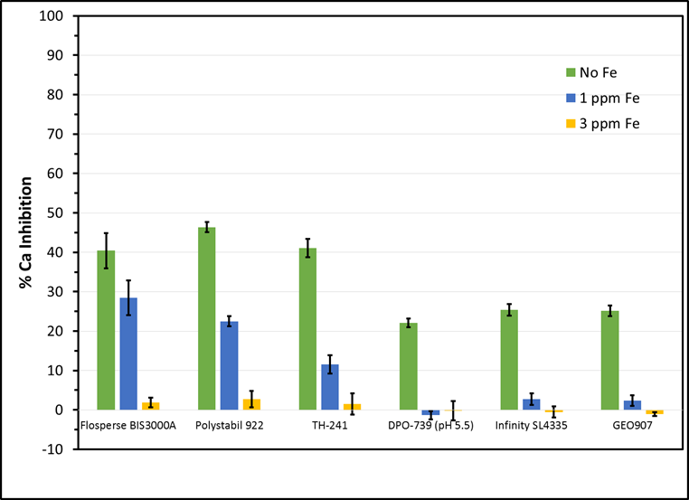
See NZGW paper. Inhibitors can be greatly impacted by cations Al, Fe, Mn.

Slide 19
GNS Independent test results
..\..\..\..\..\Desktop\NACE Solenis_2019041105.pdf

Slide 20
Conclusions
Online well cleaning very effective. Short cheap cleans <$20k on wells on SP1 and SP2 leg. More rigorous longer lasting viable on Br40,39, 16 and on Wairakei wells (constant flow and pressure).
Corrosion concern has three solutions:
      Inhibitor
      Replace acid
      Remove acid step
      And study due for completion on mixing modelling
Binary plant feasibility established, corrosion sorted only by pass issue to resolve. All set to go.
Calcite inhibitors. Worthy of a trial as problems have been identified, quantified and less risky alternatives available.

Slide 21
Thanks
Thanks to CEL for being open and honest with your challenges, data and assistance to allow us to try and find better solutions for you.
Happy that this work has already benefited other Geothermal providers in NZ and abroad.
CEL will continue to get preferential pricing and priority in all our dealings together. We will continue the open book approach.

