Slide 1
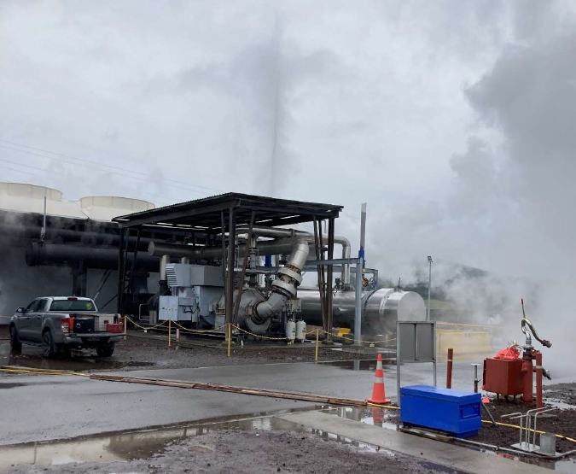
Steam Hammer Quiz
Ivo Lemmens
Principal Process Engineer
September 2024

Slide 2
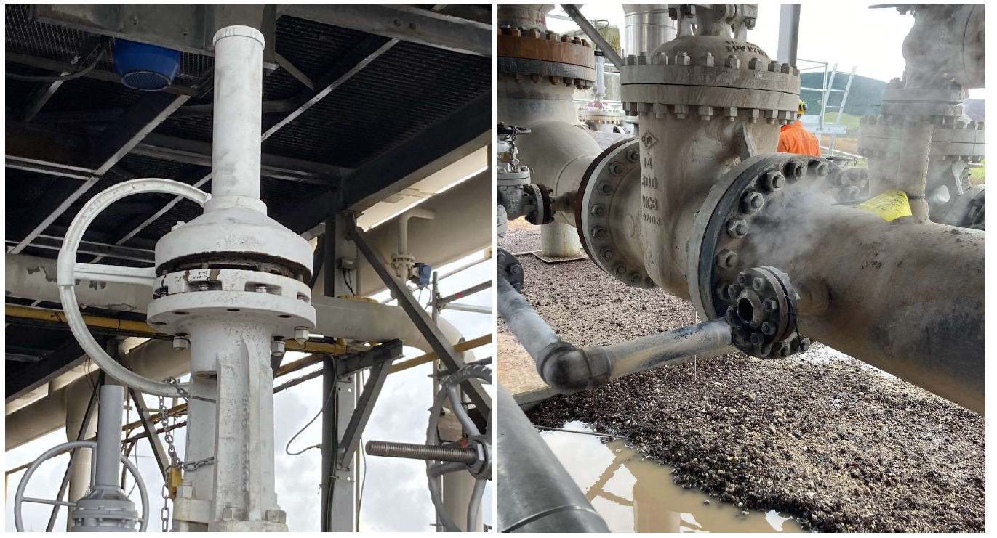
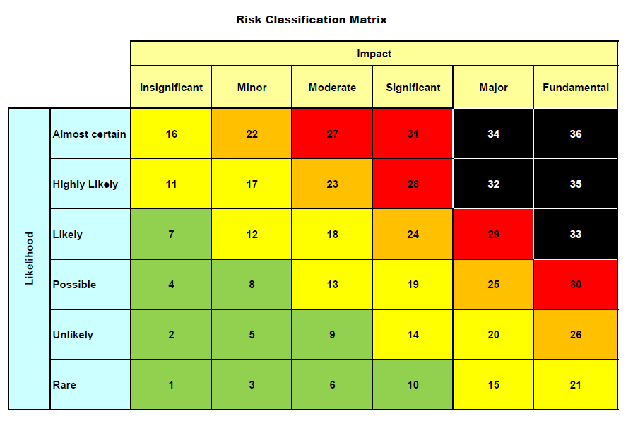
Case for change
Water hammer can result in the uncontrolled release of hazardous energy (hot water and steam), causing serious injury or death.
These types of events can be prevented with proper job planning, adequate procedures, correctly designed and maintained equipment, and sound understanding of steam and water conditions.
The Rotokawa incident was a High Potential Incident ‘‘An event, or a series of events, that causes or has the potential to cause a significant adverse effect on the safety or health of a person.’’

Slide 3
Types of ‘water hammer’
Condensation Induced Water Hammer (CIWH)
A pocket of saturated steam suddenly collapses due to steam condensing as it comes in contact with sub-cooled liquid, generating an overpressure shock wave that travels the length of the liquid-filled portion of the line. Overpressure may be sufficient to rupture pipe elements or dislodge pipe from its support.
(For example: start up of steam field and re-injection system. Hot brine bypass operation and / or too low re-injection backpressure). Continued occurrence of less severe CIWH events can cause fatiguing due to vibrations
Slug flow
Two-phase flow where a slug of condensate is being propelled at the speed of the steam flow and hits the pipe wall at a T-piece or elbow. This may dislodge pipes from its supports or cause, over time, fatiguing due to vibrations
(For example: steamfield production header, re-injection header operating in 2-phase flow regime)
Pressure Surge (Joukowsky effect, water hammer)
Usually in liquid filled systems, a sudden stop of the flow, for example by a fast-closing valve at the end of a pipeline system or trip of a pump, can lead to a pressure surge and a shock wave propagating through the pipe. This may cause rupture of pipe elements but can normally be prevented by increasing valve closing time and installing air vents on high points.
(For example: condensate re-injection system)
Condensation Induced Water Hammer (CIWH) generates the most severe overpressure and can cause catastrophic failure of equipment and piping.
Examples:
https://youtu.be/m3bj-jsOZxw?si=dvuwc3vJPgmccRAR
https://youtu.be/SR9Mq3MmDu8?si=_n9CkvLK3w5kM5Ah
https://youtu.be/nJ6xbW4VbMg?si=Pl36ktRKAG1l3ppg
https://youtu.be/Esfpz43GGsY?si=WVUtoU7dsndSzBgx&t=427 until 9:30
https://youtu.be/VBa7DSSmWrE?si=zizpUpoL65dgIo4I
https://youtu.be/rXdaZqXoEvo?si=2WsD8hjxDmDfutwh&t=43
https://youtu.be/oZbguheiVs4?si=-2yN14MjGnjwhfnz&t=28
https://youtu.be/oZbguheiVs4?si=68jvYeL_rskOf0xq&t=96
https://youtu.be/oZbguheiVs4?si=7NpawU2-wKGfrtuA&t=185
https://youtu.be/VlnOfIPotdA?si=L8Pbh05a6s9xGGU3&t=66
https://youtu.be/ujNGaQKap98?si=eFL1t1HIj-s-0l0c

Slide 4
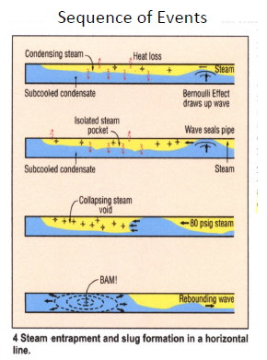
Condensation induced water hammer - the mechanism
Steam flow is from left to right.
Steam Flowing over subcooled condensate, creates waves by Bernoulli effect
If the steam velocity is high enough the wave seals the pipe trapping a line segment full of saturated steam.
If flow conditions are right, rapid mixing of sub‐cooled liquid and saturated vapor causes rapid steam bubble collapse causing a liquid slug to accelerate into the void.
The rebounding pressure wave then inflicts a high pressure at the next flow path change such as elbows or valves. Pressures can be more than 100 bar
Animation of CIWH at atmospheric pressure. Steam flow (from left to right in the video) is introduced by draining condensate on the right
https://youtu.be/m3bj-jsOZxw?si=dvuwc3vJPgmccRAR

Slide 5
Condensation induced water hammer - the mechanism
Safety Bulletin on Condensation Induced Water Hammer

Slide 6
Steam hammer quiz

Slide 7
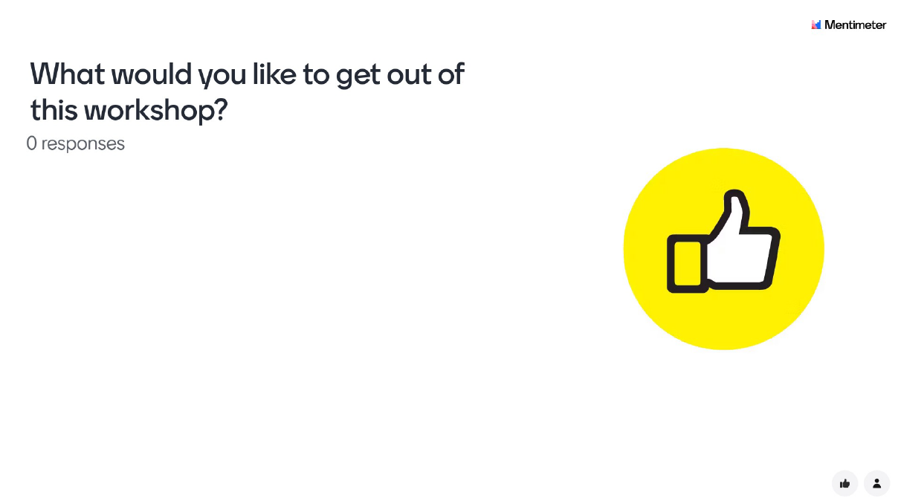

Slide 8
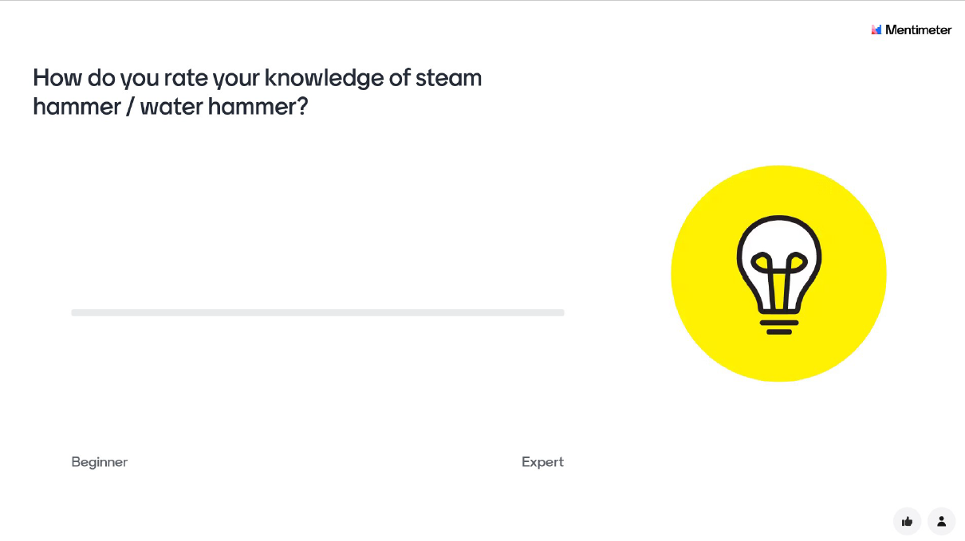

Slide 9
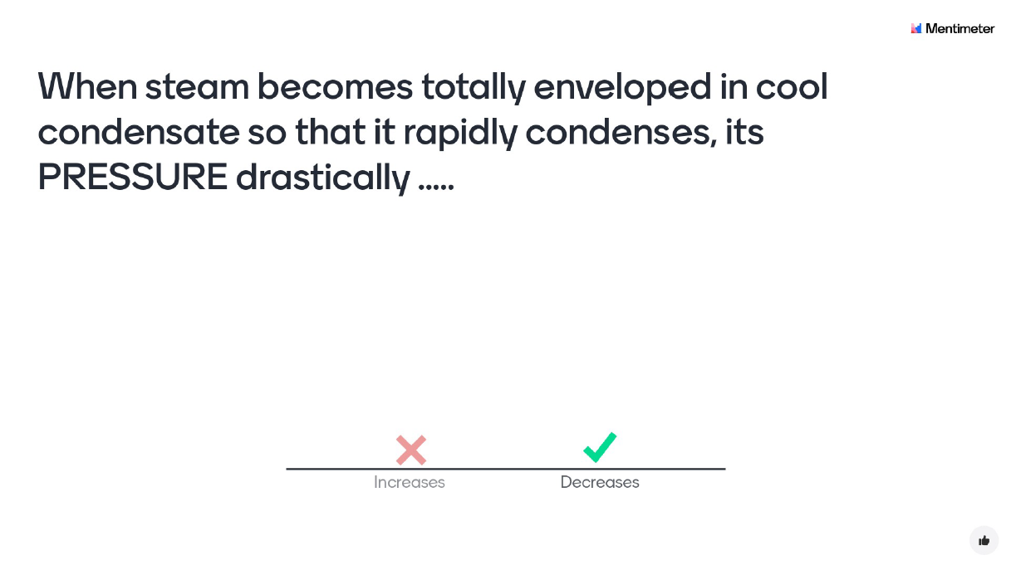

Slide 11
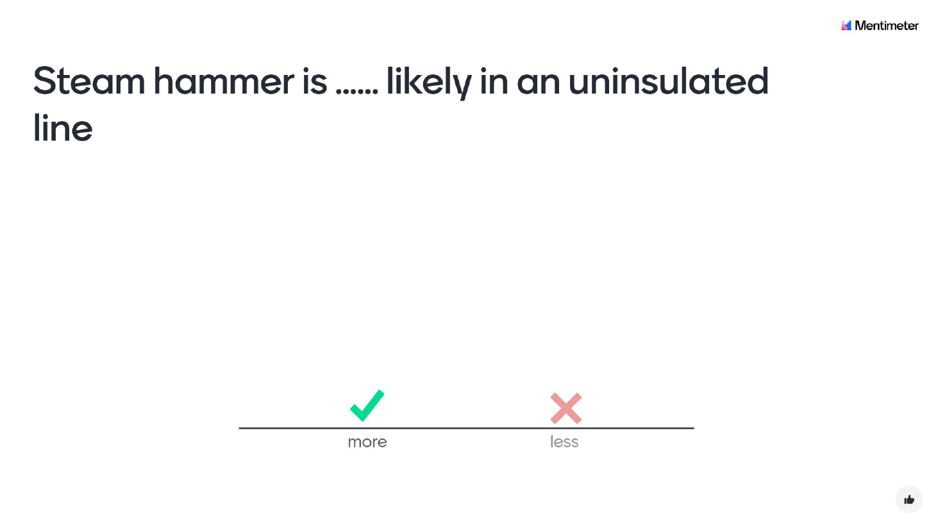

Slide 13
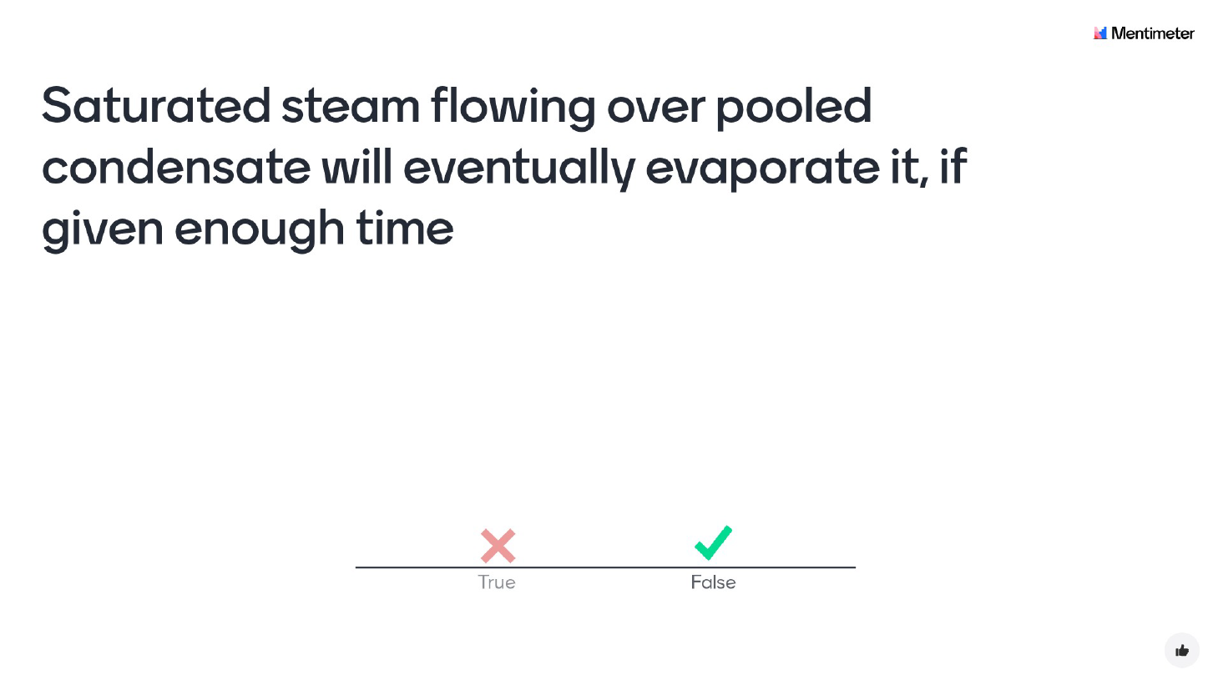

Slide 15
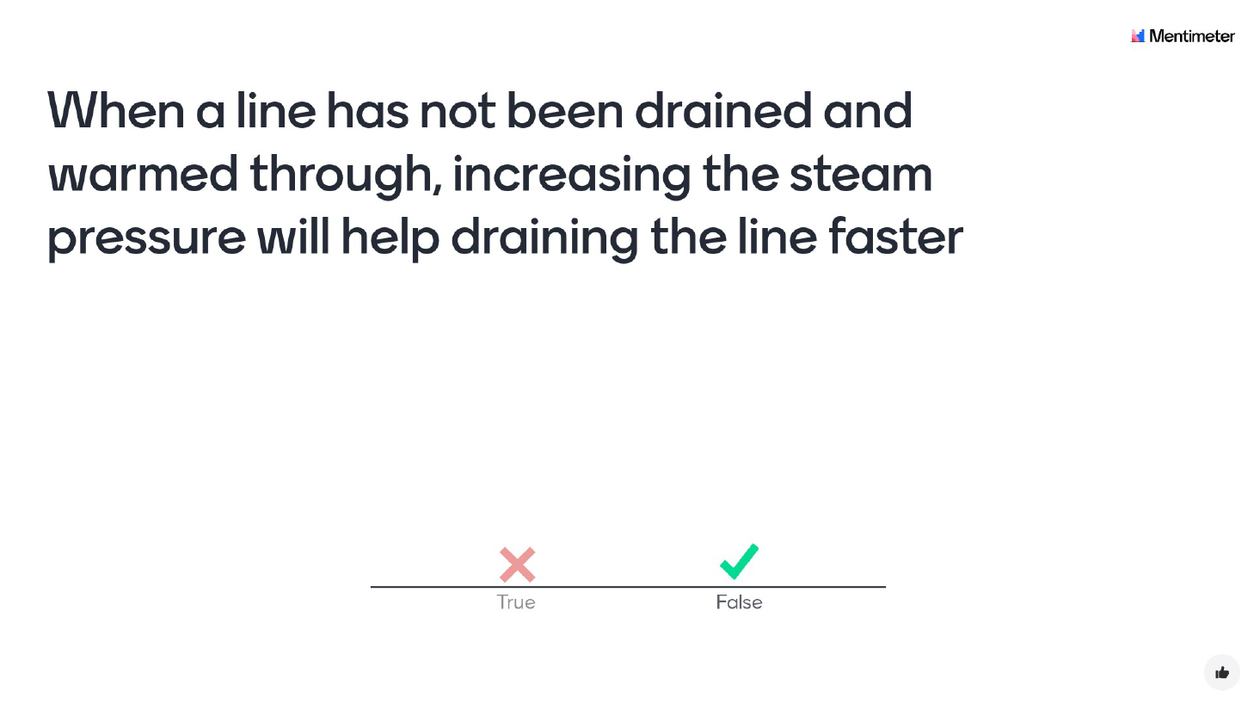

Slide 17
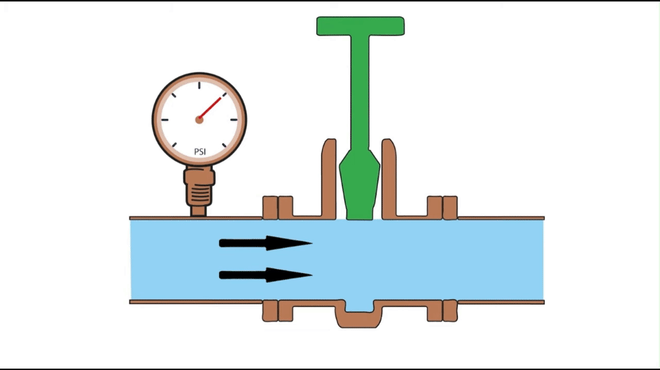

Slide 18
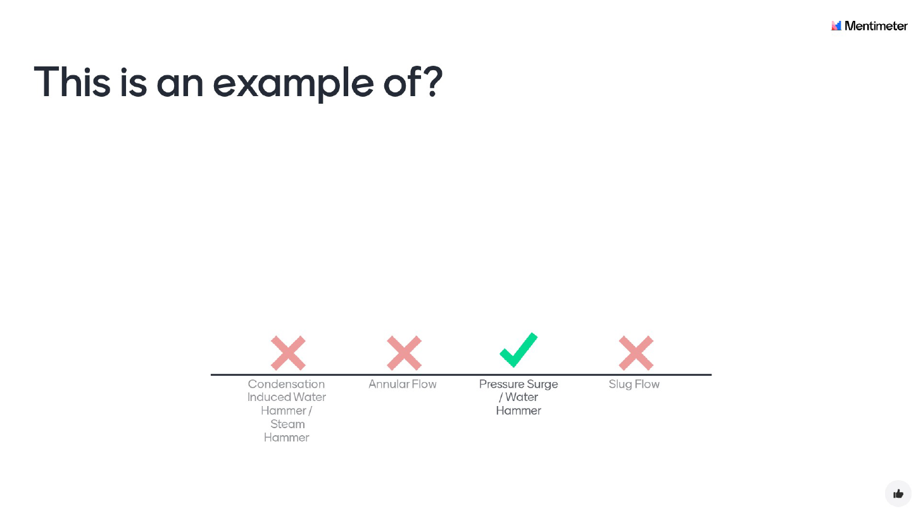
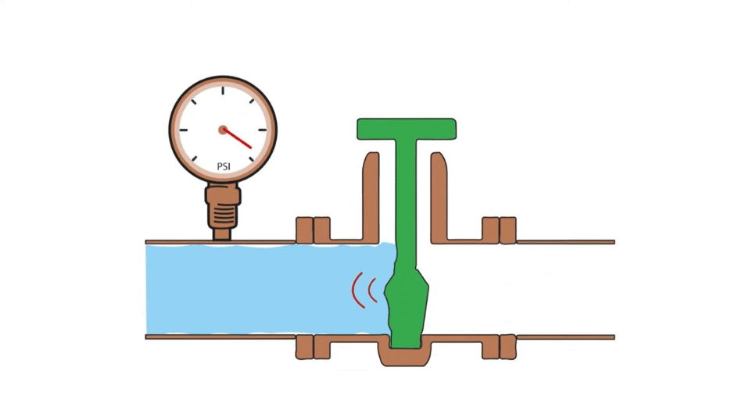

Slide 20
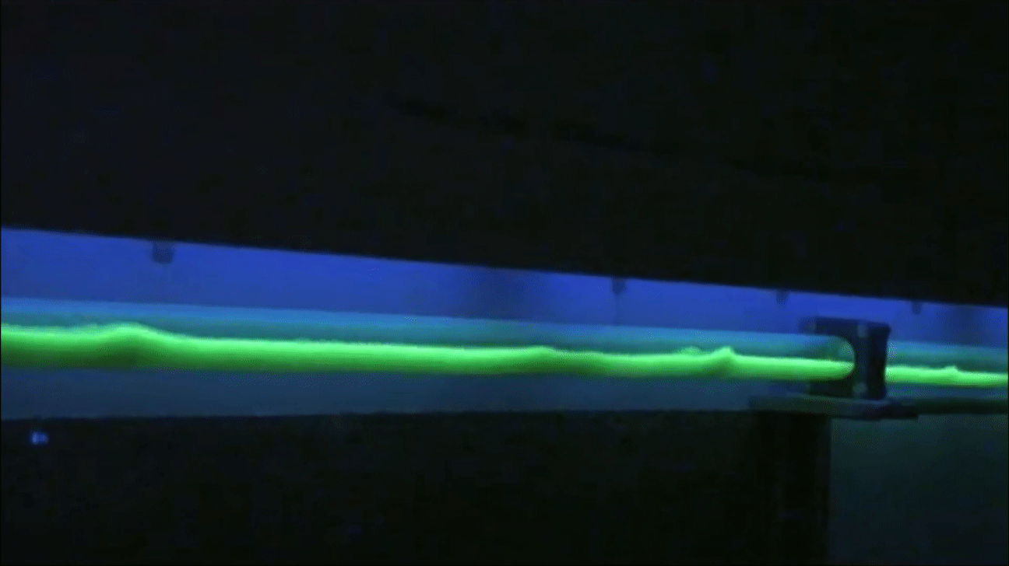

Slide 21
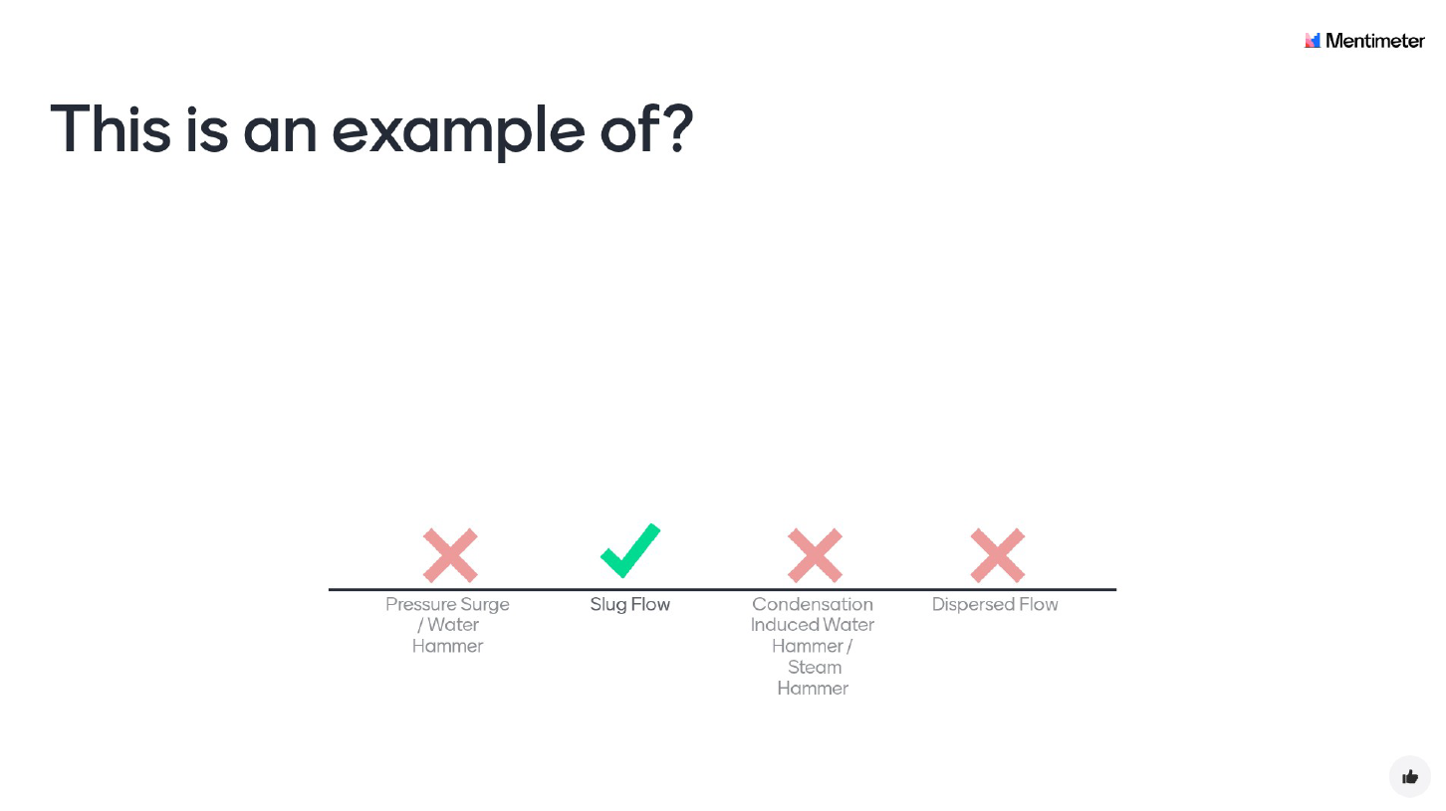
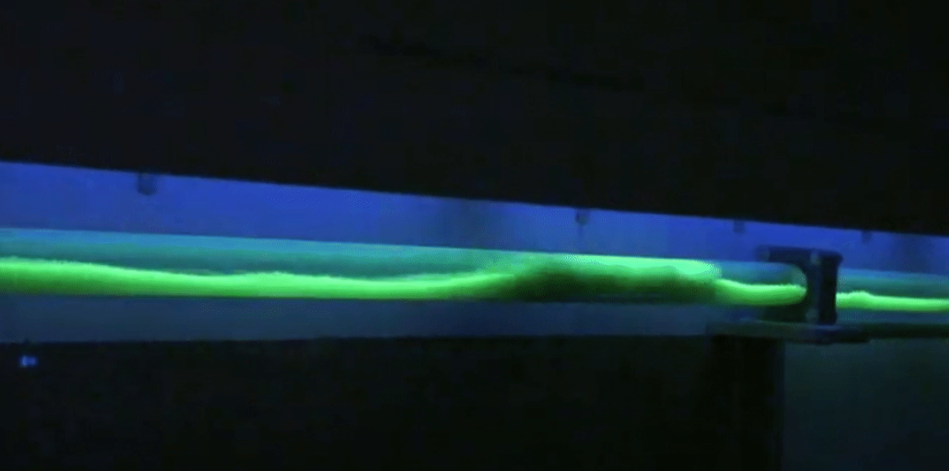

Slide 23
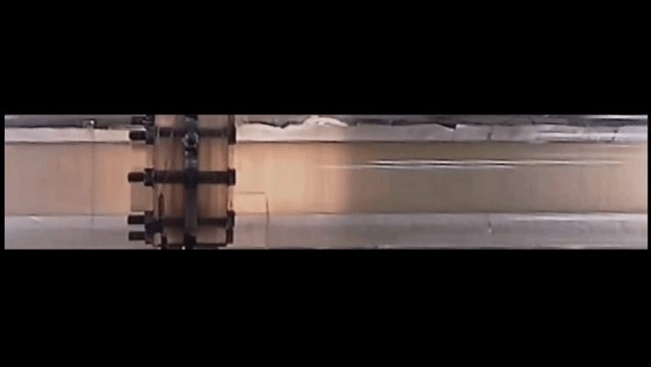

Slide 24
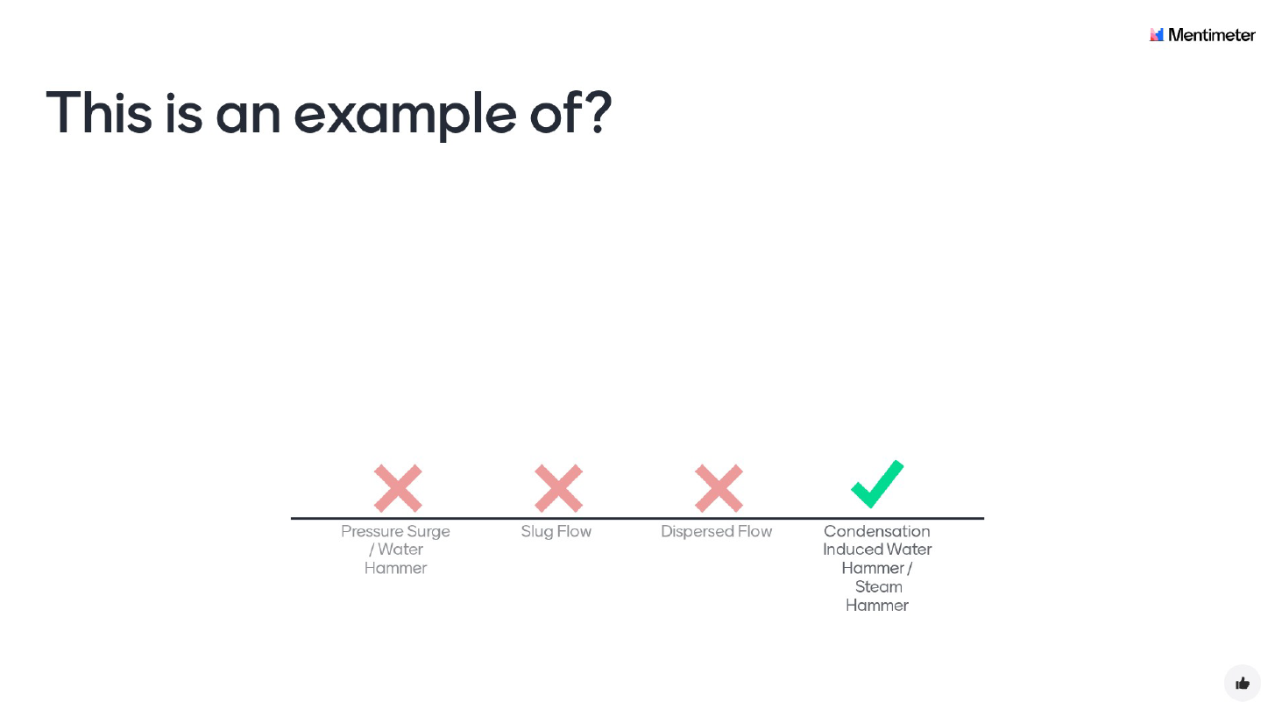
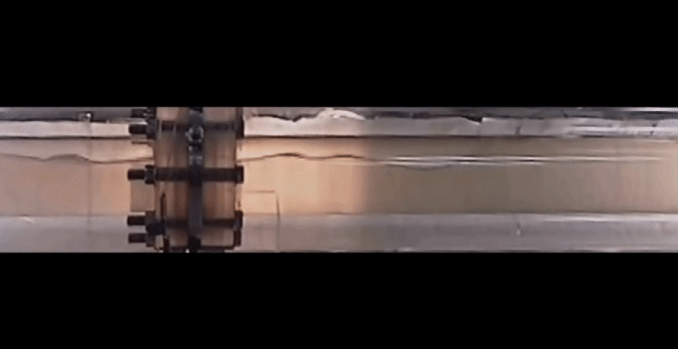

Slide 26
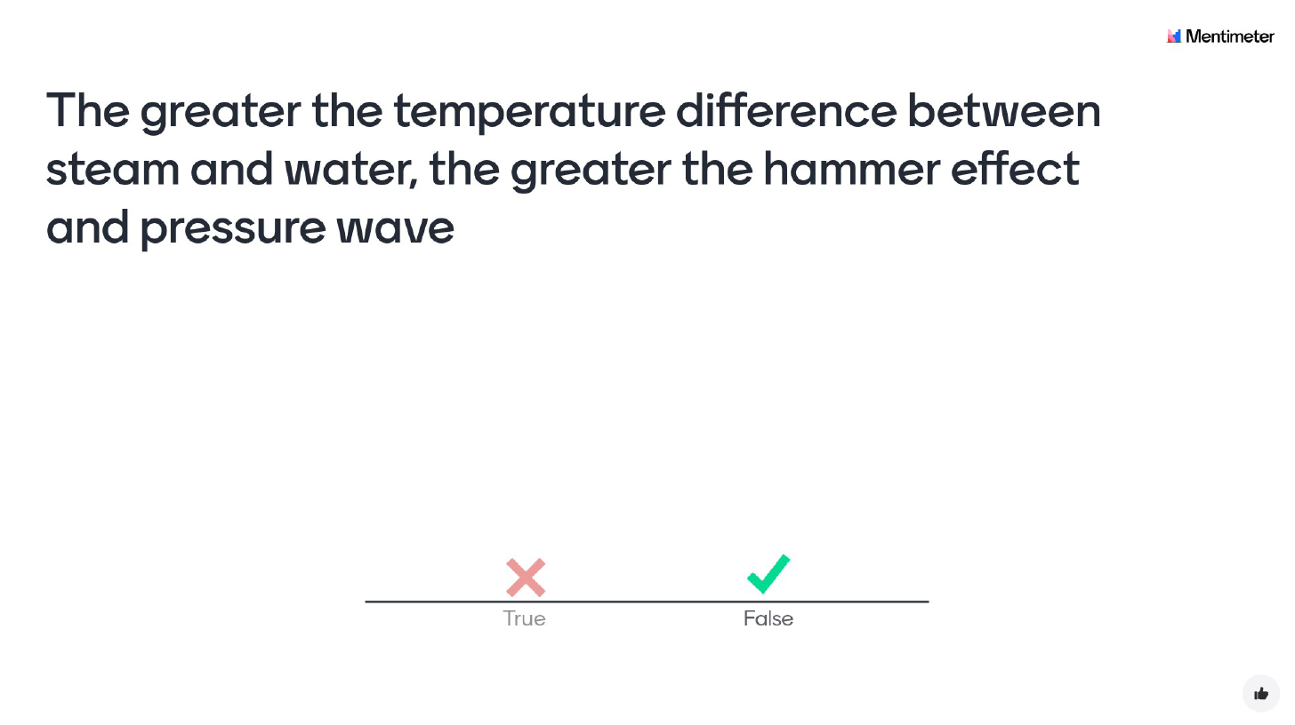

Slide 28

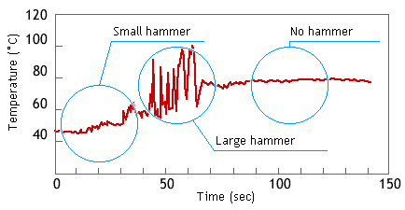
Effect of steam and water temperature difference on hammering
Experiments by TLV at a steam temperature of 100 °C:
Condensate temperature between 70 °C and 80 °C causes water hammer on a larger scale than condensate between 50 °C and 60 °C.
Left: 50-60 °C condensate (40-50 °C subcooling)
Steam comes into contact with cold condensate and immediately condenses. In this case, condensation happens on the scale of tiny steam bubbles and large 'pockets of steam' cannot form, hence only small water hammer occurs.
Middle: 70-80 °C condensate (20-30 °C subcooling)
Steam does not condense all at once, but gradually.
This allows the formation of larger pockets of steam, and hence larger water hammer when the larger pockets collapse.
Right: steam and water in equilibrium, no subcooling
Steam does not condense, and water hammer does not occur.
100
75
50
Source: https://www.tlv.com/steam-info/steam-theory/problems/waterhammer-mechanism

Slide 29
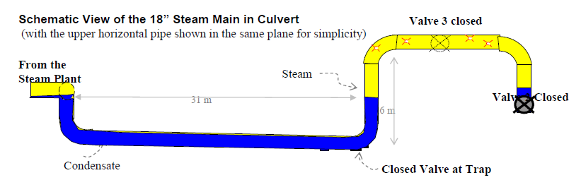
REAL-LIFE SCENARIO
A steam plant normally supplies steam to two units, downstream of valve 1 and valve 2.
Isolation valve 1 and 2 were closed due to an operational issue with the downstream units.
The upstream steam line from the steam plant remained pressurised (14 barg).
The horizontal portion of the pipeline is located in a culvert. The outage of the downstream units was used to visually inspect the piping and insulation in the culvert.
To facilitate the inspection, the steam trap located in the culvert was isolated. This prevented the trap discharging hot condensate and flash steam on the ground while the inspectors were in the vicinity.
After the inspection, the steam trap was left closed for a couple of days.
Valve 1 closed
Steam from steam plant
Steam
Valve 2 closed
Condensate
Steam trap closed
Source: kirsner.org

Slide 30
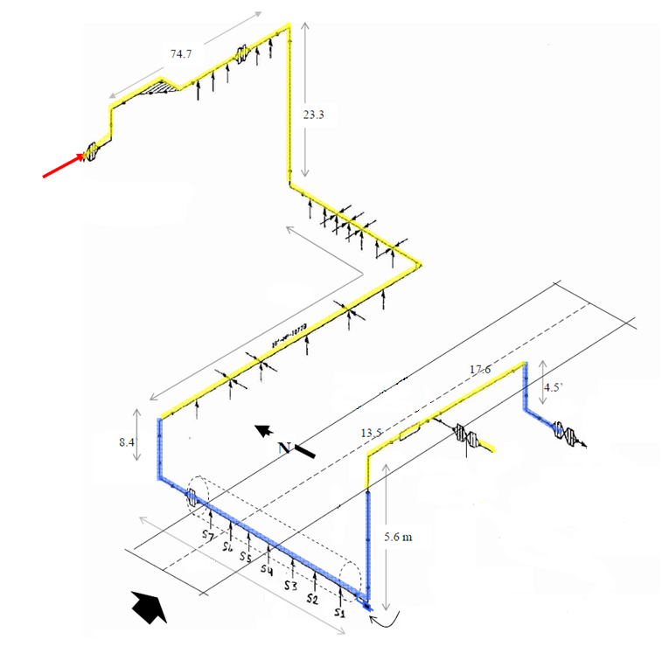
Steam from steam plant
Condensate
Valve 2 closed
Valve 1 closed
Source: kirsner.org
Steam trap closed

Slide 31
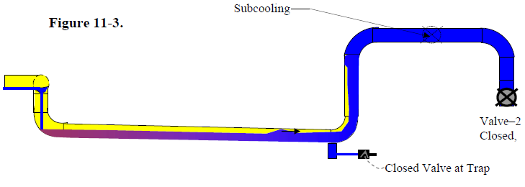
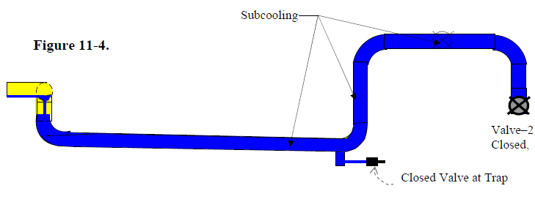
Cooling down and filling with condensate
With valve 1, valve 2 and the steam trap closed over the course of several days, the pipe cooled down and was eventually filled with subcooled condensate as indicated in figure B
Subcooling
Valve 1 closed
Subcooling
Valve 1 closed
Figure A
Figure B
Valve 2 closed
Valve 2 closed
Steam trap closed
Steam trap closed
Source: kirsner.org

Slide 32
Operation is being resumed
Operation of the unit downstream of valve 2 is about to be resumed.
The line upstream of valve 2 is filled with subcooled condensate.
What is the most important thing to do to avoid steam hammer?
Open the valve at the steam trap to bring the steam trap back into service before opening valve-2
Drain the line by opening a drain point located close to the steam trap (not shown in picture) before opening valve-2
Isolate and depressurise the upstream steam supply
Fully open a drain downstream of valve-2 (not shown in picture) and crack open valve-2 to drain the line before fully opening valve-2
Subcooling
Valve 1 closed
Figure B
Valve 2 closed
Steam trap closed
Source: kirsner.org

Slide 33
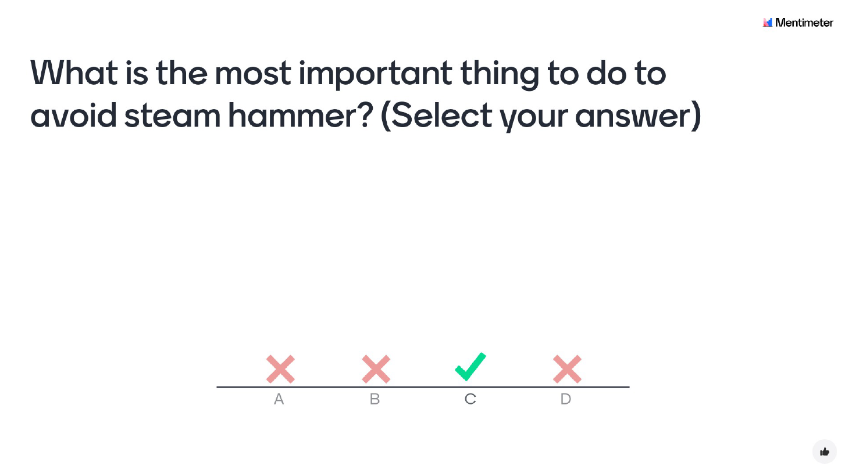
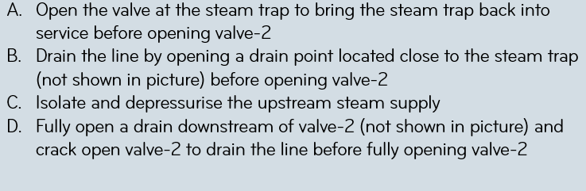

Slide 35
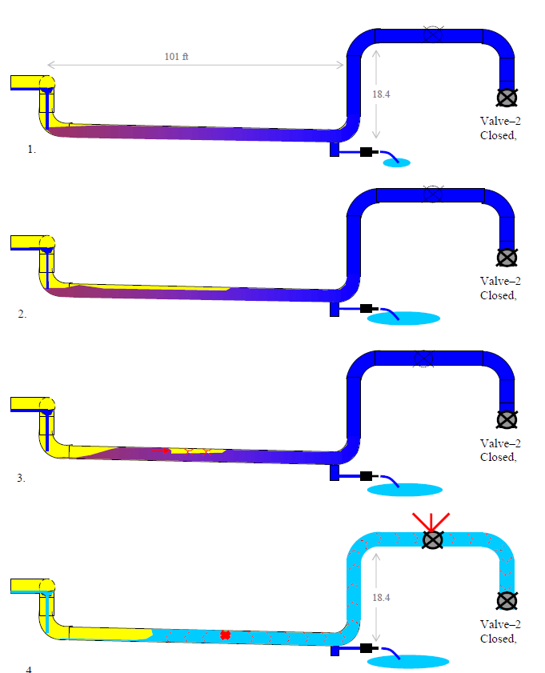
Condensation Induced Water Hammer
With the steam pipe full of subcooled condensate, the system was primed for a condensation-induced water hammer incident.
All that was needed was a “triggering event”
There were several ways for a “triggering event” to occur. They all involve draining condensate to admit steam into the lower horizontal line.
As condensate was drained, either through the reactivated steam trap or a drain, or cracking open of valve 2, the level of condensate on the left side of the pipe segment would drop until steam was able to re-enter the nearly-horizontal section of pipe in the culvert resulting in Condensation Induced Water Hammer
The pressure wave was estimated to exceed 100 bar and it ruptured the tee joint adjacent to valve 1
Valve 1 closed
Valve 2
closed
Source: kirsner.org

Slide 36
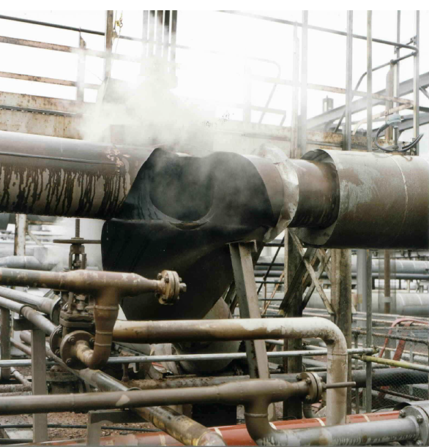
Solution
Once the condensate had subcooled sufficiently to support condensation-induced water hammer, there was no simple way to either re-establish steam flow or drain the water from the low point line, as long as the system was under steam pressure.
To avoid this accident, the steam upstream of the culvert would have had to be isolated and the system depressurised, and only then could the condensate be drained (with minimum pressure) to prevent the incident.
Hence the correct answer is
C: isolate and depressurise the upstream steam supply
(to allow safe draining of the line)
The root cause of the incident was the failure (by inadvertent closing) of the steam trap, which demonstrates the importance of properly functioning steam traps
Source: kirsner.org

Slide 37
BP Grangemouth Incident
On June 7th 2000, at the BP Plant in Grangemouth Scotland, an 18” steam pipe fractured, opening a gaping hole which spewed a steam jet 35 meters across a public road and created a blast so loud it knocked a pedestrian off his feet. Luckily, no one was injured or killed.
Source / acknowledgement:
Kirsner Consulting Engineering
Source: kirsner.org

Slide 38
Lessons learned / Guiding principles

Slide 39
Lessons Learned / guiding Principles
Importance of steam traps and start-up drains
Identify and keep a record of key steam traps and start up drains at low point locations.
Install additional steam traps and start up drains if required.
Make drains roddable to facilitate unblocking.
Periodically check that:
a) steam traps are operational (By measuring the temperature before and after the steam trap with a temperature gun)
b) start up drains are not plugged (Only open drains of lines under pressure if you are confident that there is no build up of subcooled condensate. Otherwise, check drains during steam field shuts at minimal steam pressure)
Give priority to maintenance of steam traps and drains that are not functional
Use planned and unplanned station shuts (that result in steam field shut down as well) to check and repair steam traps and drains in the steam field, to ensure they are available during startup

Slide 40
Lessons LearnEd / guiding Principles
Operational guidelines:
Be aware of and manage the toxicity and asphyxiation hazard from H₂S and CO₂ in the Non-Condensable Gases:
  NCGs exiting from well gas cap vents, piping low point drains and high point vents, and steam and brine rock mufflers during start up.
  Clear the site from non-essential personnel and contractors during start up activities.
  Cordon off areas where NCGs could collect. (While the system and fluids are still cold, NCGs can collect at grade level or in pits as they are heavier than air. Only after warming through, they will become more buoyant, but the hazard still remains)
  Be aware of the prevailing wind direction and ensure there is a safe escape route, also in case of a sudden change in wind direction
  Use personal gas detectors
Capture steam field and re-injection system start up sequence, including hold points for critical draining and warm up steps, in the station start up procedures. Re-assess potential steam hammer risks if you have to deviate from the normal sequence.
Monitor the progress of draining and warm up by measuring the temperature of the fluid exiting the start up drains with a temperature gun and monitoring the condition of the fluid (initially water and eventually steam).
Ensure that lines are drained and warmed through at the lowest practical steam pressure (preferably only slightly above atmospheric pressure) before introducing more steam and increasing the pressure of the system.
Increasing the pressure too early, when the line has not been properly drained and warmed through, will lead to even more condensate formation and a higher risk of Condensation Induced Water Hammer.
Do not drain a subcooled liquid-filled line, or portion of a line, while under steam pressure as this could cause steam to enter the formerly liquid-filled line resulting in Condensation Induced Water Hammer

Slide 41
Lessons LearnEd / guiding Principles
Operational guidelines (continued):
Do not skip draining and warm up steps by ‘cracking open’ isolation valves instead, as this could lead to Condensation Induced Water hammer. ‘Cracking open’ valves will not guarantee safe operation. The formation of a condensation-induced water slug can occur at very low condensate flow conditions
Isolation valves should have smaller bypasses. Bypass valves should be used before opening the main isolation valve. However, bypass operation will not prevent water hammer, if draining and warm through steps are not done properly or skipped and condensate is present.
Design shortcomings should not be overcome by operational methods. Instead, focus on raising and correcting the design flaws.
Watch out for weak signals that could indicate that things are not going as planned or if something unexpected occurs. Stop to re-assess the situation. Keep personnel, involved in the activity, informed.

Slide 42


Slide 43


